Slide 1




CONCEPT SOLUTION FOR AN OPEN CENTRALIZED SYSTEM OF AGRICULTURE AND RURAL DEVELOPMENT
AnimCRO
Students: Sara Kolar, Katarina Marić, Iva Tratnik & Mirta Vulje
Mentor: izv. prof. dr. sc. Dragica Šalamon

Slide 2










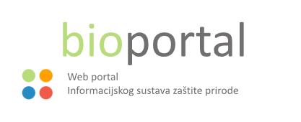










PRESENT

Slide 3






FUTURE

Slide 4
SOLUTIONS AND BENEFITS
CENTRALISED SYSTEM
improvement in data governance and coordination
efficient decision making
management of the public funds
transparency
of public services
OPEN DATA
OPEN DATA
OPEN DATA
OPEN DATA

Slide 5

THANK YOU FOR YOUR ATTENTION!

