Slide 1

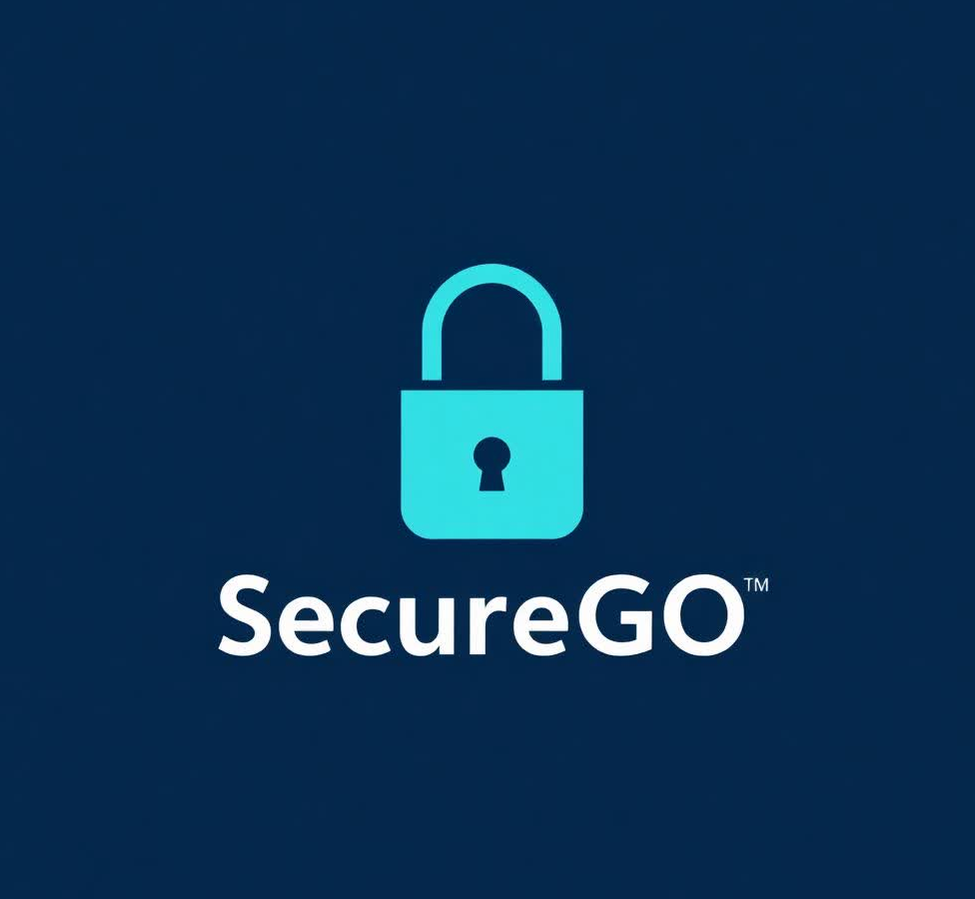
SecureGO
Click Freely, Stay Secure
Hrag Bankian
Gregory Demirdjian
Alec Kirakossian
Gevorg Markarov

Slide 2



Problem Statement
Phishing, malware, NSFW content threats rising
Need for fast, all-in-one internet safety solution
Internet security more critical than ever

Slide 3

Scope
Real-world societal problem:
improving online security

Slide 4
Our Solution: SecureGO
All-in-one browser extension
Proactive defense against online threats
Fast, lightweight, and easy to use

Slide 5
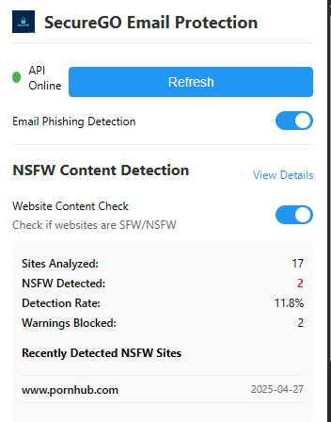
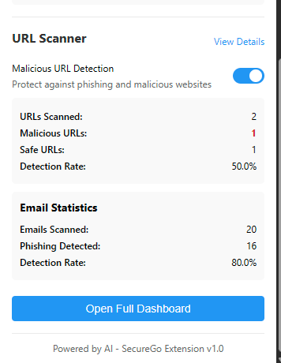
3 Core Features
Phishing email detection
Malicious URL detection
NSFW content blocking

Slide 6
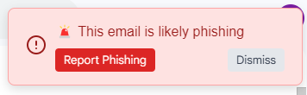
Feature 1: Phishing Email Detection
2 datasets: 10,000+ records of emails (spam/ham)
Logistic regression model
Real-time email verification: alerts for spam when opened

Slide 7
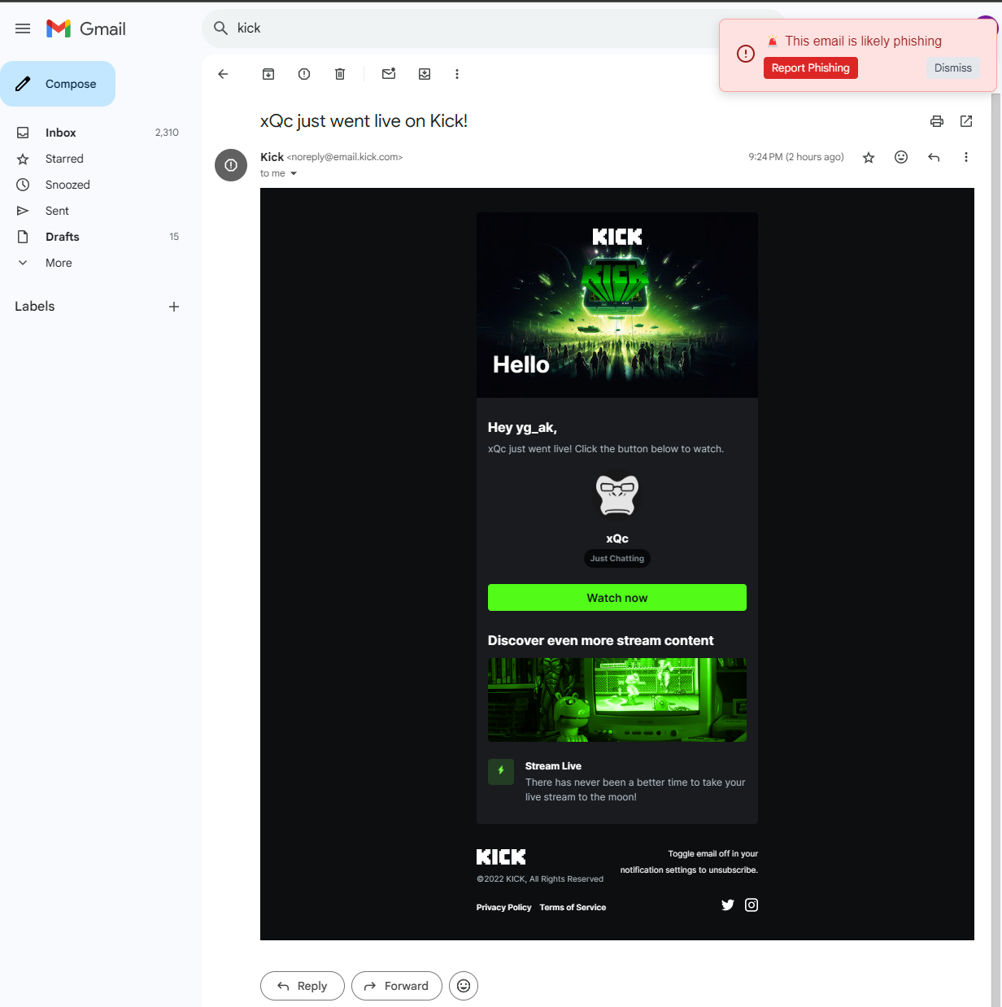
Feature 1: Phishing Email Detection

Slide 8
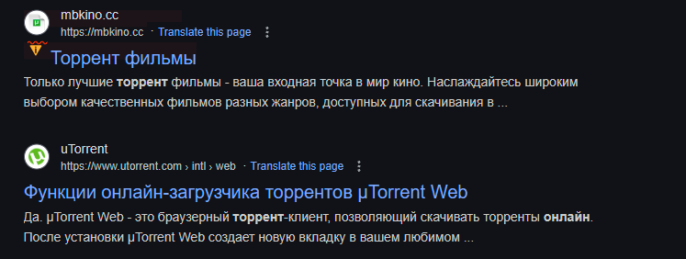
Feature 2: Malicious URL Detection
Synthetic data: 100,000 URL records generated (safe/unsafe)
Classifier model
Real-time detection of suspicious URLs during browsing

Slide 9
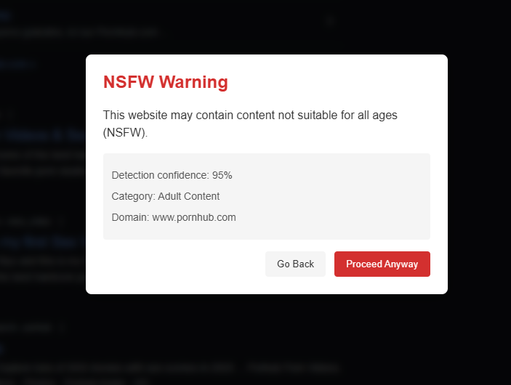
Feature 3: NSFW Content Blocking
API call to nsfwjs
Warning popup if NSFW content is detected upon clicking a link

Slide 10
Stay Protected at a Glance
Dashboard summary of all detections with % stats
Feature 1: Spam emails detected
Feature 2: Malicious URLs detected
Feature 3: NSFW content blocked
Stats stored in a database, tracked between sessions

Slide 11
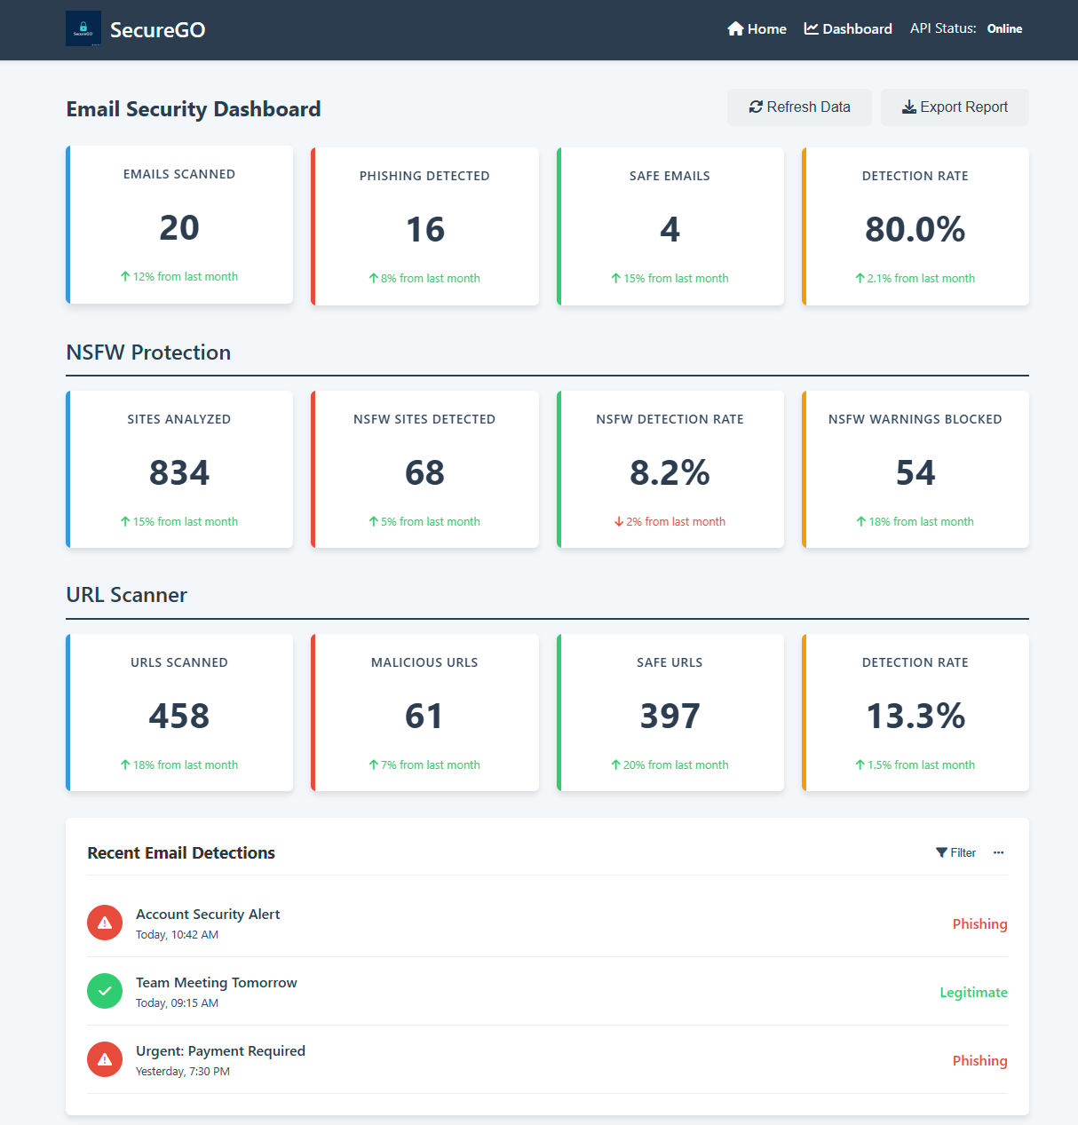
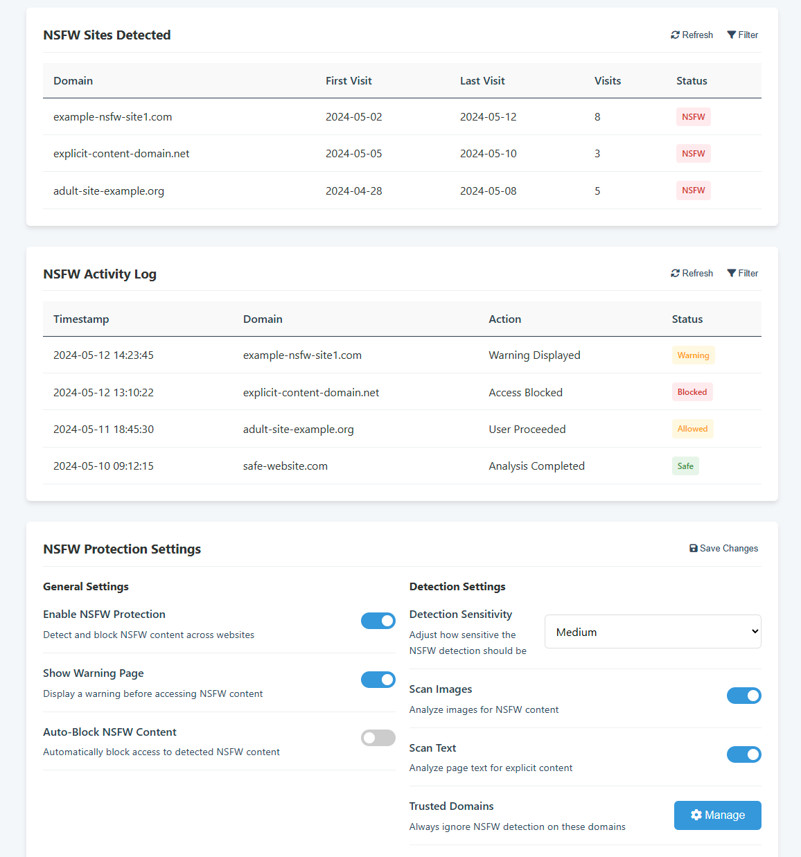
Stay Protected at a Glance

Slide 12




Behind the Scenes: Core Tech Stack

Slide 13

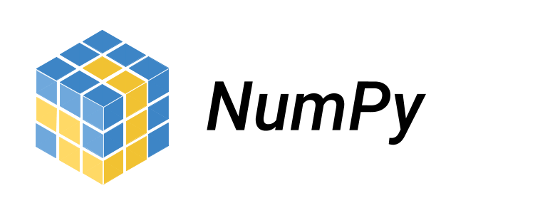

Behind the Scenes: Feature Development
Feature 1: Phishing Email Detection
Python libraries
pandas
numpy
scikit-learn
joblib
nltk
Kaggle datasets
Spam Mails Dataset
Spam Email Dataset

Slide 14

Behind the Scenes: Feature Development
Feature 2: Malicious URL Detection
Python libraries
pandas
random
pickle
Feature 3: NSFW Content Blocking
GitHub repository
nsfwjs (API call)

Slide 15


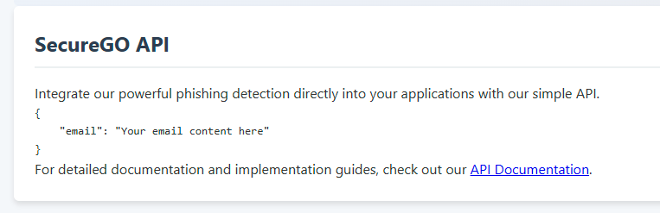
Evolving Secure Go: Next Steps
Mobile browser support (Android/iOS)
Built-in secure VPN integration
SecureGO API

Slide 16
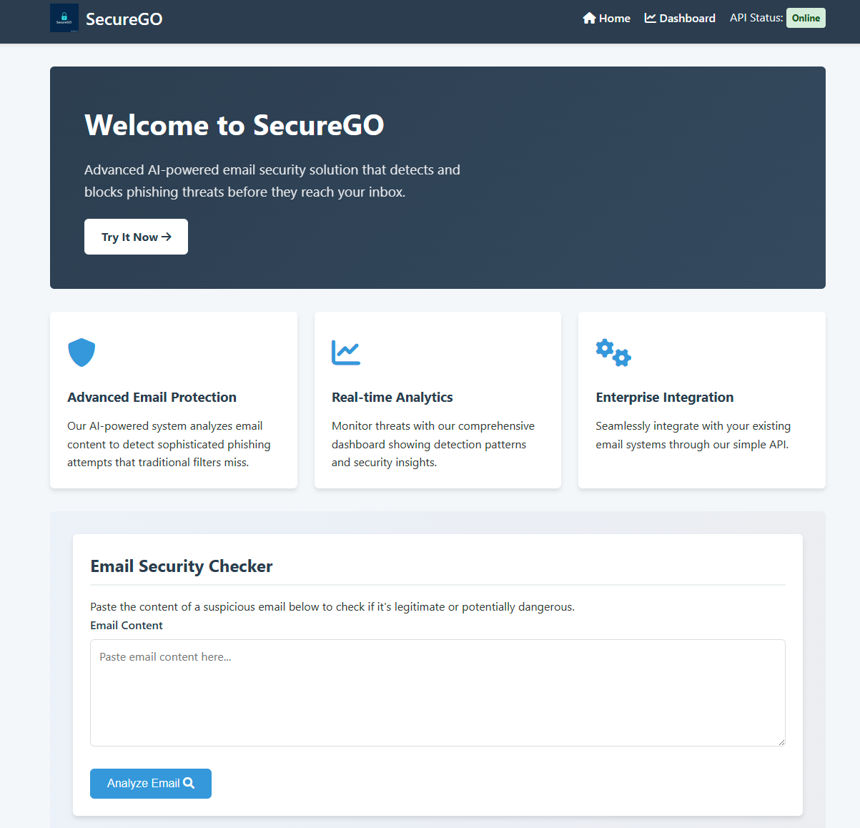
Conclusion: SecureGO
All in one internet safety solution
Protects users from phishing, malicious URLs, and NSFW content
Fast, lightweight, and proactive protection while browsing

