Slide 1


SecureGO
Click Freely, Stay Secure
Hrag Bankian
Gregory Demirdjian
Alec Kirakossian
Gevorg Markarov

Slide 2



Problem Statement
Phishing, malware, NSFW content threats rising
Need for fast, all-in-one internet safety solution
Internet security more critical than ever

Slide 3

Scope
Real-world societal problem:
improving online security

Slide 4
Our Solution: SecureGO
All-in-one browser extension
Proactive defense against online threats
Fast, lightweight, and easy to use

Slide 5
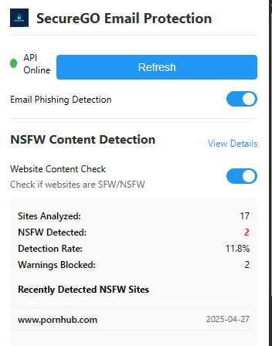
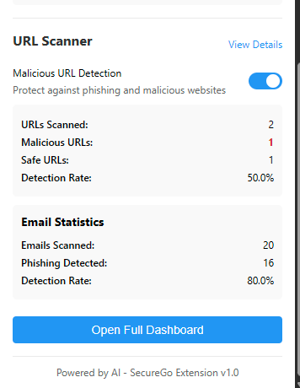
3 Core Features
Phishing email detection
Malicious URL detection
NSFW content blocking

Slide 6
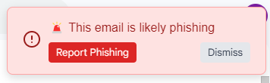
Feature 1: Phishing Email Detection
2 datasets: 10,000+ records of emails (spam/ham)
Logistic regression model
Real-time email verification: alerts for spam when opened

Slide 7
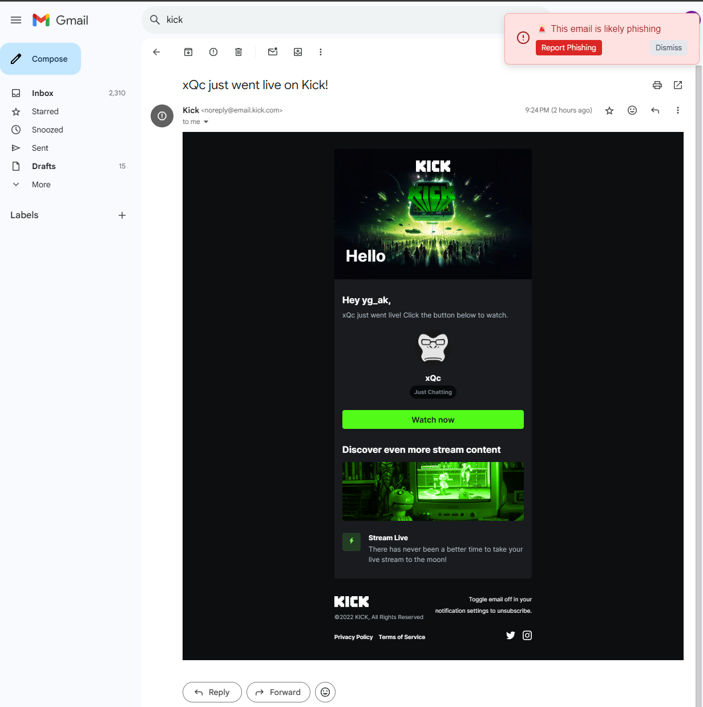
Feature 1: Phishing Email Detection

Slide 8
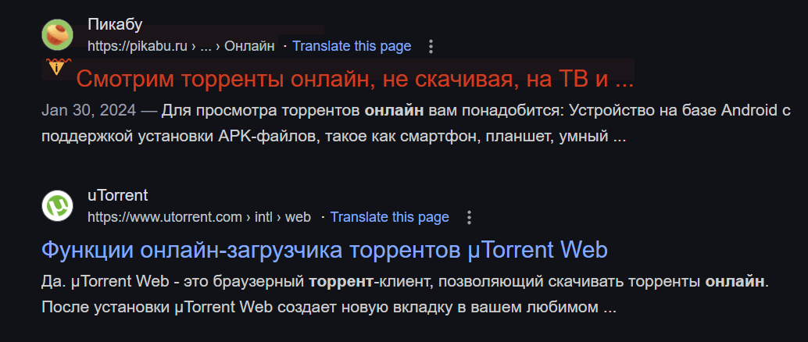
Feature 2: Malicious URL Detection
Synthetic data: 100,000 URL records generated (safe/unsafe)
Classifier model
Real-time detection of suspicious URLs during browsing

Slide 9
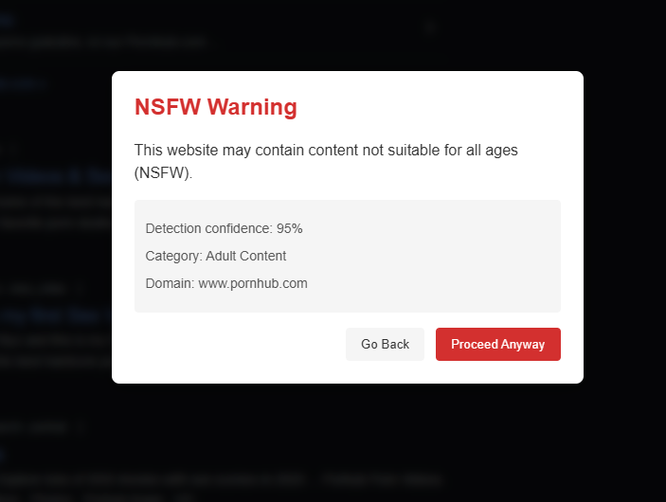
Feature 3: NSFW Content Blocking
API call to nsfwjs
Warning popup if NSFW content is detected upon clicking a link

Slide 10
Stay Protected at a Glance
Dashboard summary of all detections with % stats
Feature 1: Spam emails detected
Feature 2: Malicious URLs detected
Feature 3: NSFW content blocked
Stats stored in a database, tracked between sessions

Slide 11
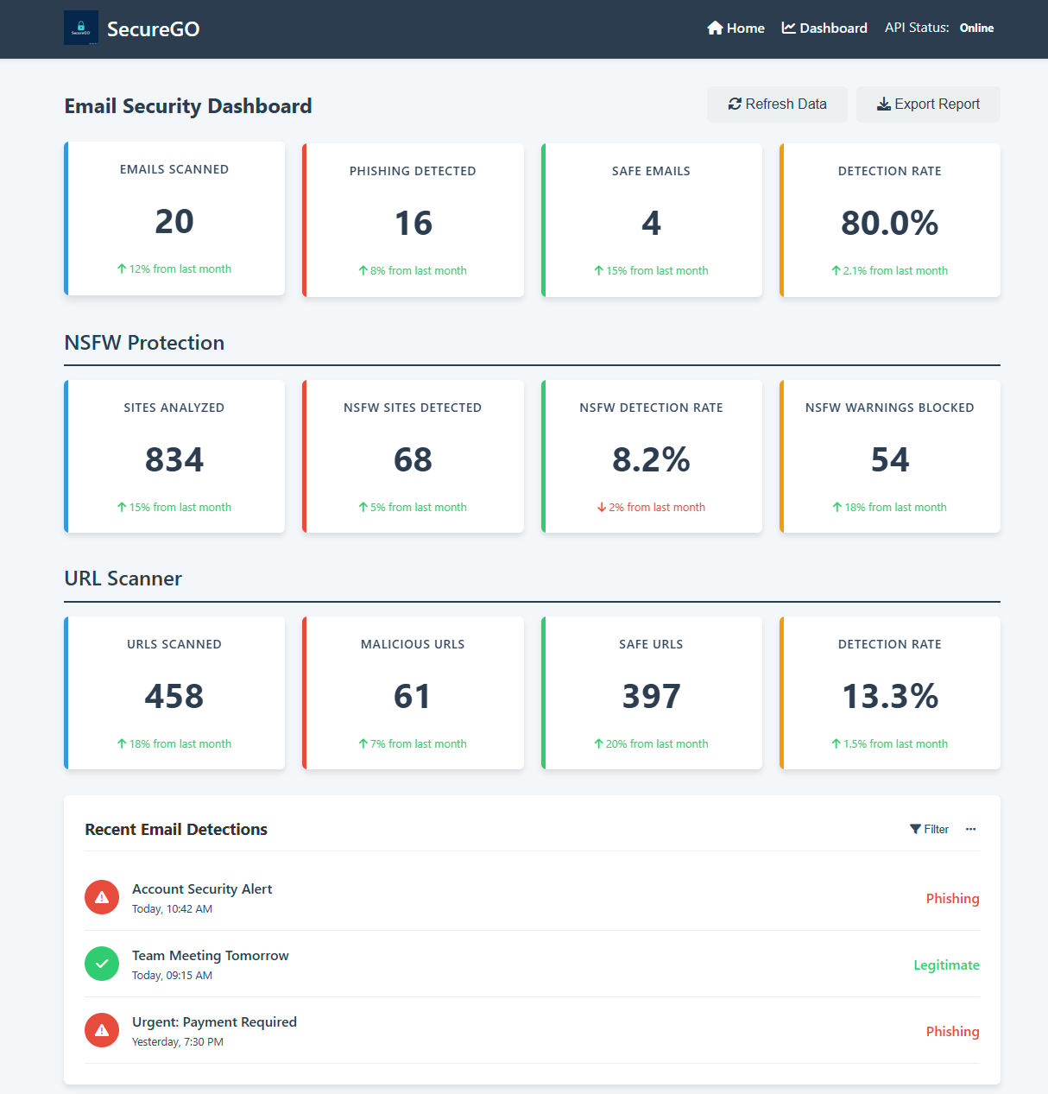
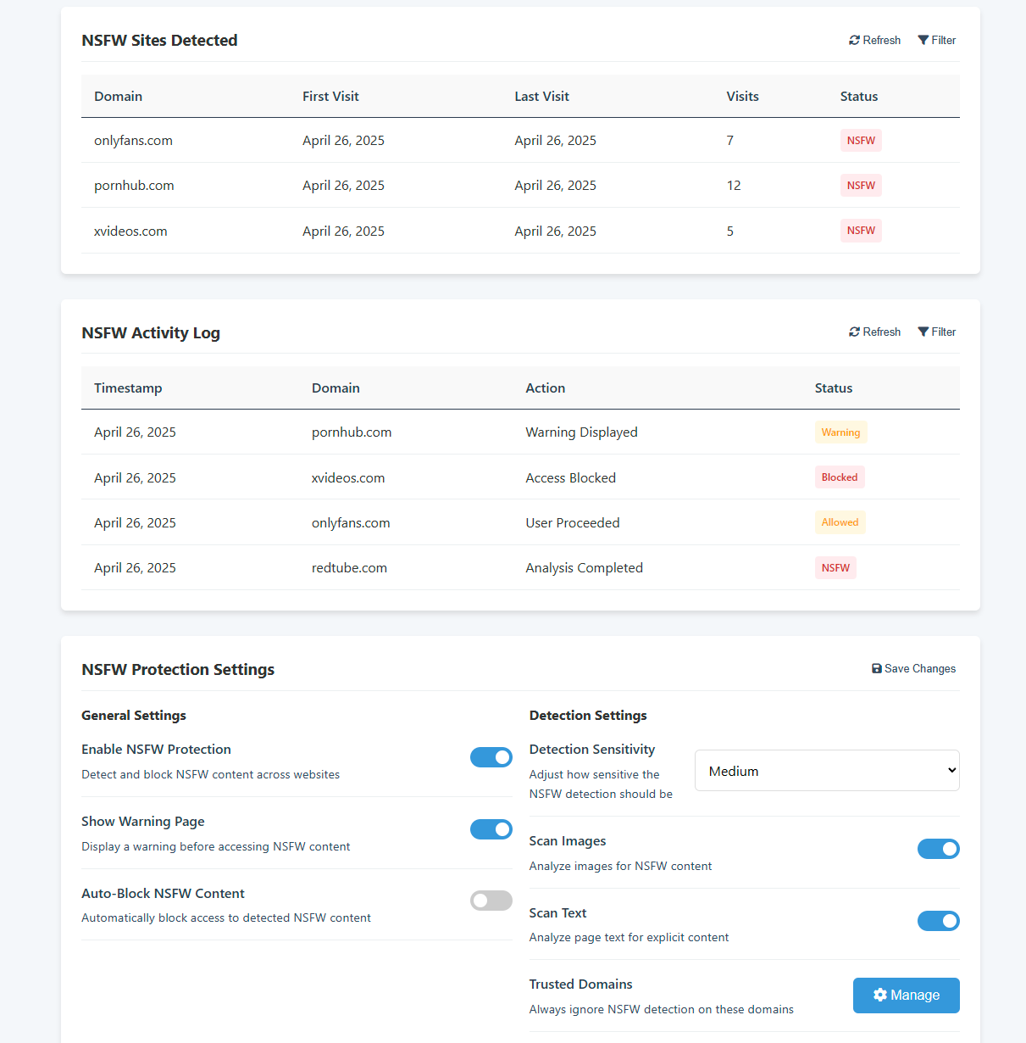
Stay Protected at a Glance

Slide 12


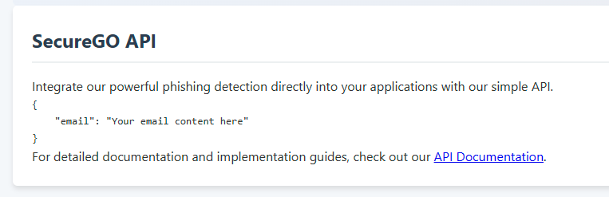
What’s Next for SecureGO?
Expanding to other browsers
Built-in secure VPN integration
SecureGO API

Slide 13
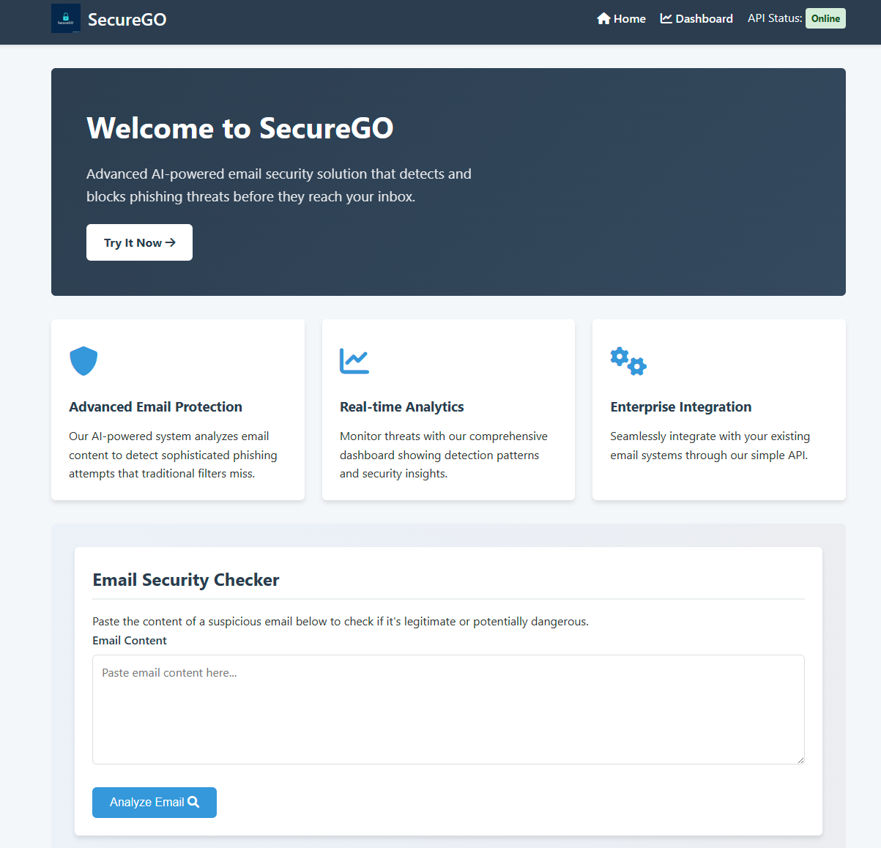
SecureGO
All in one internet safety solution
Protects users from phishing, malicious URLs, and NSFW content
Fast, lightweight, and proactive protection while browsing

Slide 14
Appendix

Slide 15




Behind the Scenes: Core Tech Stack

Slide 16



Behind the Scenes: Feature Development
Feature 1: Phishing Email Detection
Python libraries
pandas
numpy
scikit-learn
joblib
nltk
Kaggle datasets
Spam Mails Dataset
Spam Email Dataset

Slide 17

Behind the Scenes: Feature Development
Feature 2: Malicious URL Detection
Python libraries
pandas
random
pickle
Feature 3: NSFW Content Blocking
GitHub repository
nsfwjs (API call)

