Slide 1



Facial Expression
Detection System
USING CONVOLUTIONAL NEURAL NETWORKS(CNNS)

Slide 2


Problem Statement
Facial expressions are critical for non-verbal communication, providing emotional and social context that words cannot convey. Traditional methods of emotion recognition are limited in accuracy and scalability. There is a need for an automated, real-time system that leverages advanced computational techniques to enhance emotion recognition capabilities.

Slide 3






Different Facial Expressions

Slide 4
Solution
The project utilizes Convolutional Neural Networks (CNNs) to detect and classify facial expressions automatically. By training the model on datasets of labeled facial expressions and integrating it into real-time applications using tools like OpenCV, the system can effectively recognize emotions. This solution is scalable and can be applied across various domains such as human-computer interaction, healthcare, security,

Slide 5
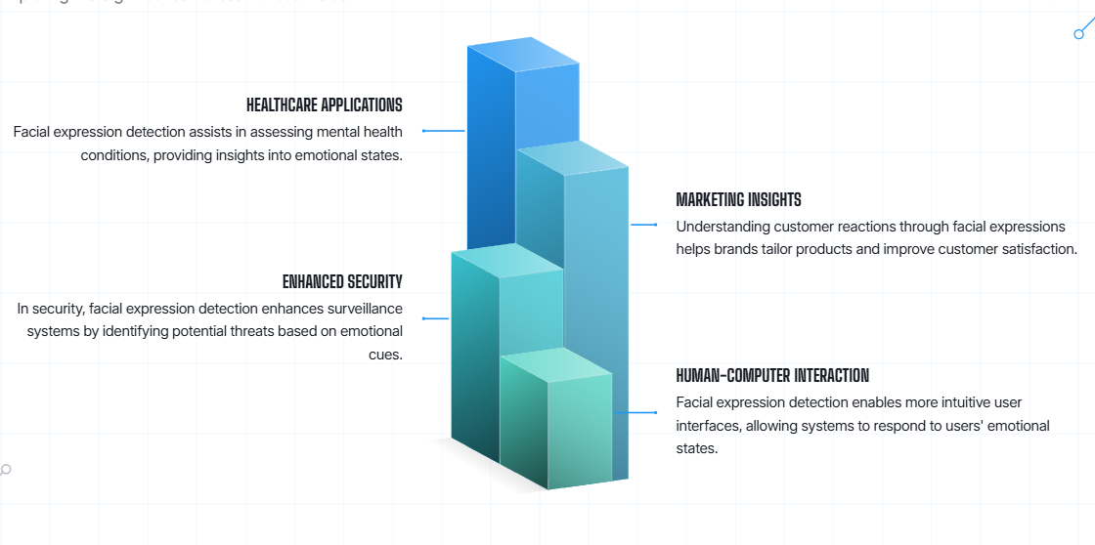
Critical Role Of Facial Expression Detection

Slide 6
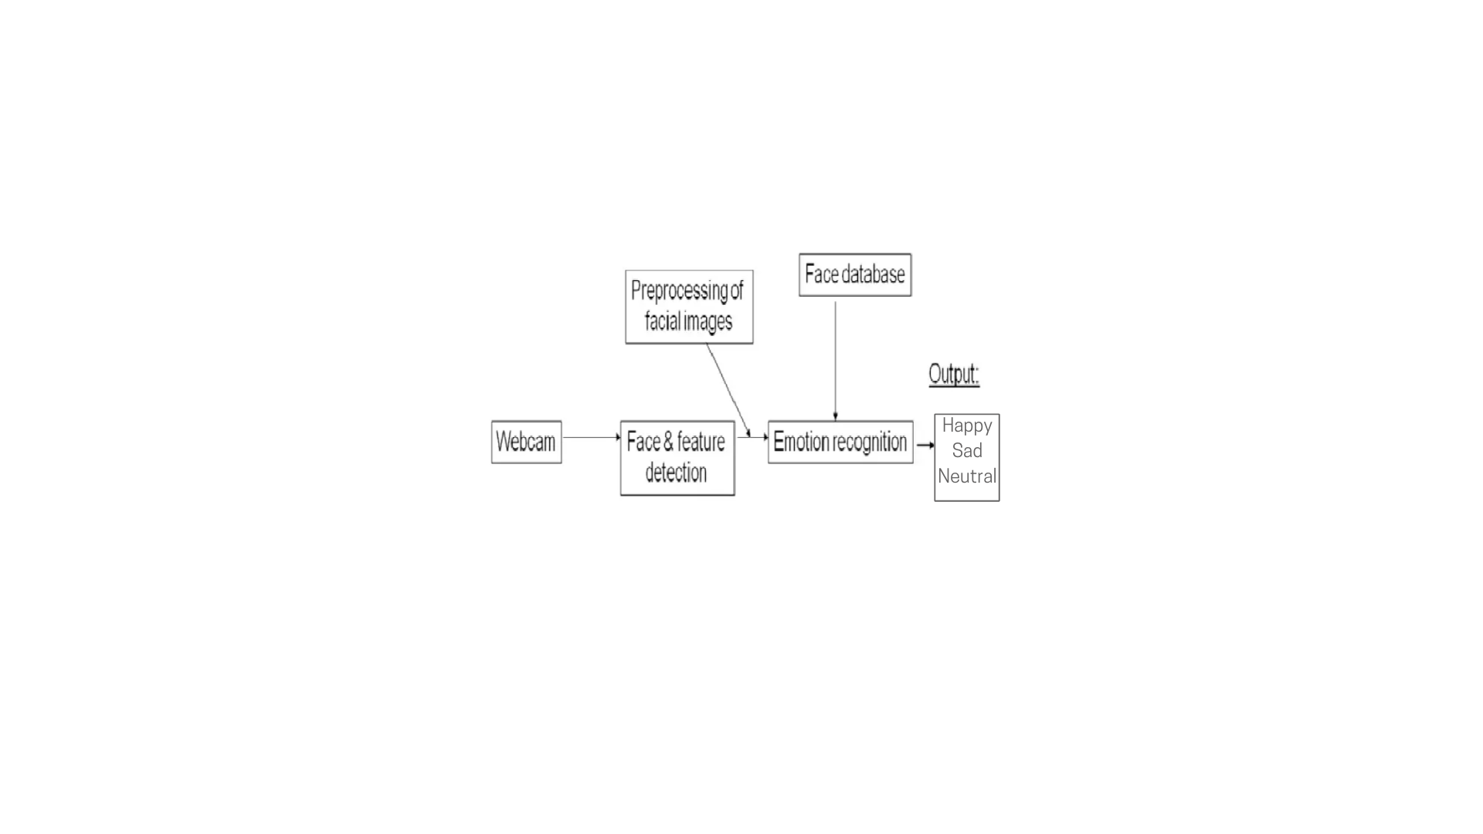
System Diagram

Slide 7
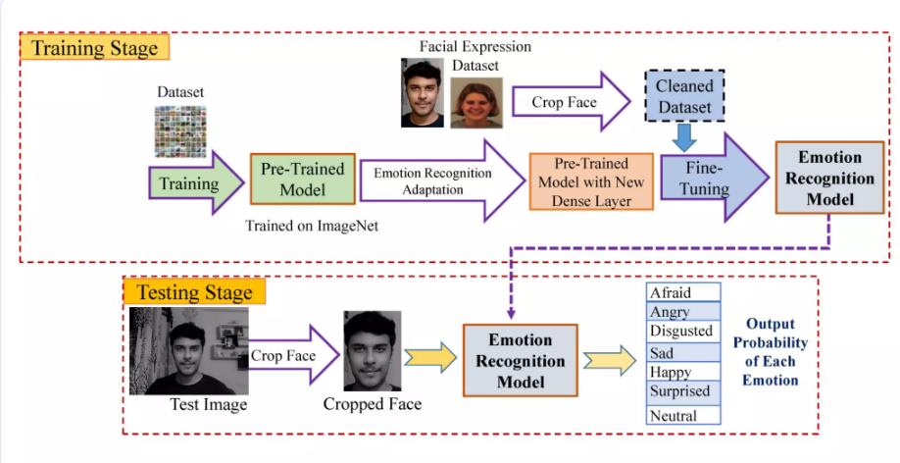

Slide 8
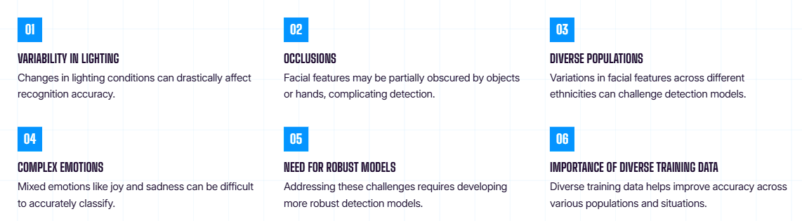
Challenges Faced in Facial Recognition

Slide 9
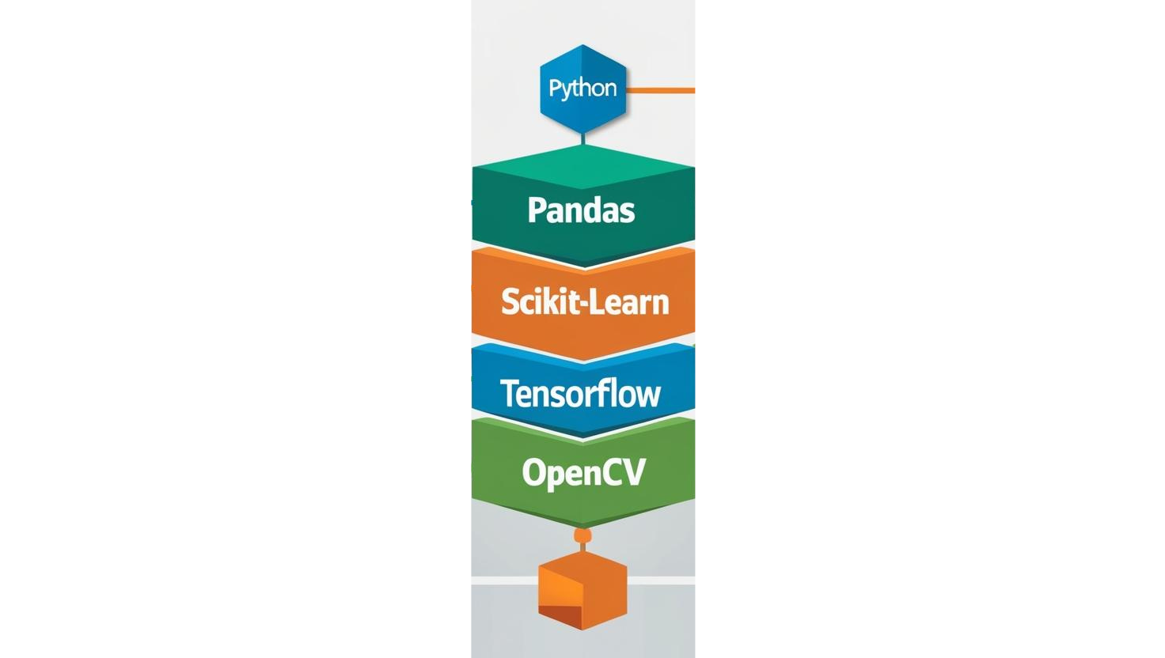
Tech Stack

Slide 10


Slide 11


