Slide 2
Build your first knowledge mining solution in a day using Azure AI services
Daniel Coelho – SR Data Scientist
Rodrigo Souza – SR Data Scientist
Xiaochen Wu – SR Program Manager
Cloud & AI
ACE Team

Slide 3
Agenda
8 AM – 5 PM
Environment
Introduction
Demos
Labs
Surface Giveaway

Slide 4
Logistics
Restrooms – hallway, to the right
Wi-fi: On the back of your badge
Lunch: 12 – 1 PM - To go boxes
Breaks: Anytime!!

Slide 5
This Training
Knowledge Mining Bootcamp
aka.ms/kmb
2 Days
Bot
Content Moderator as a Custom Skill

Slide 6
Other KM Resources
Knowledge Mining Workshop
aka.ms/kmw1
6 hours
Web Interface
Will be delivered on Thursday at 10:45 AM

Slide 7
Other KM Resources
ACE Team Blog
aka.ms/ACE-Blog
Lessons Learned
Best Practices
Inovations

Slide 8
Other KM Resources
Knowledge Mining Accelerator
aka.ms/kma
PowerShell Deployment
BYOD
Multi-facet Graph
Pre-Deployed demos for Healthcare, Retail, and Oil & Gas
Knowledge Mining Solution Accelerator
aka.ms/kmsolutions
PowerShell Deployment + Postman + Visual Studio
BYOD
Tabular results

Slide 9
This Training - What and How
What will you learn?
Azure Search
Cognitive Search
Azure Functions
Content Moderator
Bot
How will you learn?
Presentation
Hands-On-Lab
Start here
Finish later

Slide 10
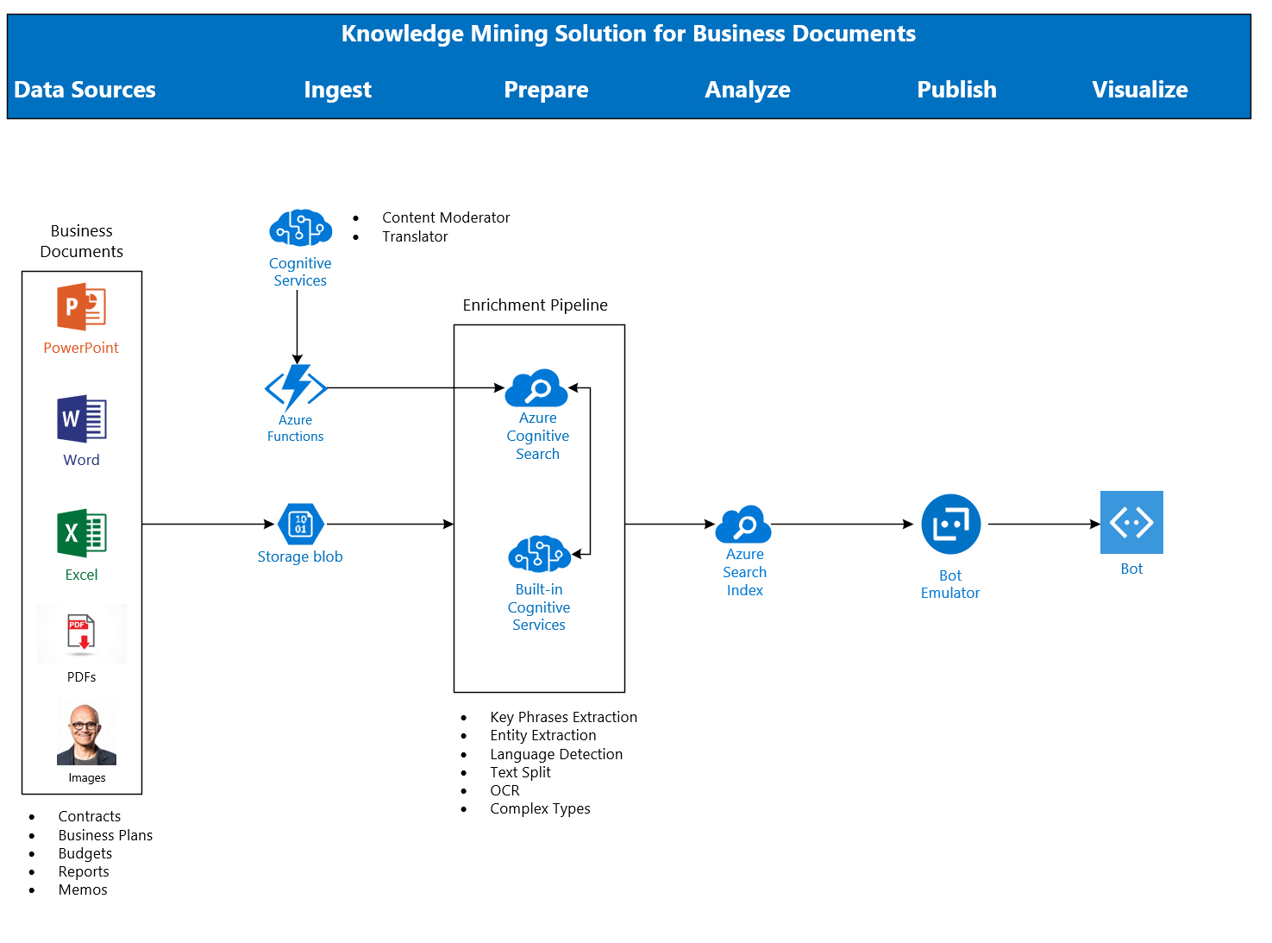
Architecture
Demo!!

Slide 11
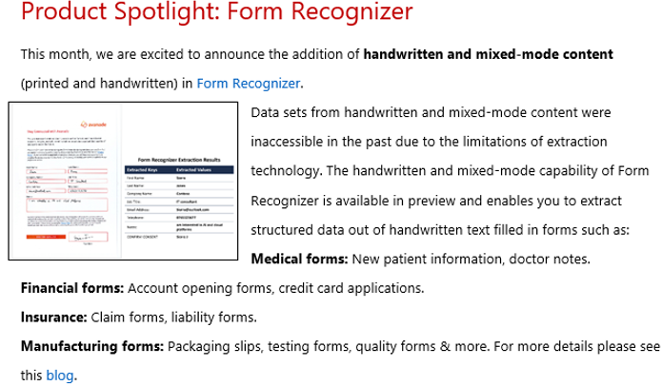

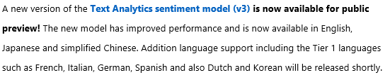
Breaking News

Slide 12
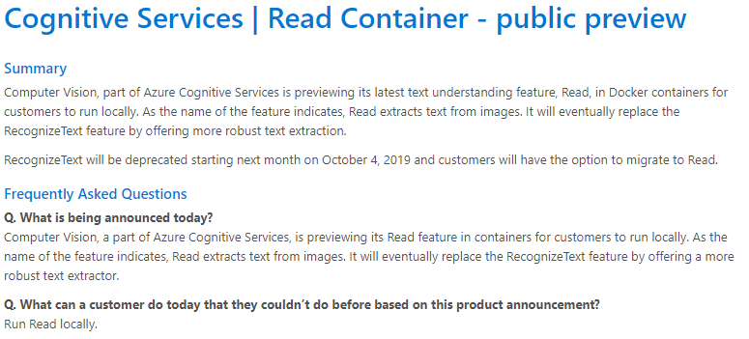
Breaking News!

Slide 13
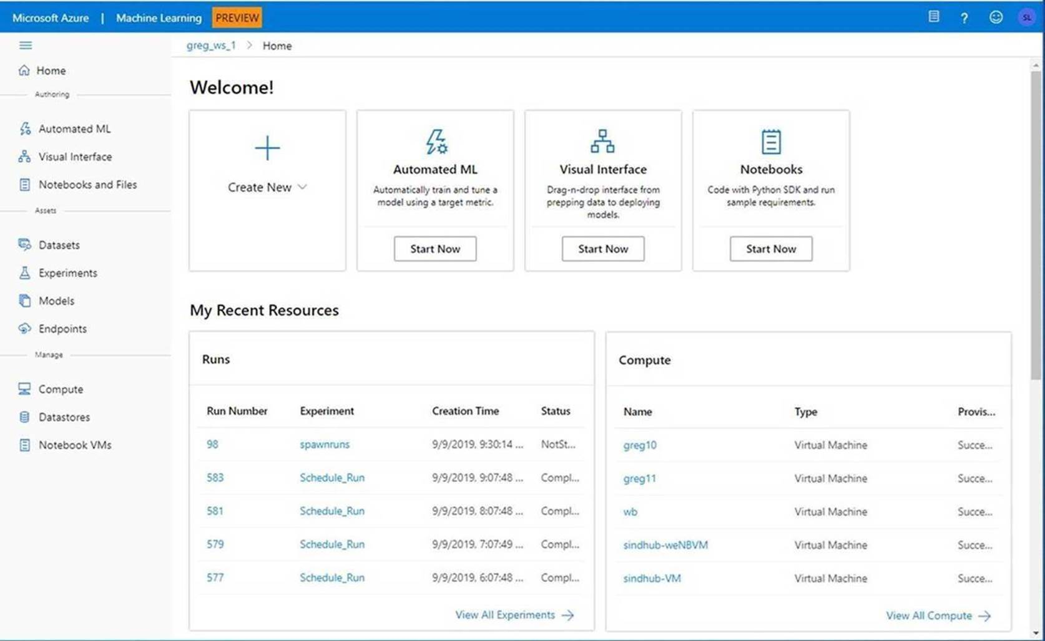
Breaking News!
Announcing the Public Preview of the new Azure Machine Learning Web Experience

Slide 14
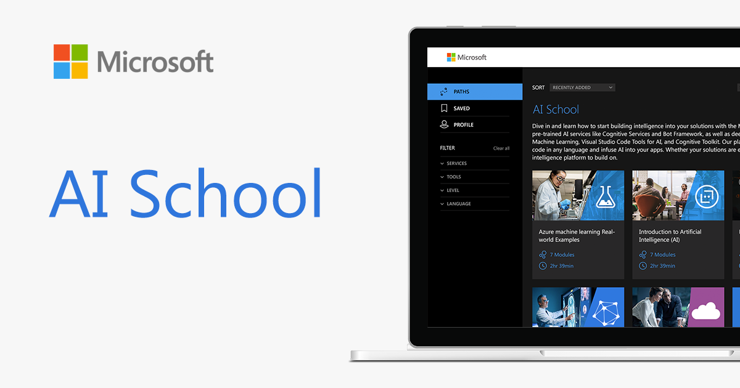
Breaking News!
http://aka.ms/ai-school

Slide 15
Key Links
AutomatedML
Hyperdrive
Azure Machine Learning Documentation
AI on IoT Edge Devices
Azure Cognitive Services
Azure Cognitive Services in Containers
Azure Machine Learning Studio

Slide 16
Key Links – ACE Team
aka.ms/ACE-Blog
aka.ms/kma
aka.ms/kmb

Slide 17
Spektra Environment
Azure Account
DSVM
Storage Account
Azure Search
Cognitive Services

Slide 18
Spektra Environment
https://aka.ms/ignite-PRE09
Activation Code = TBD
Confirmation page
Confirmation email from noreply@cloudlabs.ai

Slide 19
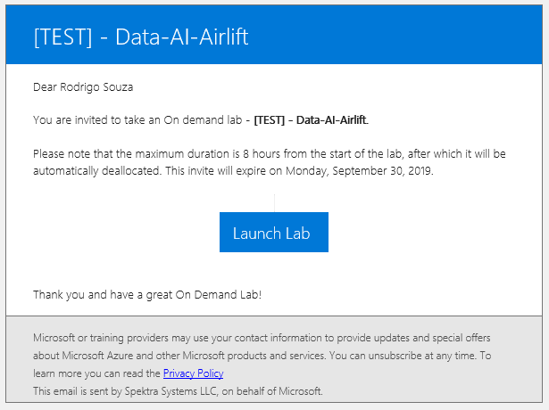
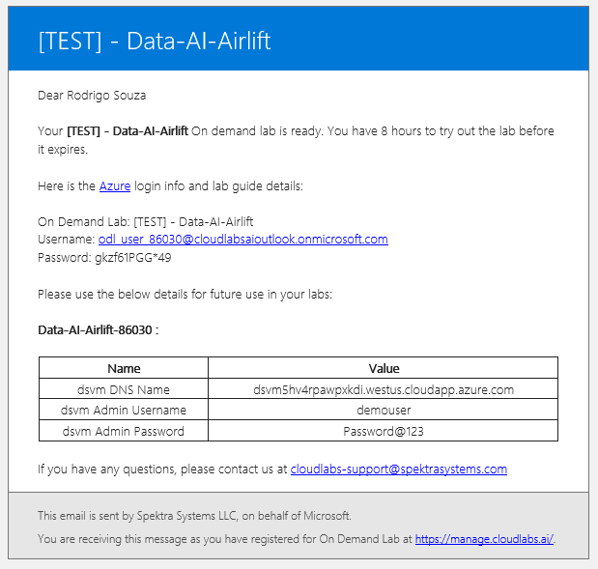
Spektra Environment

Slide 20
Let’s go! aka.ms/kmb

Slide 21
Thank you! Rodrigo Souza rosouz@microsoft.com

