Slide 1

IdeaForge AI: An AI-Powered Academic Project Intelligence Platform
AI-powered platform for Computer Science projects
Group 2 : CSE299.3; Hrick Romit (2322136642)
Yoshiki Zaman (2311806042)
Imtiaz Ahmed Khan (2323985642)
Adib Araf Sabab (2322163042)

Slide 2

Problem Statement
Students unknowingly select duplicate projects
Difficult to search previous projects
Hard to judge project difficulty
Manual proposal checking takes time
No AI guidance for students

Slide 3
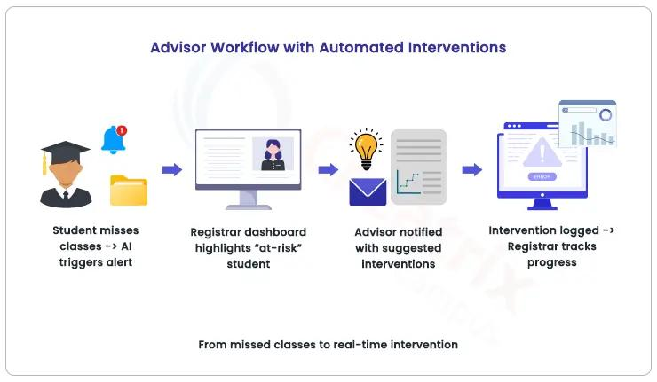
Proposed Solution
👨‍🎓 Student Portal
Search previous projects
Upload proposals
Get AI recommendations
👨‍🏫 Faculty Portal
Review proposals
View AI summaries
Check similarity reports
👨‍💼 Admin Portal
Manage users
Manage project database

Slide 4

AI Features :
Semantic Search
Similarity Detection
Novelty Analysis
Technology Recommendation
AI Chatbot (RAG)
Technologies :
React.js , FastAPI
PostgreSQL , Python
LangChain
FAISS / ChromaDB
OpenAI / Gemini API

Slide 5

Expected Outcome
Reduce duplicate projects
Better project selection
Faster proposal review
AI-assisted decision making
Improve project originality
Build a long-term project repository

