Slide 1
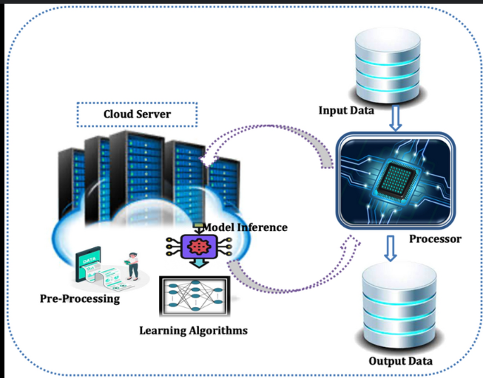
Securing Cloud Computing Environment via Optimal Deep Learning-based Intrusion Detection Systems
Presented by :
Hriday Gandhi – 16010122055
Mayur Dumbre – 16010122051
Farzan Irani- 16010122065

Slide 2
Introduction to Cloud Security Challenges
Cloud computing (CC) offers scalability and flexibility but faces significant security concerns due to large data volumes.
Security is critical to protect applications and infrastructure from cyber threats.
Intrusion Detection Systems (IDS) monitor network traffic for malicious behavior or unauthorized access.
Need for advanced IDS leveraging anomaly detection and Machine Learning (ML) to enhance cloud security.

Slide 3
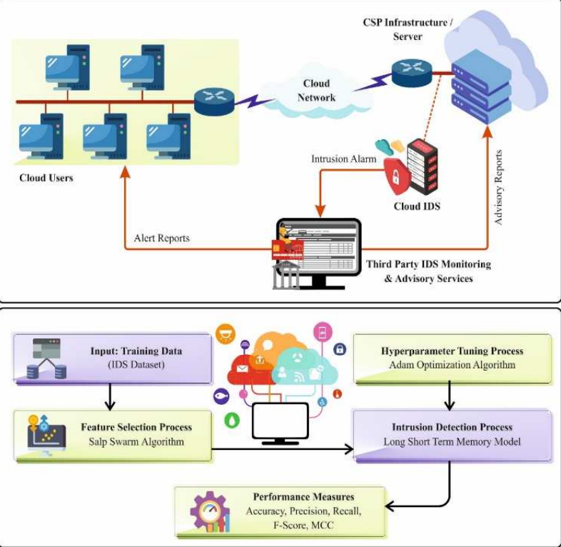
Proposed SSAFS-DLID Method
Novel Salp Swarm Algorithm-Based Feature Selection with Deep Learning-Based Intrusion Detection (SSAFS-DLID) method.
Components:
Salp Swarm Algorithm (SSA) for Feature Selection (FS).
Long Short-Term Memory (LSTM) for intrusion detection classification.
Adam optimizer for training optimization.
Goal: Improve IDS effectiveness and efficiency in cloud infrastructure.

Slide 4
Feature Selection Using SSA
SSA mimics the swarming behavior of salps for optimal feature selection.
Process: Population Initialization: Randomly initializes salp positions in an n-dimensional space.
Leader Position Update: Leader salp directs the swarm toward the food source (optimal features).
Follower Position Update: Followers move in a chain based on Newton’s laws.
Benefits: Reduces computational complexity and dimensionality while retaining crucial data.

Slide 5
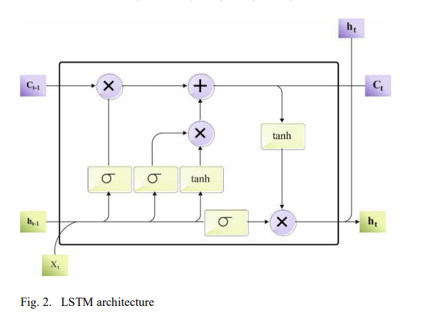
Intrusion Detection Using LSTM
LSTM (Long Short-Term Memory) classifier detects anomalies in cloud infrastructure.
Architecture includes:
Input gate, forget gate, output gate, and memory cells.
Handles sequential data to identify patterns of malicious behavior.
Advantage: Effective against various cyberattacks due to memory retention.

Slide 6
Optimization with Adam
Adam optimizer ensures effective convergence during training.
Combines benefits of RMSprop and SGD with adaptive learning rates.
Dynamically adjusts learning rates using first and second gradient moments.
Result: Faster and more stable convergence for the SSAFS-DLID model.

Slide 7
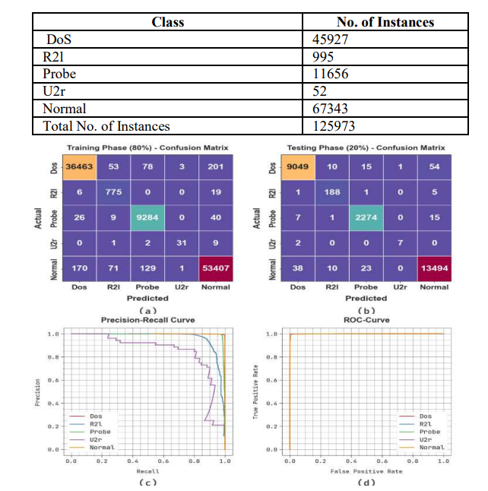
Performance Validation - Dataset
Evaluated using an intrusion detection dataset with 125,973 samples.
Classes and Instances:
Normal: 67,343
DoS: 45,927
Probe: 11,656
R2L: 995
U2R: 52
Split: 80% training (TRAS), 20% testing (TESS).

Slide 8
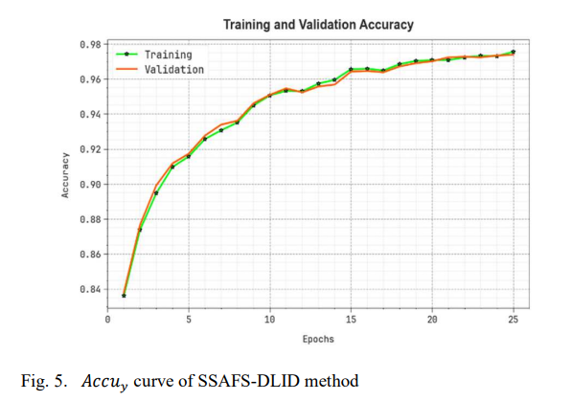
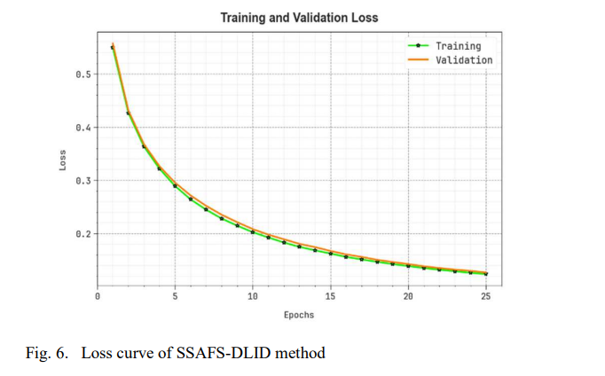
Training and Validation Curves
Training Accuracy (TRAAC) and Validation Accuracy (VALAC) improve consistently over epochs.
Training Loss (TRLA) and Validation Loss (VALL) decrease progressively.
Indicates strong generalizability and pattern detection capability.

Slide 9
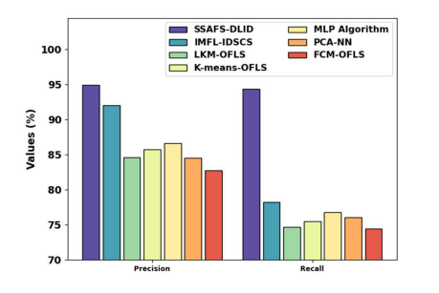
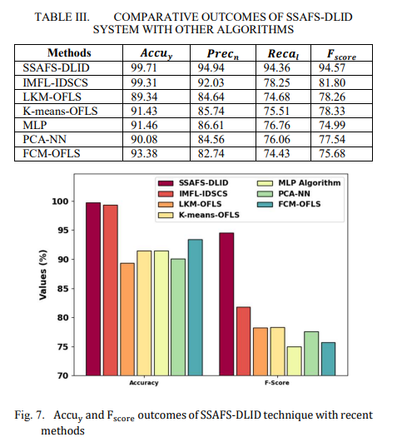
Comparative Analysis
SSAFS-DLID outperforms other methods:
Accuracy: 99.71% (vs. IMFL-IDSCS: 99.31%, LKM-OFLS: 89.34%, etc.)
Precision: 94.94% (vs. IMFL-IDSCS: 92.03%, LKM-OFLS: 84.64%)
Recall: 94.36% (vs. IMFL-IDSCS: 78.25%, LKM-OFLS: 74.68%)
F-score: 94.57% (vs. IMFL-IDSCS: 81.80%, LKM-OFLS: 78.26%)

Slide 10
Conclusion
SSAFS-DLID is an effective tool for cloud intrusion detection.
Key strengths:SSA reduces dimensionality efficiently.
LSTM detects anomalies with 99.71% accuracy.Adam optimizer ensures stable training.
Achieves high accuracy, low false positives, and computational efficiency.
Future work: Explore additional datasets and real-time applications.

Slide 11
References
Rawaa Al-Dabbagh, et al. "Improving Network Intrusion Detection System Using Deep Learning with Feature Selection."
This paper explores optimizing deep learning models with feature selection methods like binary particle swarm optimization (BPSO) to enhance IDS accuracy, using the CSE-CICIDS2018 dataset.
Weikai Ren, Ningde Jin, and Lei OuYang. "PSGCN: Phase Space Graph Convolutional Network Model for Intrusion Detection."
Introduces a deep learning approach using graph convolutional networks to analyze network traffic patterns, relevant to IDS in cloud environments.
Adel Abusitta. "A Proactive Multi-Cloud Cooperative Intrusion Detection System Using Deep Learning."
Proposes a deep learning-based IDS using stacked denoising autoencoders for proactive intrusion detection across multiple cloud providers.
Moustafa, Nour, and Jill Slay. "UNSW-NB15: A Comprehensive Data Set for Network Intrusion Detection Systems.
Provides a detailed dataset used for evaluating IDS performance, which could be relevant for the research paper's experimental validation
Sharafaldin, Iman, et al. "Toward Generating a New Intrusion Detection Dataset and Intrusion Traffic Characterization."
Describes the CSE-CIC-IDS2018 dataset, which is widely used for testing IDS models, potentially aligning with the paper's methodology

Slide 12
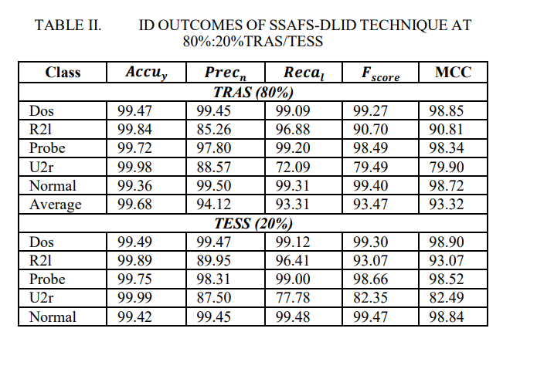
Miscellaneous
TRAS (80%): Avg. Accuracy 99.68%, Precision 94.12%, Recall 93.31%, F-score 93.47%, MCC 93.32%
TESS (20%): Avg. Accuracy 99.71%, Precision 94.94%, Recall 94.36%, F-score 94.57%, MCC 94.36%

