Slide 1
Bankruptcy
-Hriday Raj and Ghson Alotibi
Notes:
GH

Slide 2
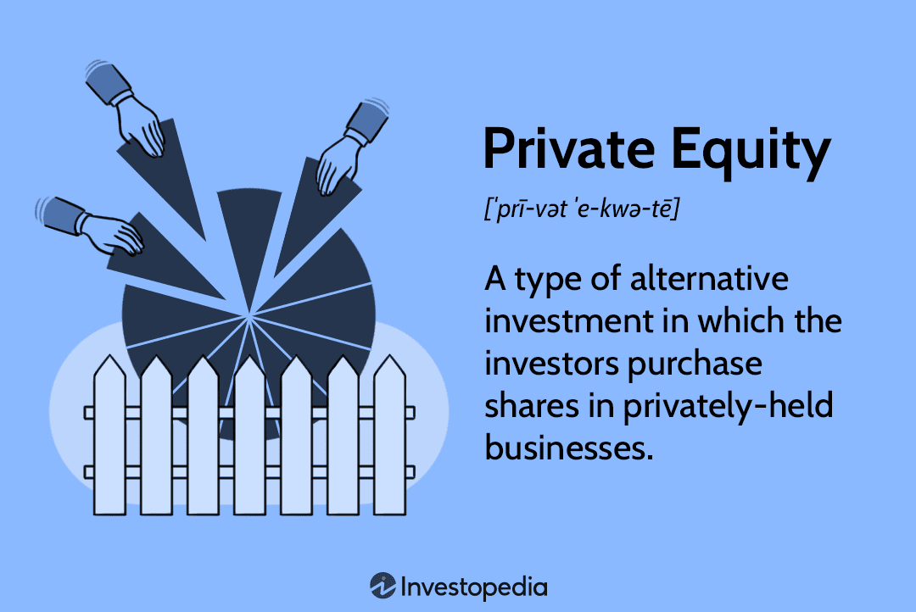

Context

Slide 3
Agenda
Context/Key Definitions
Example
Metrics
Random Forest Model
Example Revisited
Conclusion/Takeaways

Slide 4
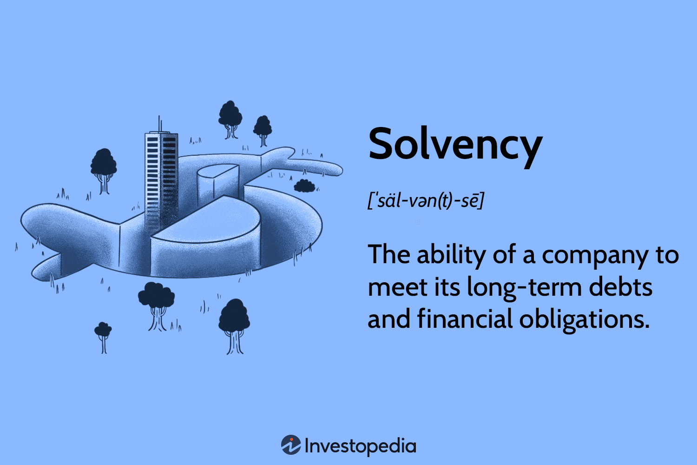
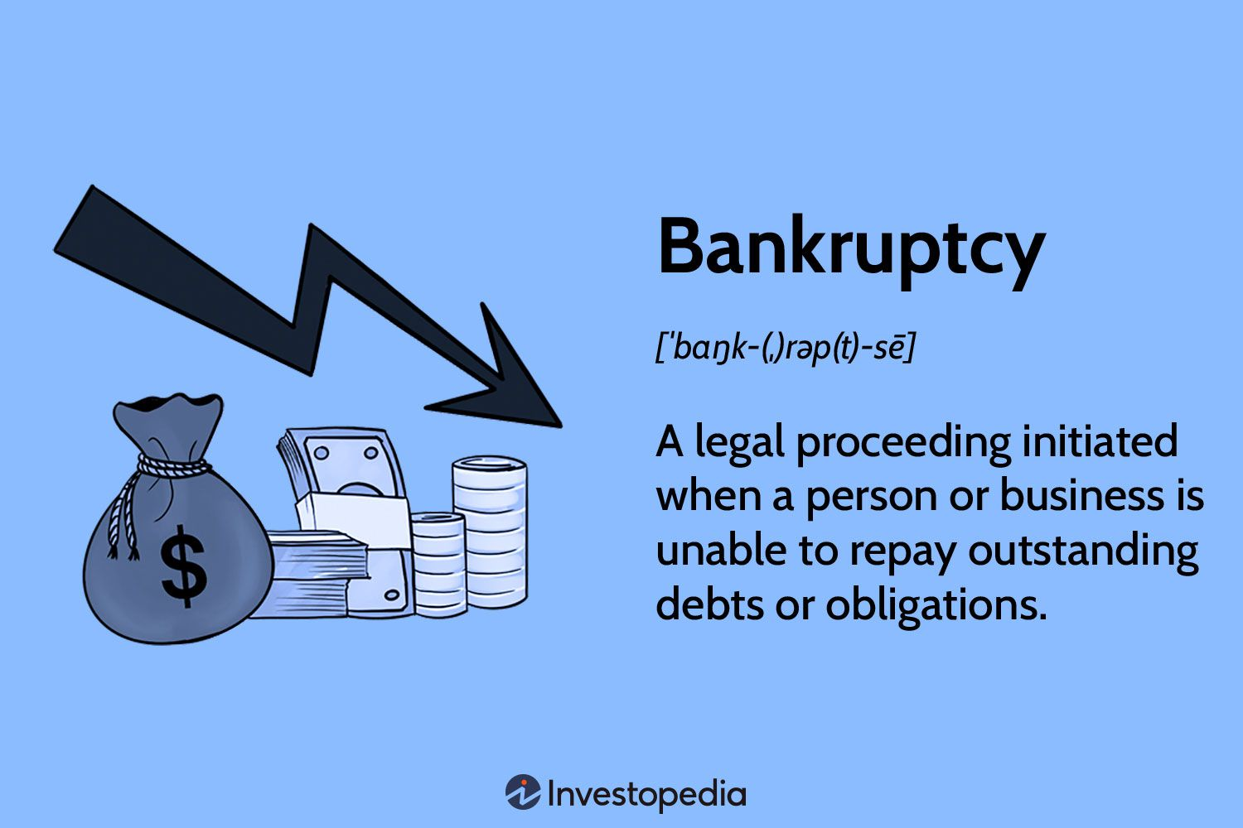
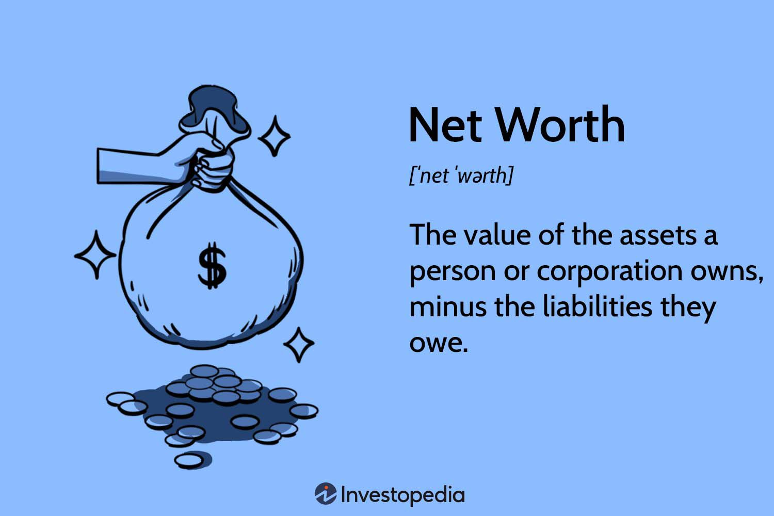
Key Definitions
Notes:
GH

Slide 5
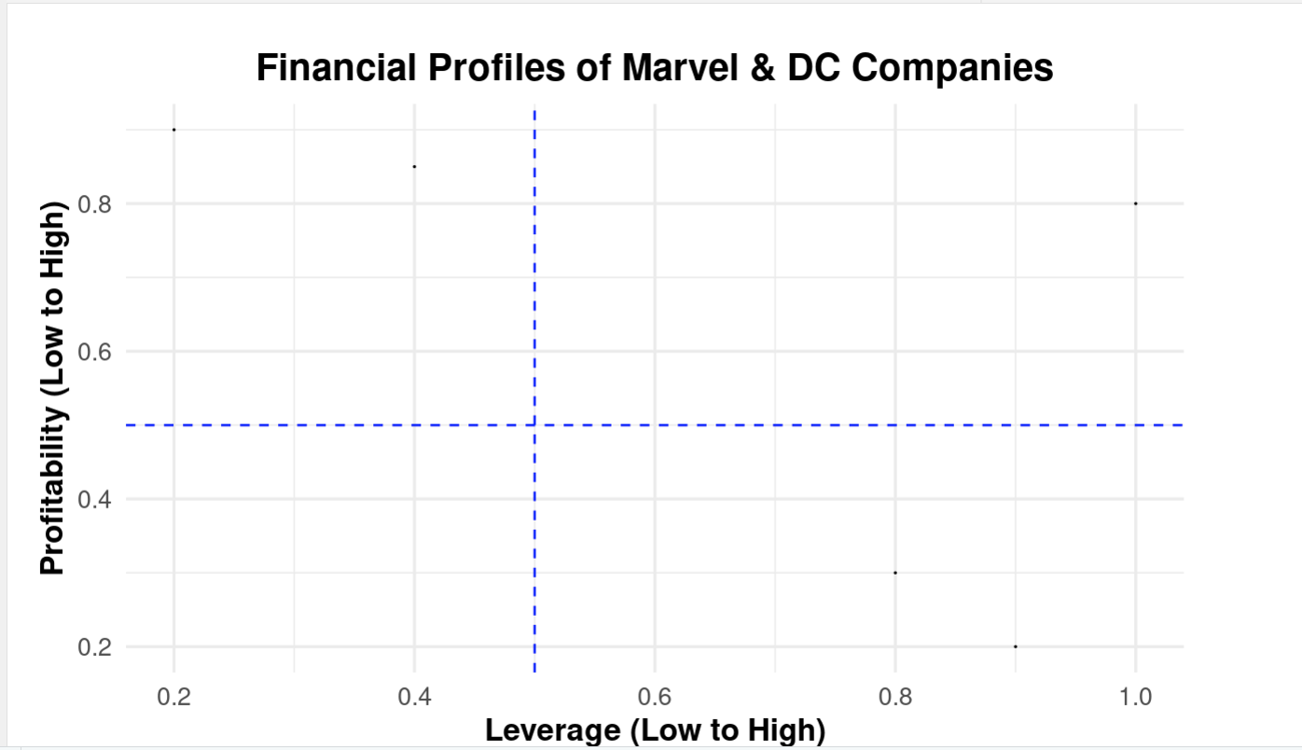





Consider~
Oscorp: High liquidity
Kord Industries: Low Liquidity
Roxxon Energy: Low Liquidity
Queen Consolidated: Medium Liquidity
Waynetech: High Liquidity

Slide 6
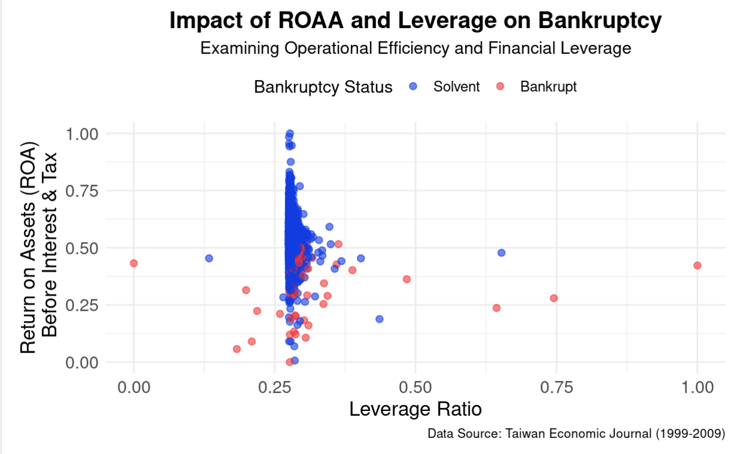
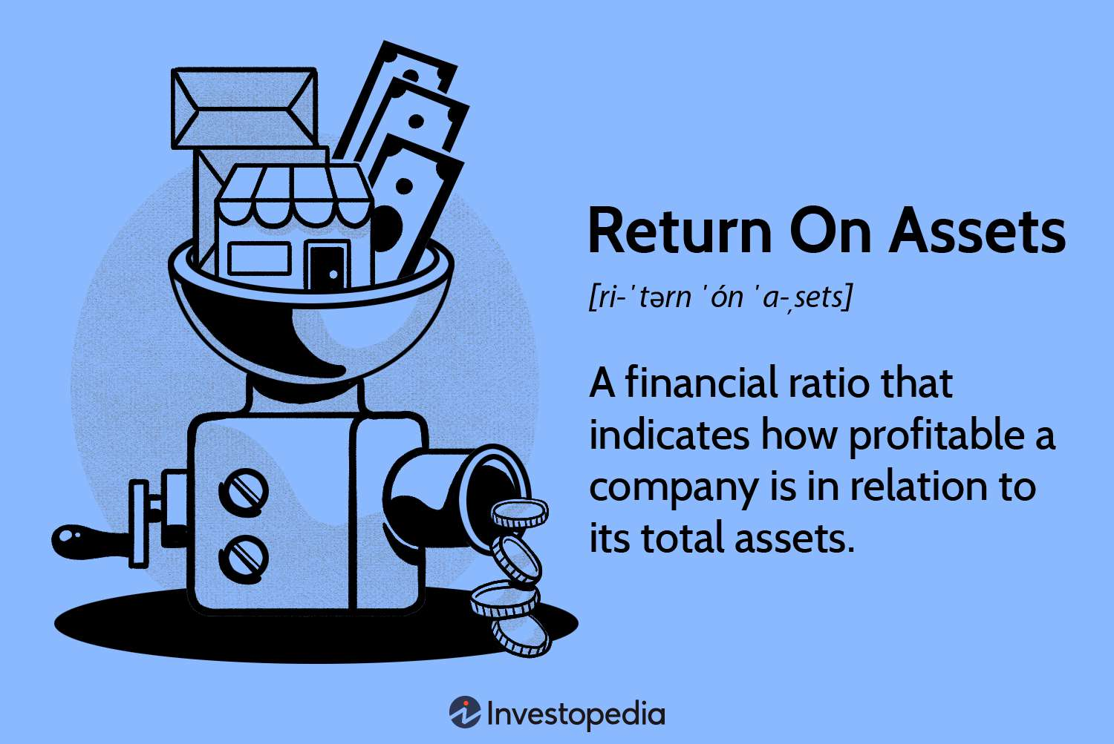
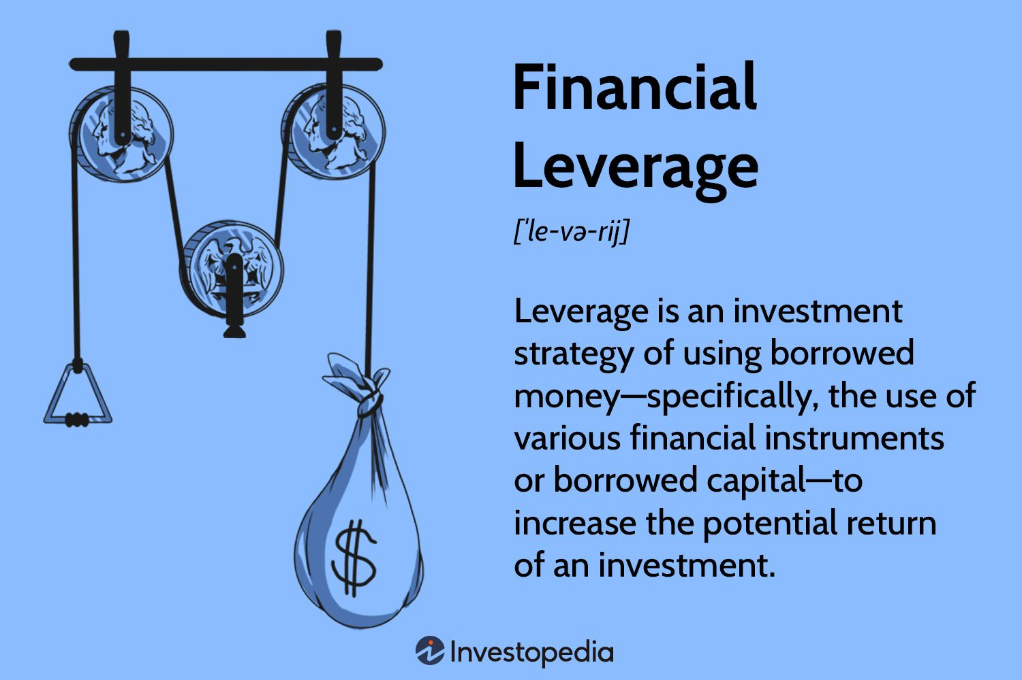
Takeaways
Low ROA stay away
High Leverage is ok but risky with High ROA
High leverage, Low ROA is a very bad idea
Notes:
Higher Return on assets mean higher risk

Slide 7
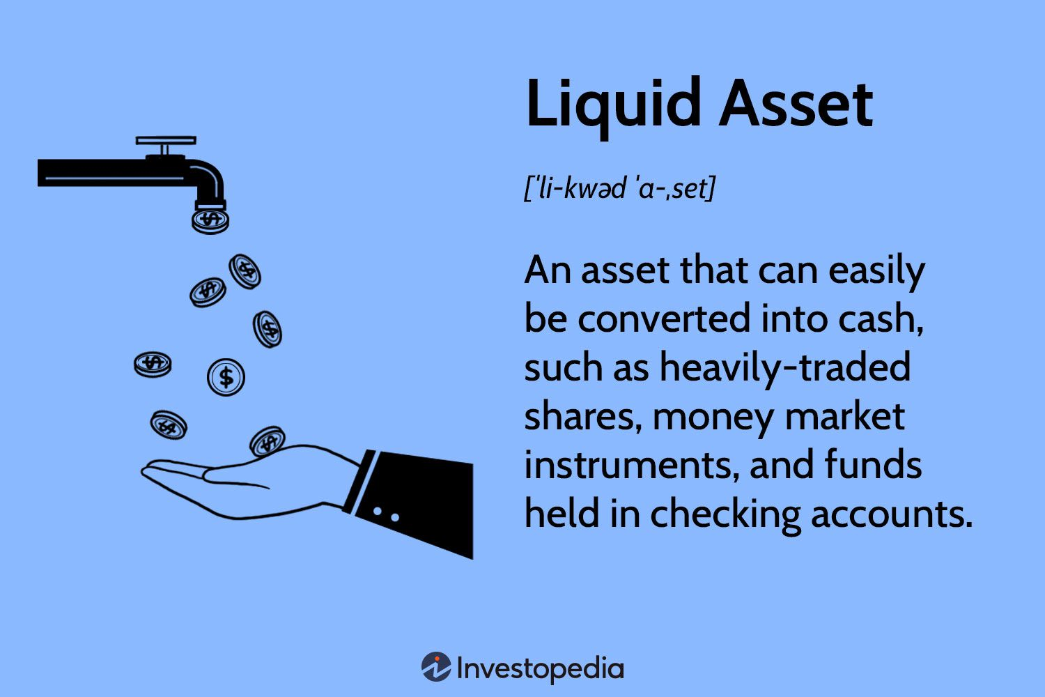
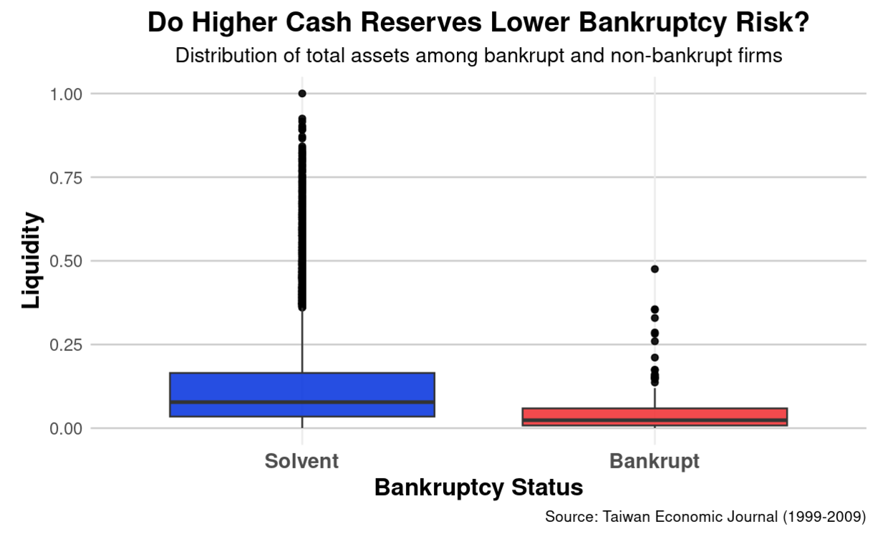
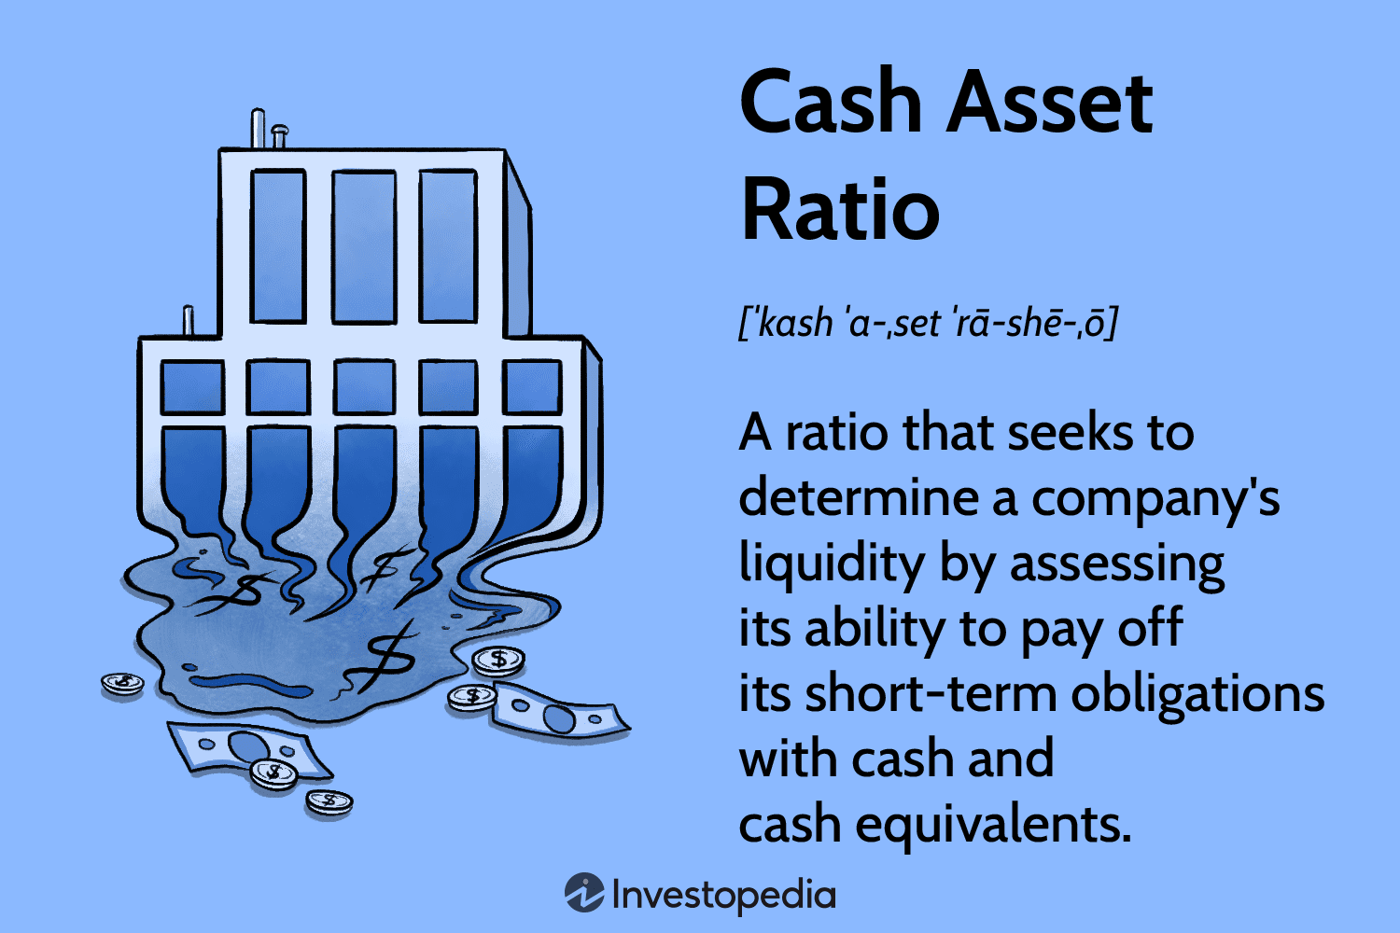
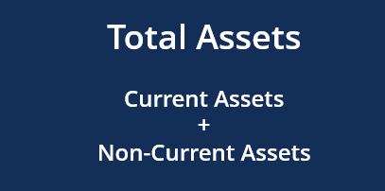
Takeaways
Solvent firms have broad and high total asset range
Bankrupt firms have moderate cash reserves
Notes:
GH

Slide 8
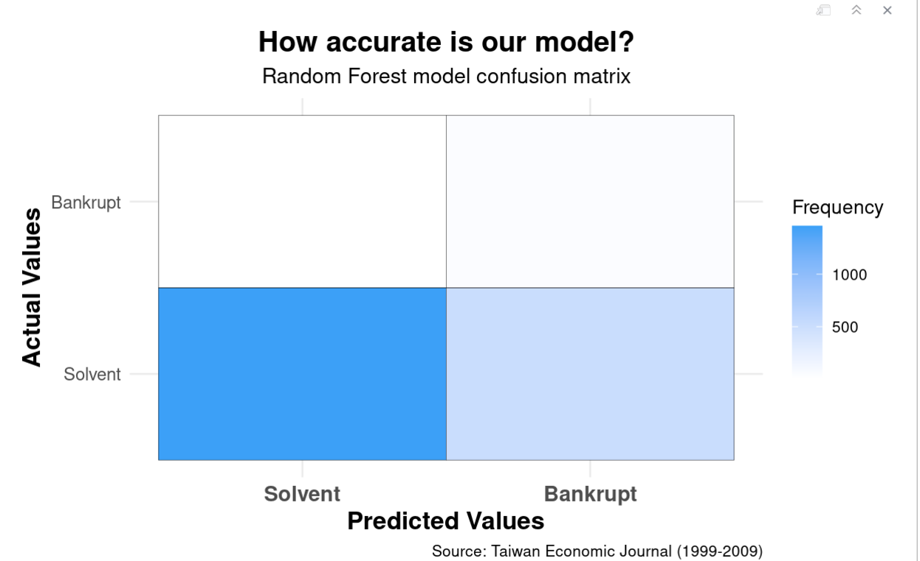
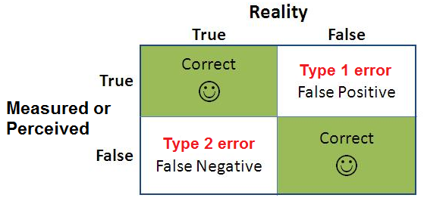
Takeway
aaaa
PPV: 98.98% – Accurate at identifying solvent firms.
NPV: 8.93% – Frequently misclassified bankrupt firms (false positives).
Kappa: ~0 – Our Model is barely better than random guessing.
McNemar's Test: P-value = 1 – No significant improvement over random chance.
Overall our model struggles with solvent firm predictions and needs further work.

Slide 9
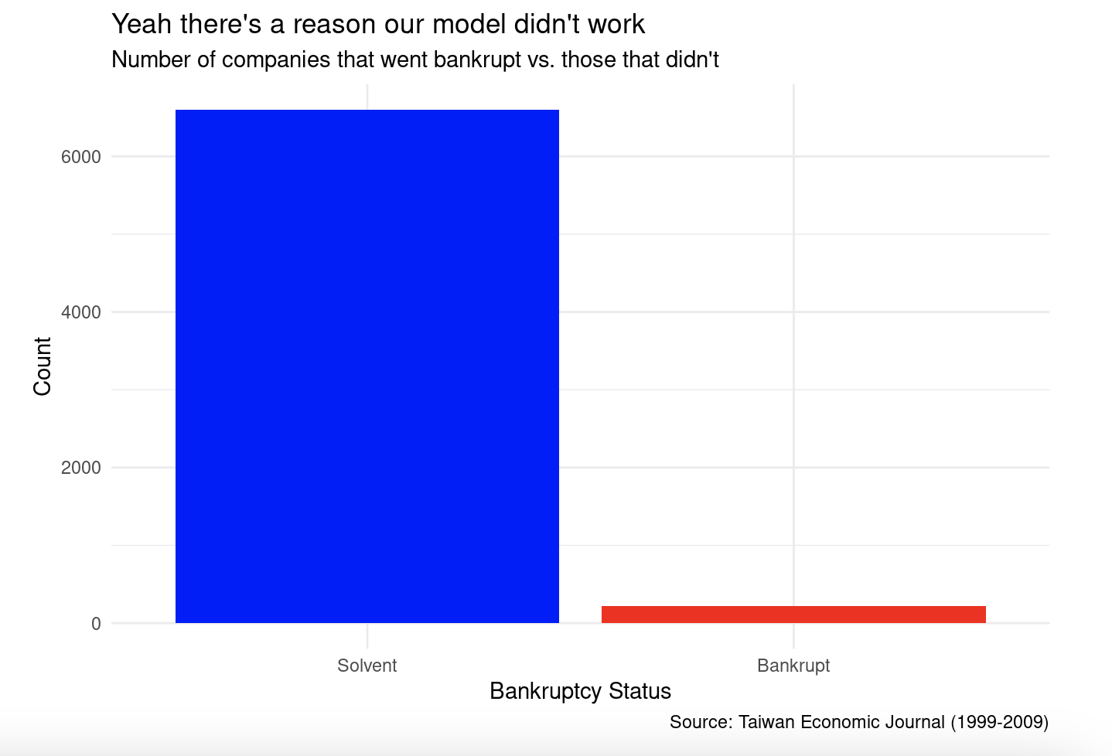
ONE FINAL GRAPH
Notes:
Ghson will present this

Slide 10
Revisitation
Oscorp: Bankrupt
Kord Industries: Bankrupt
Roxxon Energy: Solvent
Queen Consolidated: Solvent
Waynetech: Bankrupt

Slide 11
Conclusion and Future Work
Takeaways:
Financial ratios like leverage, profitability, and cash reserves are critical in assessing bankruptcy risk.
Whilst these metrics protect us from bankruptcy risk they are not always fool proof
While machine learning models like Random Forest can offer valuable insights, their effectiveness depends on data quality and balance.
Looking Ahead:
Future improvements in model accuracy and handling of data imbalance will lead to better prediction capabilities.
For investors, combining analytical tools with experienced judgment remains key to minimizing risk.

Slide 12
Questions?

Slide 13
Thanks for listening!

Slide 14
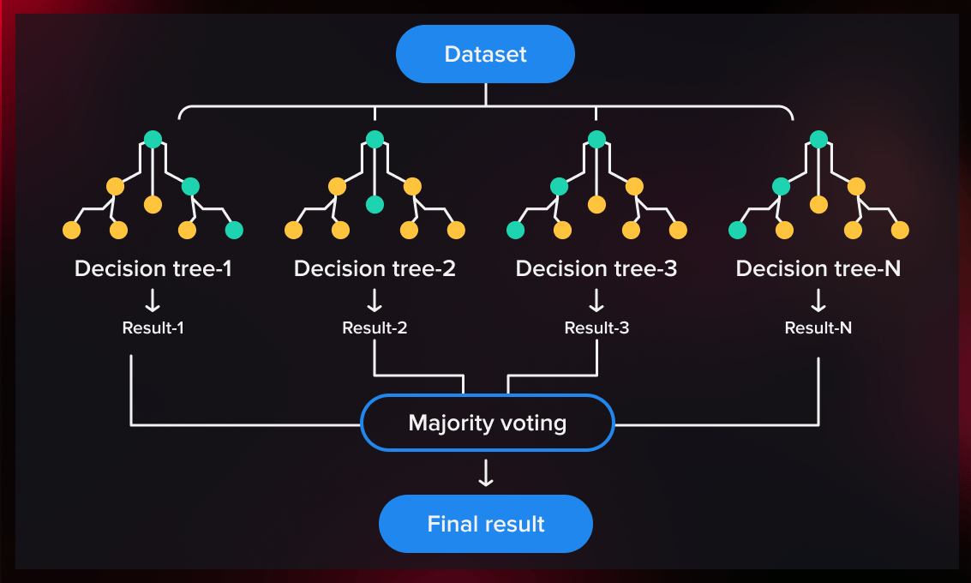
Huh what is Random Forest?
What it is: An ensemble method combining multiple decision trees.
How it works:
Uses random subsets of data (bagging) to train each tree.
Combines predictions via majority vote (classification) or averaging (regression).
Key Benefits:
Reduces overfitting.
Handles non-linear relationships.
Robust to noise and complex interactions.
Challenges: Needs tuning; struggles with imbalanced datasets.

