Slide 1
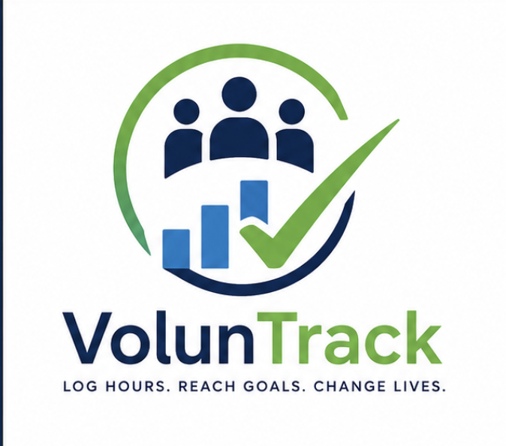
LIVE
hriday21223.github.io
/VolunteerTrack
VOLUNTRACK
The volunteer hour
tracker students
actually keep open.
12
auto-earning
badges
PWA
installs on
any device
A privacy-first PWA for logging service hours, hitting goals, and exporting
reports that survive a college application. Built for students, schools, and clubs.
0
account server
needed
React 18 + Vite
PWA, offline-first
localStorage private
MIT licensed
Showcase + pitch · v2.0

Slide 2
WHAT IT IS
A real product, not a mockup.
VolunTrack is already live, already deployed, and already in use. It runs as an installable PWA, ships with a school/admin layer, and exports PDF reports a counselor will actually accept.
5 user roles
12 badges
PWA install
Student, supervisor, school admin, district admin, and platform admin. Each gets the right surface — nothing more.
Auto-earning achievements turn consistency into something students can see, share, and feel good about.
Installs on iOS, Android, Windows, macOS, and Linux. Works offline after the first visit. No app store gate.
THE POINT
Take the friction out of proving you showed up — and the data lives on the student's own device, not in someone else's system.
voluntrack.app
Slide 2

Slide 3
THE WORKFLOW
Five minutes from service hour to verified record.
1
2
3
4
5
Log it
Track it
Prove it
Verify it
Own it
Activity, hours, supervisor, notes — and a photo of proof — in one form.
Progress ring, weekly chart, and 12 badges keep momentum visible.
PDF report, CSV export, or a printable certificate in one click.
Optional school dashboard with PIN join, rosters, and PDF review.
Data stays in the student's browser. No account server, no data harvesting.
Every step fits on one screen. Every record stays portable. That's the whole product.
voluntrack.app
Slide 3

Slide 4
THE PRODUCT
Calm UI, dense info, no clutter.
voluntrack
Dashboard
Alex · Senior · Lincoln High
ONE SENTENCE
AI hour logger
THIS MONTH
BADGES EARNED
Type a sentence — the on-device agent drafts a full log entry. Confirm and you're done.
TOTAL HOURS
12.5
7 / 12
62.5
+3.5 vs last month
PROGRESS
of 100 hour goal
RECENT
Streaks + rings
Food bank — 3.0h · Sat
Daily streak, weekly chart, and a progress ring toward the primary goal.
Park cleanup — 2.5h · Sun
Tutoring — 1.5h · Wed
THIS WEEK
PORTABLE
PDF + CSV export
Counselor-ready service log and a printable certificate. No locked-in formats.
M
T
W
T
F
S
S
voluntrack.app
Slide 4

Slide 5
AUDIENCE
One product, three real buyers.
STUDENTS
SCHOOLS
DISTRICTS
Log it once, prove it forever.
Stop chasing spreadsheets.
One rollout, every student.
One-tap logging with photo proof
School PIN join — no manual roster uploads
Multi-school admin dashboard
12 badges that turn consistency into something visible
Verified supervisor flow with PDF review
Payment + subscription tracking already built
PDF report that survives a college application
Bulk CSV import + export for counseling
An AI agent that monitors system health 24/7
voluntrack.app
Slide 5

Slide 6
WHY IT'S SAFE
Privacy isn't a feature. It's the foundation.
Counselors and parents ask the same question first. Here's the honest answer.
✓
✓
✓
Local-first by default
No tracking, no telemetry
School data is opt-in
Volunteer logs live in the student's browser (localStorage). No cloud, no account, no server talking to volunteer data.
The only analytics are Vercel pageviews and speed metrics. There is no event tracking on hours, names, schools, or activity.
When a school signs up, only then does the server see anything — and only what the student explicitly submits.
✓
✓
✓
JWT + bcrypt, rate-limited
Open source, MIT
Recovery without lockout
Server-side auth uses bcrypt password hashing, JWT tokens, parameterized queries, and request rate limiting. See SECURITY.md.
Every line is on GitHub. Schools can self-host, audit, and extend without vendor lock-in.
Forgot your PIN or password? A 6-digit recovery code is emailed — works for both new and returning students.
voluntrack.app
Slide 6

Slide 7
THE STACK
Modern, boring, and ready to extend.
Everything is documented in the repo, runs on free tiers, and survives being handed to a junior dev.
FRONTEND
PWA via vite-plugin-pwa. No Webpack, no Next.js, no lock-in.
React 18 · Vite 5 · React Router 6 · Tailwind CSS 3
STATE
Data lives under the voluntrack: namespace — fully exportable, fully portable.
localStorage namespaces · React Context · custom hooks
BACKEND
Optional. The full app works without it. School features turn it on.
Express 4 · PostgreSQL (Neon) · JWT + bcrypt
EXPORTS
Counselor-ready PDF logs, CSV exports, and printable certificates.
jsPDF · jspdf-autotable · CSV stringifier
AI HELPER
Drafts entries from a single sentence. Detects + auto-fixes production incidents.
On-device agent for log drafting + system monitoring
DELIVERY
CI runs lint + build + preview as three jobs. Green commits auto-deploy.
GitHub Actions · GitHub Pages · Render · Vercel Analytics
voluntrack.app
Slide 7

Slide 8
WHAT'S SHIPPED
Phases 1 through 3 are live. Phase 4 is on deck.
11
12
100%
0
Pages live in the SPA
Auto-earning badges
Client-side privacy
Account server needed
Dashboard, log, calendar, achievements, reports, profile, settings, about, contact, status, admin.
First Hour, Streak, 10/50/100 Hours, Category Master, Community Hero, etc.
All volunteer data in the browser under the voluntrack: namespace.
The core app is fully usable without ever talking to a server.
RECENT RELEASES
Email reset for PIN recovery
Jul 2025
latest
CI: 3 jobs (lint · build · preview) on Node 24
Jun 2025
ci
Initial VolunteerTrack release
Apr 2025
v0.1
voluntrack.app
Slide 8

Slide 9
HOW IT EARNS
Free for students. Paid for the orgs that need admin.
STUDENT
SCHOOL
DISTRICT
Free
$2
Custom
forever
per student / year
per district
Every student gets the full app, every badge, every export, no strings.
Everything in Student, plus the school admin layer. PIN join, rosters, supervisor flow.
Multi-school rollout, white-glove onboarding, AI system monitoring, and SLA support.
Full hour logging + badges
School PIN join (no CSV upload)
Multi-school admin dashboard
PDF, CSV, certificate export
Verified supervisor + PDF review
Custom branding + subdomain
Offline PWA install
Bulk import + roster management
AI agent monitoring + fix log
All 12 auto-earning badges
Counselor-ready reports
Priority support · 24h SLA
Open the app
Pilot a school
Talk to us
voluntrack.app
Slide 9

Slide 10
ROADMAP
Phased, scoped, and already underway.
PHASE 1
PHASE 2
PHASE 3
PHASE 4
Core app
Auth + recovery
School partnerships
Native + integrations
SHIPPED
SHIPPED
SHIPPED
NEXT
Hour logging
Email + password login
School PIN join
Native iOS + Android
Goals + progress
PIN protection
Verified supervisor flow
Public REST API
12 badges
Recovery codes
Payment + subscription tracking
Zapier + Make webhooks
Reminders + dark mode
Account dashboards
Admin dashboard
Bulk CSV import v2
PWA install
Multi-user isolation
AI system monitoring
Calendar integrations
voluntrack.app
Slide 10

Slide 11
HOW IT PLAYS OUT
Lincoln High · 1,200 students · one semester.
THE STORY
THE OUTCOMES
Maria is a senior at Lincoln High. She needs 100 verified hours to graduate and 75 for her scholarship application.
12 min
average time to log + verify a single session
She joins VolunTrack with the school PIN and gets a private account on her own device.
$0
student pays for the app
She logs hours at the food bank. The AI agent drafts the entry from a one-sentence description. She confirms.
100%
of her hours are exportable, portable, and provable
Her supervisor uploads a signed PDF. The school admin verifies it inline. Maria's record updates automatically.
Counselor exports her full log for the scholarship committee. Done — 12 minutes, end to end.
1 link
instead of a backpack full of paper sign-in sheets
voluntrack.app
Slide 11

Slide 12
HIRE ME
I built VolunTrack. I can build yours too.
Same stack, same discipline, applied to your product, your school, or your internal tool.
BUILD
EXTEND
WHITE-LABEL
RETAIN
Custom product
Add a feature
License VolunTrack
Monthly partnership
$8k – $25k
$500 – $4k
$5k + $1k/yr
$2k – $6k / mo
A full React + Vite + Tailwind PWA, deployed to your domain, branded to you. 3–6 weeks.
Auth, payments, dashboards, AI helpers, export pipelines, integrations. Scoped per ticket.
Your branding, your domain, your student data on your Postgres. Source code included.
Hosting, monitoring, AI agent ops, feature requests, and on-call. Cancel any month.
voluntrack.app
Slide 12

Slide 13
NEXT STEPS
Three ways to take the next ten minutes.
01
Try the live demo
OPEN THE APP
Open the app, sign in with any email + password, and log a single hour. Time it — it's under 90 seconds.
hriday21223.github.io/VolunteerTrack
02
Read the source
VIEW ON GITHUB
Everything is on GitHub under MIT. Read SECURITY.md for the auth model, README.md for the stack.
github.com/Hriday21223/VolunteerTrack
03
Start the conversation
EMAIL ME
Email is the fastest path. I reply within a business day, and I'm happy to do a 20-minute call before any commitment.
volunteertrack@googlegroups.com
voluntrack.app
Slide 13

