Slide 1
Automobile Data Analysis
NAME:HRIDHTHIK TP
MENTOR:JAYA PANDEY

Slide 2
INTRODUCTION:
Project Overview: This project aims to analyze a car dataset to identify key factors for launching new car models. By examining the data, we will extract insights to inform strategic decisions on new product development, innovation, and competitive positioning in the automotive industry.
Industry Context: The automotive industry is undergoing a transformation, with increasing consumer focus on eco-friendly vehicles, fuel efficiency, and safety. As the market shifts, data analytics plays a critical role in understanding consumer preferences and guiding future product development.

Slide 3
OBJECTIVE
Identify Potential Car Models: Analyze the dataset to determine key factors that influence the success of new car models, focusing on market trends such as eco-consciousness, fuel efficiency, safety, and performance.
Market Trend Analysis: Evaluate the shifting preferences of consumers toward fuel efficiency, safety, and innovation to inform new product development.
Competitive Benchmarking: Assess how different manufacturers compare in terms of innovation, product offerings, and market positioning.
Diversity in Vehicle Offerings: Determine which car manufacturer in the given country provides the most diverse range of vehicles, including various segments, fuel types, and features.
Support Strategic Decisions: Provide actionable insights that help shape decisions for launching new models, based on data-driven evidence of market demands and manufacturer diversity.

Slide 4
BUSINESS OBJECTIVE
1:Top 10 Cars With Highest Miles Per Gallon
we can able to determine the highest mileage produced by the car manufacturer.
2:Top 10 Cars With Highest Miles Per Gallon
i have identified highest mileage produced by the car based on the high displacement of top 10 cars.
Displacement | Variant | make
1197 | Ignis | Suzuki
1248 | Bolt | Tata
998 | Alto K10 | Suzuki
1498 | Polo | Volkswagen
2179 | Tuv300 Plus | Mahindra
1497 | Altroz | Tata
1198 | Kuv100 Nxt | Mahindra
1199 | Tiago | Tata
1461 | Verito Vibe | Mahindra
999 | Kwid | Renault

Slide 5
3:-Top Three Manufacturers With Highest Number Of Cars Of Hatchback Body Type.
in this task we have calculated the top three manufacturer through body type hatchback.
And displayed visually through the bar chart.
5:-Relationship Between (I).Displacement And City Mileage(ii)city Mileage And Fuel Tank Capacity
Negative correlation
negative correlation

Slide 6
6:Identify The Car Which Is Best For Adventurous Drives.
In This Task We Have Calculated The Adventure Car, which Has Maximum Ground Clearance Is BMW.
7:Choosing car for the Family Usage based on the certain criteria.
In This Task We Have Calculated The Car Which Is Suitable For The Family Which Is MAHINDRA.
Row Labels | Max of Height_ | Max of Length_ | Max of Width_ | Max of Number of_Airbags | Max of Ground_Clearance | Max of Wheelbase | Max of Cylinders | Max of Displacement
Bmw | 1805 | 5219 | 2218 | 10 | 498 | 3210 | 12 | 6592
M4 | 1383 | 4671 | 1870 | 10 | 121 | 2812 | 6 | 2979
Row Labels | Max of Width_ | Max of Seating_Capacity | Max of Number_of_Airbags | Max of Length_ | Max of Height_ | Max of City_Mileage_km_litre
Mahindra | 1960 | 8 | 9 | 5118 | 1880 | 80
marazzo | 1866 | 8 | 2 | 4585 | 1774 | 16.3

Slide 7
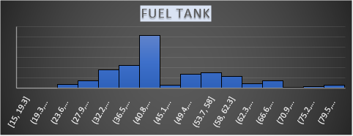
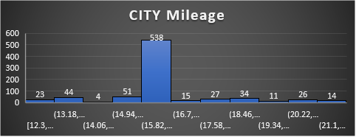
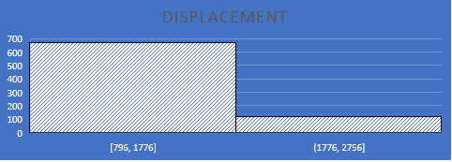
8: Manufacture has decided to launch two types of car (i)Compact car for city usage (ii) City for Highway Usage.
Here We Have Calculated The compact Car, We Need city mileage.
Here We Have Calculated The Family Car, for The Family Car We Need Seating Capacity Efficiency.
9: OUTLIERS
Row Labels | Max of City_Mileage_km_litre | Max of Displacement | Max of Fuel_Tank_Capacity_litre | Max of Seating_Capacity | Max of Height_mm | Max of Length_mm | Max of Width_mm
Suzuki | 27.39 | 1248 | 60 | 5 | 1675 | 3995 | 1745
Baleno | 27.39 | 1248 | 37 | 5 | 1510 | 3995 | 1745
Row Labels | Max of Displacement | Max of City_Mileage_km_litre | Max of Fuel_Tank_Capacity_litre | Max of Seating_Capacity | Max of Height_mm | Max of Length_mm | Max of Width_mm | Max of Boot_Space_litre | Max of Number_of_Airbags
Mahindra | 2523 | 18.49 | 80 | 9 | 1995 | 5118 | 1960 | 600 | 9
Bolllero power plus | 2157 | 16.3 | 70 | 9 | 1845 | 4850 | 1960 | 348 | 9

Slide 8
10: Top 3 cars with the highest number of variant in the hatchback category.
Top 3 cars with the highest number of variant in the Sedan Category.
Top 3 cars with the highest number of variant in the SUV Category.
11:Most popular car body type by count from the analysis of task 2.
Identified the most popular body type is Hatchback
Row Labels | Count of Variant
Suzuki | 96
Hyundai | 46
Tata | 36
Grand Total | 178
Row Labels | Count of Body_Type
Hatchback | 263
suv | 224
Sedan | 223
MUV | 32
MPV | 25
Crossover | 10
Coupe | 3
Sports, Convertible | 2
SUV, Crossover | 2
Crossover, SUV | 2
Sedan, Coupe | 1
Grand Total | 787
Row Labels | Count of Variant
Hyundai | 44
Skoda | 39
Toyota | 32
Grand Total | 115
Row Labels | Count of Variant
Mahindra | 78
Tata | 40
Hyundai | 40
Grand Total | 158

Slide 9
1: Top Two Car Manufacturer Of Widest Range Of Car Variants.
The Number Of Variants Under Each Body Type For The Top Two Manufacturer.
Here We Are Finding The Widest Variant Using The Body Type For The Top Two Manufactures Of Previous Task.

Slide 10
2: we need to calculate and compare the variation of three manufacturer.
From This Table We Can Able To See That Suzuki Offfers Widest Variation Of City Mileage.
3:a)relationship between city mileage and fuel tank. b) relationship between displacement and fuel tank.
 | tata | suzuki | hyundai
mean | 17.71 | 18.99 | 16.50
variance | 12.47 | 18.57 | 4.06
standard deviation | 3.53 | 4.31 | 2.01
coefficient of variance | 20% | 23% | 12%

Slide 11
5:compare fuel efficiency across car make, models and fuel type.
Plot average speeds and distances driven against fuel efficiency to identify trends.

Slide 12
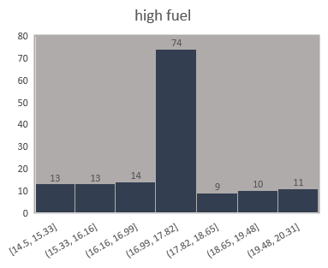
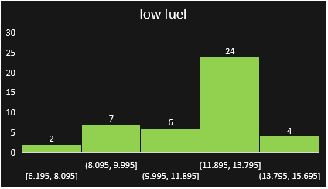

Slide 13
SUMMARY
Mahindra is the leading manufacturer based on maximum city mileage.
Hyundai is the top manufacturer with the highest highway mileage based on displacement.
Suzuki is the leading manufacturer of hatchback body types.
Renault, Suzuki, and Skoda don't have any outliers.
There is a negative association between displacement and fuel tank capacity and city mileage.
The Toyota Land Cruiser Vx is an adventurous vehicle.
A good automobile for a family is the Skoda Kodiaq.
Suzuki is a rival of Mahindra for family long-distance vehicles and compact cities.
The majority of body types are made by Mahindra SUVs, Hyundai sedans, and Suzuki hatchbacks.

Slide 14
THANK YOU

