Slide 1
ECEN 5743 Deep Learning
Final Project
Convolutional Neural Networks for Emotion Classification
Dr. Martin Hagan
Claudia Pauyac
Hridi Prova Debnath

Slide 2
* Outline
Introduction
Dataset Overview
Methodology 3.1. Data Preparation & Augmentation 3.2. Hybrid Architecture Design 3.3. Progressive Training Strategy 3.4. Comparative Analysis of 4 Models
Results & Analysis
Key Challenges & Solutions
Real-Time Demo
Summary & Conclusions
Future Work
References

Slide 3

I. Introduction
* Problem statement
Why emotion recognition?
Critical for applications like human-computer interaction (HCI), mental health monitoring, and customer experience analysis.
Challenges: Variability in facial expressions, lightning, pose, and dataset limitations (e.g., dataset’s class imbalance, low-resolution images).
* Objective
Goal: Develop a robust model for emotion recognition by:
Leveraging pre-trained model for feature extraction
Integrating transformer layers to capture spatial attention
Enhancing generalization with data augmentation
Adding custom CNN/dense layers to refine predictions
Target outcome: Improve accuracy over baseline models and address dataset challenges.

Slide 4














II. Dataset Overview
* Dataset Source:
* Sample Images:
FER2013: Public benchmark dataset for facial emotion recognition, introduced in ICML, 2013
Angry (4953 images)
* Key Statistics:
Disgust (547 images)
Total images: 35 887 grayscale faces (48x48 pixels)
Emotion classes: 7 (angry, disgust, fear, happy, sad, surprise, neutral)
Resolution: 48x48 pixels (low resolution)
Split:
Training: 22 967 images
Validation: 5 742 images
Test: 7 178 images
Fear (5121 images)
Happy (8989 images)
Sad (6077 images)
* Preprocessing:
Resizing for desired pre trained model compatibility
If required, Grayscale → RGB conversion via channel duplication
Surprise (4002 images)
Neutral (6198 images)

Slide 5
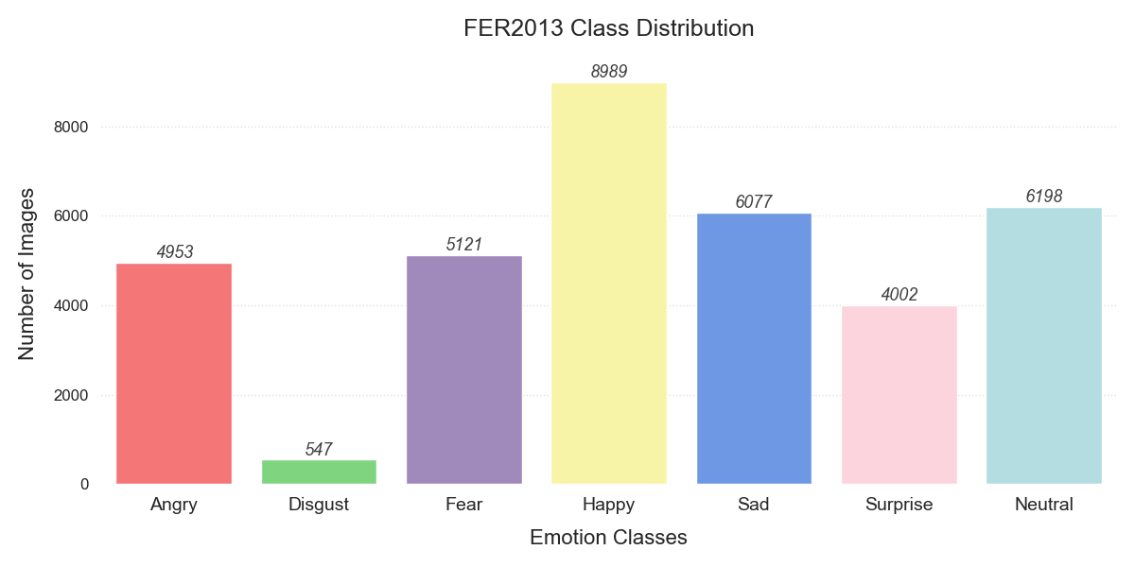
* Challenges:
Class imbalance (Disgust <5% - only 547 images)
Low resolution (e.g., upscaled to 224x224 for ResNet50 compatibility)
Generalization (Variability in poses, lighting, and occlusions)

Slide 6
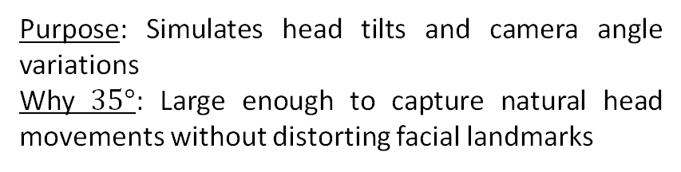
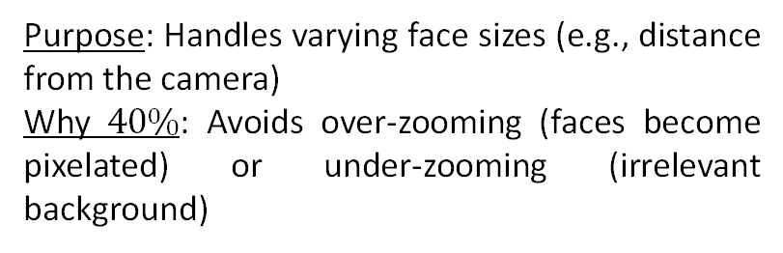
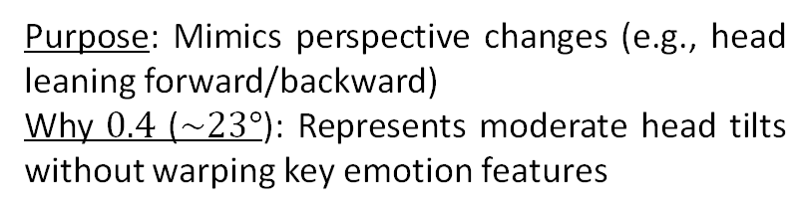
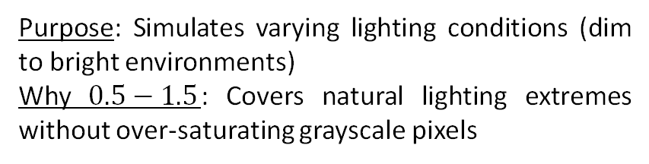
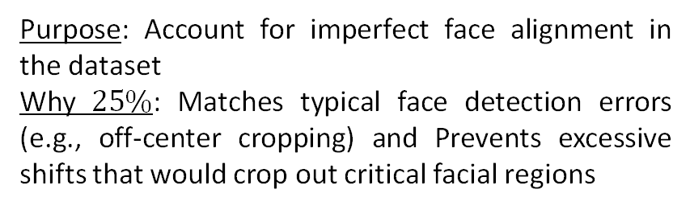
III. Methodology
3.1. Data Preparation & Augmentation
Augmentation techniques:
Rotation ($±35°$)
Shear range ($0.4$)
Purpose: Simulates head tilts and camera angle variations
Why $35°$: Large enough to capture natural head movements without distorting facial landmarks
Purpose: Mimics perspective changes (e.g., head leaning forward/backward)
Why $0.4$ ($\sim 23°$): Represents moderate head tilts without warping key emotion features
Weight and height shift range ($0.25$)
Zoom range ($0.4$)
Purpose: Account for imperfect face alignment in the dataset
Why $25\%$: Matches typical face detection errors (e.g., off-center cropping) and Prevents excessive shifts that would crop out critical facial regions
Purpose: Handles varying face sizes (e.g., distance from the camera)
Why $40\%$: Avoids over-zooming (faces become pixelated) or under-zooming (irrelevant background)
Brightness range ($[0.5,1.5]$)
Horizontal flip ($True$)
Purpose: Simulates varying lighting conditions (dim to bright environments)
Why $0.5−1.5$: Covers natural lighting extremes without over-saturating grayscale pixels
Purpose: Increases dataset diversity using facial symmetry
Why: Most emotions are symmetric (e.g., happiness, surprise)

Slide 7
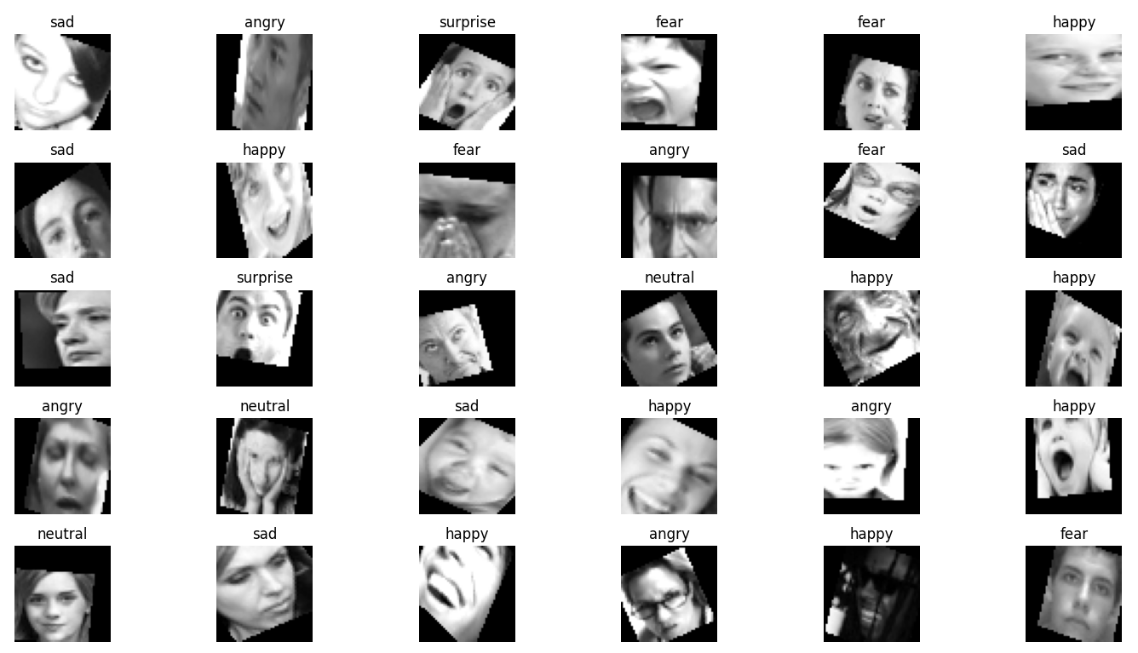



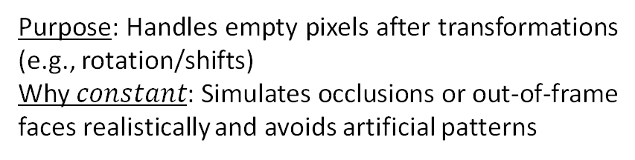
Fill mode ($constant$)
Purpose: Handles empty pixels after transformations (e.g., rotation/shifts)
Why $constant$: Simulates occlusions or out-of-frame faces realistically and avoids artificial patterns
Original
Augmented

Slide 8
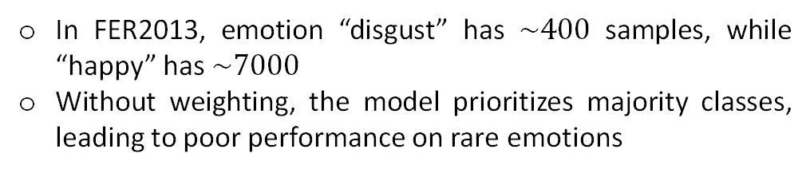
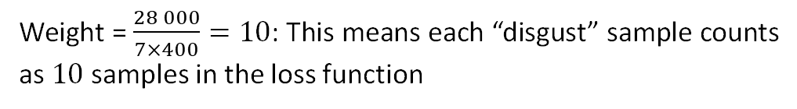
Class weighting:
Problem:
In FER2013, emotion “disgust” has $\sim 400$ samples, while “happy” has $\sim 7000$
Without weighting, the model prioritizes majority classes, leading to poor performance on rare emotions
Class | Samples | Weight
“angry” | 4953 | 0.81
“disgust” | 547 | 7.31
“fear” | 5121 | 0.78
“happy” | 8989 | 0.44
“sad” | 6077 | 0.66
“surprise” | 4002 | 0.99
“neutral” | 6198 | 0.65
Solution:
Assign higher weights to underrepresented classes during training
Forces the model to “pay attention” to minority classes by amplifying their impact on the loss function (the loss for each sample is multiplied by its class weight)
Example:
If “disgust” has $400$ samples and total samples = $28 000$:
Weight = $\frac{28 000}{7×400}=10$: This means each “disgust” sample counts as $10$ samples in the loss function

Slide 9
3.2. Hybrid Architecture Design
ResNet50 Backbone:
2. Efficient Transformer Block
Pretrained on ImageNet to leverage strong low-level feature extractors
Initial layers frozen during early training phases to retain general image features
Later layers gradually unfrozen during fine-tuning to adapt to facial emotion nuances in grayscale FER2013 images
Uses multi-head self-attention to detect relationships between distant facial landmarks
Enhances understanding of global emotion context, especially useful in complex expressions like fear or surprise
3. Class-Specific Branches
Key Architectural Additions:
Combat class imbalance and improve performance on underrepresented or confused classes (e.g., angry, disgust, fear, sad)
Each branch processes ResNet + Transformer output separately
Encourages the model to learn unique features for challenging classes, boosting their recall and F1 scores
1. Spatial-Channel Attention (SCA)
Channel Attention: Learns which features (e.g., textures, edges) are most important per class
Spatial Attention: Learns where to look on the face
Suppresses irrelevant background noise and emphasizes subtle facial cues (focus on discriminative facial regions like eyes, mouth, and eyebrows)

Slide 10

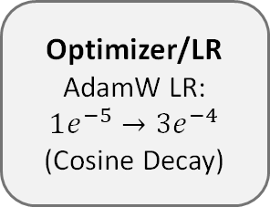
3.3. Progressive Training Strategy
FEATURE EXTRACTION (FROZEN BASE)
ResNet50 Layers Pre-trained weights (Frozen)
Custom Head Spatial-Channel Attention
Transformer block
Class-Specific Dense Layers
Fusion Layer
175 layers
Input Feature Map from ResNet50
Output
neurons
Phase 1: Feature extraction (Frozen base)
Objective: Learn task-specific patterns without altering pre-trained ResNet50 features
30 epochs
Why?
Optimizer/LR AdamW LR:
$$1e^{−5}→3e^{−4}$$
(Cosine Decay)
ResNet50’s pre-trained features (trained on ImageNet) already detect edges, textures, and basic shapes
Prevents "noisy" gradients from destabilizing the base early in training

Slide 11
Phase 2: Fine-tuning (Gradual layer unfreezing)
Objective: Gradually adapt ResNet50 to emotion-specific features
Implementation:
Layers unfreezing: Unfreeze ResNet50 layers in stages (deep → shallow)
1. Stage 1: Layers 160-175 (final ResNet50 blocks, closest to head)
2. Stage 2: Layers 140-160 (mid-level blocks)
3. Stage 3: Layers 100-140 (earlier blocks)
Why deep → shallow?
1. Deeper layers encode high-level features (facial structures) critical for emotions
2. Earlier layers detect generic patterns (edges) that need minimal adjustment

Slide 12
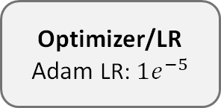


PROGRESSIVE FINE-TUNING (50 epochs)
Stage 1
Stage 2
Stage 3
ResNet50 Layers Pre-trained weights (Frozen)
ResNet50 Layers Pre-trained weights (Frozen)
ResNet50 Layers Pre-trained weights (Frozen)
Layers 140-175
(unfreezed)
Layers 100-175
(unfreezed)
Layers 160-175
(unfreezed)
Custom Head Spatial-Channel Attention
Transformer block
Class-Specific Dense Layers
Fusion Layer
Custom Head Spatial-Channel Attention
Transformer block
Class-Specific Dense Layers
Fusion Layer
Custom Head Spatial-Channel Attention
Transformer block
Class-Specific Dense Layers
Fusion Layer
Optimizer/LR Adam LR: $1e^{−5}$
Optimizer/LR Adam LR: $5e^{−6}$
Optimizer/LR Adam LR: $1e^{−6}$
15 epochs
15 epochs
20 epochs

Slide 13
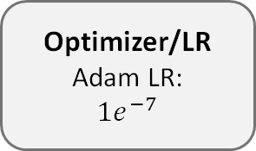
Phase 3: Head optimization (Dense layers)
Objective: Final polish of the custom architecture
HEAD TUNING
ResNet50 Layers Pre-trained weights (Frozen)
Implementation:
Custom Head Spatial-Channel Attention
Transformer block
Class-Specific Dense Layers
Fusion Layer
Freeze ResNet50: Base model weights locked again
Unfreeze head: Attention layers, dense layers, and class-specific branches
175 layers
Why?
20 epochs
After adapting ResNet50, focus shifts to refining decision boundaries
Prevents overfitting by isolating head training
Optimizer/LR Adam LR:
$$1e^{−7}$$
Optimizer: AdamW with cosine learning rate decay
Adam Optimizer: Ensures robust parameter updates with effective regularization (preserving ResNet50’s pre-trained knowledge)
Cosine Decay: Enables smooth transitions between training phases

Slide 14
3.4. Comparative Analysis of 4 Models
Model | Strengths | Weaknesses | Highlights
ResNet50 | Best balanced accuracy (58.30%), Top macro F1 (58.29%) Excellent per-class recall (e.g., Happy 83.2%, Surprise 77.5%) | High computational cost (77.4M params) Slower inference | High-accuracy applications in production and scientific research
EfficientNetB3 | Good recall for Sad (73%) and Surprise (65%) Moderate Cohen's Kappa (42.81%) | Fails on Fear (12%) and Disgust (28%) Performance unstable without tuning | Resource-aware deployments that can afford tuning and moderate performance
Xception | Moderate recall for Happy (64.83%) Lightweight with 74.6M parameters | Low balanced accuracy (24.6%) Very poor on Surprise (2.49%) and Sad (5.68%) | Only with class balancing or additional training data
MobileNetV3Small | Compact model Decent recall on Happy (59.92%) Very low parameter count (~2.5M) | Extremely low recall on Disgust (6.31%) and Fear (2.05%) Lowest macro F1 (17.69%) | Edge devices, mobile apps, rapid prototyping where speed > accuracy

Slide 15
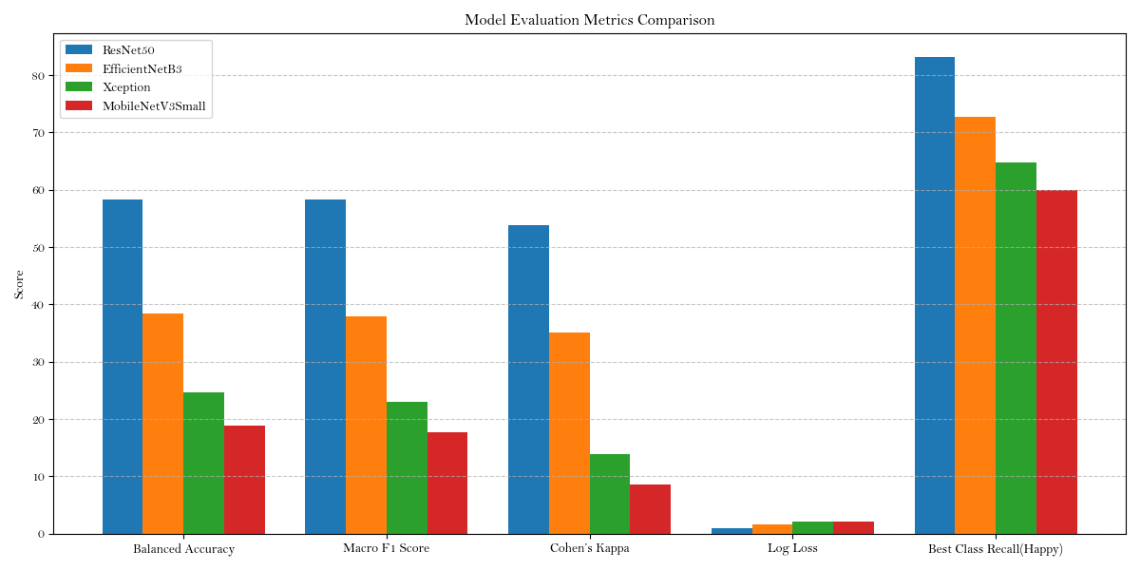
IV. Results & Analysis

Slide 16
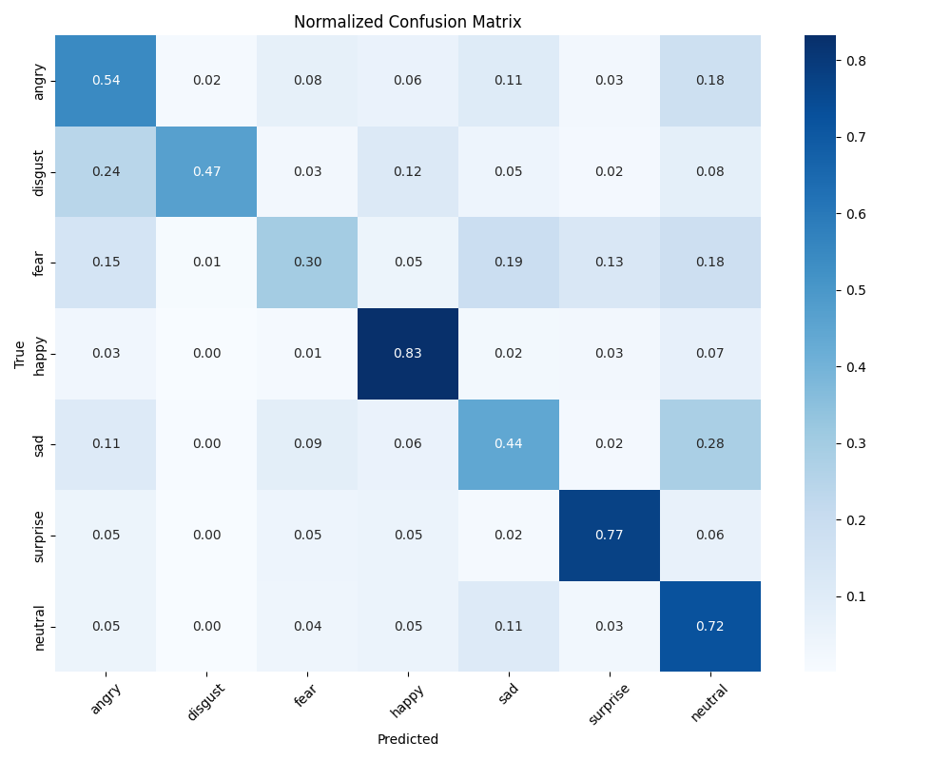
Why ResNet50?
1. Best Overall Performance
ResNet50 consistently outperformed all other tested models across all key evaluation metrics:
Highest balanced accuracy (58.87%)—indicating better handling of class imbalance.
Strong macro F1 score (57.37%)—demonstrating reliable predictions across all emotion classes.
Lowest log loss (1.056)—showing well-calibrated confidence in predictions.
Highest per-class recall (83.09% for Happy)—capturing even subtle expressions better than others.
2. Powerful Yet Proven Architecture
ResNet50 uses residual connections to allow training of deep networks without vanishing gradients. This enables it to:
Learn complex patterns in facial expressions.
Generalize better to unseen faces.
Avoid performance collapse that occurs in very deep or very shallow models.
3. Ideal for Transfer Learning
Pretrained on ImageNet, ResNet50 effectively transfers low-level features to FER2013, making it perfect for small, real-world emotion datasets.
4. Balance Between Accuracy and Efficiency
While heavier than MobileNet, ResNet50 is much smaller than newer transformer-based models and runs efficiently on standard GPUs, making it suitable for real-time applications like social robotics and assistive technologies.

Slide 17
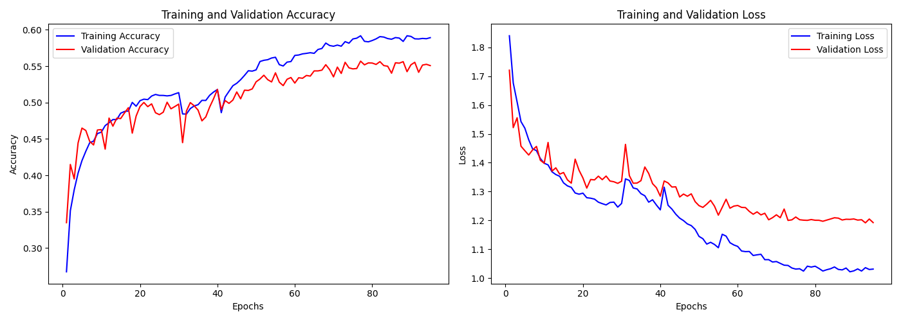
V. Key Challenges & Solutions
1. Class Imbalance & Confidence Issues
Challenge: The model struggled with underrepresented classes like Disgust (111 samples) and Fear (1,024), while overpredicting dominant ones like Happy (1,774). Predictions were often overconfident and poorly calibrated.
Solution:
Apply class-aware augmentations and synthetic oversampling (GANs).
Incorporate heavy class weighting (e.g., Disgust ×15, Fear ×8).
Use temperature scaling and MC Dropout to improve prediction confidence and uncertainty handling.
3. Overfitting & Optimization
Challenge: With ~77 million parameters, ResNet50 risked overfitting the small FER2013 dataset.
Solution:
Frozen early layers and fine-tuned only higher layers.
Add strong regularization (dropout, L2 penalty).
Use cosine learning rate decay with warmup for stable training dynamics.
2. Input Mismatch & Feature Loss
Challenge: FER2013 grayscale images (48×48) were mismatched with ResNet50's 224×224 RGB input, leading to degraded feature quality with naive channel repetition.
Solution:
Introduce a learnable grayscale-to-RGB adapter using CNN layers.
Employ multi-scale image fusion to preserve both local and global expression cues.

Slide 18
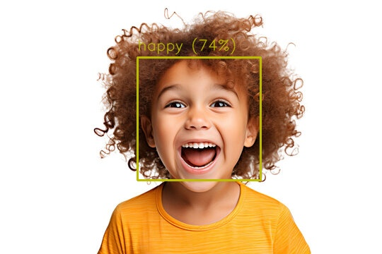
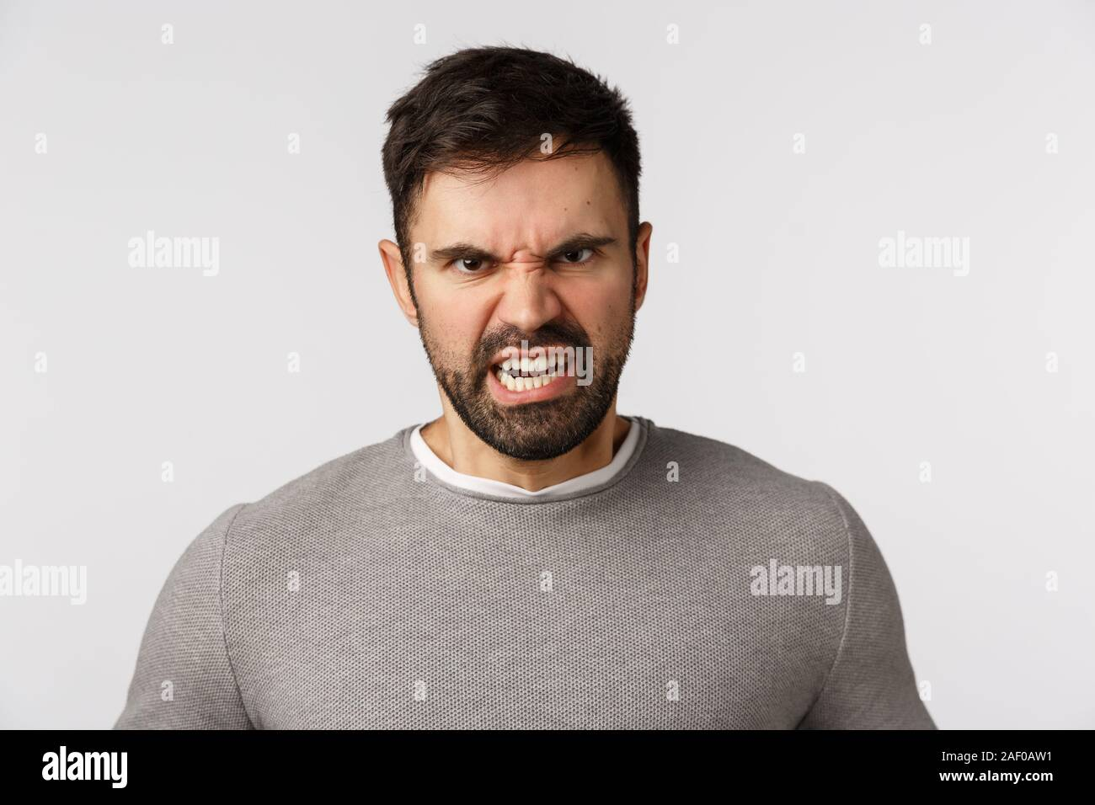

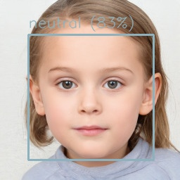
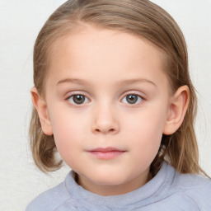

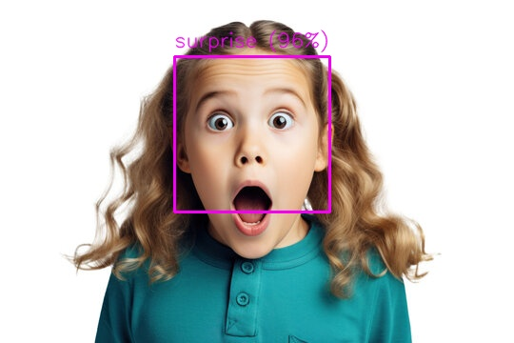

VI. Real-Time Demo

Slide 19
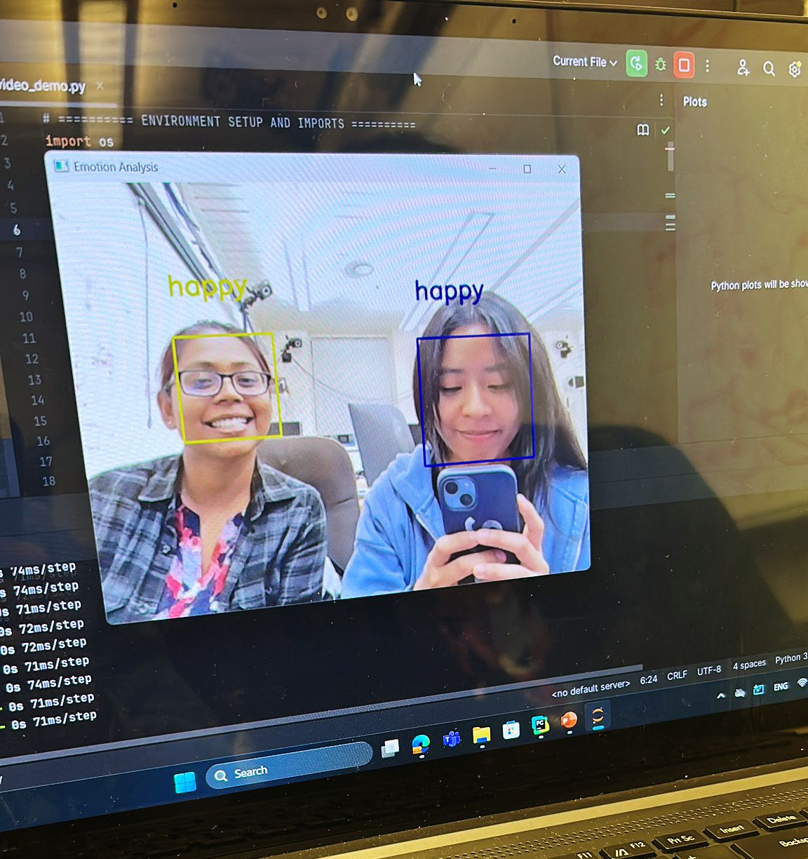
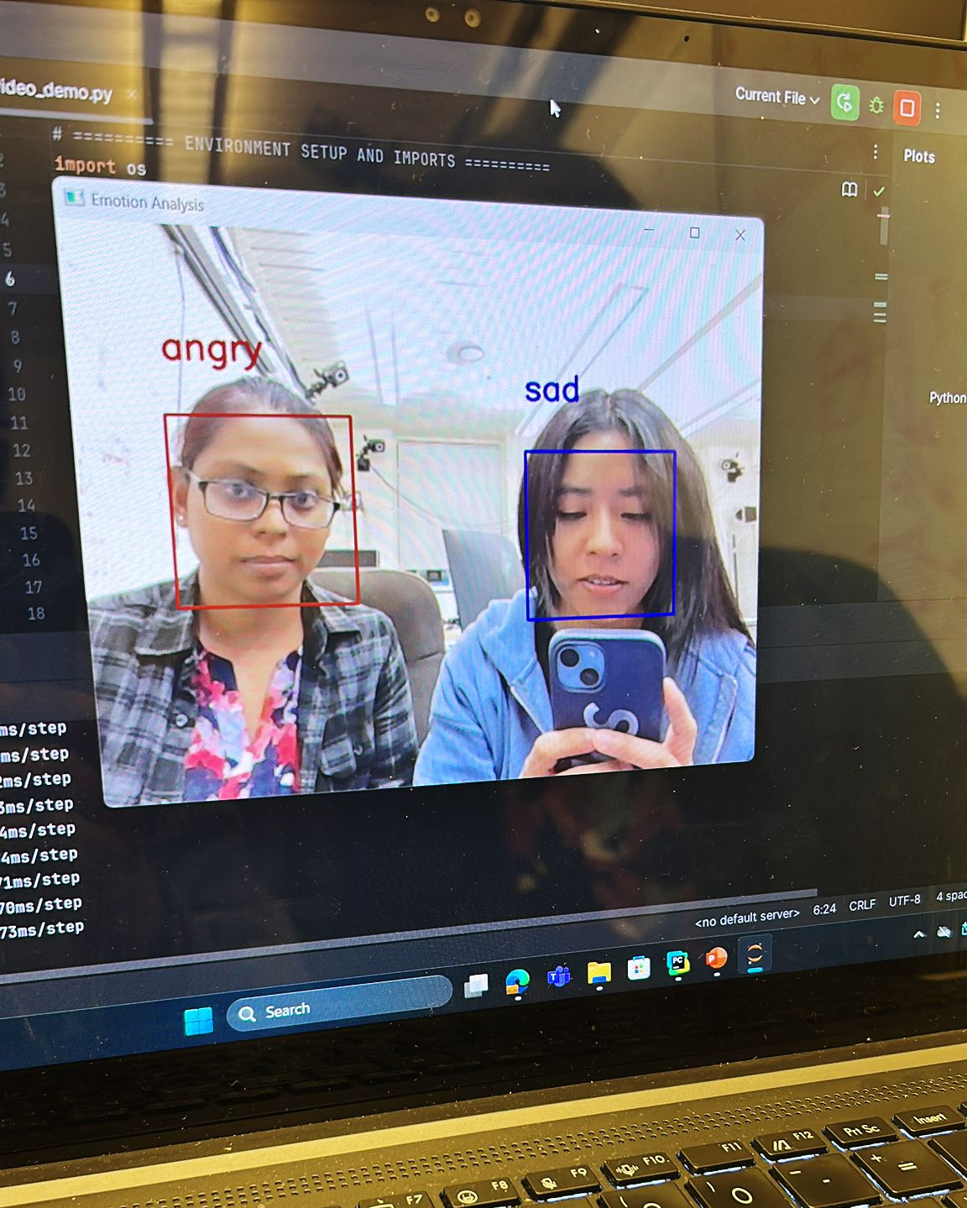
VII. Summary
Developed a ResNet50-based architecture tailored for FER2013 emotion recognition
Incorporated attention modules and class-specific output branches
Tackled key challenges: class imbalance, grayscale input, and small dataset size
Used a progressive training strategy (freeze →fine-tune → optimize) to reduce overfitting
Model was robust, scalable, and well-calibrated
Take Home:
ResNet50 proved to be a high-performing and adaptable backbone
Ideal for real-time emotion recognition in assistive robotics, mental health monitoring, and affective computing

Slide 20
VIII. Future Work
8.1. Improve Feature Discrimination
8.3. Explore Cutting-Edge Architectures
Challenge: Misclassification of similar emotions (e.g., "fear" vs. "sad“, “angry” vs. “disgust”, “sad” vs. “angry”)
Research Directions:
Vision Transformers (ViTs)
Self-Supervised Learning: Pre-train on unlabeled video data to improve feature learning
Innovations:
Cross-Domain Attention: Add 3D attention blocks to capture spatial-temporal features
Multi-Modal Fusion: Combine facial, vocal, and textual cues for holistic emotion analysis
8.4. Real-World Applications
Use Cases:
8.2. Expand Dataset Diversity
Mental Health Monitoring: Integrate with apps to track emotional well-being
Human-Computer Interaction: Enable emotion-aware chatbots or VR systems
Current Limitation: Biases in FER2013 (limited demographics/lighting conditions)
Steps:
Use AffectNet or RAF-DB for richer variation
Audit model performance across age, gender, and ethnicity subgroups
Deployment: Develop a user-friendly API for easy integration

Slide 21
IX. References
ResNet50 Architecture
K. He, X. Zhang, S. Ren, and J. Sun, "Deep Residual Learning for Image Recognition," in IEEE Conference on Computer Vision and Pattern Recognition (CVPR), 2016, pp. 770-778. DOI: 10.1109/CVPR.2016.90.
Data Augmentation
F. Chollet et al., "Keras: Deep Learning for Humans," GitHub Repository, 2015. [Online]. Available: https://keras.io/api/preprocessing/image/. [Accessed: 10-Oct-2023].
Spatial-Channel Attention
J. Hu, L. Shen, and G. Sun, "Squeeze-and-Excitation Networks," in IEEE/CVF Conference on Computer Vision and Pattern Recognition (CVPR), 2018, pp. 7132-7141. DOI: 10.1109/CVPR.2018.00745.
Transformer Blocks
A. Vaswani et al., "Attention Is All You Need," in Advances in Neural Information Processing Systems (NeurIPS), 2017, pp. 5998-6008. arXiv: 1706.03762.
Class Weighting
F. Pedregosa et al., "Scikit-learn: Machine Learning in Python," Journal of Machine Learning Research, vol. 12, pp. 2825-2830, 2011. [Online]. Available: https://jmlr.csail.mit.edu/papers/v12/pedregosa11a.html.
FER2013 Dataset
I. J. Goodfellow et al., "Challenges in Representation Learning: A Report on Three Machine Learning Contests," Neural Networks, vol. 64, pp. 59-63, 2015. DOI: 10.1016/j.neunet.2014.09.005.
Mixed Precision Training
P. Micikevicius et al., "Mixed Precision Training," in International Conference on Learning Representations (ICLR), 2018. arXiv: 1710.03740.
AdamW Optimizer
I. Loshchilov and F. Hutter, "Decoupled Weight Decay Regularization," in International Conference on Learning Representations (ICLR), 2019. arXiv: 1711.05101.
Model Architecture Inspiration
A. Mollahosseini, B. Hasani, and M. H. Mahoor, "AffectNet: A Database for Facial Expression, Valence, and Arousal Computing in the Wild," IEEE Transactions on Affective Computing, vol. 10, no. 1, pp. 18-31, 2019. DOI: 10.1109/TAFFC.2017.2740923.
Cosine Learning Rate Decay
I. Loshchilov and F. Hutter, "SGDR: Stochastic Gradient Descent with Warm Restarts," in International Conference on Learning Representations (ICLR), 2017. arXiv: 1608.03983.
Real-Time Deployment
H. Yang et al., "Efficient Facial Emotion Recognition Using Hierarchical Neural Networks," 2017. arXiv: 1710.07557v1.

Slide 22
Thank you!

Slide 23
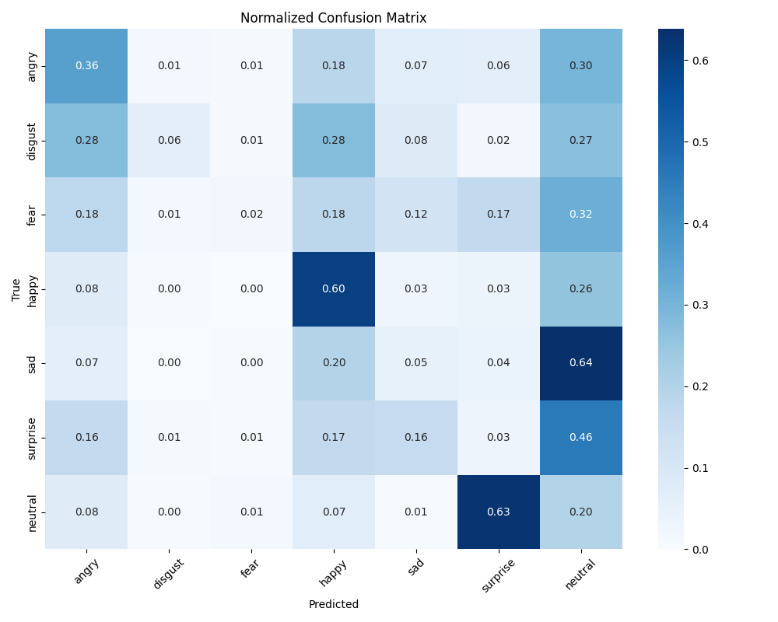
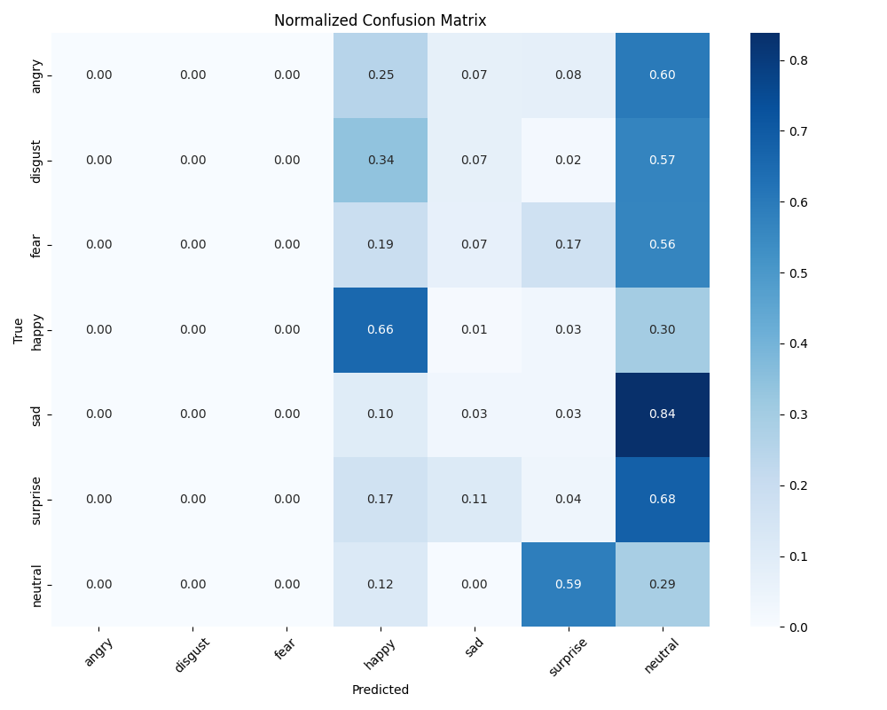
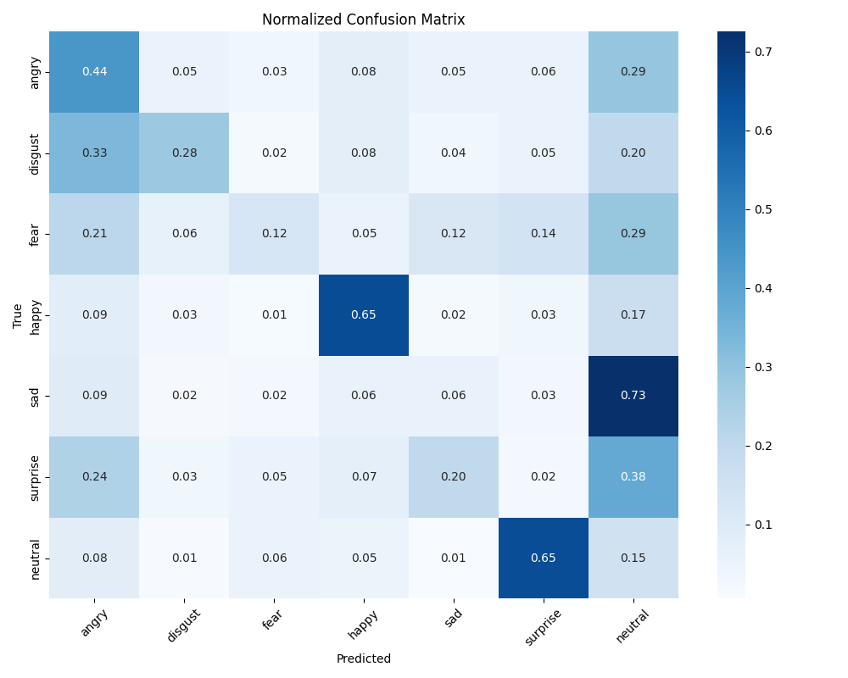
Appendix I
(Confusion Matrix)
ResNet50
MobileNetV3Small
EfficientNetB3
Xception

Slide 24
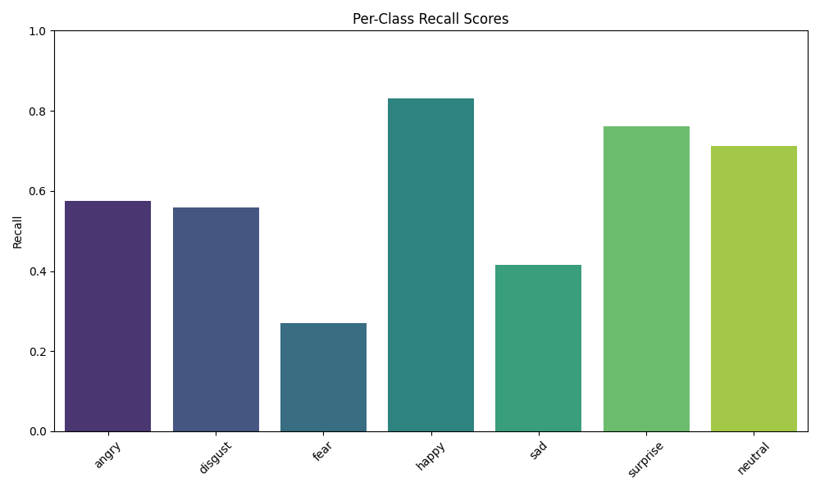
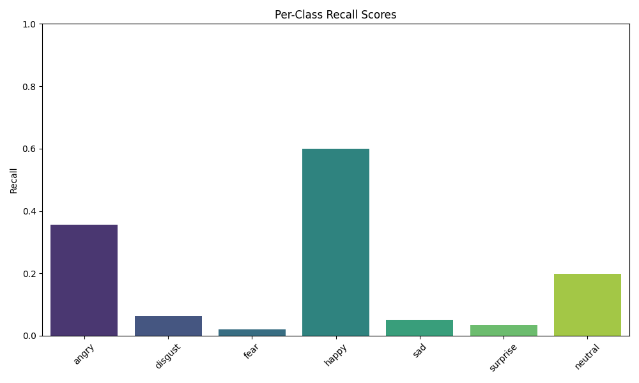
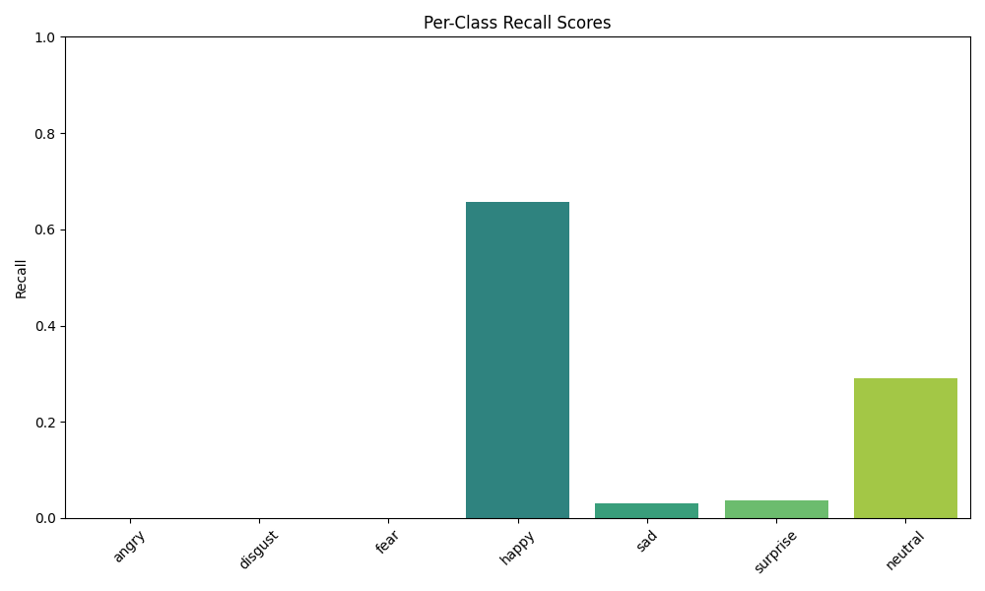
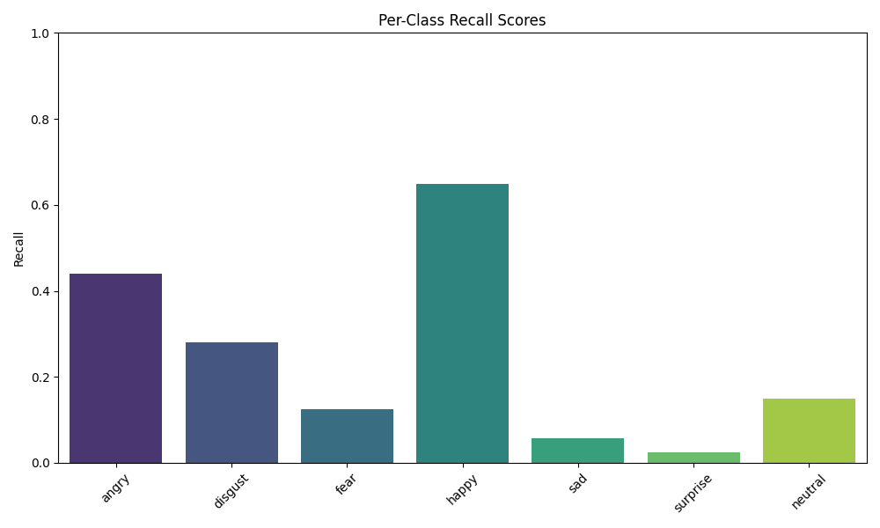
Appendix I
(Recall Distribution)
ResNet50
MobileNetV3Small
EfficientNetB3
Xception

Slide 25
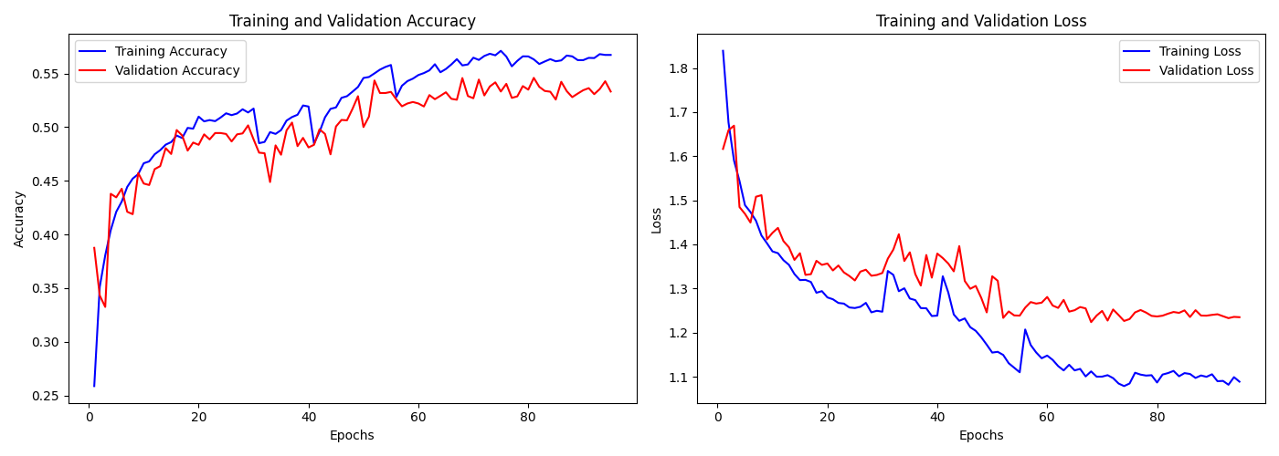
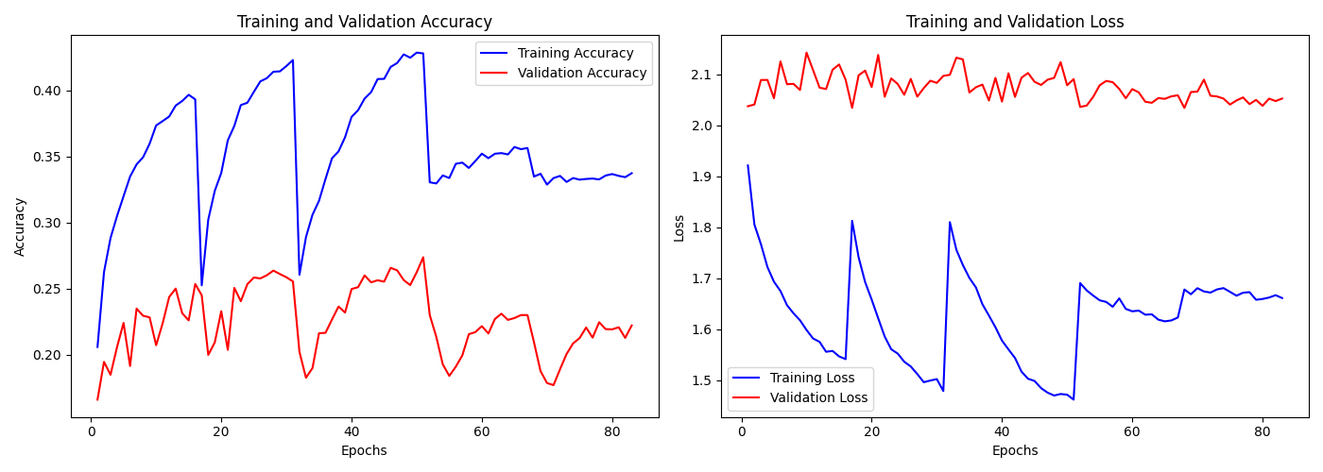
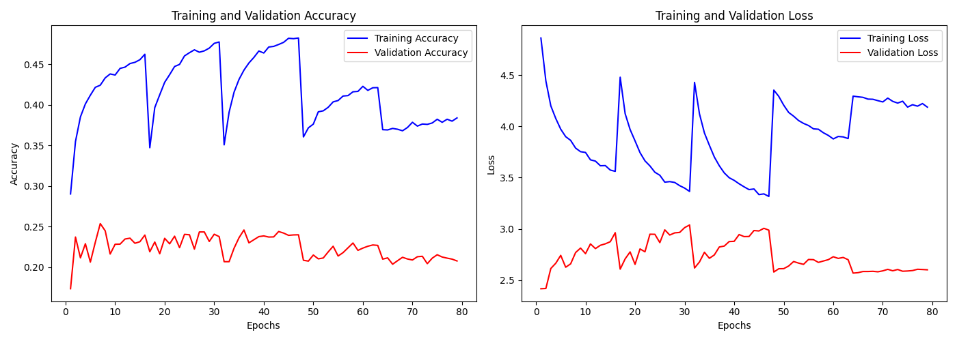
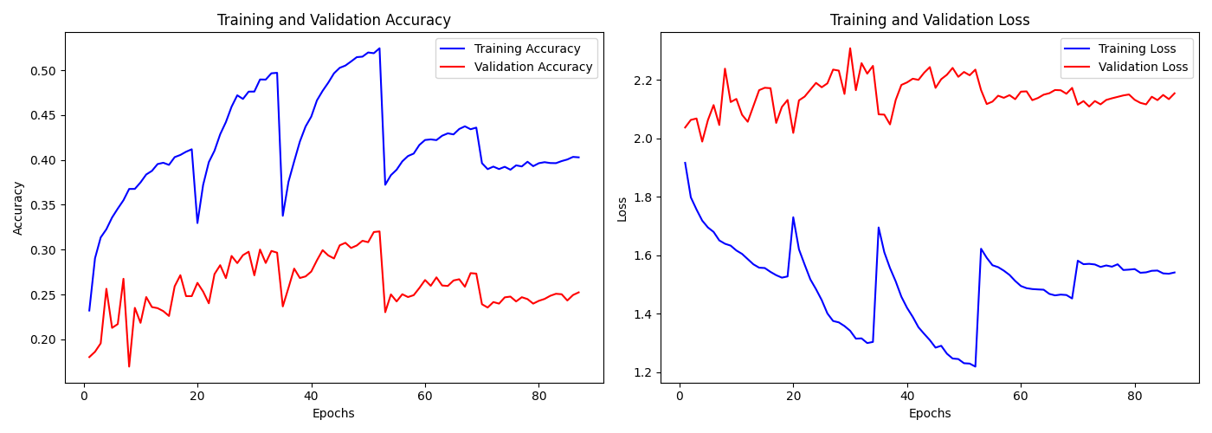
Appendix I
(Training History)
ResNet50
MobileNetV3Small
EfficientNetB3
Xception

