Slide 1
Chapter 4: Threads

Slide 2
Motivation
Most modern applications are multithreaded
Threads run within application
Multiple tasks with the application can be implemented by separate threads
  Update display
  Fetch data
  Spell checking
  Answer a network request
Process creation is heavy-weight while thread creation is light-weight
Can simplify code, increase efficiency
Kernels are generally multithreaded

Slide 3

Multithreaded Server Architecture

Slide 4
Benefits
Responsiveness – may allow continued execution if part of process is blocked, especially important for user interfaces
Resource Sharing – threads share resources of process, easier than shared memory or message passing
Economy – cheaper than process creation, thread switching lower overhead than context switching
Scalability – process can take advantage of multiprocessor architectures

Slide 5
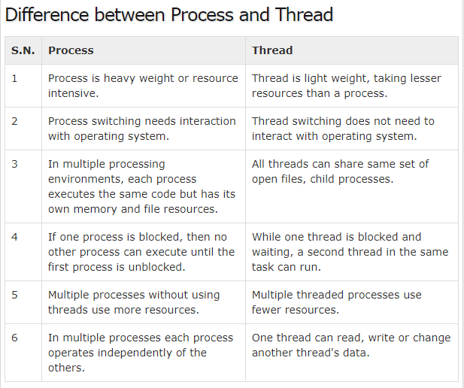


Slide 6
Multicore Programming
Multicore or multiprocessor systems putting pressure on programmers, challenges include:
  Dividing activities
  Balance
  Data splitting
  Data dependency
  Testing and debugging
Parallelism implies a system can perform more than one task simultaneously
Concurrency supports more than one task making progress
  Single processor / core, scheduler providing concurrency

Slide 7


Concurrency vs. Parallelism
Concurrent execution on single-core system:
Parallelism on a multi-core system:

Slide 8
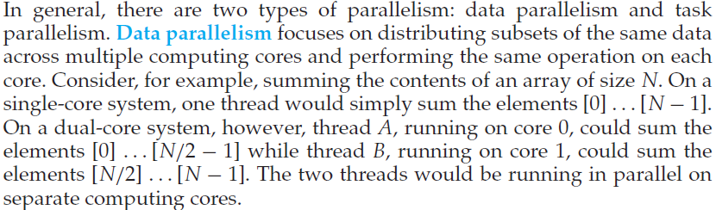
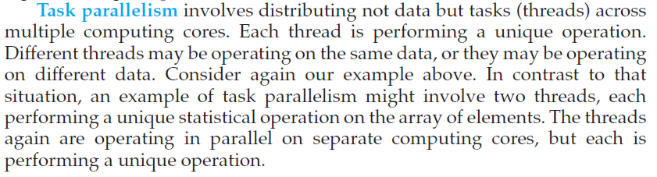
Types of Parallelism

Slide 9

Single and Multithreaded Processes

Slide 10
User Threads and Kernel Threads
Support for threads may be provided either at the user level, for user threads, or by the kernel, for kernel threads.
User threads –
  the thread management kernel is not aware of the existence of threads. The thread library contains code for creating and destroying threads, for passing message and data between threads, for scheduling thread execution and for saving and restoring thread contexts. The application starts with a single thread. management done by user-level threads library
Three primary thread libraries:
  POSIX Pthreads
  Windows threads
  Java threads

Slide 11
User Threads and Kernel Threads
Kernel threads - thread management is done by the Kernel. There is no thread management code in the application area. Kernel threads are supported directly by the operating system.
The Kernel maintains context information for the process as a whole and for individuals threads within the process. Scheduling by the Kernel is done on a thread basis. The Kernel performs thread creation, scheduling and management in Kernel space. Kernel threads are generally slower to create and manage than the user threads.
Examples – virtually all general purpose operating systems, including:
  Windows
  Solaris
  Linux
  Tru64 UNIX
  Mac OS X

Slide 12
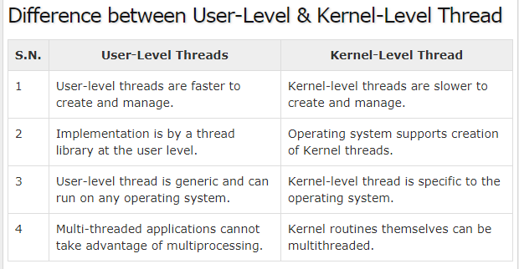

Slide 13
Multithreading Models
Many-to-One
One-to-One
Many-to-Many

Slide 14

Many-to-One
Many user-level threads mapped to single kernel thread
One thread blocking causes all to block
Multiple threads may not run in parallel on muticore system because only one may be in kernel at a time
Few systems currently use this model
Examples:
  Solaris Green Threads
  GNU Portable Threads

Slide 15

One-to-One
Each user-level thread maps to kernel thread
Creating a user-level thread creates a kernel thread
More concurrency than many-to-one
Number of threads per process sometimes restricted due to overhead
Examples
  Windows
  Linux
  Solaris 9 and later

Slide 16

Many-to-Many Model
Allows many user level threads to be mapped to many kernel threads
Allows the operating system to create a sufficient number of kernel threads
Solaris prior to version 9
Windows with the ThreadFiber package

Slide 17

Two-level Model
Similar to M:M, except that it allows a user thread to be bound to kernel thread
Examples
  IRIX
  HP-UX
  Tru64 UNIX
  Solaris 8 and earlier

Slide 18
End of Chapter 4

