Slide 1

Bangladeh
All about the national configuration of bangladesh

Slide 2
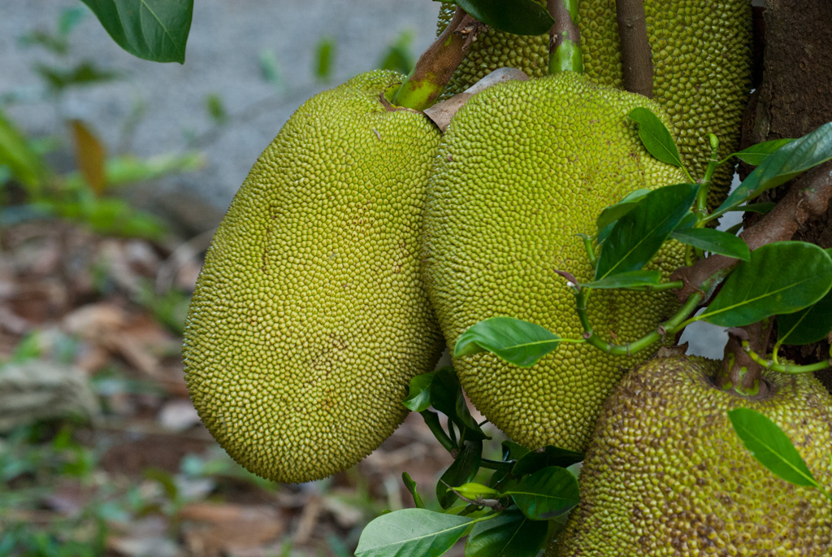
National fruit of bangladesh
Jackfruit is the national fruit of Bangladesh. The jackfruit (Artocarpus heterophyllus)^{[6]} is a species of tree in the fig, mulberry, and breadfruit family (Moraceae).^{[7]} The jackfruit is the largest tree fruit, reaching as much as 55 kg (120 pounds) in weight, 90 cm (35 inches) in length, and 50 cm (20 in) in diameter.^{[7][8]} A mature jackfruit tree produces some 200 fruits per year, with older trees bearing up to 500 fruits in a year.^{[7][9]} The jackfruit is a multiple fruit composed of hundreds to thousands of individual flowers, and the fleshy petals of the unripe fruit are eaten.^{[7][10]}
This Photo by Unknown Author is licensed under CC BY-NC-ND

Slide 3
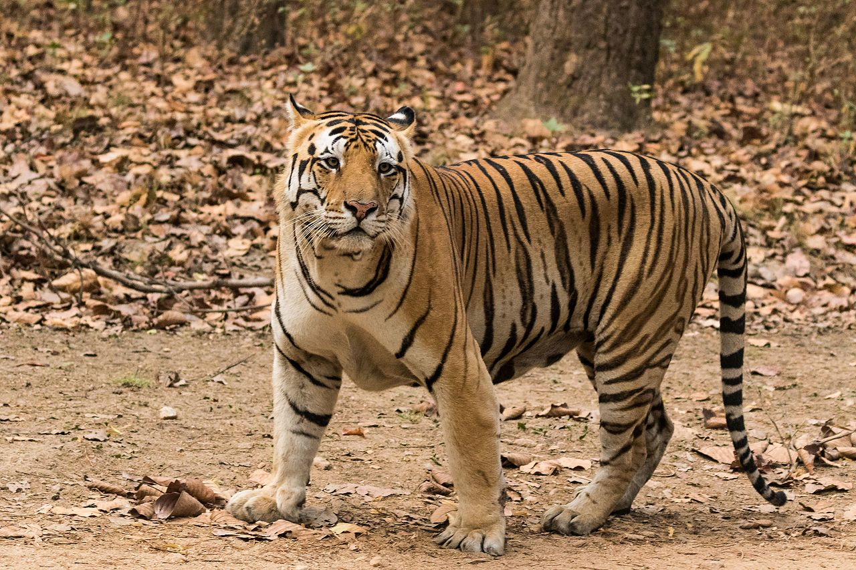
National animal of bangladesh
This Photo by Unknown Author is licensed under CC BY-SA

Slide 4
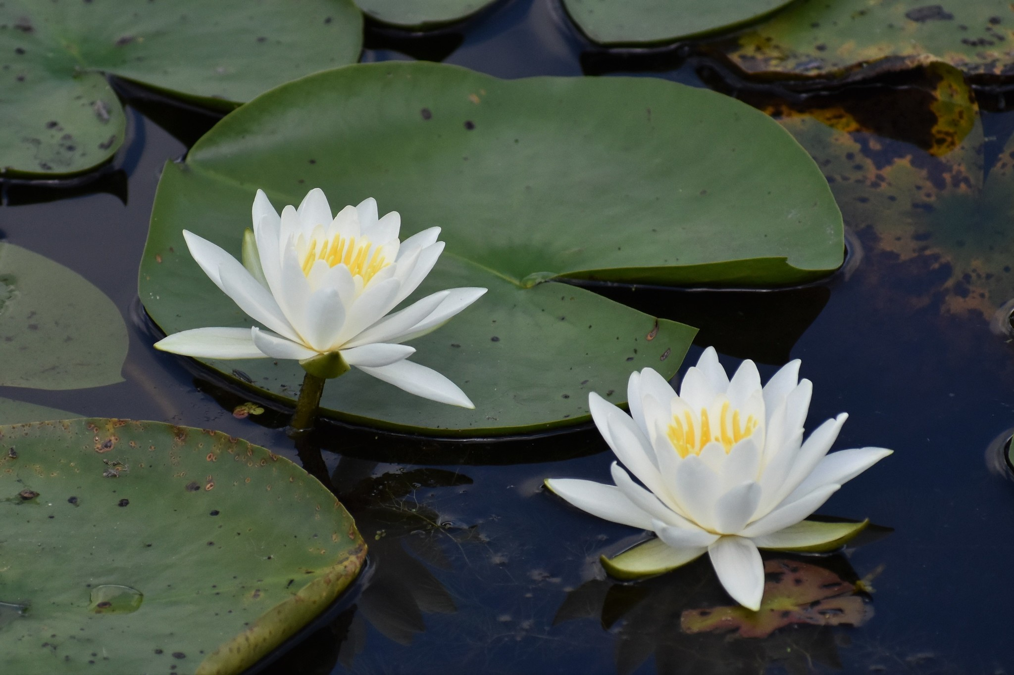
National flower of bangladesh
Nymphaeaceae (/ˌnɪmfiˈeɪsi.iː, -ˌaɪ/) is a family of flowering plants, commonly called water lilies. They live as rhizomatous aquatic herbs in temperate and tropical climates around the world. The family contains five genera^{[4]} with about 70 known species.^{[5]} Water lilies are rooted in soil in bodies of water, with leaves and flowers floating on or rising from the surface. Leaves are oval and heart-shaped in Barclaya. Leaves are round, with a radial notch in Nymphaea and Nuphar, but fully circular in Victoria and Euryale.
This Photo by Unknown Author is licensed under CC BY-NC

Slide 5
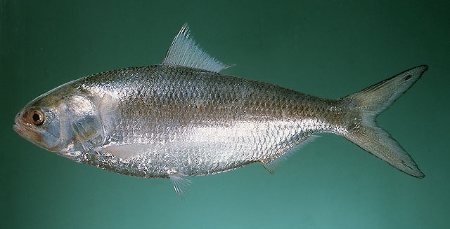
National fish of bangladesh
This Photo by Unknown Author is licensed under CC BY-NC

Slide 6
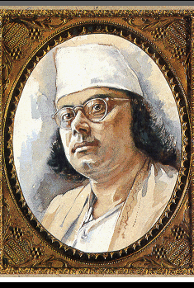
National poet of bangladeshn
Kazi Nazrul islam is the national poet of Bangladesh.hr is born is churulia village of india,his
This Photo by Unknown Author is licensed under CC BY-NC-ND

