Slide 1
Slide Editor application
Barseghyan Hripsime

Slide 2
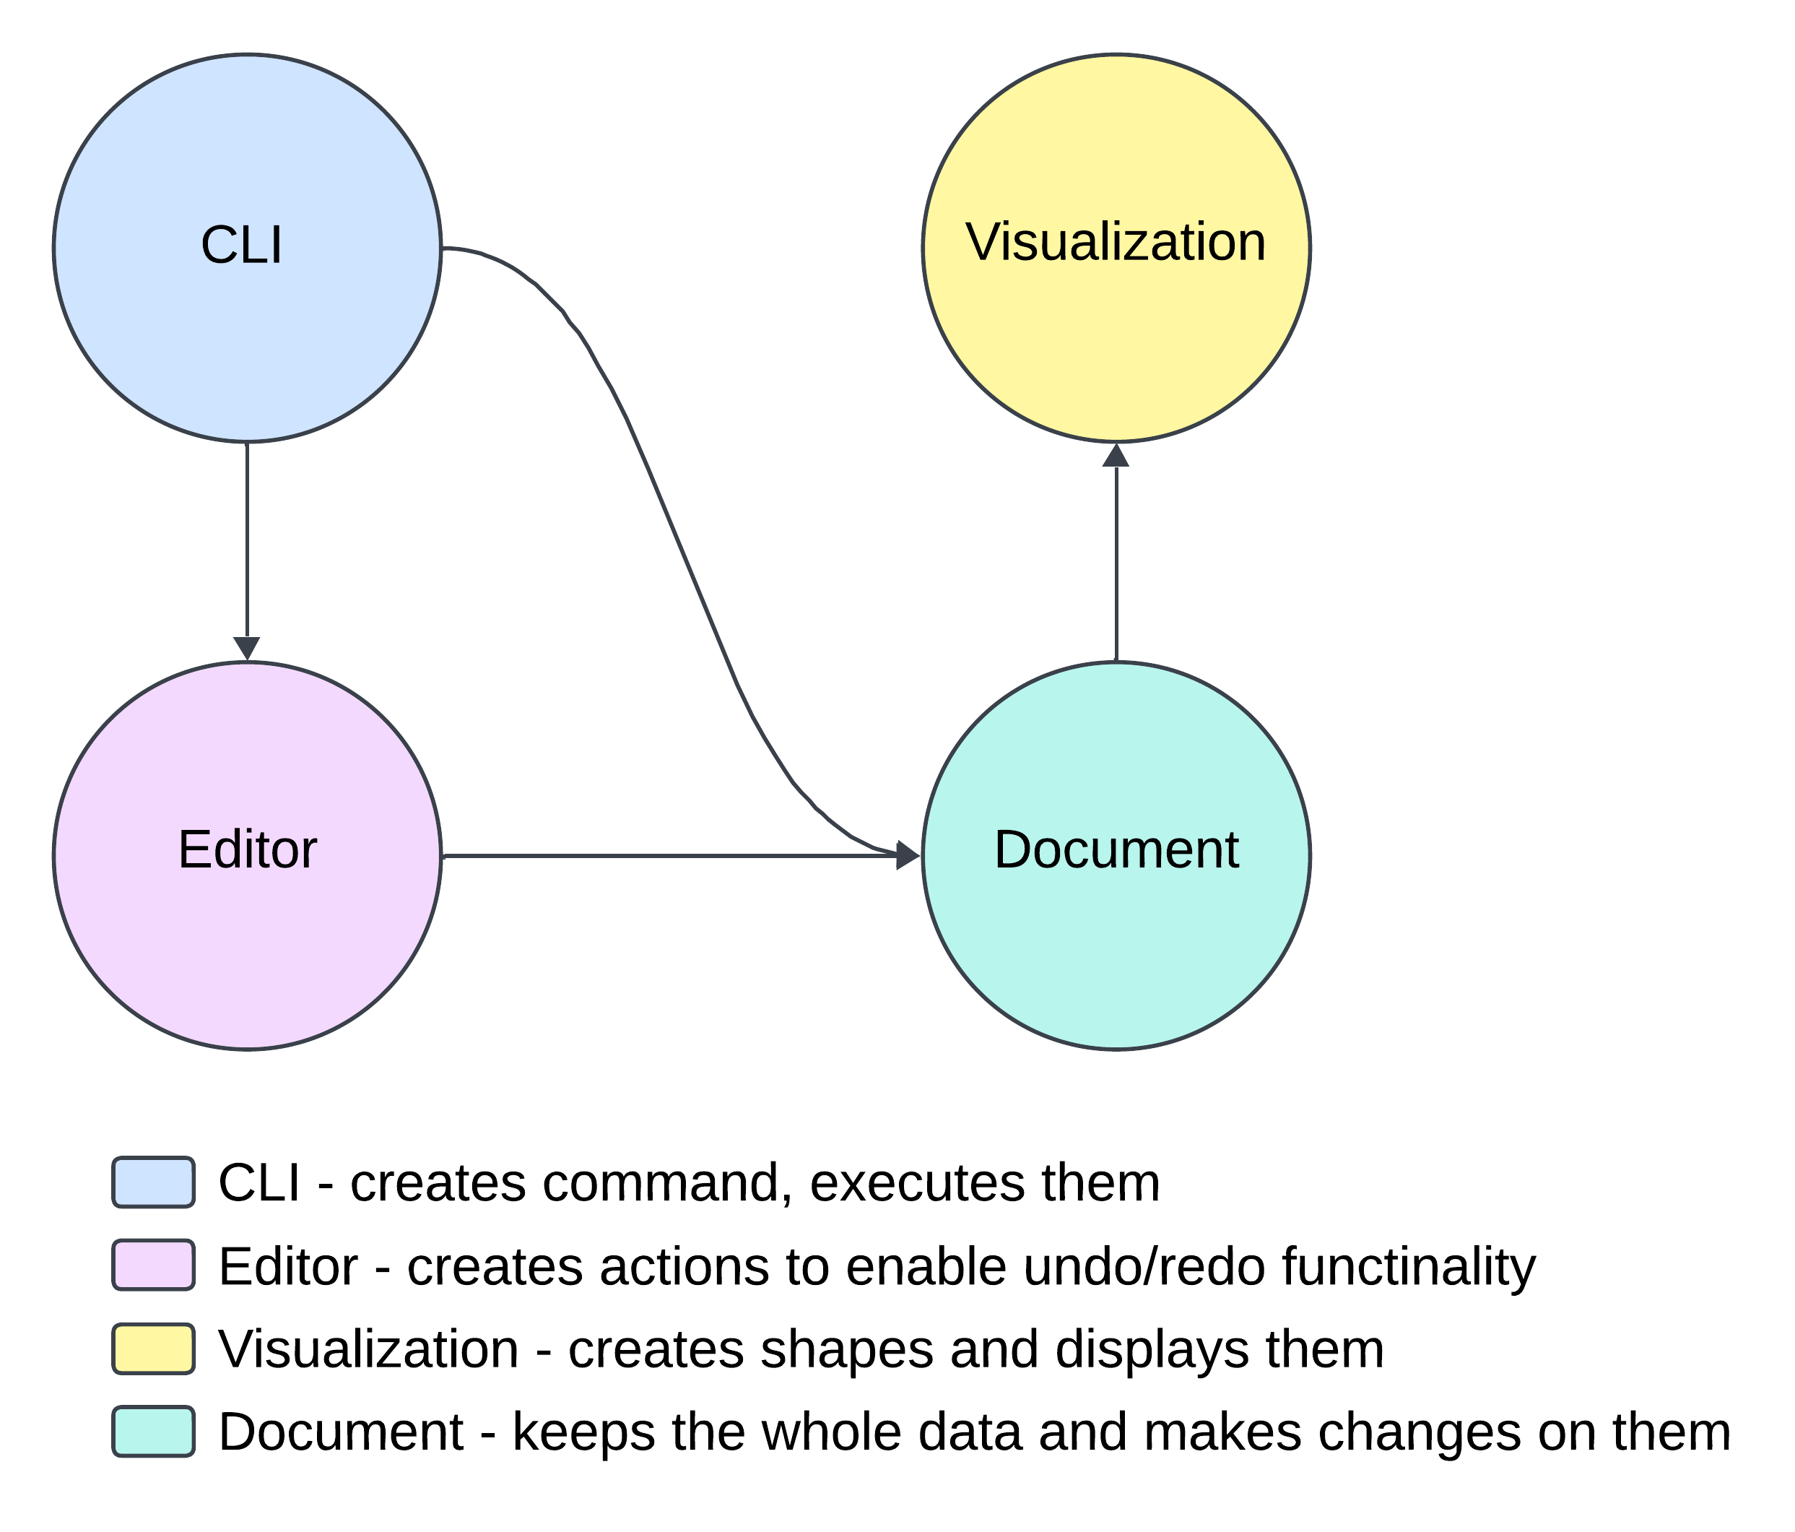
Visual represantation

Slide 3
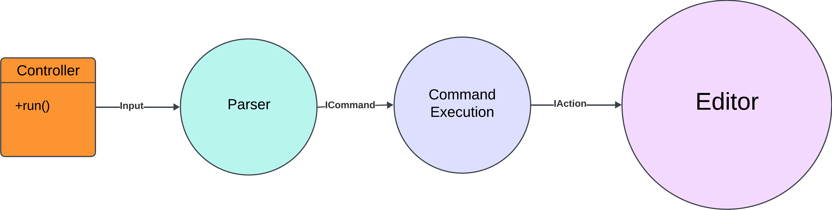
CLI Brief Representation

Slide 4
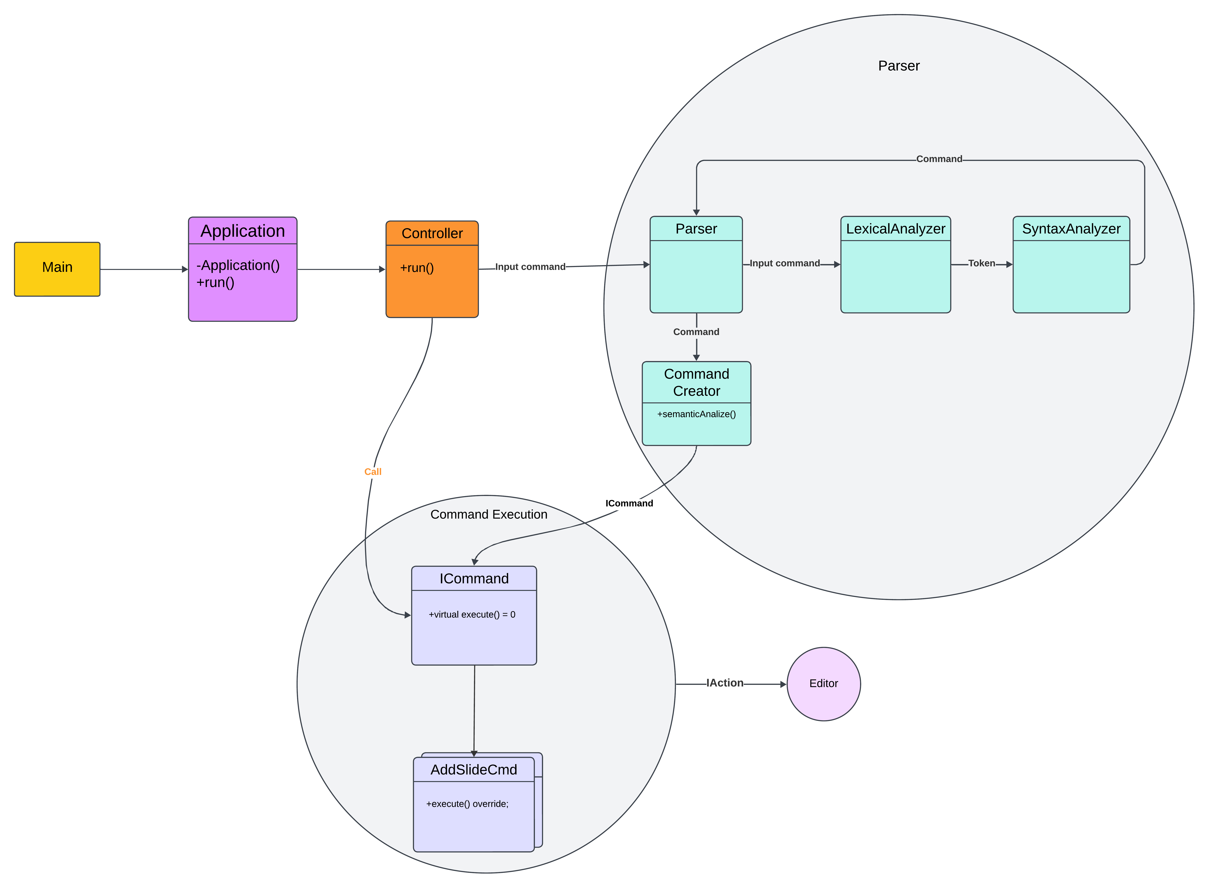
Start of an application CLI

Slide 5
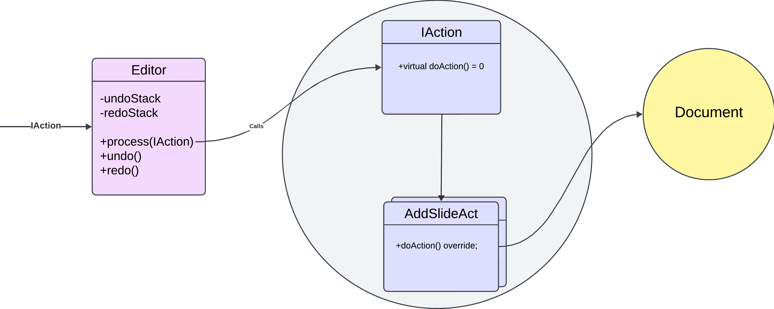
Editor Part with actions
5

Slide 6
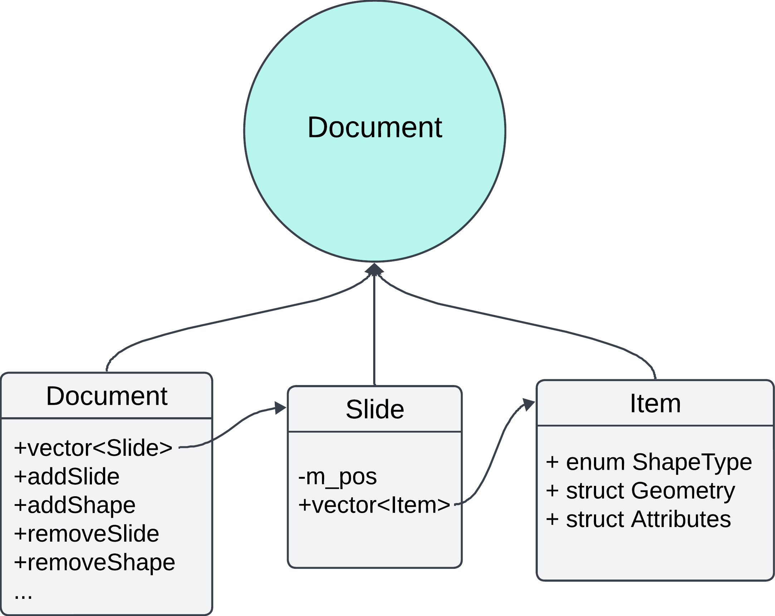
Document part

Slide 7
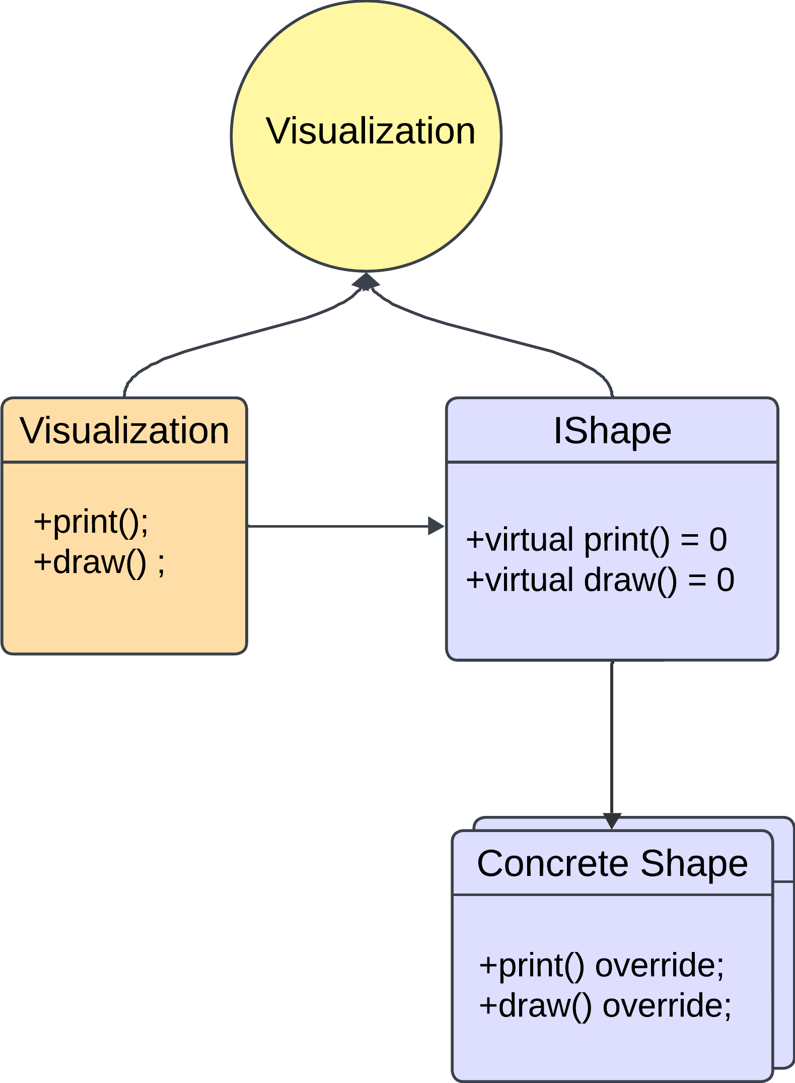
Visualization part

Slide 8
Thank you

