Slide 1
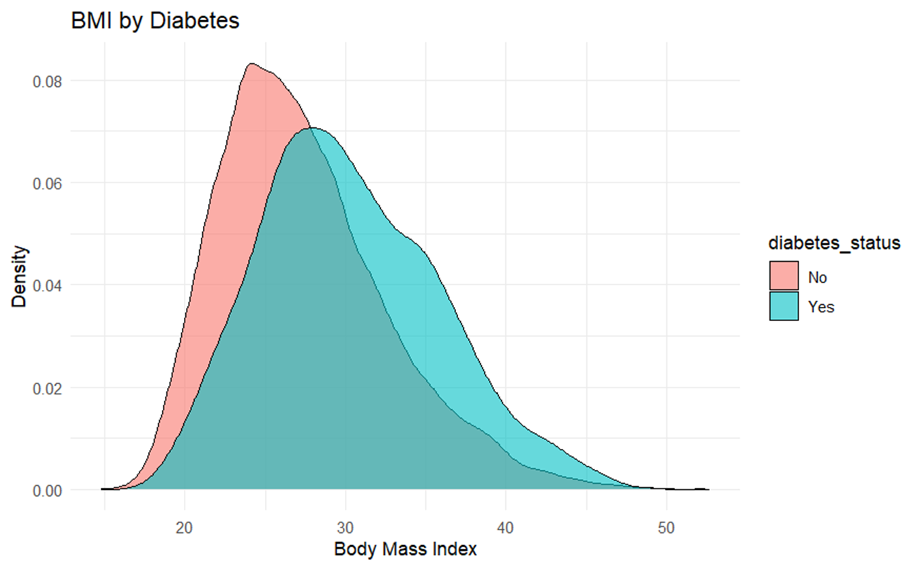
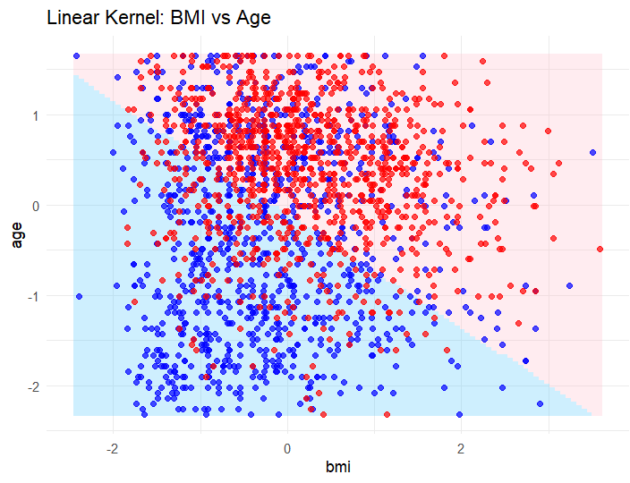
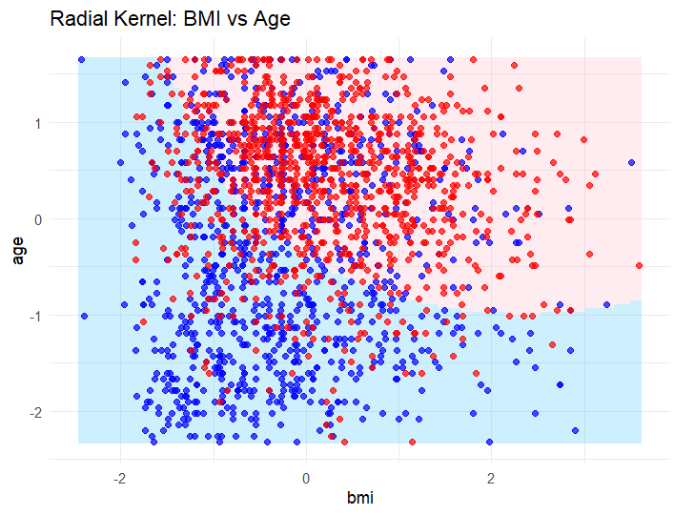
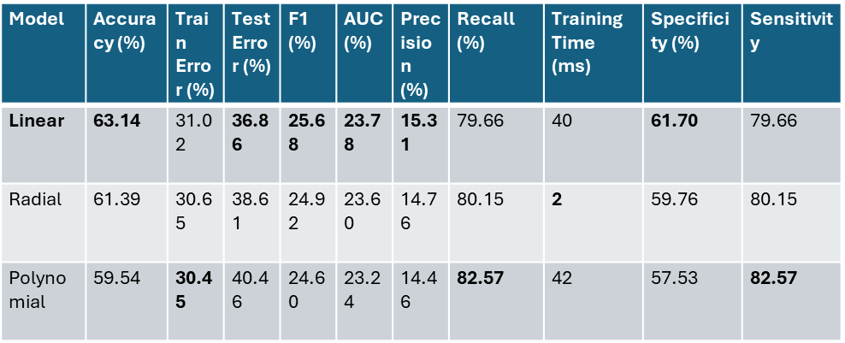
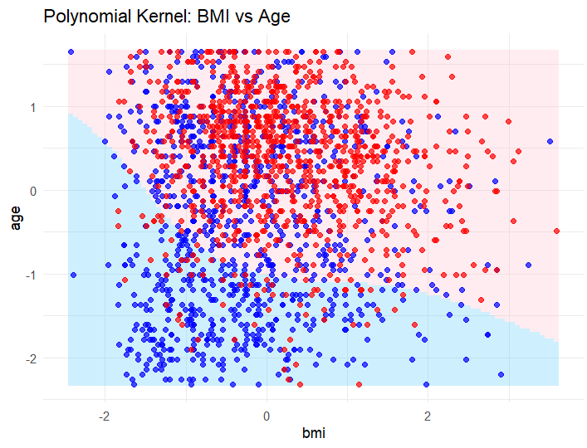
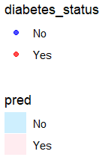
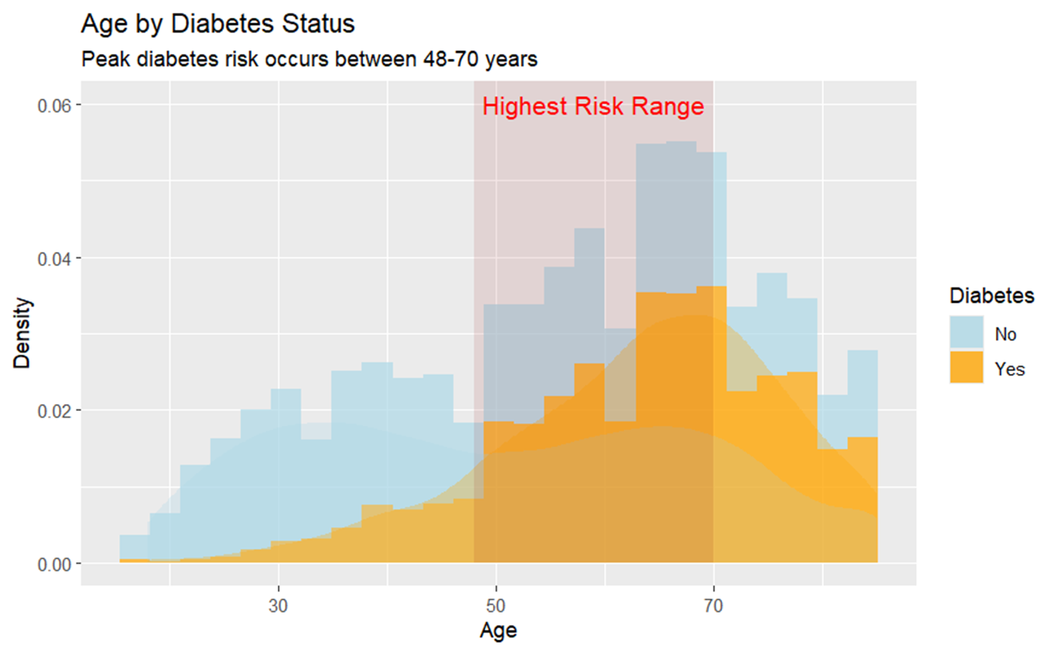
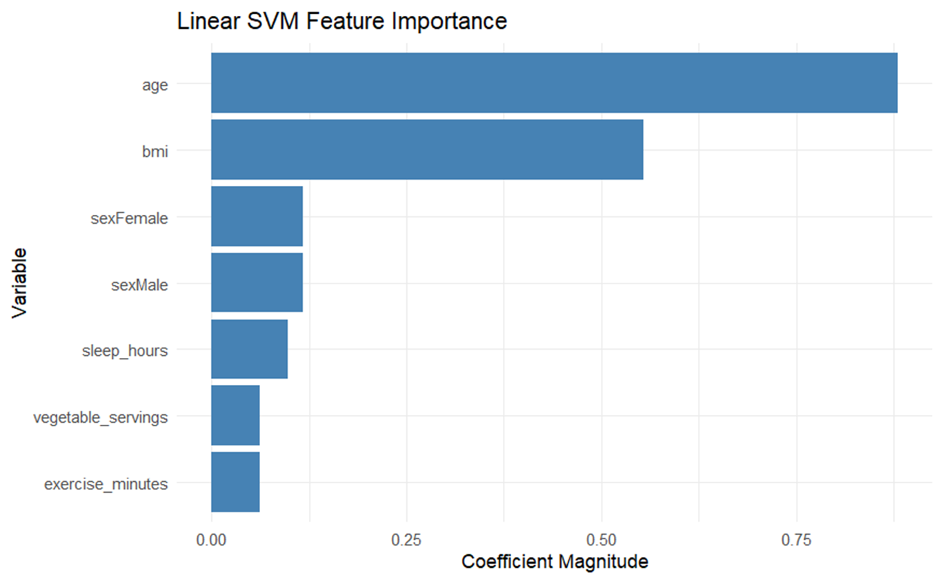
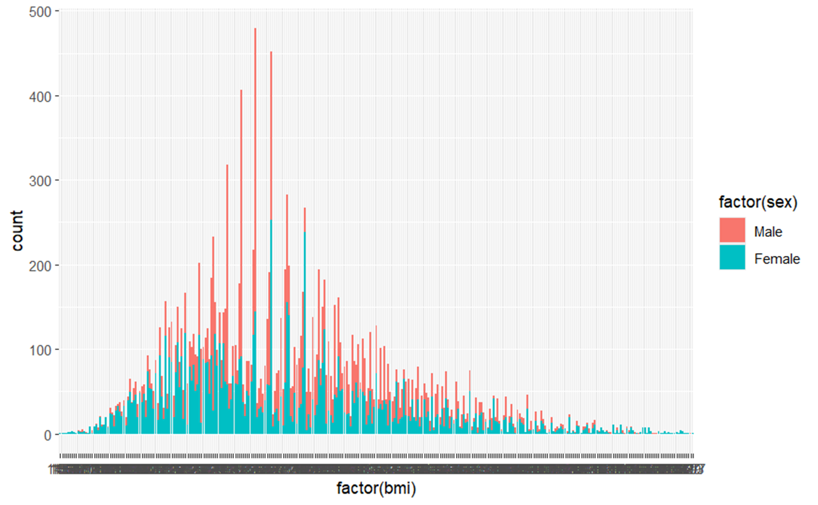
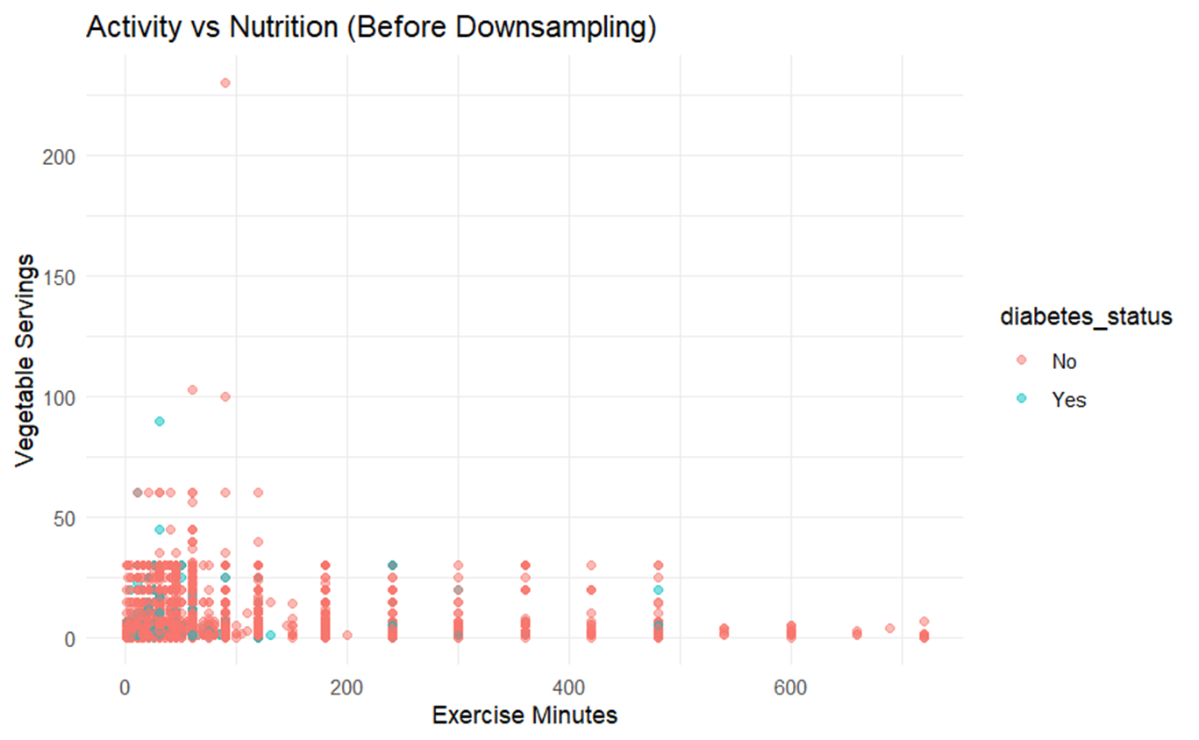
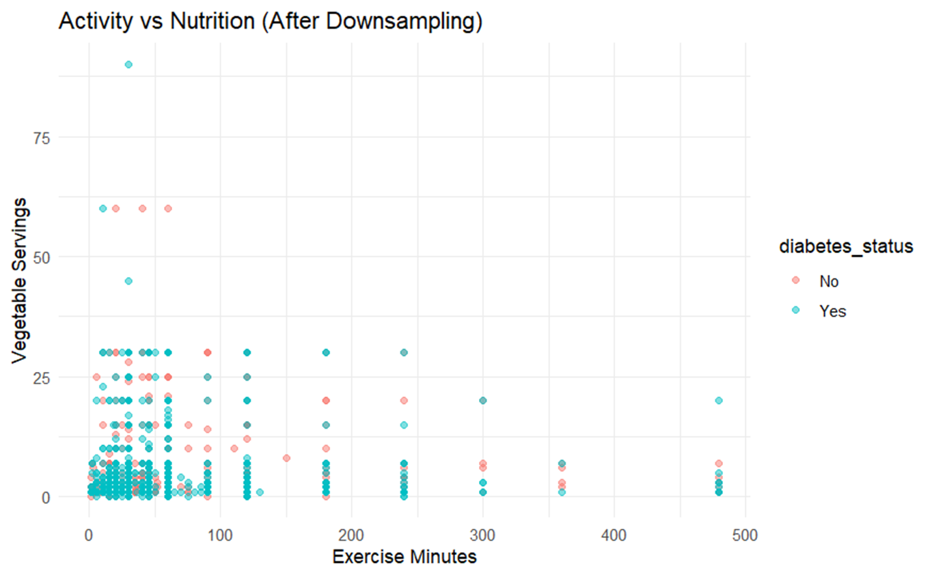
PREDICTING DIABETES RISK USING SVM
HRISHABH KULKARNI
Abstract
Methodology
Results
Conclusion
PROBLEM:
Diabetes affects 2 in 10 adults globally, but early detection remains inconsistent.
Current screening is often reactive (symptom-based) rather than data-driven.
GOAL:
Predict diabetes risk using health/ lifestyle /demographic factors
(BMI, age, exercise, nutrition).
DATASET:
NHIS 2022 has 35,115 observations
Demographics: Age, Sex
Biometrics: BMI
Lifestyle: Exercise, Nutrition, Sleep
- The density plot shows the distribution of BMI for individuals with and without diabetes.
- Individuals with diabetes tend to have higher BMI values compared to those without diabetes.
EXPLORATORY DATA ANALYTICS (EDA)
1) The density plot shows the distribution of BMI for individuals with and without diabetes.
- Individuals with diabetes tend to have higher BMI values compared to those without diabetes.
EVALUATION METRICS
- The linear kernel SVM achieved the highest accuracy (63.14%) and sensitivity (79.66%) but had a longer training time (0.45 seconds).
- The radial kernel SVM had a similar sensitivity (80.15%) and a much shorter training time (0.06 seconds).
- The polynomial kernel SVM had the lowest accuracy (59.54%) but the highest sensitivity (82.57%) and a highest training time of 0.52 seconds.
- The linear kernel SVM is best for this dataset.
SVM DECISION BOUNDARY
- The decision boundary plots show the regions of predicted diabetes status based on BMI and age for each SVM kernel.
- The linear kernel SVM is good, then comes the radial and then the polynomial shows a clear separations between the two classes as the dataset is cluttered.
- The decision boundary captures non-linear separation between diabetic and non-diabetic.
- Several data points are on the wrong side of the decision boundary.
- Shows that data points are cluttered and overlapping.
2) The histogram and density plot show the distribution of age for individuals with and without diabetes.
- The plot indicates that the peak diabetes risk occurs between the ages of 48 and 70 years.
- The rectangle highlights age range and the annotation emphasizes the highest risk range.
- This suggests that age is a significant factor in diabetes risk, with older individuals being more likely to have diabetes.
Background
OBJECTIVE: Find the optimal hyperplane that maximizes the margin between classes.
KEY TERMS:
Support Vectors: Data points closest to the decision boundary
Margin: Distance between hyperplane and nearest points (maximized during training)
LINEAR SVM - Draws a straight line to separate groups
Key Hyperparameter: Cost: Controls Strictness
RADIAL SVM – Flexible, curved boundaries to wrap around clusters
Key Hyperparameter: Gamma: Controls Curviness
POLYNOMIAL SVM - Draws scribbled/ complex borders
Key Hyperparameter: Degree of polynomial: Controls Complexity
IMPORTANT VARIABLE
Same key predictors emerging as most important across all kernels.
The most important predictors for every kernel SVM are:
AGE > BMI > EXECISE MINUTES > VEGETABLE SERVING > SLEEP HOURS
- Age and BMI are the strongest predictors among Demographical and Biological factor.
SVM shows that Age and BMI are the most important predictors for diabetes status.
FINAL TAKEAWAYS
How Models predict Diabetes Risk:
Higher Age and BMI Higher Risk
Screening Recommendations:
Screen all individuals aged 50+ with BMI ≥ 30
Insightful Priorities (Prioritize lifestyle counseling for those):
Exercising < 150 mins/week
Consuming < 3 vegetable servings/day
Model Recommendation:
Use Linear SVM for fast, reliable, clear, clinic-based risk assessments.
HOW TO HANDLE CLASS IMBALANCE?
Original data had 90% healthy vs 10% diabetic cases
Created balanced training set (1,376 each group)
Prevents model from ignoring the minority class
Scatter plot shows the relationship between exercise minutes and vegetable servings, coloured by diabetes status.
3) This plot tells me distribution of BMI based on gender.
- It also shows that dataset have higher number data related to men than women.
Citations
[1] Lynn A. Blewett, Julia A. Rivera Drew, Miriam L. King, Kari C.W. Williams, Daniel Backman, Annie Chen, and Stephanie Richards. IPUMS Health Surveys: National Health Interview Survey, Version 7.4 [dataset]. Minneapolis, MN: IPUMS, 2024. https://doi.org/10.18128/D070.V7.4.
[2] H. Wickham et al., tidyverse: Easily Install and Load the 'Tidyverse', [Online]. Available: https://tidyverse.tidyverse.org/
[3] tictoc: Functions for timing R scripts, [Online]. Available: https://cran.r-project.org/web/packages/tictoc/index.html

