Slide 1
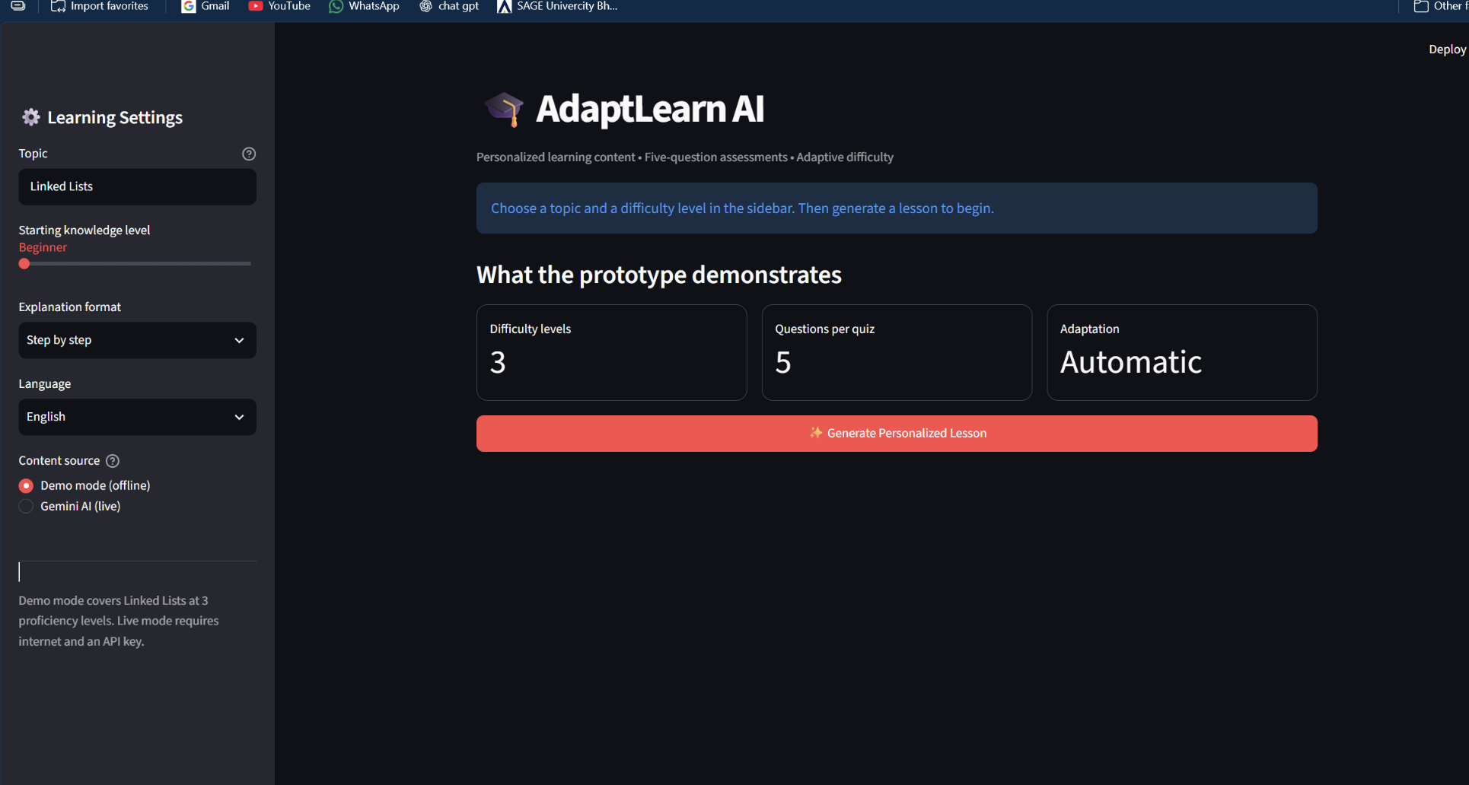
FINAL PROJECT · PS-1
AdaptLearn
AI
AI-Based Personalized
Learning Content Generator
Generative AI & Creative Intelligence
B.Tech — Artificial Intelligence & Machine Learning
3rd Semester • Academic Project 2026
Prototype interface · Streamlit
Presented by Team Wheel Of Evolution
Notes:
Good morning. Our project is AdaptLearn AI, an AI-Based Personalized Learning Content Generator. Traditional learning materials often give everyone the same explanations even when their understanding differs. Our prototype generates educational material at Beginner, Intermediate and Advanced levels and adapts the next lesson based on quiz performance. We built it using Python, Streamlit and the Gemini API.

Slide 2
01 / THE CHALLENGE
One-size-fits-all learning leaves gaps
Why we built AdaptLearn AI
THE PROBLEM
OUR OBJECTIVES
Beginners struggle when explanations assume prior knowledge.
Generate personalized lessons and worked examples with AI.
Support Beginner, Intermediate and Advanced proficiency.
Advanced students repeat concepts they already understand.
Assess understanding using five-question quizzes.
Static lessons do not respond to assessment performance.
Recommend the next difficulty level from quiz results.
Students need immediate feedback on learning gaps.
Show progress within the current learning session.
ADAPTLEARN AI • B.TECH AI/ML • 2026
02 / 07
Notes:
The problem is that many educational resources offer the same content to every student. A beginner may find it too difficult, while an experienced learner may find it repetitive. Our main goals are to generate level-appropriate lessons using generative AI, create quizzes, evaluate performance, recommend an easier, same or harder next level, and display progress in the current session.

Slide 3
02 / TECH STACK
A simple, practical AI application
We used existing generative AI rather than training a model from scratch
01
Python
02
Streamlit
03
Gemini API
Application logic and quiz scoring
Web UI, forms, tabs, session state
Generates lessons and quiz content
04
Pydantic
05
Prompt engineering
06
python-dotenv
Validates structured JSON responses
Adjusts content to learning level
Loads local environment configuration
Student input → Streamlit + Python → Gemini API → Lesson + Quiz → Adaptive Engine
ADAPTLEARN AI • B.TECH AI/ML • 2026
03 / 07
Notes:
Python is the main language. Streamlit builds the interface and provides temporary session storage. In live mode, we call Google's Gemini API to generate content. We create difficulty-aware prompts to guide the model and use Pydantic plus custom validation to check the returned response structure. Python scores the quizzes and applies simple adaptive rules. The python-dotenv library allows local configuration of an API key. We did not train an ML model from scratch and the prototype does not have a permanent database.

Slide 4
03 / ARCHITECTURE
From learning preferences to adaptive practice
Six steps connect generative AI with performance-based assessment
01
STUDENT INPUT
02
BUILD PROMPT
03
GEMINI API
Topic, level, language, explanation style
Python creates level-specific AI instructions
Generate lesson and five MCQs
06
ADAPT NEXT LEVEL
05
EVALUATE QUIZ
04
VALIDATE & SHOW
Use score and missed questions for next lesson
Compare answers and calculate score
Check output; display lesson and quiz
ADAPTIVE LOOP: the next lesson uses the recommended level + questions the student missed
ADAPTLEARN AI • B.TECH AI/ML • 2026
04 / 07
Notes:
The student selects the topic, difficulty, preferred explanation style, and language. Streamlit collects the information and Python composes a structured prompt, which the Gemini API uses in live mode. The response contains the lesson, key points, a worked example and five MCQs. Pydantic and a validation function check the required fields. Students take the quiz; Python scores their answers. The adaptive engine chooses the next level and the next lesson can focus on previously missed questions. Offline demo mode uses predefined Linked Lists content instead of calling Gemini.

Slide 5
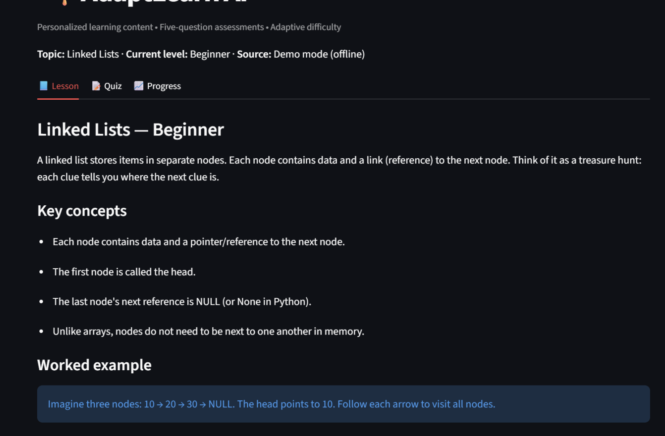
04 / PERSONALIZATION
One topic. Three different learning paths.
Dynamic prompts adapt both the explanation and the assessment
BEGINNER
ACTUAL PROTOTYPE: BEGINNER LESSON
Node, head, next pointer, simple 10 → 20 → 30 examples
INTERMEDIATE
Insertion, deletion, traversal, pseudocode, time complexity
ADVANCED
Floyd cycle detection, reversal, edge cases, trade-offs
Prompt inputs
Topic • Level • Style • Language • Missed questions
Gemini mode generates new content; offline mode uses curated lessons.
ADAPTLEARN AI • B.TECH AI/ML • 2026
05 / 07
Notes:
Our key personalization technique is prompt engineering. We pass the topic, level, explanation style, language, and missed quiz questions into Gemini's prompt. Beginner requests basic definitions and analogies. Intermediate requires implementation, algorithms and practice. Advanced asks for edge cases, optimization and deeper reasoning, plus harder questions. This screenshot is from our offline Linked Lists demonstration. In live mode, Gemini generates new content. We use structured response fields for title, overview, key points, worked example and quiz.

Slide 6
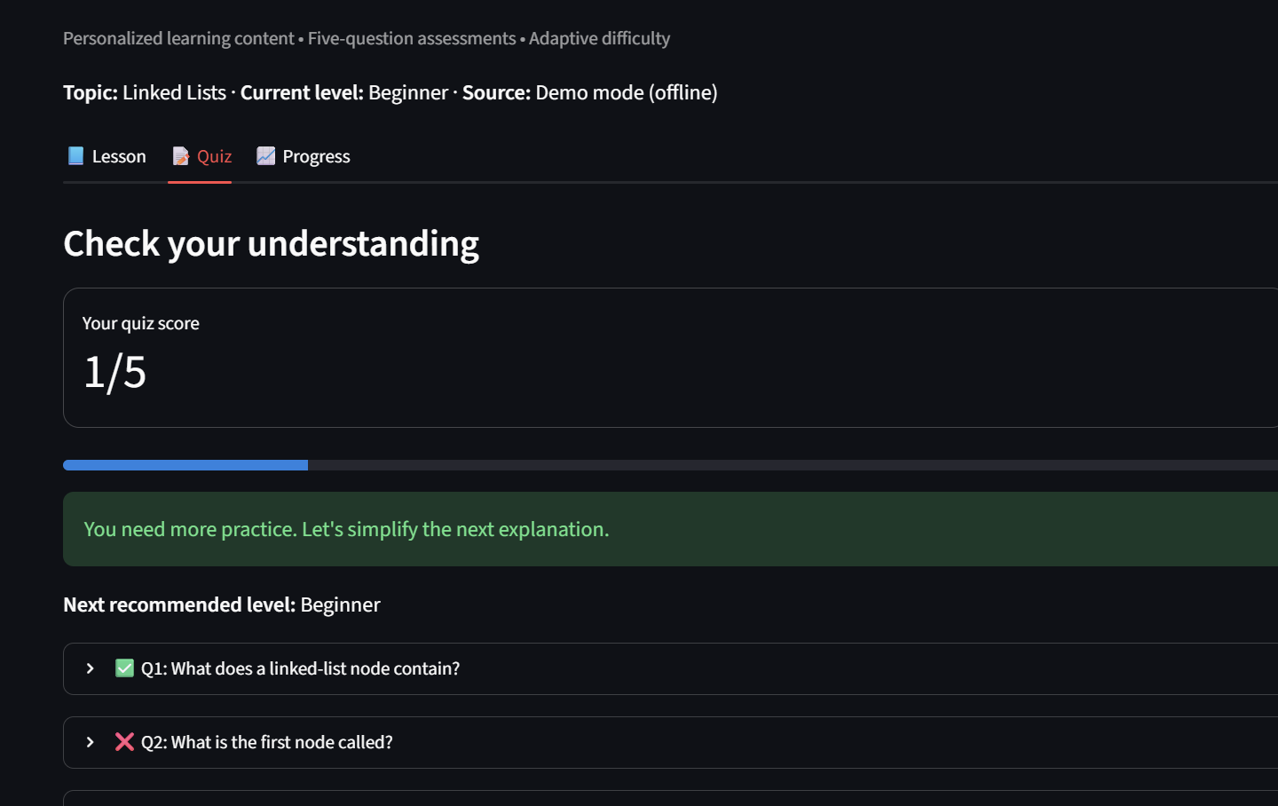
05 / ADAPTIVE ASSESSMENT
The quiz decides what comes next
Five MCQs; a transparent, rule-based difficulty adjustment
ADAPTIVE RULES
QUIZ RESULT IN ADAPTLEARN AI
0–2 / 5
LOWER
Step down one level, if possible
3–4 / 5
REPEAT
Practice at the same level
5 / 5
ADVANCE
Move up one level, if possible
ACTUAL TEST
1/5
20% → Beginner (more practice)
Score = correct answers ÷ 5 × 100
ADAPTLEARN AI • B.TECH AI/ML • 2026
06 / 07
Notes:
Each lesson includes five multiple-choice questions. The application compares selected options against the correct answer indices and calculates a score. The difficulty policy is straightforward: zero to two correct lowers the level by one if possible, three to four correct keeps the level, and five correct raises it by one if possible. Beginner is the floor and Advanced is the ceiling. In our actual test, one out of five at Beginner level resulted in Beginner recommended again. The app can also collect missed question texts for the next Gemini prompt. This is an adaptation of content, not the training of the model.

Slide 7
06 / RESULTS & OUTLOOK
A working MVP with a clear path forward
Generative lessons, structured assessment and feedback-driven learning
DELIVERED
LIMITATIONS
FUTURE SCOPE
Interactive Streamlit application
Live AI depends on network and API
Student accounts and a database
Three distinct learning levels
AI content requires accuracy checks
Upload syllabus and PDF learning material
Gemini API integration and offline mode
Progress is not stored permanently
AI doubt-solving tutor
Quiz scoring and adaptive recommendations
Adaptation uses fixed score thresholds
Smarter weakness tracking and analytics
In-session learning progress
AdaptLearn AI: a practical foundation for personalized, AI-assisted learning.
ADAPTLEARN AI • B.TECH AI/ML • 2026
07 / 07
Notes:
In summary, we delivered a Streamlit interface, three proficiency levels, the option to generate educational content with Gemini, a five-question quiz, feedback-based difficulty adjustment, and a progress table for the current session. The limitations are that the live AI requires network access, generated content needs verification, progress is temporary, and the rule engine is simple. Future improvements include permanent student records, PDF syllabus upload, doubt solving and richer learning analytics. Thank you.

