Slide 1
Quantum Differential Machine Learning:
# as applied to European Options Pricing

Slide 2
contents = [
‘black-scholes merton’,
‘dml’,
‘parameter shift rule’,
‘embedding’,
‘circuit’,
‘learning’,
‘analysis’
]

Slide 3



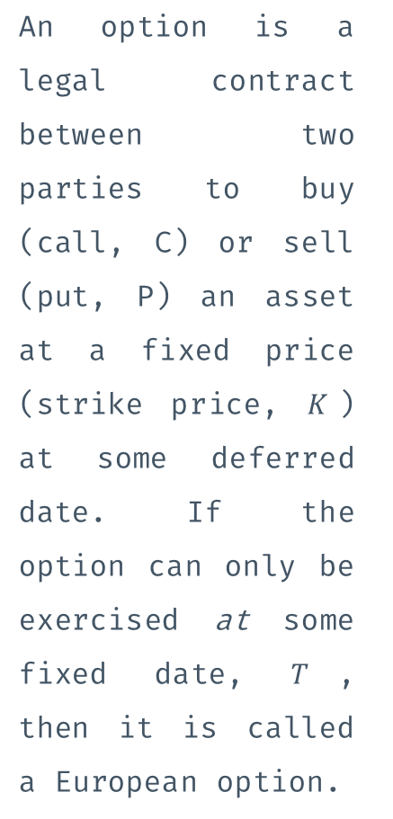



Options
Black-Scholes Equation
An option is a legal contract between two parties to buy (call, C) or sell (put, P) an asset at a fixed price (strike price, $K$) at some deferred date. If the option can only be exercised at some fixed date, $T$, then it is called a European option.
To establish a fair price, $V$, for an option, we assume a principle of no-arbitrage and that asset prices, $S,$ follow Brownian motion to derive the Black Scholes Equation, which relates $V$ with $S$ via a second order partial differential equation. $V$ also depends on two other quantities, the risk free return rate, $r$, and the volatility, $σ$ of the asset, which are assumed fixed for a European option.
$$\frac{∂V}{∂t}+\frac{1}{2}σ^{2}S^{2}\frac{∂^{2}V}{∂S^{2}}+rS\frac{∂V}{∂S}−rV=0$$
The Greeks
The sensitivities of prices, V, with respect to the parameters of the equation, S, T, r, etc. are known as the Greeks collectively.
$$\frac{∂V}{∂S}=Δ$$
$$\frac{∂^{2}V}{∂S^{2}}=Γ$$
$$−\frac{∂V}{∂τ}=Θ$$
$$\frac{∂V}{∂σ}=𝒱$$

Slide 4
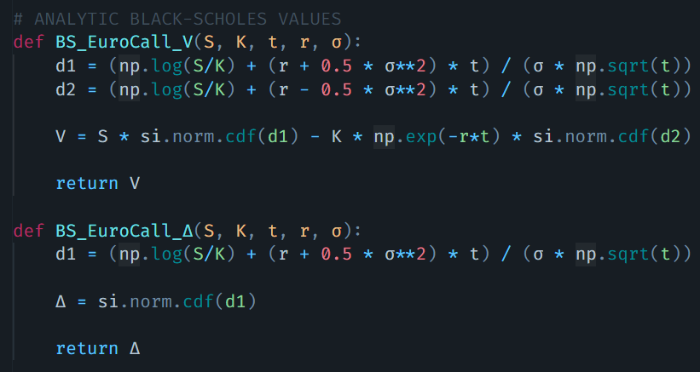

Slide 5


Feedforward
$$z_{0}=x \\ z_{l}=g_{l−1}\left(z_{l−1}\right)𝓌_{l}+b_{l} \\ y=z_{L}$$
The feedforward mechanism describes the forward flow of information through a neural network.
Backpropagation
The backpropagation algorithm describes the backward flow of information used during learning.
$$\overline{z_{L}}=\overline{y} \\ \overline{z_{l−1}}=\left(\overline{z_{l}}𝓌_{l}^{T}\right)∘g_{l−1}^{′}\left(z_{l−1}\right) \\ \overline{x}=\overline{z_{0}}$$
Differential Machine Learning
DML leverages the similarity between backpropagation and feedforward equations by defining a twin network, where backpropagation acts as a second feedforward network. Inputs 𝑥 are transformed into intermediate 𝑦 and final output 𝑑𝑦/𝑑𝑥, enabling the network to learn the function's behavior, not just its values.

Slide 6
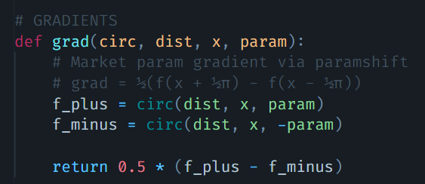





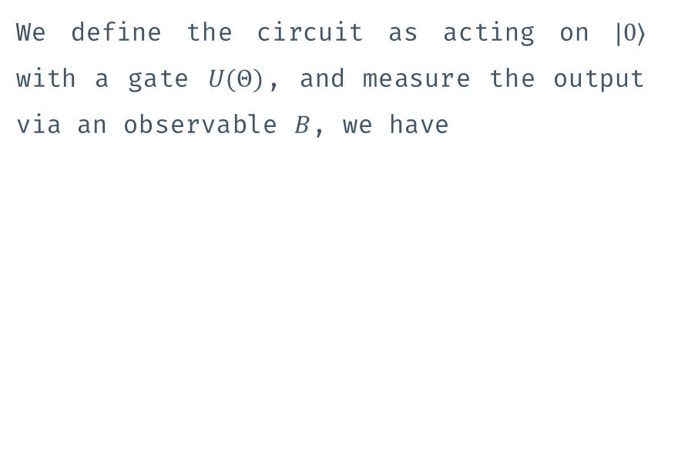
We define the circuit as acting on $|0⟩$ with a gate $U(Θ)$, and measure the output via an observable $B$, we have
$$f\left(θ_{1},θ_{2},…\right)=\left\langle 00\left|U^{\text{†}}BU\right|00\right\rangle$$
The Parameter Shift Rule
Given a gate $U_{P}\left(Θ\right)=e^{iaθ𝒢}$, for $θ∈Θ, a∈ℝ$, with the matrix $𝒢$ having exactly two unique eigenvalues $e_{0}$ and $e_{1}$, we have the following relation ship
If $𝒢∈\left\{X, Y, Z, X⊗X, Y⊗Y, Z⊗Z\right\}$ then we have $a=\frac{1}{2}$, $e_{0}=−1, e_{1}=1,$ and $r=\frac{1}{2}$. Thus, we obtain, for any parameter $φ$ of the circuit
$\frac{∂f}{∂θ}=r\left(f\left(θ+\frac{π}{4r}\right)−f\left(θ−\frac{π}{4r}\right)\right)$ where $r=\frac{a}{2}\left(e_{1}−e_{0}\right)$
$$\frac{∂f}{∂φ}=\frac{f\left(φ+\frac{π}{2}\right)−f\left(φ−\frac{π}{2}\right)}{2}$$

Slide 7
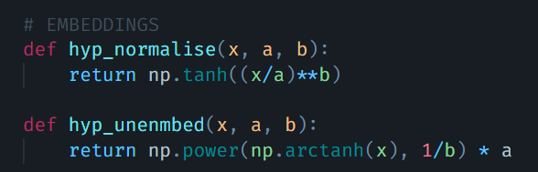



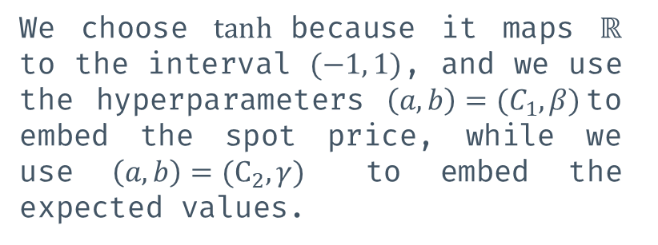
Embedding The Data
The gate parameters, $Θ=\left\{θ_{1},θ_{2},…\right\}$, are implemented via rotation gates, $X, Y, Z, X⊗X,Y⊗Y,Z⊗Z$ which rotate qubits by $θ$. Similarly, the market parameters are embedded into the circuit by rotation gates which rotate the initial qubit state by $Φ=\left\{φ_{1},φ_{2},…\right\}$. We embed the market parameters S into $Φ$ via the map
$$x=\tanh{{\left(\frac{X}{a}\right)}^{b}}$$
$$φ=arcsin⁡(x)$$
We choose $\tanh{ }$because it maps $ℝ$ to the interval $(−1, 1)$, and we use the hyperparameters $\left(a,b\right)=(C_{1},β)$to embed the spot price, while we use $\left(a,b\right)=(C_{2},γ)$ to embed the expected values.

Slide 8
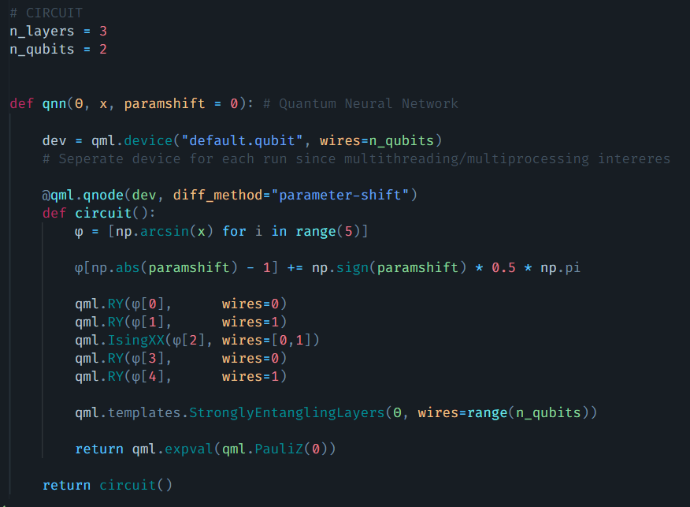

The Circuit
The Quantum Neural Network is represented as a function which accepts the parameters $Θ$ which represents the trainable weights of the network along with the input x and the hyperparameter paramshift.
The circuit itself is self-descriptive, using a combination of rotation and entangling gates to process the input.
The IsingXX gate and Strongly Entangling Layers template provide the building blocks to create a highly expressive quantum circuit capable of capturing quantum correlations.

Slide 9
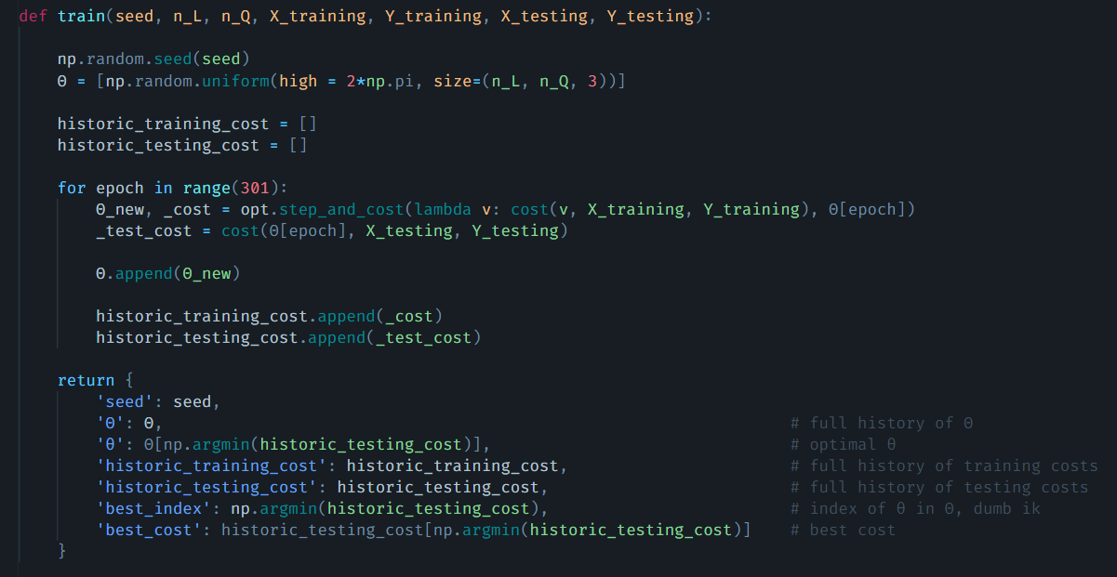
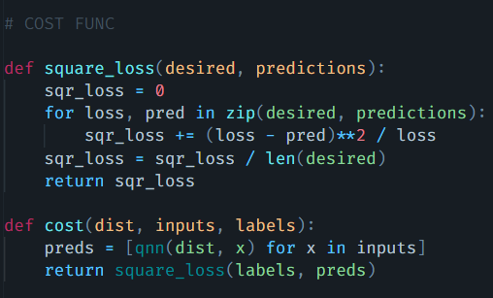
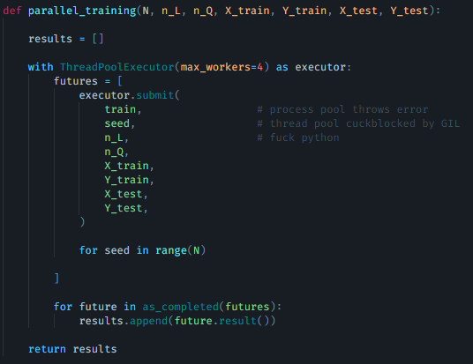
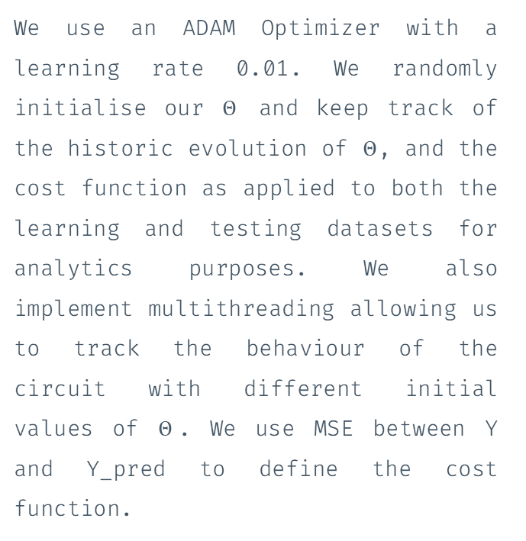

Learning
We use an ADAM Optimizer with a learning rate 0.01. We randomly initialise our $Θ$ and keep track of the historic evolution of $Θ$, and the cost function as applied to both the learning and testing datasets for analytics purposes. We also implement multithreading allowing us to track the behaviour of the circuit with different initial values of $Θ$. We use MSE between Y and Y_pred to define the cost function.
Cost Function
We define the cost function as $C=MSE+λ\overline{MSE}$ to allow the QNN to learn both Values and their Deltas.

Slide 10
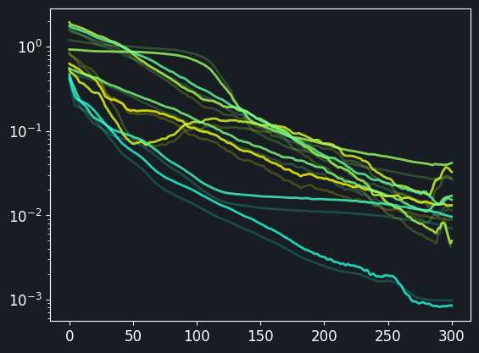
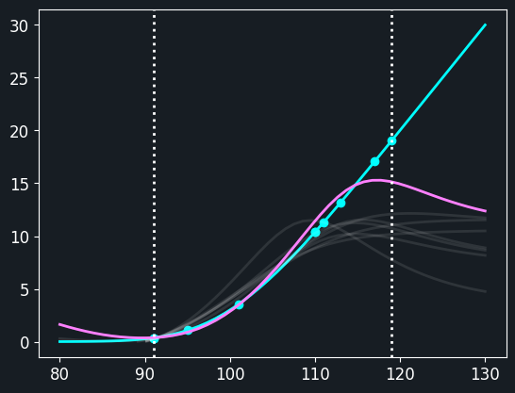
epoch
option value
epoch
spots

Slide 11
References
Quantum Differential Machine Learning
T Sakuma, 2023
Differential Machine Learning
B.N. Huge & A. Savine, 2020
Quantum Circuit Learning
K Mitarai et al., 2019
Evaluating Analytic Gradients on Quantum Hardware
M Schuld et al., 2018
Optimal Quantum Circuits for General Two-Qubit Gates
F. Vatan & C. Williams, 2004

