Slide 1
STRAY ANIMAL RESCUE & WELFARE
PawPatrol
See a stray in trouble → report in 30 seconds → nearest rescuer gets notified.
Notes:
PawPatrol: a community rescue network for stray animals. One-line pitch: see a stray in trouble, report in 30 seconds, nearest rescuer gets notified.

Slide 2
62M
The Problem
Injured, sick, or at-risk strays get hurt every day — with no fast way for a bystander to alert someone who can help.
NGOs and volunteers exist, but have no visibility into where help is needed right now.
estimated stray dogs across Indian cities
Notes:
India has roughly 62 million stray dogs. Bystanders who spot an injured or sick animal have no fast way to alert someone who can actually help, and rescuers have no visibility into where help is needed right now.

Slide 3




How It Works
Report
Notify
Rescue
Photo, AI tags, location & urgency — in under 30 seconds
Nearby volunteers, NGOs & shelters are alerted instantly
A rescuer claims the case and tracks it through to resolved
Notes:
The core loop: report a case with a photo and location, the nearest volunteers and shelters are notified instantly, and they respond and resolve it.

Slide 4
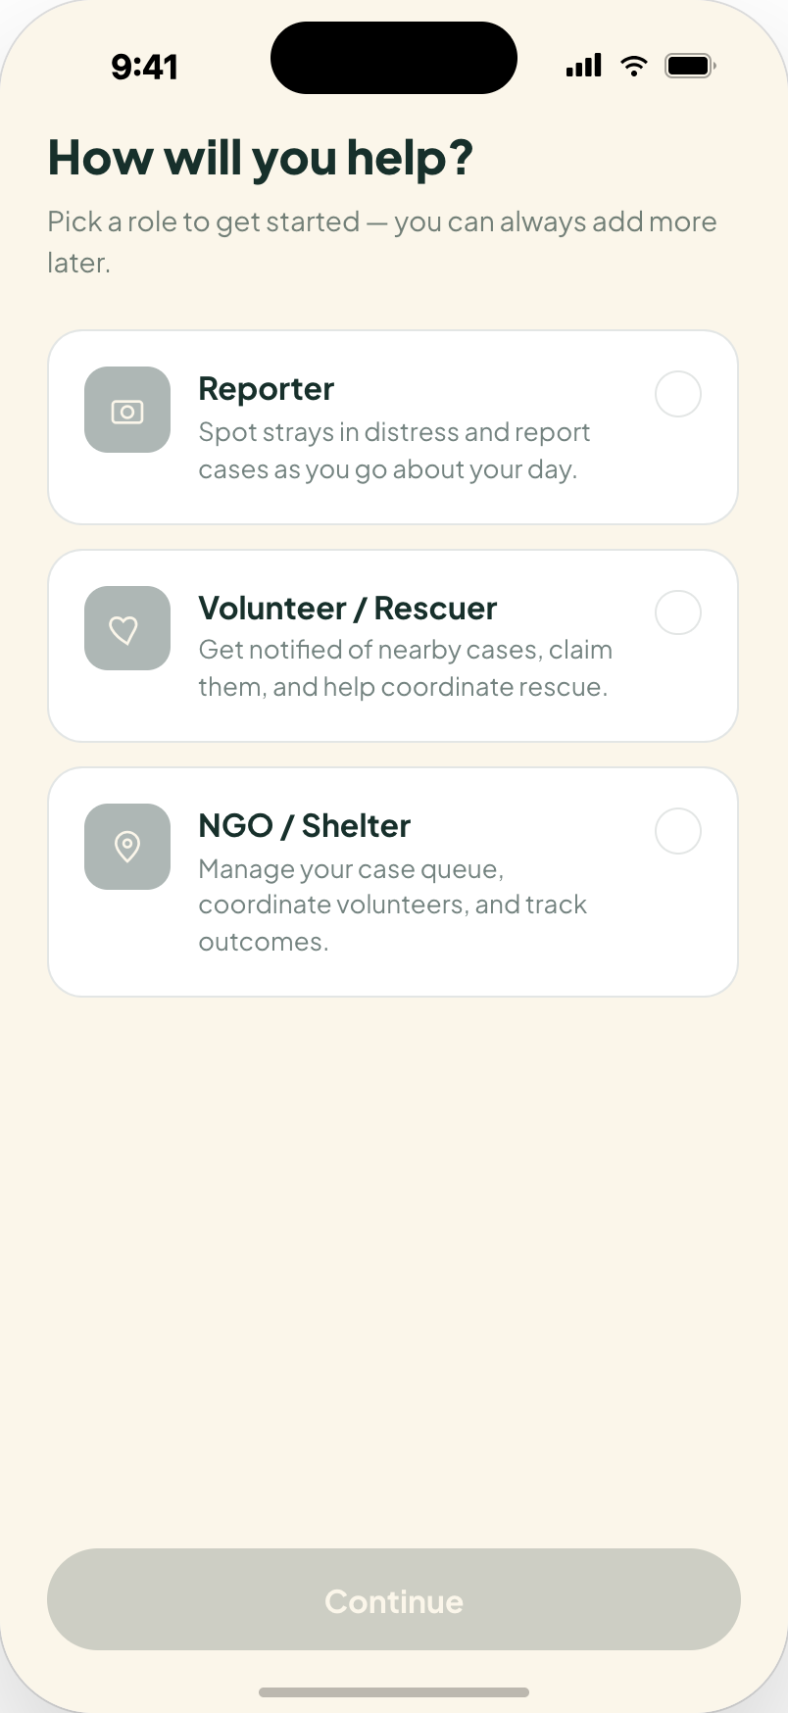

Onboarding & Choose Your Role
Three quick slides frame the mission.
Reporter, Volunteer, or NGO/Shelter — one flow, three roles.
The pick personalizes what the person sees next.
Notes:
A short mission-driven intro, then the user picks a role: reporter, volunteer or rescuer, or NGO / shelter, which shapes what they see next.

Slide 5
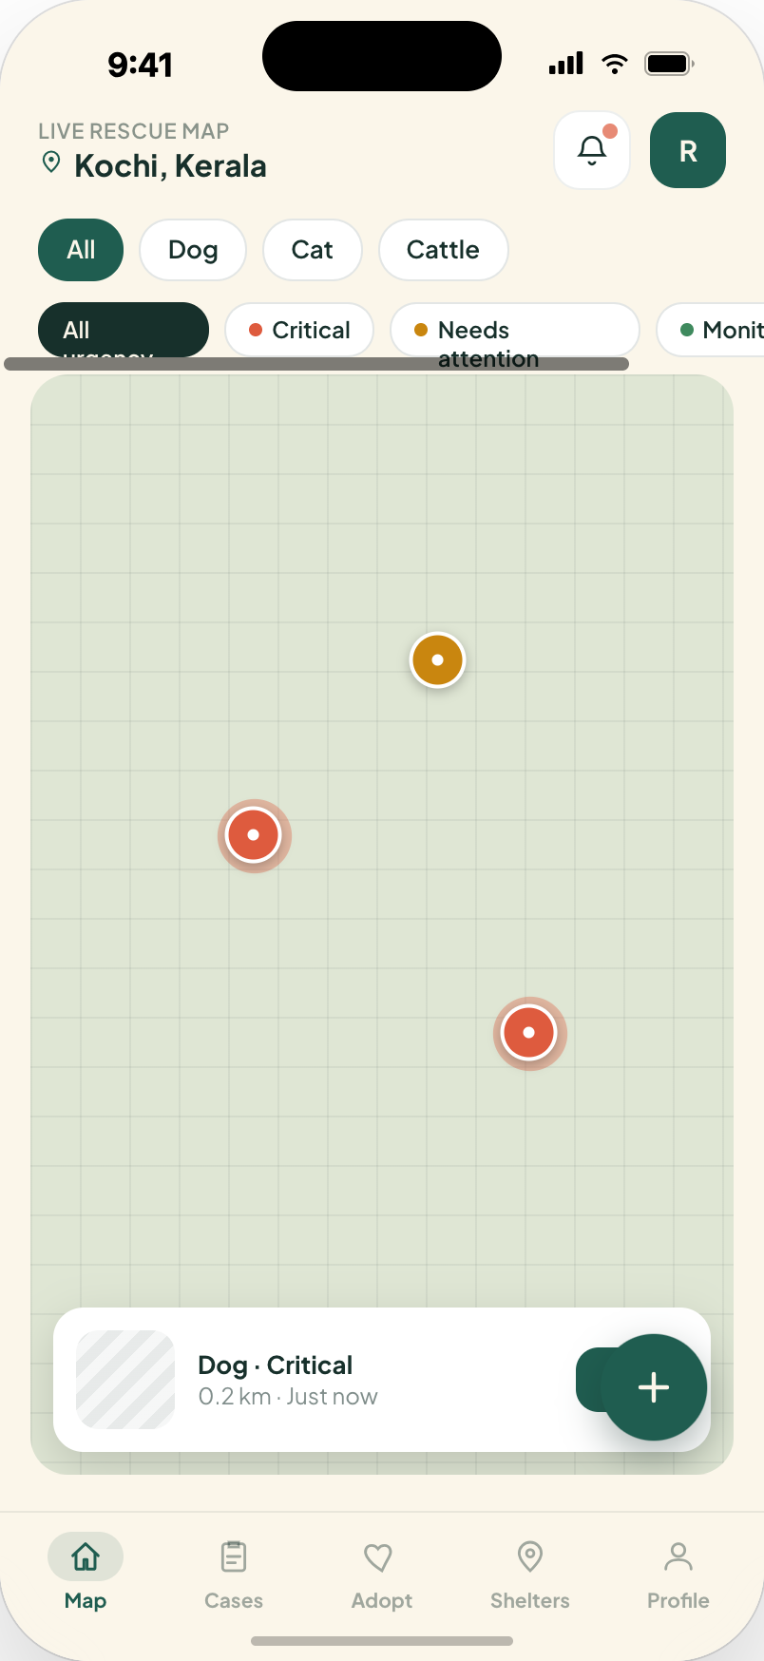
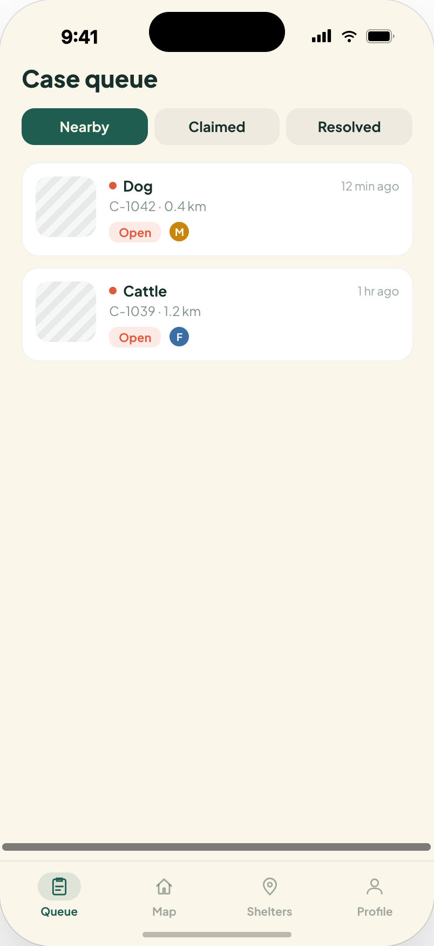
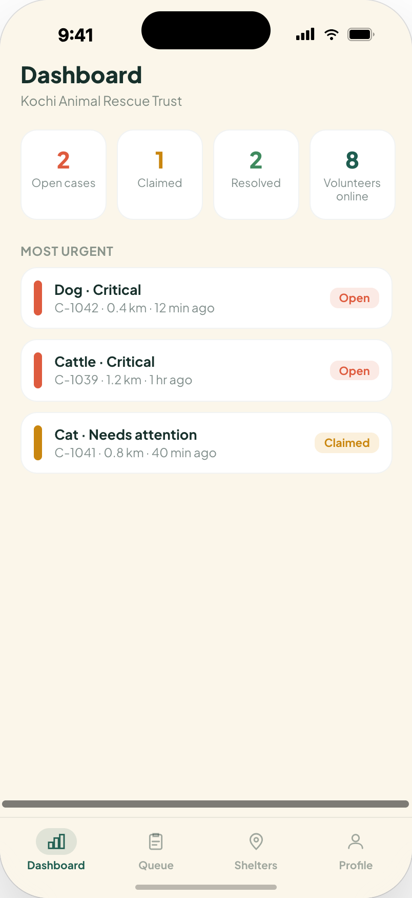
Three Roles, One App
The role picked at onboarding reshapes the navigation, the home screen, and the case-detail actions.
Reporter
Volunteer
NGO / Shelter
Map & report flow
Nearby queue, claim-nearest
Dashboard & case queue
Notes:
Onboarding routes each user into a role-specific experience: reporters get the map and report flow, volunteers get a queue of nearby unclaimed cases with a claim-nearest action, and NGOs get a dashboard plus a case queue for assigning and verifying.

Slide 6
Live Rescue Map
Every open case, plotted live and color-coded by urgency.
Filter by species, urgency, distance, or status.
Tap any pin for an instant preview before diving in.
Notes:
The home screen is a live map of every open case near the user, color-coded by urgency, with filters and an instant preview when a pin is tapped.

Slide 7
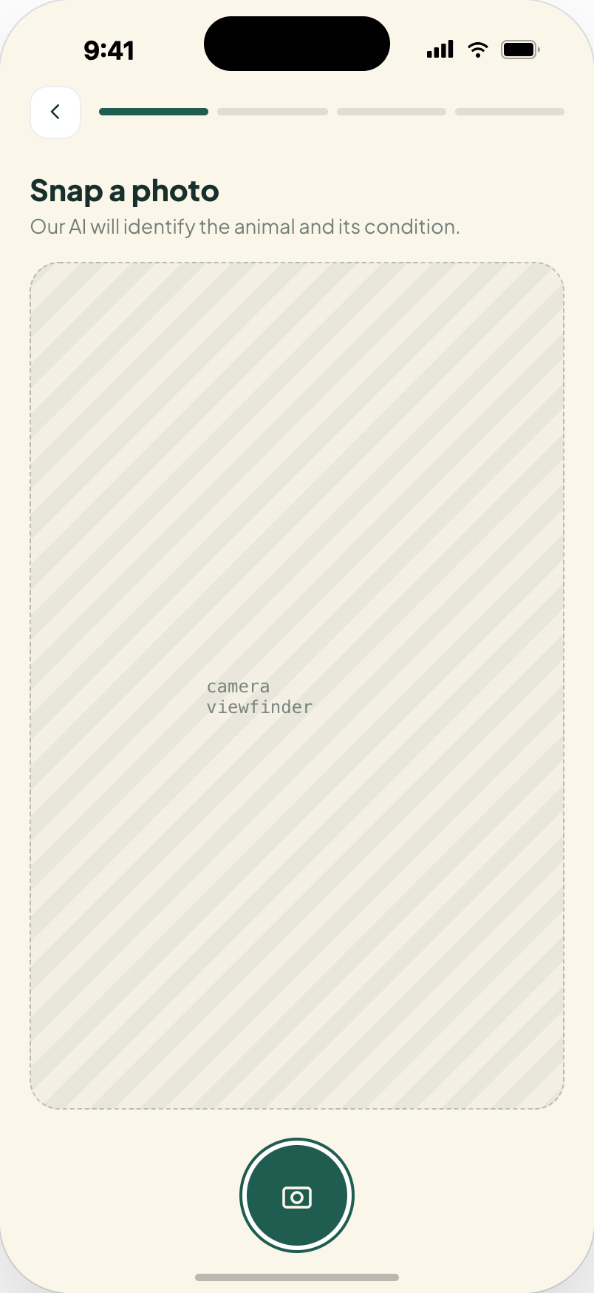
Report In Under 30 Seconds
Snap a photo — AI suggests species, breed, and condition tags.
Confirm the location, dragging the pin if it's off.
Pick an urgency level, add a note, and submit.
Notes:
Reporting a case takes under 30 seconds: snap a photo, let AI suggest species and condition tags, confirm the location pin, pick an urgency level, and submit.

Slide 8
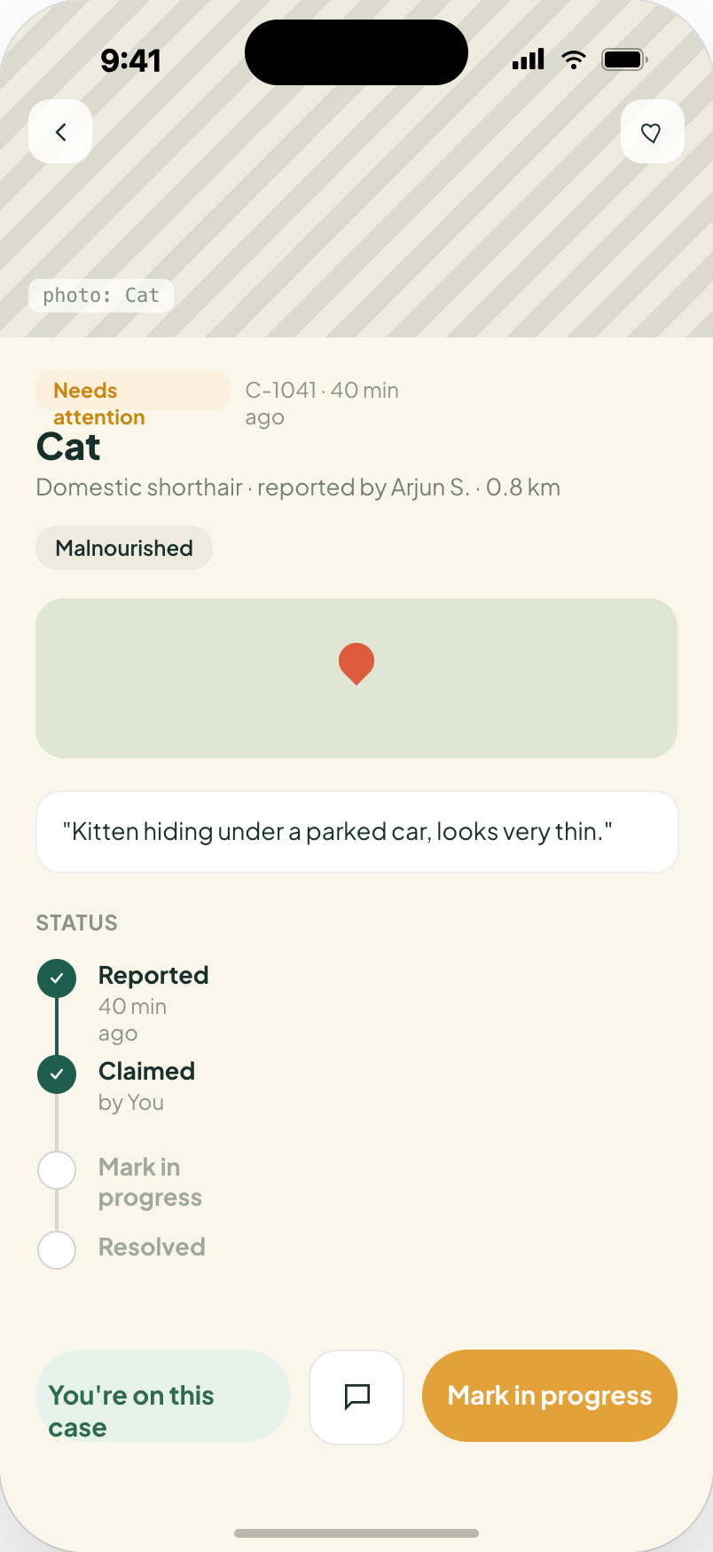
Nearest Rescuer Responds
"I'll help" claims the case instantly — the reporter is notified.
A status timeline tracks Reported → Claimed → In Progress → Resolved.
In-app chat keeps reporter and rescuer coordinated.
NGOs see an extra layer here: reassign the volunteer and add internal notes.
Notes:
On the case detail screen, a rescuer taps I'll help to claim it, then moves it through a status timeline while chatting directly with the reporter.

Slide 9
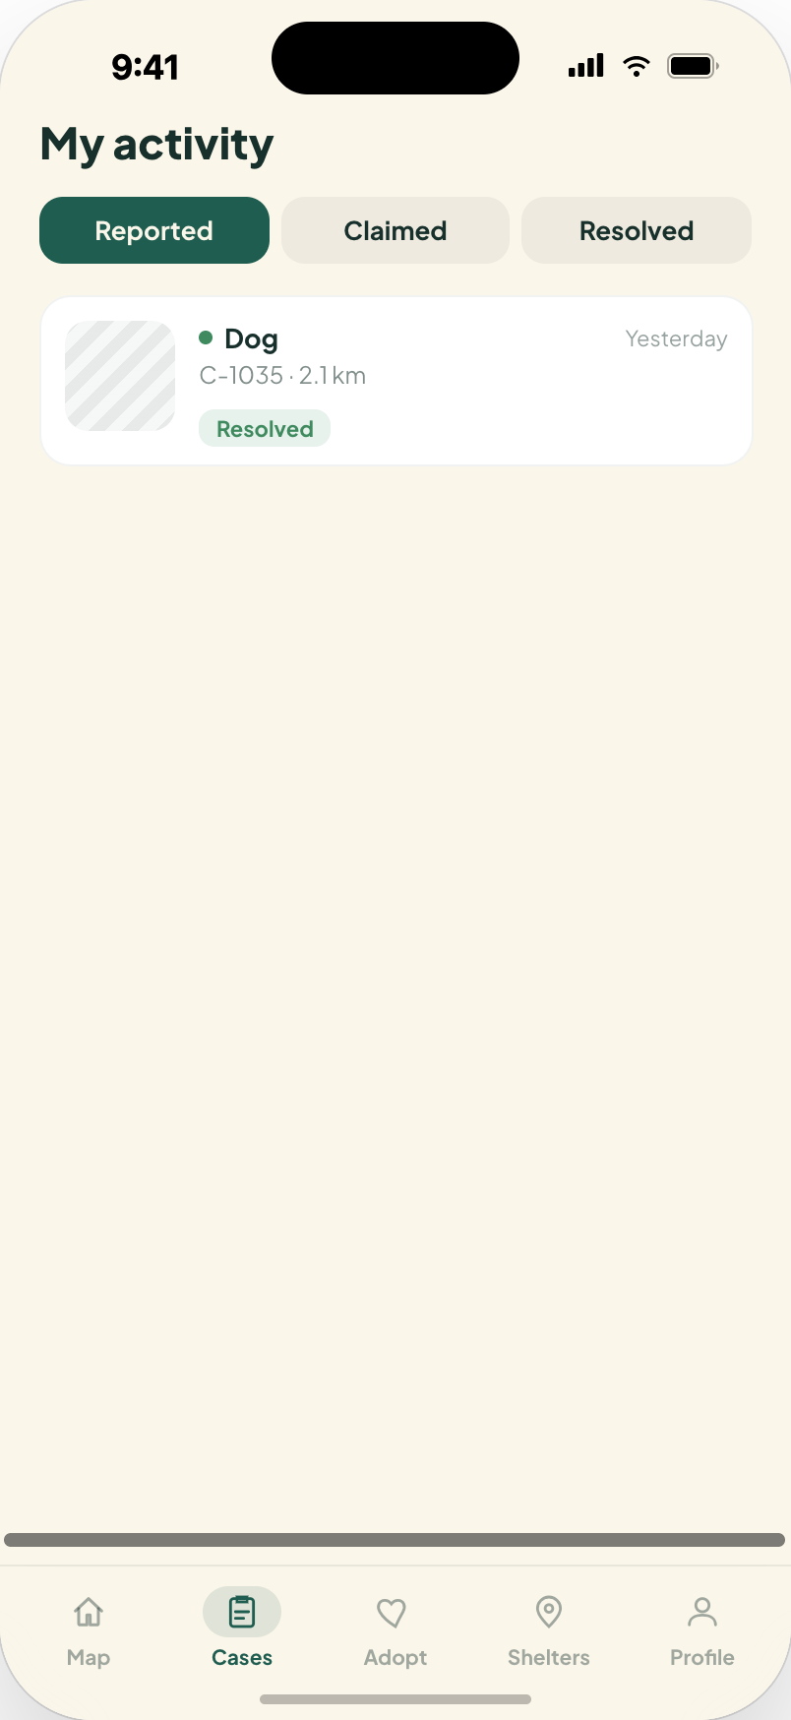
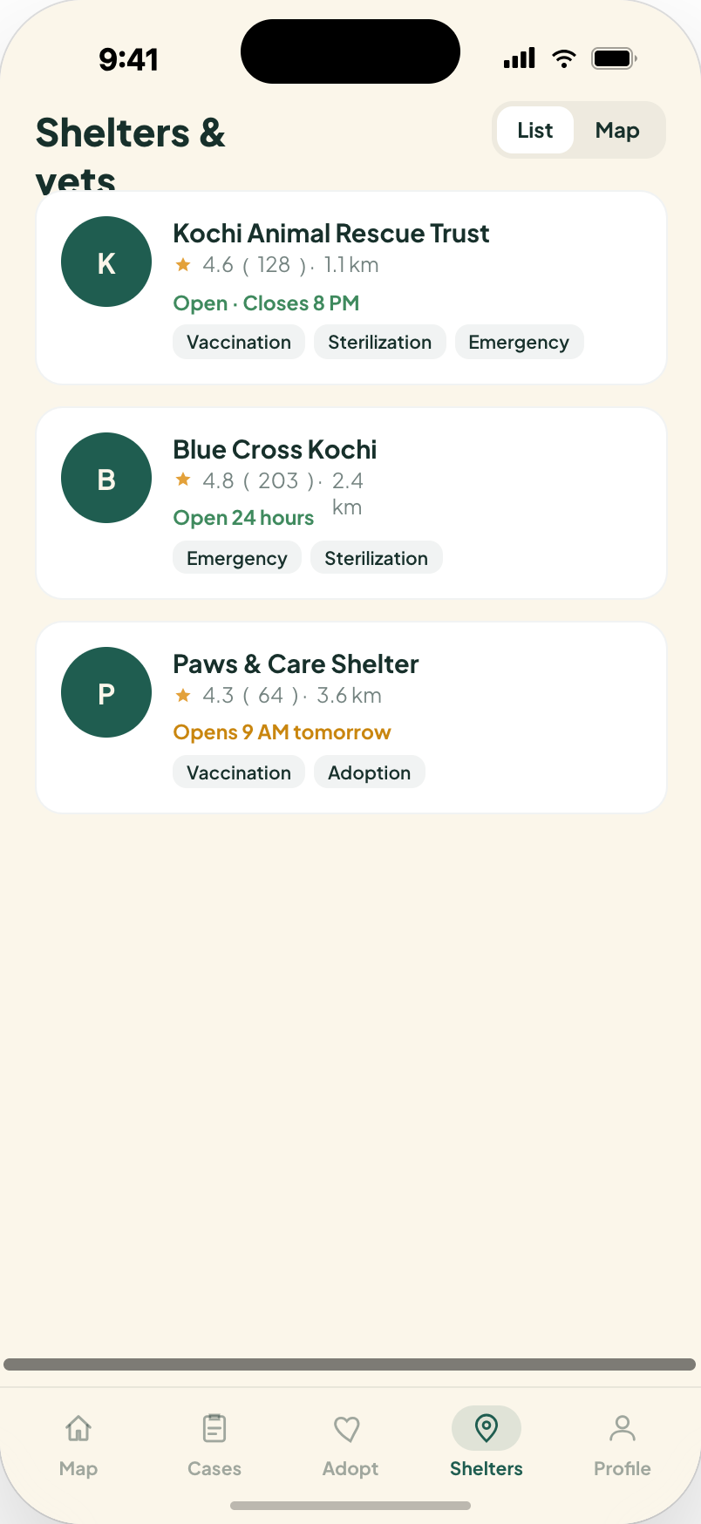
Track Every Rescue
A personal activity feed: Reported, Claimed, Resolved.
Verified shelters & vets nearby, with live hours and services.
One tap to call or get directions.
Notes:
Beyond one case, the app tracks a user's full activity history, and connects them to a directory of verified nearby shelters and vets with live hours and services.

Slide 10
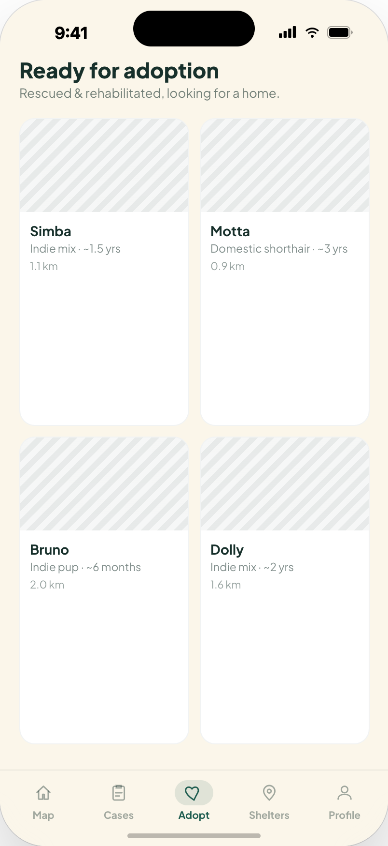
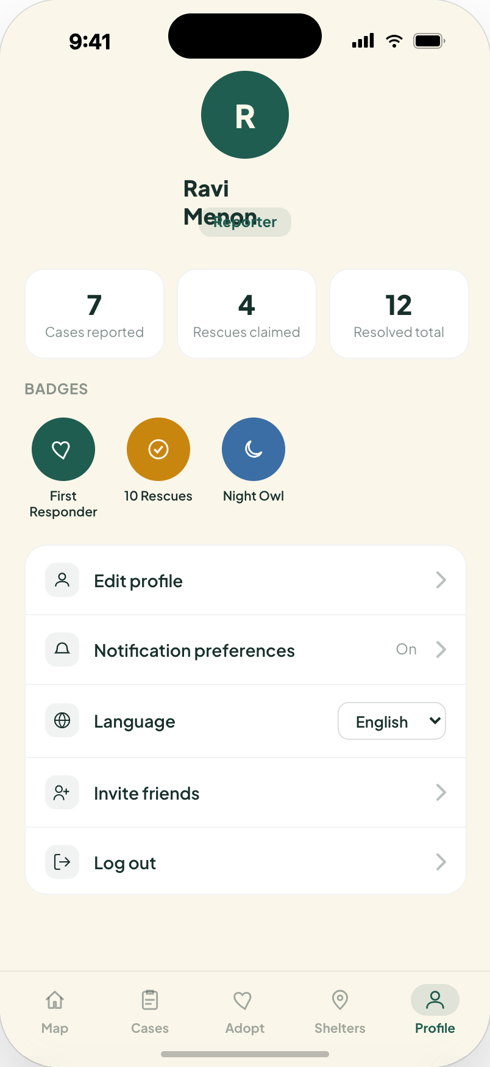
Adoption & Community
Rehabilitated animals, ready for a home.
Impact stats and badges turn rescue into a habit.
The full experience works in English, Malayalam, or Hindi.
Notes:
Rehabilitated animals are browsable for adoption, and the profile screen turns rescue into a habit with impact stats and badges, in the user's chosen language.

Slide 11
What's Next
Sterilization & Vaccination Drives
Donations for NGOs
Scheduling for community feeders and shelters.
Fund specific cases directly through the app.
Proximity Push Alerts
AI Severity Scoring
Get notified of new cases within your radius.
Auto-triage which cases need help first.
Notes:
Roadmap for phase two: sterilization and vaccination drive scheduling, donation integration for NGOs, proximity push notifications, and AI-driven severity scoring to help triage.

Slide 12
Thank You
See a stray in trouble → report in 30 seconds → nearest rescuer gets notified.
Notes:
Close on the mission and the one-line pitch.

