Slide 1
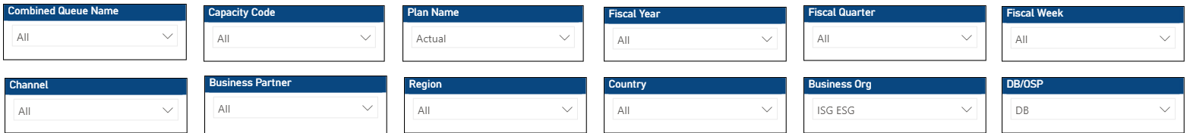
Filters
Cards
Total Queues Active and Inactive
Call Volume Offered & Handled
DB/OSP offered volume Split
Forecast Accuracy
% of CQN within +- 10 variance
Drill down while click on the Cards
List of Active queues
Column chart with offered and handled and line for handled % based on Fiscal year,qtr,month,week
Column chart with DB and OSP based on Fiscal year,qtr,month,week
Column chart with actuals and forecast and line for forecast accuracy based on Fiscal year,qtr,month,week
What is the percentage of queues with variance less than
10% variance and what are those queues
Graphs
Layer 1
Visual 1
Visual 2
Visual 3
Layer Name – Plan over Plan
Plan comparison with variance %
Region wise Plan comparison with variance %
CQN’s with highest variance %
How the visual should look? Column chart with Plan 1 and Plan 2 in columns and variance % in line based on Fiscal Year, quarter,month,week and should change according to the filters above. On the top right of the graph there should be 2 dropdown to select two different plans.
How the visual should look? Column chart with Plan 1 and Plan 2 in columns with region like EMEA,AMER,Global,APJ on x axis as default and variance % in line based on Fiscal Year, quarter,month,week(restrict only for FY25,FY26,FY27 similarly for fiscal quarter and week and should change according to the filters above.A toggle on the top right corner with region and country so when a user clicks on the country it should appear country wise plan over plan comparison.Also if the user clicks on particular region then all the countries under that region should show up as a drill down. On the top right of the graph there should be 2 dropdown to select two different plans.
How the visual should look? Column chart with Plan 1 and Plan 2 in columns with CQN name on x-axis and variance % in line based on Fiscal Year, quarter,month,week and should change according to the filters above. On the top right of the graph there should be 2 dropdown to select two different plans.

Slide 2
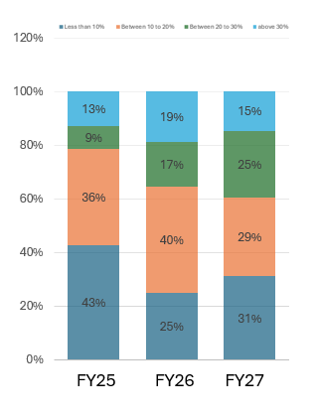
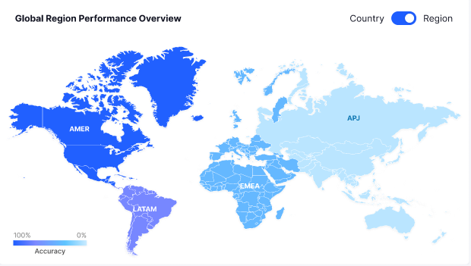
Layer 2
Visual 1
Visual 2
Visual 3
Graphs
Actual vs Plan comparison with adherence %
Region wise Plan comparison with variance %
CQN’s with highest variance %
Layer Name – Actual vs Plan
How the visual should look? Column chart with actuals and Plan in columns and adherence % in line based on Fiscal Year, quarter,month,week and should change according to the filters above.
On the top right of the graph there should be 1 dropdown to select the plans.
How the visual should look? – Exactly like this below show it at fiscal year default On the top right of the graph there should be 1 dropdown to select the plans.
How the visual should look? Column chart with Plan 1 and Plan 2 in columns with CQN name on x-axis and variance % in line based on Fiscal Year, quarter,month,week and should change according to the filters above.
Graphs
Layer 3
Geo Map
How the visual should look? Showing all the CQN,S across regions with color coding - high adherence - green color , low with red and so on. It should have toggle as well between region and country

Slide 3
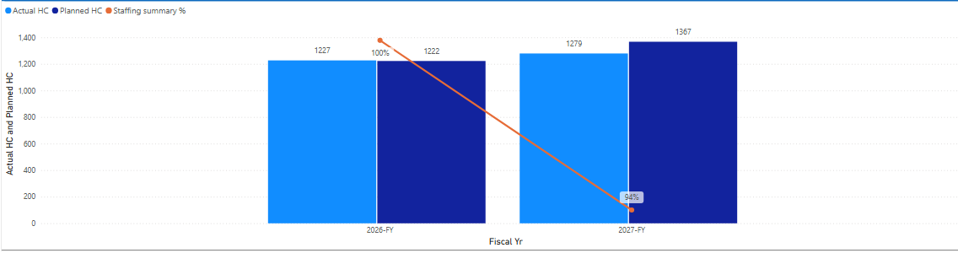
Filters
Cards
Staffing summary
Utilization %
SL %
Total FTE
Attrition %
Default View
It should show percentage –recommended % -94 and the card should change according to the filter panel above
It should show actuals % - recommended -84% and target should be shown and accordingly up down arrow with red green if actuals>target then green and vice versa
It should show actuals % - recommended -84% and target should be shown and accordingly up down arrow with red green if actuals>target then green and vice versa
It should show actuals - recommended - 3400 and plan should be shown like 3500 and accordingly up down arrow with red green if actuals>plan then red and vice versa
It should show actuals % - recommended -10% and target should be shown for example – 8% and accordingly up down arrow with red green if actuals>target then red and vice versa
Graphs
Layer 1
Actual vs Planned HC Staffing summary
Attrition
Actual vs Plan trend with SL %
Layer Name –
Headcount and SL%
How the visual should look? – Exactly like this below show it at fiscal year default and then be able to drill down to Fiscal quarter and week On the top right of the graph there should be 1 dropdown to select the plans.
How the visual should look? – It should show total employee count in column and attrition in line (attrition numbers should be very low) and employee count should be around 3000-4000 range and should be shown on Fiscal year FY25,FY26,FY27 then be able to drill down to Fiscal quarter and week . Also a region and Country toggle should be there at the right top corner
How the visual should look?
-Actual vs plan in column and sl % in line(for the queues where actual is more than plan) with the defaulter queues ascending wise should be shown on Fiscal year FY25,FY26,FY27 then be able to drill down to Fiscal quarter and week .

Slide 4
Layer 2
Plan over Plan Comparison
* Only one graph should be there in this layer it should cover the entire layer
Plan over Plan Comparison
How the visual should look?
Plan over Plan headcount comparison should be there with two dropdowns at the top right corner Named Plan A and Plan B (put in plan names like Dec Plan, Jan Plan ,April Plan –same name in both the dropdowns. Column chart should be there for Plan A and Plan B and variance % line should be there (i.e difference % between two plans). It should be shown on Fiscal year FY25,FY26,FY27 then be able to drill down to Fiscal quarter and week .
Visual 1
Visual 2
Visual 3
Layer 3
Actual vs Target Utilization
Queues with Aux culprit
Outage -Actual vs Target Leaves
Utilization
How the visual should look?
Actual and Targets in column chart and adherence % on hover highlight due to which Aux(Aux 1 to 9) utilization went down.
How the visual should look?
Actual and Targets utilization in column chart and adherence % in line and on hover highlight due to which Aux(Aux 1 to 9) utilization went down.
How the visual should look?
Actual and Targets leave in column chart (x –axis – CQN) and CQN with highest delta(actual vs plan) – should be arranged in ascending order.
How the visual should look? Showing all the CQN,S across regions with color coding – max deficit dark to light for min deficit in headcount and also SL% same conditional formatting. It should have toggle as well between region and country
Layer 4
Geo Map

Slide 5
Filters pane
ASU Actuals
SR Actuals
CPASU
Current UCR
UCR Impacted SR
Drill down while click on the Cards
* Trend line showcasing the actuals over year, quarter,month,week
* Stacked Column chart showcasing the actuals handled by DB/OSP over year, quarter, month, week
* Column and line chart combination showing SR and ASU in column while line shows CPASU number(dividing SR/ASU) over year ,quarter, month,week
* Column and line chart combination showing current UCR and Target in column while line shows adherence number(dividing current /Plan) over year ,quarter, month,week
* Stack column chart with combination of actual SR + SR deflected over over year, quarter,month,week
ASU Layer
ASU Actual vs Plan with Adherence
ASU Plan on Plan Comparison
ASU Plan Impact Analysis
How the visual should look? Column chart with actuals and Plan in columns and adherence % in line based on Fiscal Year, quarter,month,week and should change according to the filters above.
How the visual should look? Column chart with Plan 1 and Plan 2 in columns and variance % in line based on Fiscal Year, quarter,month,week and should change according to the filters above.
How the visual should look?
Graph should show in which region(AMER,EMEA,APJ) in columns and when clicked on particular regionthe LOB'S contributed to the drop should be shown.On top right corner there should be two options to select Plan namely Plan A and Plan B.So basically the graph should look like two columns for Plan A and Plan B and then these three regions in x-axis.
Read the dashboard and give AI generated RCA and there CLCA based on RCA in simple words
RCA & CLCA
SR Layer
How the visual should look?
Graph should show in which region(AMER,EMEA,APJ) in columns and when clicked on particular regionthe LOB'S contributed to the drop should be shown.On top right corner there should be two options to select Plan namely Plan A and Plan B.So basically the graph should look like two columns for Plan A and Plan B and then these three regions in x-axis.
SR Plan Impact Analysis
ASU Actual vs Plan with Adherence
SR Plan on Plan Comparison
How the visual should look? Column chart with actuals and Plan in columns and adherence % in line based on Fiscal Year, quarter,month,week and should change according to the filters above.
How the visual should look? Column chart with Plan 1 and Plan 2 in columns and variance % in line based on Fiscal Year, quarter,month,week and should change according to the filters above.

Slide 6
Layer 3
ASU impact on SR Trend with CPASU
UCR Impact on SR
UCR runrate with target
Layer name- ASU impact on SR Trend
How the visual should look?
ASU and SR actuals in column chart and CPASU(SR/ASU) in line chart based on Fiscal Year, quarter,month,week(restrict only for FY25,FY26,FY27 similarly for fiscal quarter and week and should change according to the filters above.A toggle on the top right corner with region and country so when a user clicks on the country it should appear country wise
How the visual should look?
SR (Total SR’s and SR’s handled by Bots) so basically for example if there are 10 total SR and if 4 are handled by BOTS it should show that distribution in single column and in another column, it should show SR plan. based on Fiscal Year, quarter,month,week(restrict only for FY25,FY26,FY27 similarly for fiscal quarter and week and should change according to the filters above
How the visual should look?
It should show the UCR runrate(actauls )and target in % and should be able to show what all CQN are not adhering to target based on Fiscal Year, quarter,month,week(restrict only for FY25,FY26,FY27 similarly for fiscal quarter and week and should change according to the filters above
Layer 4
Showing all the LOB'S across regions with color coding - high adherence - green color , low with red and so on
Geo Map

Slide 7


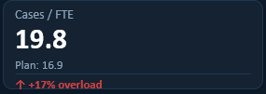
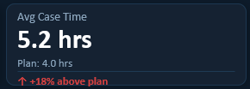

Filters
Cards
Graphs
Layer 1
Actual vs Plan Summary
Attrition
Actual vs Plan utilization
Layer Name – Headcount and Attrition
How the visual should look? – Exactly like this below show it at fiscal year default and then be able to drill down to Fiscal quarter and week
How the visual should look? – It should show total employee count and attrition in line chart(attrition numbers should be very low) and employee count should be around 3000-4000 range and should be shown on Fiscal year FY25,FY26,FY27 then be able to drill down to Fiscal quarter and week . Also a region and Country toggle should be there at the right top corner
How the visual should look? – It should show actual and planned utilization in column chart and adherence(actuals vs plan) in line chart should be shown on Fiscal year FY25,FY26,FY27 then be able to drill down to Fiscal quarter and week Also a region and Country toggle should be there at the right top corner

Slide 8
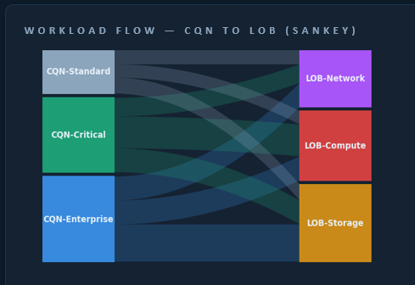
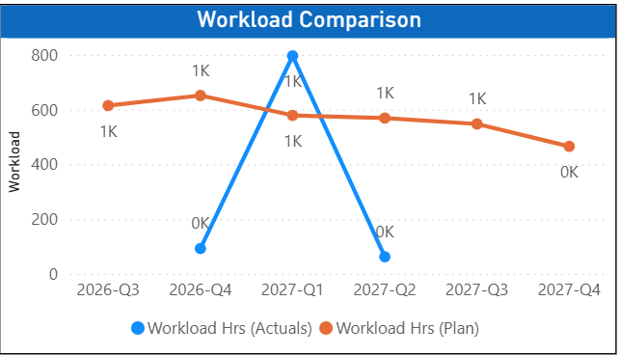
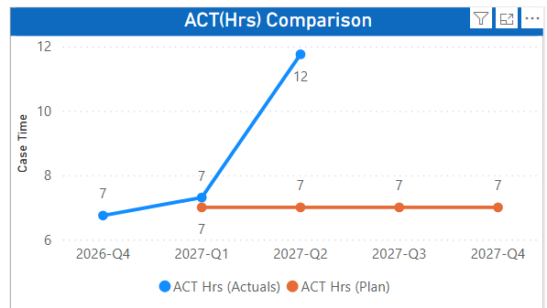
Layer 2
Plan over Plan Comparison
* Only one graph should be there in this layer it should cover the entire layer
Plan over Plan Comparison
How the visual should look?
Plan over Plan headcount comparison should be there with two dropdowns at the top right corner Named Plan A and Plan B (put in plan names like Dec Plan, Jan Plan ,April Plan –same name in both the dropdowns. Column chart should be there for Plan A and Plan B and variance % line should be there (i.e difference % between two plans). It should be shown on Fiscal year FY25,FY26,FY27 then be able to drill down to Fiscal quarter and week .
Layer 3
Distribution - LOB to CQN and CQN to LOB
Workload act vs plan
ACT Trend with actual and plan comparison
Workload distribution
How the visual should look? – Exactly like this below show it at fiscal year default and then be able to drill down to Fiscal quarter and week
How the visual should look? – Exactly like this below show it at fiscal year default and then be able to drill down to Fiscal quarter and week.
How the visual should look? – Exactly like this below show it at fiscal year default and then be able to drill down to Fiscal quarter and week.

Slide 9
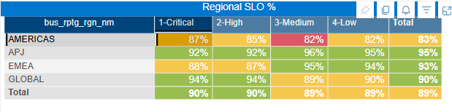
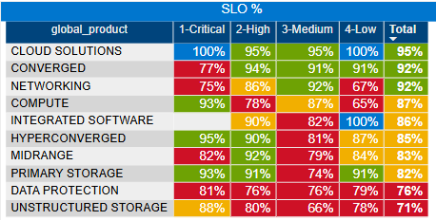
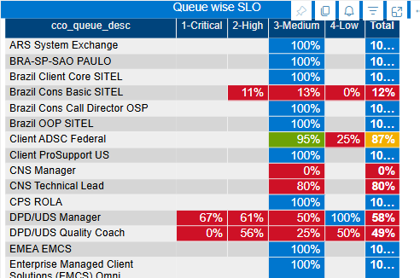
Layer 4
SLO Region Wise Heatmap
SLO Product Wise Heatmap
SLO CQN Wise Heatmap
SLO Trend
How the visual should look? – Exactly like this below show it at fiscal year default and then be able to drill down to Fiscal quarter and week
How the visual should look? – Exactly like this below show it at fiscal year default and then be able to drill down to Fiscal quarter and week c
How the visual should look? – Exactly like this below show it at fiscal year default and then be able to drill down to Fiscal quarter and week c
Layer 5
Showing all the CQN'S across regions with color coding - high SLO - green color , low with red and so on
Geo Map

