Slide 1

A Vocational Training Presentation on Smart Resume Analyzer
Submitted to
DEPARTMENT OF COMPUTER SCIENCE AND ENGINEERING
Shri Shankaracharya Technical Campus
An Autonomous Institute Affiliated to
Chhattisgarh Swami Vivekanand Technical University, Bhilai (CG)
In partial fulfillment of requirement for the award of the degree of
Bachelor of Technology in
Computer Science and Engineering
Submitted by:
Hrishi Shrivastava, 301042223095
CD727

Slide 2
INTRODUCTION
The rapid expansion of digital content has made the manual verification of textual originality highly inefficient and increasingly prone to human error.
This project introduces an automated Plagiarism Detector Tool designed to instantly scan, analyze, and compare large volumes of text for duplicated content.
The core architecture relies on advanced Natural Language Processing (NLP) techniques, utilizing Python, NLTK, and scikit-learn to extract and evaluate semantic similarities.
The primary objective is to deliver a fast, accurate, and scalable solution that safeguards academic integrity and intellectual property for educators and digital creators.

Slide 3
PROBLEM STATEMENT
The Challenge: Manual resume screening is slow, biased, and inconsistent, overwhelming recruiters with massive pools of applicants.
The The Solution: An intelligent, AI-powered system designed to automate parsing, skill evaluation, and candidate matching.
Technology Stack: Leverages Natural Language Processing (NLP), Machine Learning algorithms, and robust PDF extraction tools.
The Goal: Streamline the hiring pipeline, reduce human fatigue, and provide actionable feedback to job seekers for ATS optimization.

Slide 4
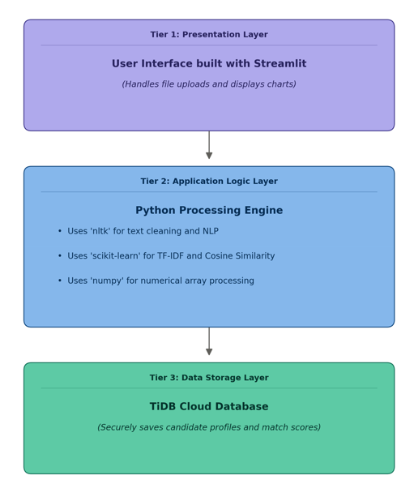
Three-Tier Architecture
Tier 1: Presentation Layer (User Interface): A highly interactive, responsive web dashboard built with Streamlit, to easily upload PDF resumes and instantly match percentages and skill gap analytics.
Tier 2: Application Layer (Business Logic): The core intelligence engine, Python backend, PDFMiner for text extraction and scikit-learn (TF-IDF and Cosine Similarity) to execute natural language processing and scoring algorithms.
Tier 3: Data Layer (Storage): A scalable TiDB cloud database that securely stores parsed candidate records, contact info, and evaluation scores.

Slide 5
REQUIREMENTS
Document Ingestion: Seamlessly accept and process unstructured PDF resume uploads..
Data Extraction: Accurately parse and extract raw text, contact information, and core competencies.
Algorithmic Evaluation: Calculate an objective compatibility score between the applicant's resume and a provided job description.
Skill Gap Analysis: Identify and display specific missing keywords or required technical skills.
Secure Storage: Safely export and manage candidate records within a cloud database infrastructure.

Slide 6
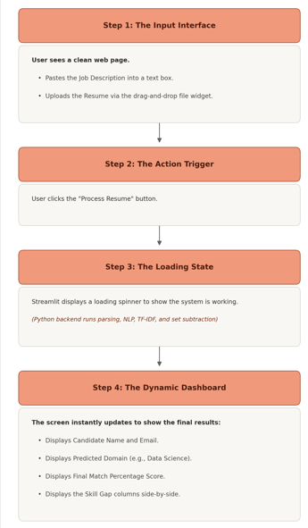
Data Extraction: Parse raw text and contact details from PDF resumes using PDFMiner and regex.
METHODOLOGY
Document Upload: User submits PDF(s) — study notes, PYQs, or textbook chapters.
Text Vectorization: Convert unstructured words into mathematical vectors using the TF-IDF algorithm.AI
Algorithmic Scoring: Calculate exact match percentages between resumes and job descriptions using Cosine Similarity.
Skill Gap Analysis: Identify missing technical skills and keywords through set subtraction.
Dashboard & Storage: Display results on a Streamlit web interface and securely log candidate data in TiDB.

Slide 7
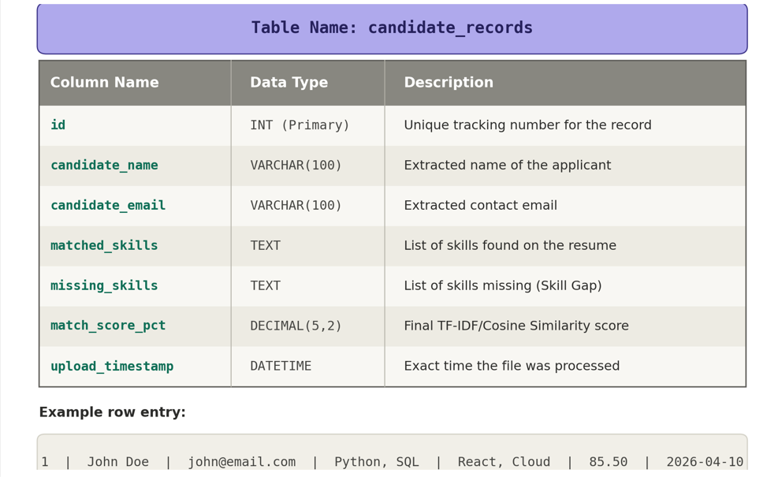
DATABASE DESIGN
Cloud Infrastructure: Powered by TiDB Cloud for scalable, secure, and distributed SQL data storage.
Relational Schemas: Structured to efficiently log applicant contact details, calculated match percentages, and extracted skill analytics.

Slide 8
OUTPUT AND RESULTS
Instant Compatibility Scoring: Generates precise, mathematical match percentages comparing candidate profiles directly against job requirements.
Automated Skill Gap Analysis: Explicitly identifies and lists critical missing keywords, allowing recruiters to see exactly where a candidate falls short.
Structured Data Extraction: Successfully isolates and standardizes contact information (emails, phone numbers) from highly unstructured PDF formats.
Streamlined Workflow: Reduces manual screening time from minutes per resume to seconds, presenting all actionable data on a single interactive dashboard.

Slide 9
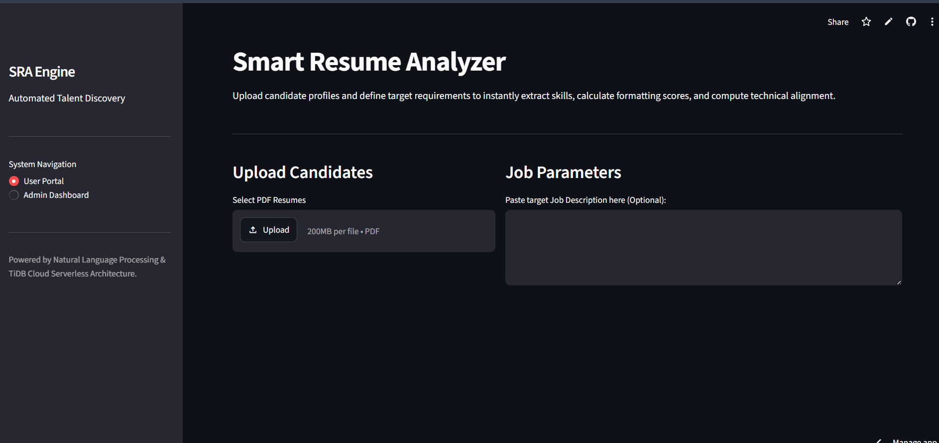
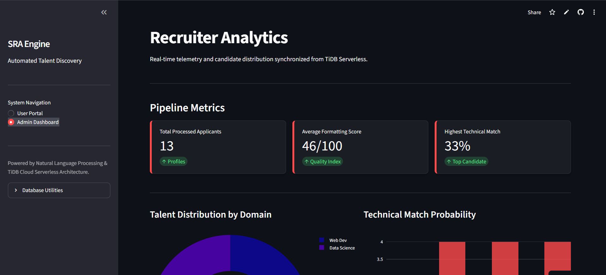
User Portal
Admin Dashboard

Slide 10
CONCLUSION & FUTURE SCOPE
CONCLUSION:
Process Optimization: Successfully automated the initial screening phase, drastically reducing recruiter fatigue and manual review time.
Objective Hiring: Minimized human bias by relying on mathematical vectorization and data-driven skill matching.
Proven Accuracy: Demonstrated the practical effectiveness of NLP techniques like TF-IDF and Cosine Similarity in evaluating unstructured text.
FUTURE SCOPE:
Advanced AI Models: Upgrading the scoring engine from TF-IDF to deep learning language models (like BERT or GPT) for deeper semantic understanding of context.
Broader File Support: Integrating Optical Character Recognition (OCR) to parse image-based resumes and expanding support for DOCX and TXT formats.
Platform Integration: Developing APIs to seamlessly plug the analyzer.

Slide 11
THANK YOU

