Slide 1
LPR Digital Activity System
Business tools for transportation services.
Presented by Hrishikesh Gadkari
January 21, 2019

Slide 2
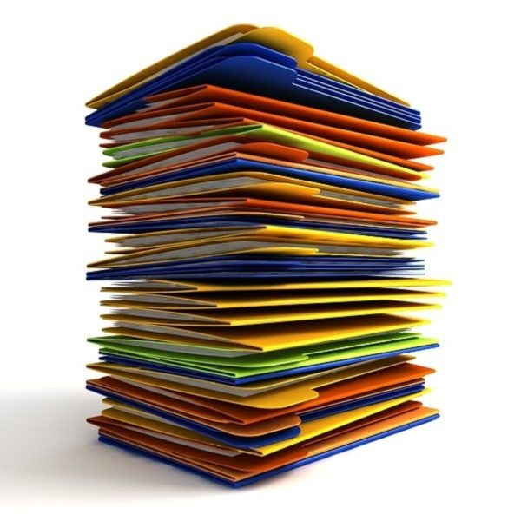
Introduction
The aim of the project is to provide business tools for LPR
LPR provides transportation services to students with special needs from home to the school and vice-versa. Our client has fleet of vehicles to provide the services.
Transition from manual work to digital tools.
Manual work
Track the rides through excel sheets
Paper work for billing system
Pile of documents with information.
Manage drivers
Track the vehicles through third party services.

Slide 3

Business Tools
Provided solution through the business Tools
Transportation system
Vehicle Tracking system

Slide 4
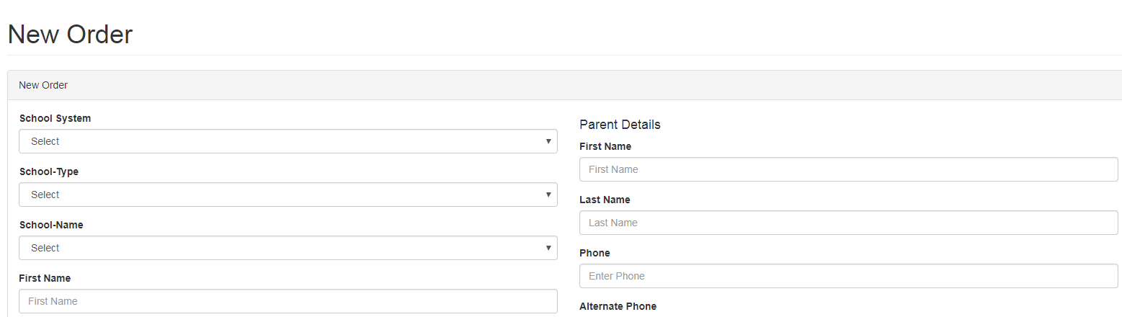
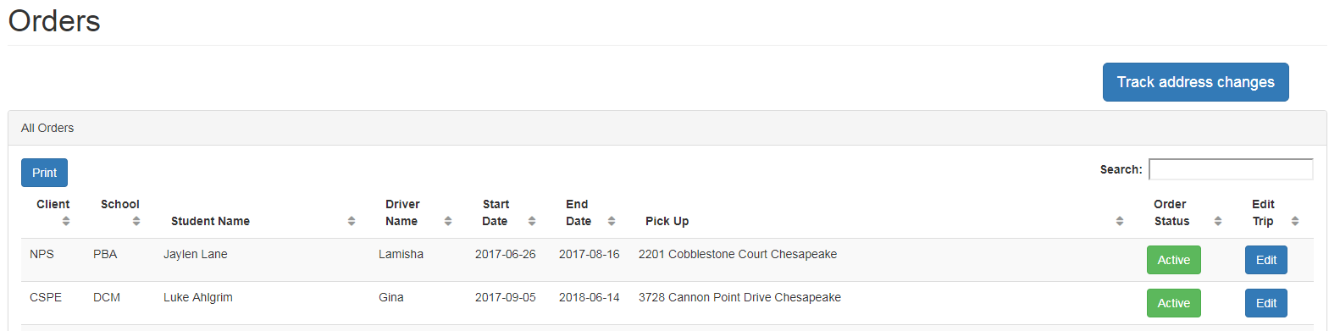
Transportation system: Create orders

Slide 5
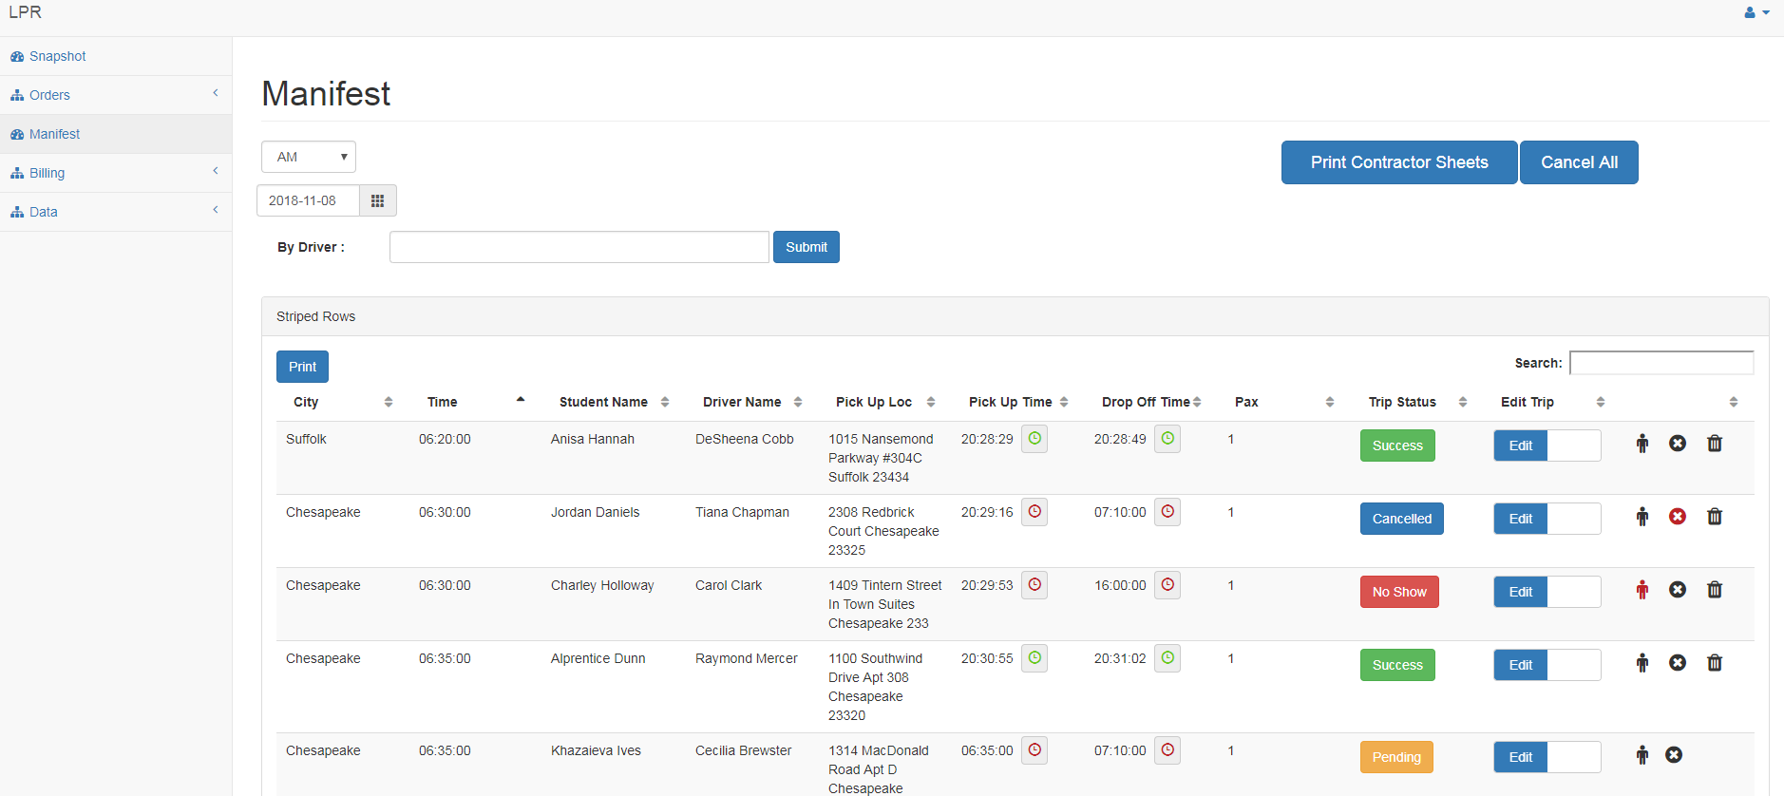
Transportation system: Track the rides

Slide 6
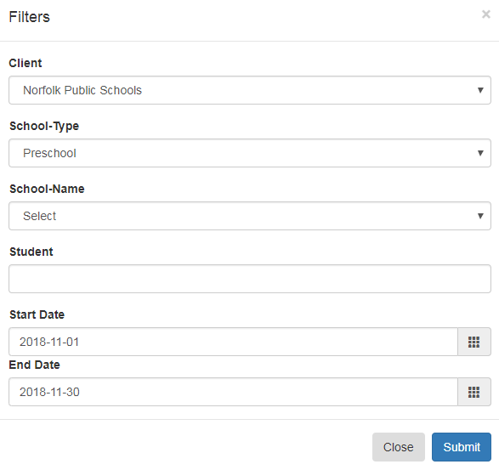
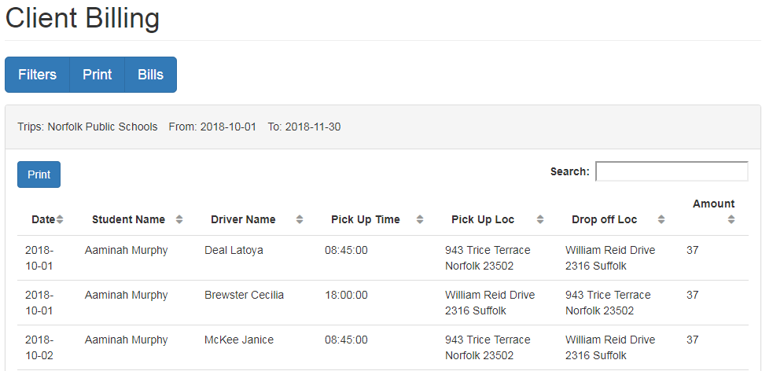
Transportation system: Billing System

Slide 7
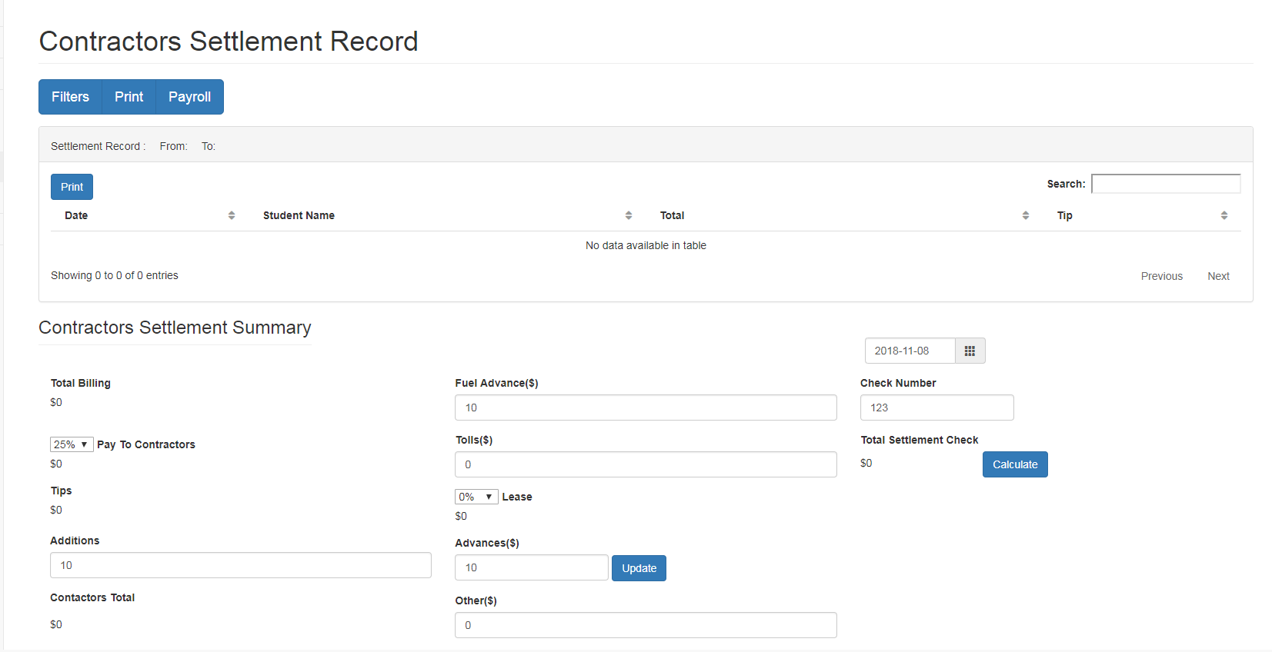
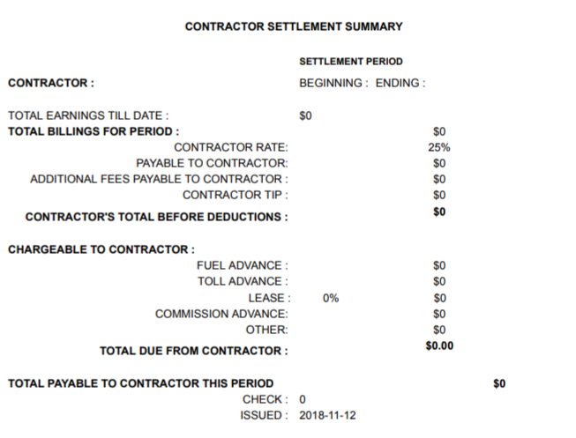
Transportation system: Billing System(Drivers)

Slide 8
Transportation system
Services
Driver management
Ride Along Management/ Billing
School Information
Statistics
Cash advance tracking system
& many more…….

Slide 9
Transportation system
Results
Track about 20,000 Rides per month.
Reduce billing time from 2 weeks to half hour
Manage 300 Active Drivers Effectively.
Manage Database of more than 300 schools
Manage Price variations.
Provide exceptional services to the clients
Expand the business : Manage 1000 Orders simultaneously.
New Job Opportunities.

Slide 10

Vacation………

Slide 11
Transportation system: Current work
Developing
Reporting system.
Analytics system.
Production support.

Slide 12
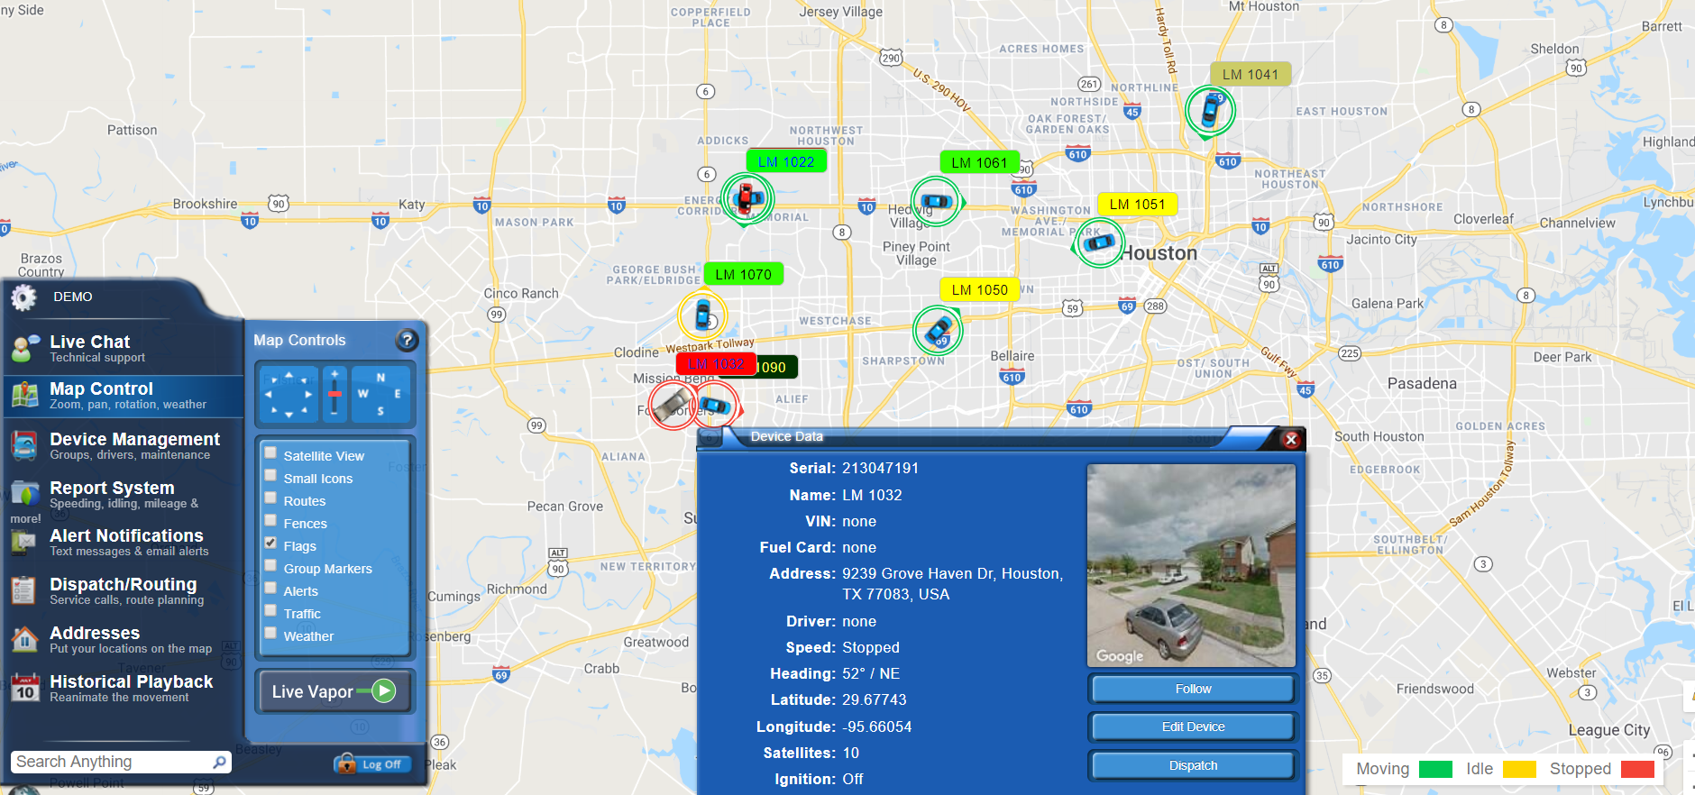
Vehicle Tracking system – New business opportunity

Slide 13
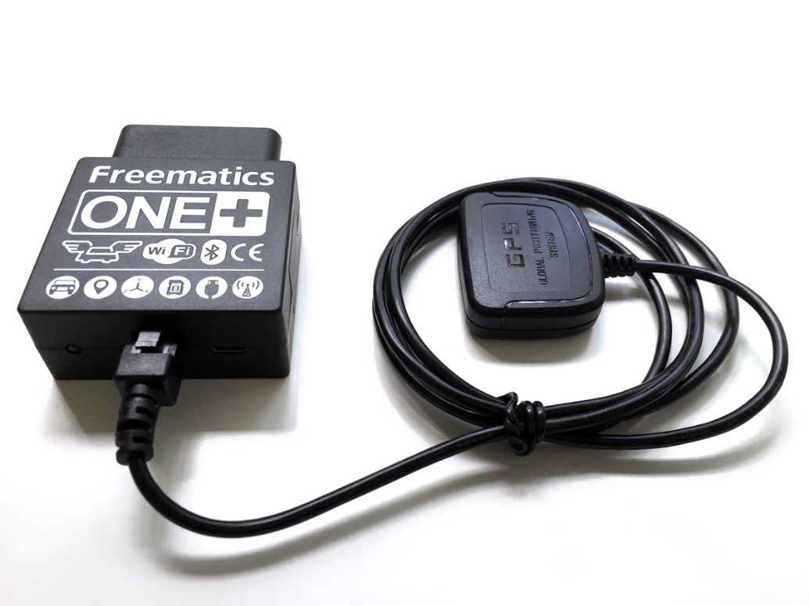
Vehicle Tracking system: Project Design
Project is divided into 3 phases
Phase 1
Customize Freematics ONE+ device
Develop server to receive and transmit the data.
Develop UI to track the service.

Slide 14
Vehicle Tracking system: Project Design
Phase 2
Test the device with vehicles.
Integration testing
Security protocols and access management
Phase 3
Commercialize

Slide 15

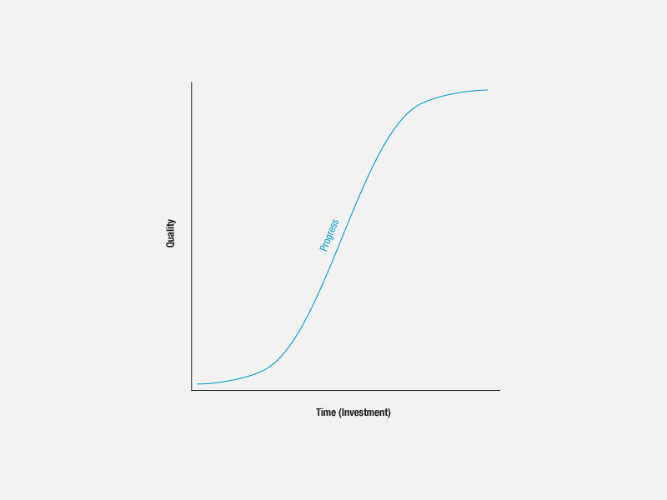



Graduate student : Learning Curve
“To master a new technology, you have to play with it”

Slide 16
Conclusion
We are developing digital solution to LPR by providing tools which will reduce the human involvement to a great extent through
Transportation system
Vehicle Tracking system

Slide 17
Thank You

