Slide 1



Personal Finance Dashboard using Power BI
A Data Analytics Project
Hrishikesh Sarma
hrishikesh2005sarma@gmail.com
linkedin.com/in/hrishikesh-sarma-67b58528a/
1

Slide 2
Project Description
Managing personal finances is often challenging without proper tracking. This project leverages Power BI to design an interactive dashboard that monitors key metrics such as income, expenses, and savings, helping users make smarter financial decisions.
2

Slide 3
Project Objectives
KPIs & Tracking → Income, Expense %, Savings %, Net Worth.
Visual Insights → Expense Breakdown, Income vs Expense Trend
Savings Focus → Allocation by type, Savings Goal (target %)
3

Slide 4
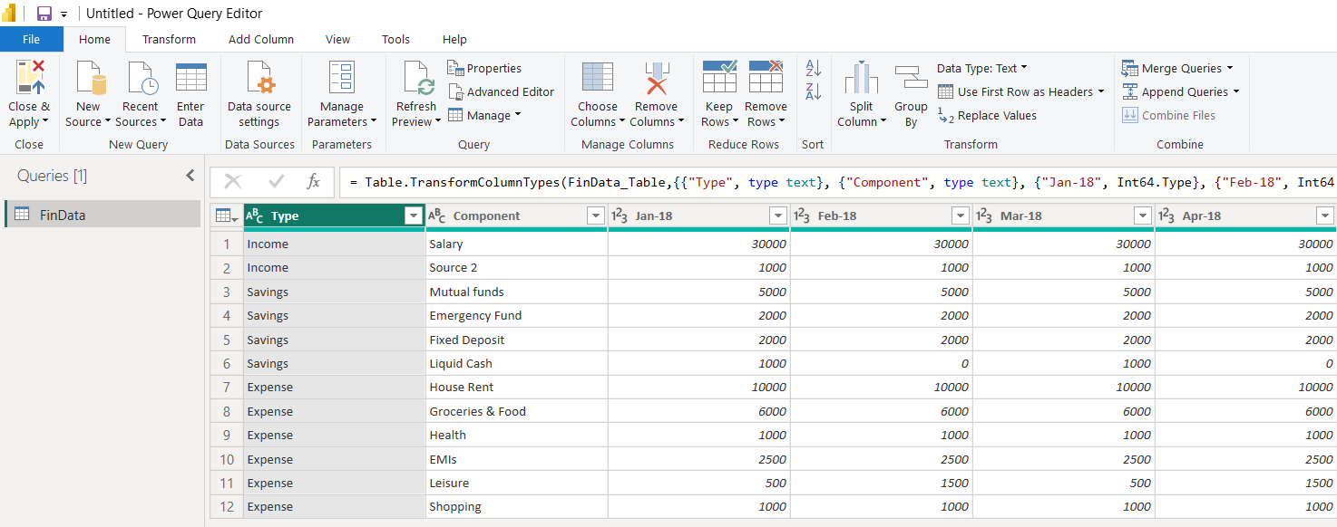
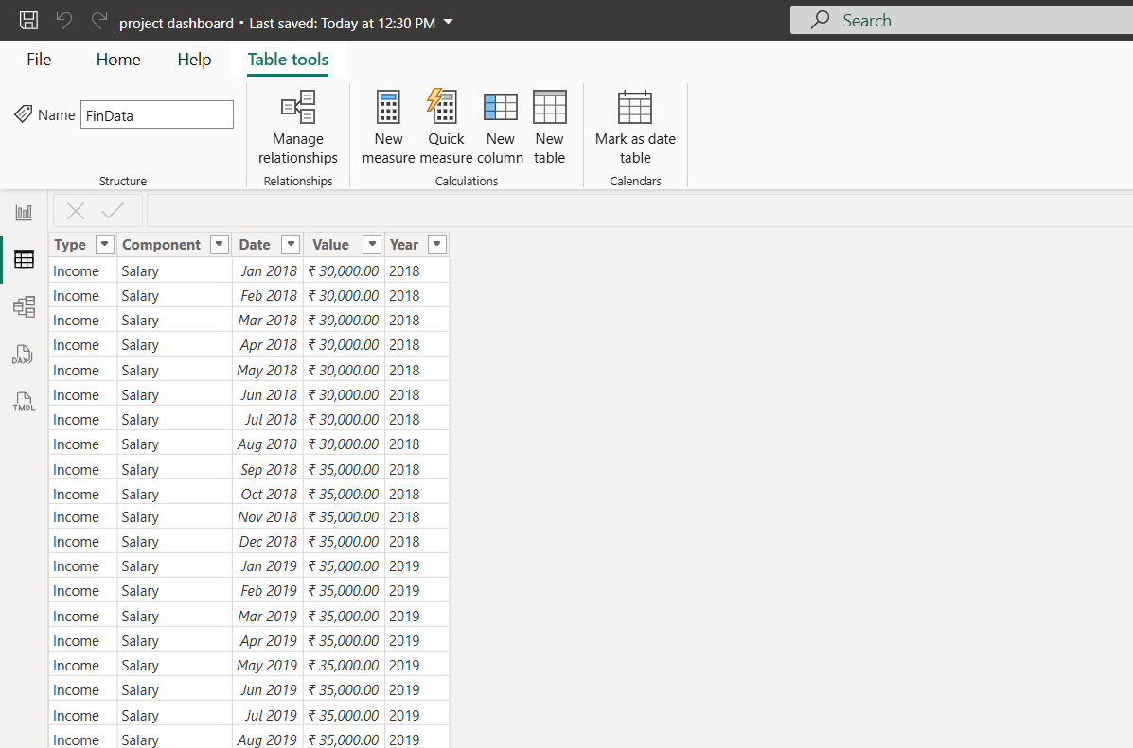
Data Transformation
The dataset initially had multiple date columns and inconsistent formats. I applied transformations in Power Query — unpivoted the date columns into a single Date column, formatted it as MMM YYYY, formatted the Value column into rupees, and created a Year column for time-based analysis. On the left is the dataset before transformation, and on the right is after.
4

Slide 5
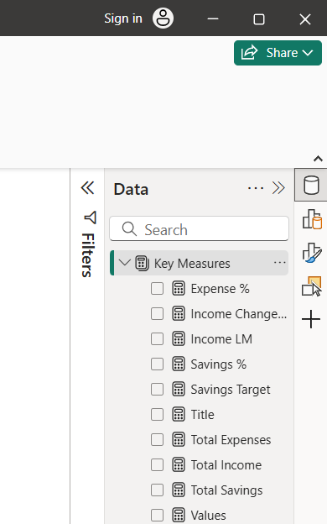
Key Measures in Power BI
Measures play a crucial role in transforming raw data into meaningful insights. In this project, DAX measures were created to calculate key financial indicators such as Total Income, Total Expense, Savings%, Expense %, and Total Savings. These measures serve as the foundation for KPIs and charts, enabling accurate trend analysis and performance tracking across time.
5

Slide 6
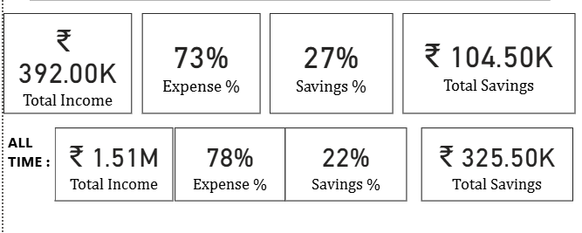
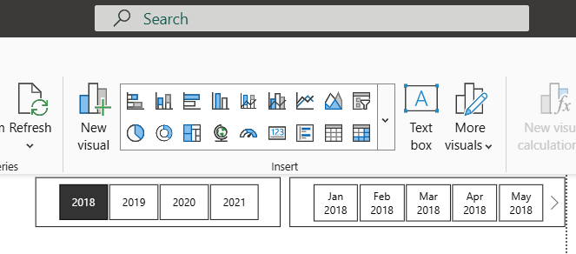
KPIs and Slicers in Dashboard
Interactive slicers (in button form) were created for Year and Month–Year selections. They enable users to filter data dynamically and analyze performance across specific time frames while comparing them with all-time totals.
The dashboard includes KPIs for Total Income, Total Savings, Expense %, and Saving %, offering a quick snapshot of financial performance. Additionally, “All Time” KPIs were added — these remain unaffected by slicers, allowing users to compare selected period values with overall totals for better context.
6

Slide 7
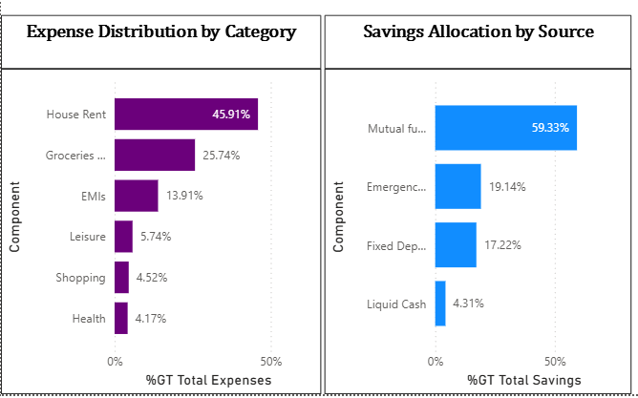
Expense and Savings Distribution
The bar charts visualize how income is distributed across expenses and savings. The Expense Distribution chart highlights major spending categories such as rent, food, and shopping, while the Savings Allocation chart shows how savings are divided across sources like bank accounts and mutual funds. These visuals help identify spending patterns and evaluate saving efficiency.
7

Slide 8
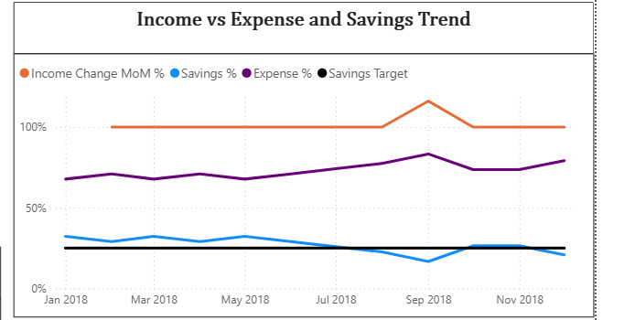
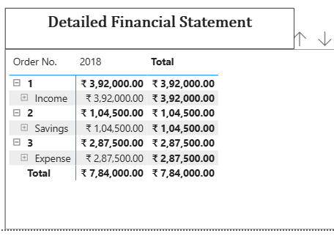
Trend Analysis and Detailed Financial Statement
The trend line chart illustrates the relationship between income, expenses, and savings over time, helping identify months of overspending or improved savings. A target line (e.g., 25% savings goal) is added to track whether the savings percentage meets the desired benchmark. The detailed financial table provides the exact figures for income, expenses, and savings, supporting the insights seen in the trend chart.
8

