Slide 1
AI PROJECT
Bingo with Bot
Name - Hrishikesh Eknath Padale
Branch - Computer
Division - II
MIS - 111803164

Slide 2
About BINGO ….
Bingo is a game of chance in which each player matches numbers printed in different arrangements on cards with the numbers the game host (caller) draws at random, marking the selected numbers with tiles. When a player finds the selected numbers are arranged on their card in a row, they call out "Bingo!" to alert all participants to a winning card, which prompts the game host (or an associate assisting the host) to examine the card for verification of the win. Players compete against one another to be the first to have a winning arrangement for the prize or jackpot.

Slide 3
1-25 BINGO
There are many versions of BINGO in different countries.
1-25 BINGO is one of those in which there are 1-25 numbers randomly arranged on a 5X5 grid/table on each player’s card.
Every player selects a number randomly and shouts out the number to all players and all of them has to mark it and this way on each turn a number is selected and cut.
Player with 5 row/column/diagonal(s) marked will win.
i.e., n(rows) + n(columns) + n(diagonals) = 5

Slide 4
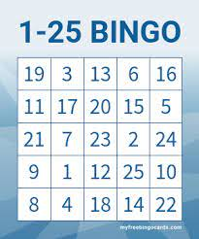

Slide 5
Algorithm
Much similar to Min-Max algorithm.
Difference is we can’t think of minimum lose as it is a completely randomized game.
A player will have to think of maximizing his win chances .
In short , the Max part of the Min-Max algorithm can be implemented.
Bot will make an optimal move.

