Slide 1
IBM APPLIED DATA SCIENCE CAPSTONE
SETTING UP A NEW VEGAN RESTAURANT IN BENGALURU, INDIA
HRISHIKESH BHANDARKAR

Slide 2
Business Problem
The restaurants have been a most profitable now a days.
City like Bengaluru always makes a top place when it comes to breakfast items like Idly, Dosa etc.
A Vegetarian restaurant makes about profitable business.
Business problem :
In a city like Bengaluru, if one wishes to open a vegetarian restaurant, which would be the best place to start ?

Slide 3
Data Description
The main data used are the list of neighborhoods in Bengaluru city and Coordinates of each.
The source data for neighborhood is : https://en.wikipedia.org/wiki/Category:Neighbourhoods_in_Bangalore
The Geocoder package to get the coordinates.
Foursquare API data for the venues

Slide 4
Methodology
Web scraping Wikipedia page for neighbourhoods list
Get latitude and longitude coordinates using Geocoder
Use Foursquare API to get venue data
Group data by neighbourhood and taking the mean of the frequency of occurrence of each venue category
Filter venue category by Vegetarian Restaurant
Perform clustering on the data by using k-means clustering
Visualize the clusters in a map using Folium

Slide 5
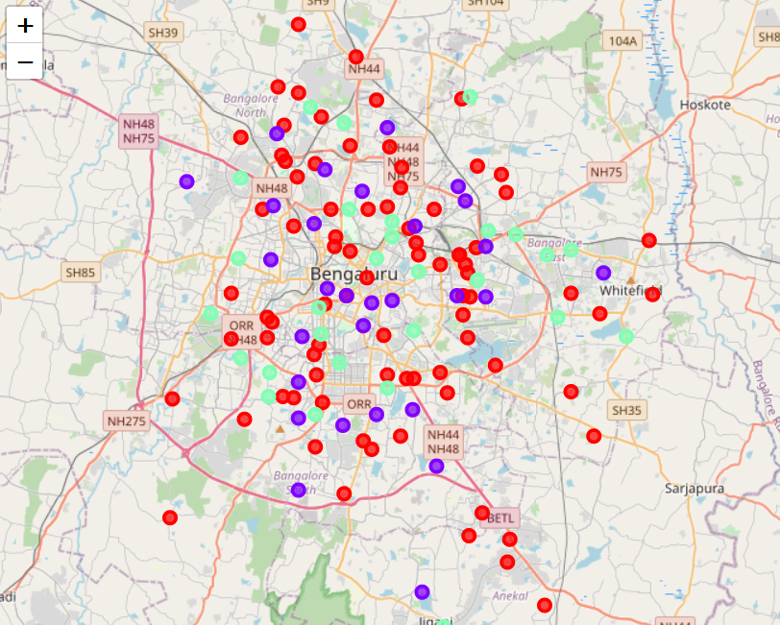
Result
categorize the neighbourhoods into 3 clusters based on the frequency of occurrence for “Vegetarian Restaurant”:
Cluster 0: Neighbourhoods with a moderate concentration of Veg. Restaurants
Cluster 1: Neighbourhoods with a very less or no concentration of Veg. Restaurants
Cluster 2: Neighbourhoods with a high concentration of Veg. Restaurants
The results of the clustering are visualized in the map below with cluster 0 in red colour, cluster 1 in purple colour, and cluster 2 in mint green colour.

Slide 6
Discussion
veg restaurants are dense in the areas come under cluster 2 which means the competition is very high
In cluster 1 , the very less means there is a chance that it would be hard to find customers in those regions
when we look for a location to open up a restaurant, it should have a little competition as it helps in keeping up the standards time to time.
Which means cluster 0 which has moderate frequency of vegan restaurant is a good place to start.

Slide 7
Recommendation
Open new restaurant in cluster 0 neighborhoods where the moderate competition is observed
Can also go with cluster 1 neighborhoods but a detailed check on population of those area must be checked.
Avoid opening up in dense and competitive area like cluster 2

Slide 8
Conclusion
For the business question, answer is : Neighborhoods in cluster 0 are most preferred followed by cluster 1
These areas can benefit the owners by gaining both customers and business depending upon how different is the restaurant from others.
Avoid over crowded areas like cluster 2

Slide 9
THANK YOU

