Slide 1
Bike Sharing Prediction system

Slide 2
Hello!
I am Hrishikesh Namboothiri V N
hrishi4musiq@gmail.com

Slide 3
Objective:
Development of a predictive model to predict possible number of bikes in demand by the customer for a particular day . The model will determine whether. a cust
Detection of upcoming demands.
Gives better insight of customers need.
Helps in easy flow for managing resources.

Slide 4
Model Training:
Data Export from Db :
The accumulated data from dB is exported in csv format for model training
Data Preprocessing
Performing EDA to get insight of data like identifying distribution , outliers ,trend among data etc.
Check for null values in the columns. If present impute the null values.
Encode the categorical values with numeric values.
Perform Min max Scalar to scale down the values.

Slide 5
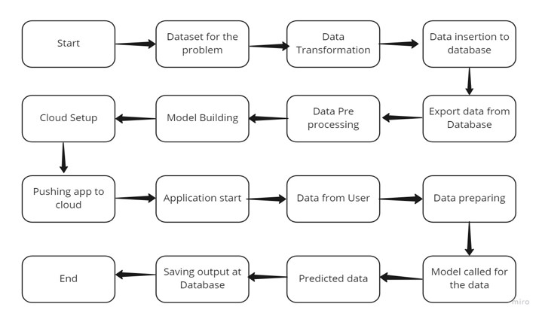
Architecture

Slide 6
Data Insertion in Database:
Table creation :- Table name “day" is created in the database named “bike_sharing” for inserting the files. If the table is already present then new files are inserted in the same table.
Insertion of files in the table - All the user given data with predicted value are inserted in the ”new_day” table in “bike_sharing” database.

Slide 7
Model Training:
Data Export from Db :
The accumulated data from db is exported in csv format for model training
Data Pre-processing
Performing EDA to get insight of data like identifying distribution , outliers ,trend among data etc.
Check for null values in the columns. If present impute the null values.
Encode the categorical values with numeric values.
Perform Standard Scalar to scale down the values.
Create different models and train all models with the dare

Slide 8
Model Selection –
After the data pre-processed, we find the best model . By using different
algorithms “Linear Regressor” ”Extra tree regressor” ”Random forest regressor” and “Decision tree regressor". For the training data the hyper tuned algorithms are used. We calculate the Accuracy scores for models and select the model with the best score. The best model saved for use in prediction.

Slide 9
Prediction:
On the new data entered we perform the same data pre-processing , scaling etc..
The model for prediction is loaded from “models” folder.
Then we perform prediction on the entered data..
The new data along with the predicted data then stored to database.

Slide 10
Q & A:
Q1) What’s the source of data?
The data for training is downloaded from UCI repository .
Q 2) What was the type of data?
The data was of numerical values, it includes both nominal and ordinal data
Q 3) What’s the complete flow you followed in this Project?
Refer slide 5th for better Understanding

Slide 11
Q 4) What techniques were you using for data pre-processing?
Removing unwanted attributes
Visualizing relation of independent variables with each other and output variables
Checking and changing Distribution of continuous values
Removing outliers
Cleaning data and imputing if null values are present.
Converting categorical data into numeric values.
Scaling the data

Slide 12
Q 5) How training was done or what models were used?
Training and validation data were divided.
The scaling was performed over training and validation data
Algorithms like Extra tree regressor , Random Forest, Decision Tree, Linear regression were used based on the accuracy final model selected and we saved that model .

Slide 13
Q 6) How Prediction was done?
The data on which prediction has to be done collected through web page inputs.
On the input data all the pre-processing and scaling techniques will be applied, then the model loaded and do prediction on the data.
Q 7) What are the different stages of deployment?
We will be deploying the application in AWS .To deploy the app to AWS, we use the git push command to push the code from local repository's master or main branch to our AWS remote.

