Slide 1
Requirement Engineering
UNIT 2

Slide 2
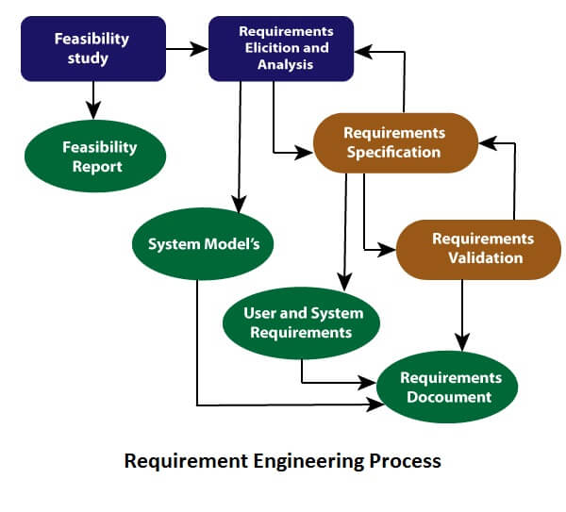

Slide 3
Types of Requirement
User requirements:-
User requirements are the statements which describes services provided by the system and the constraints under which it must operate.
These statements can be provided in natural language along with some diagrams
System requirement:-
System requirements specify the system’s functions, services and operational constraints in detail. System requirement document should define exactly what is to be implemented.
Software system requirements are often classified as functional and non-functional requirements.

Slide 4
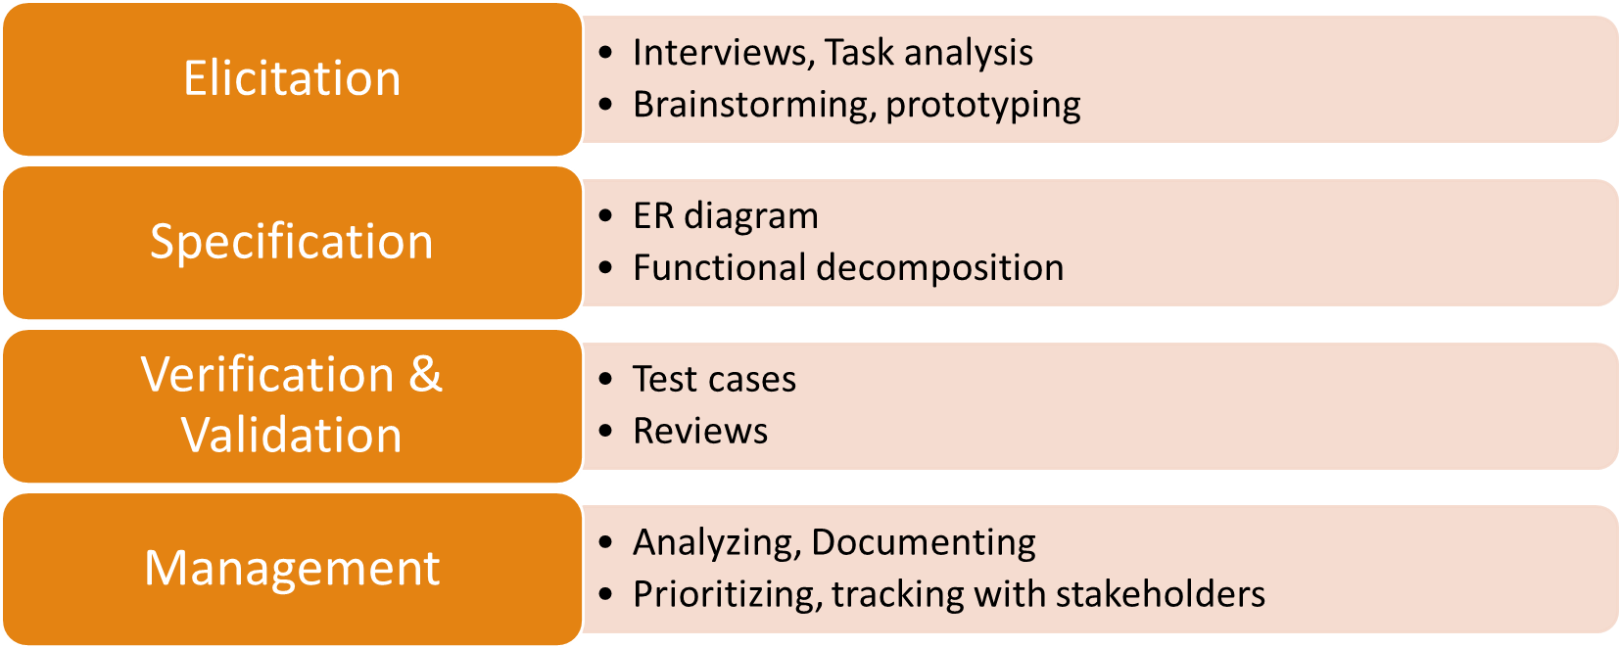
Phases of Requirement Engineering

Slide 5
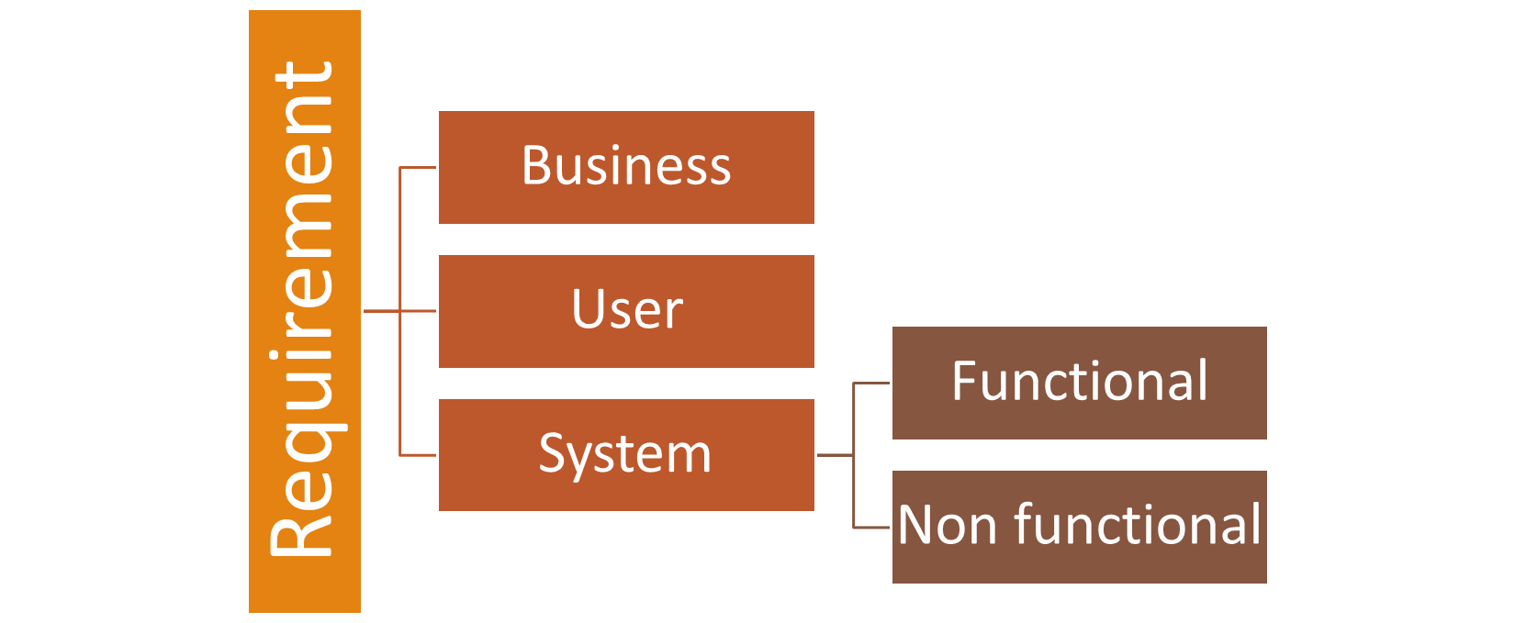

Slide 6
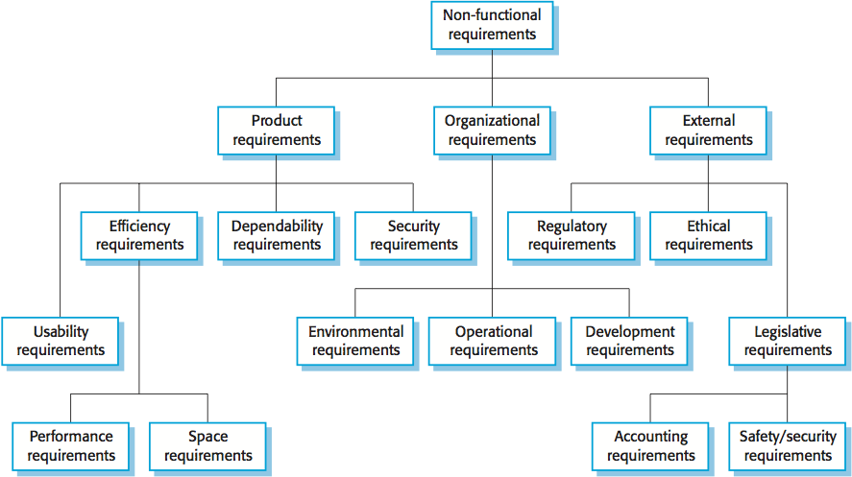

Slide 7
Software Requirement Specification

Slide 8
Features of SRS
SRS forms basis for software development.
SRS also helps clients to understand their own requirements.
It provides reference for validation of product.
High quality SRS is a prerequisite for high quality software.
High quality SRS reduces the development cost.

Slide 9
Characteristics of good SRS
Correctness
Complete
Unambiguous
Verifiable
Consistent
Ranked for importance and stability
Modifiable
Traceable

Slide 10
1. Introduction
1.1 Purpose
1.2 Document Conventions
1.3 Product Scope
1.4 References

Slide 11
2. Overall Description
2.1 Product Perspective/Product Functions
2.2 User Classes and Characteristics
2.3 Operating Environment
2.4 Design and Implementation Constraints
2.5 Assumptions and Dependencies

Slide 12
3. External Interface Requirements
3.1 User Interfaces
3.2 Hardware Interfaces
3.3 Software Interfaces
3.4 Communications Interfaces

Slide 13
4. System Features
4.1Functional Requirements

Slide 14
5. Other Nonfunctional Requirements
5.1 Performance Requirements
5.2 Safety Requirements
5.3 Security Requirements
5.4 Software Quality Attributes
5.5 Business Rules

Slide 15
6. Other Requirements
Appendix A: Glossary
Appendix B: Analysis Models

Slide 16
Case
Following activities describe a simplified process model of Loan Accounting system of a bank. Reserve Bank of India sends parameter such as Loan Limits, Interest Rates for different type of loans. Customers approach bank for loan and furnish all details. Bank scrutinizes the application and either approves or disapproves the proposals. For approved proposals the new loan account is created and loan amount is debited on that loan account. Customer pays loan installment every month and upon such payments the account is credited and the transaction is recorded. The interest is computed every month by scanning all transactions (credit) during that month. Whenever customer demands, stamen of account is given. Interest statement is given to General Manager from the interest register. New Loan Sanctioned Statement is generated every year and is submitted to RBI.
Prepare SRS (Scope, Objectives, Functional requirement and, system specifications) for above scenario.

