Slide 1
MECHANICAL VIBRATIONS (ME 531)
Professor : Santhosh.K.Dwivedy

Slide 2
1st Semester Project
Group : G-13
224103418 - Lipun Kumar Sahoo
224103220 - U Ravi Chandra
224103426 - Rishabh Saluja

Slide 3
Dynamic Analysis of Non-Traditional Vibration Absorber

Slide 4
Abstract
The Voigt-type of dynamic vibration absorber(DVA) is a classical model and has attracted considerable attention in many years because of its simple design, high reliability and useful applications in the fields of civil and Mechanical Engineering. Unlike the traditional damped absorber configuration, the Non-traditional absorber has a linear viscous damper connecting the absorber mass directly to the ground instead of the main mass. In this study, the effectiveness of NT-DVA on the attenuation of vibrations on the primary main system under harmonic load is investigated.

Slide 5
Introduction
Dynamic vibration absorber (DVA) is an auxiliary spring mass system which, when correctly tuned and attached to a vibrating system subject to harmonic excitation, causes to cease the steady state motion at the point to which it is attached. The optimal non traditional dynamic vibration absorbers (NT-DVA) suppress vibration in wide bandwidth and requires less DVAs’ stroke than traditional DVAs’. In this project, this non-traditional damped DVA is proposed to minimize the impulse response of a single degree-of-freedom system.

Slide 6
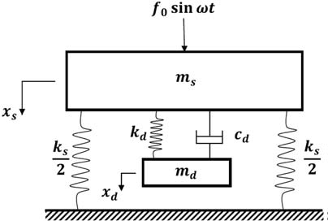
Traditional Vibration Absorber

Slide 7
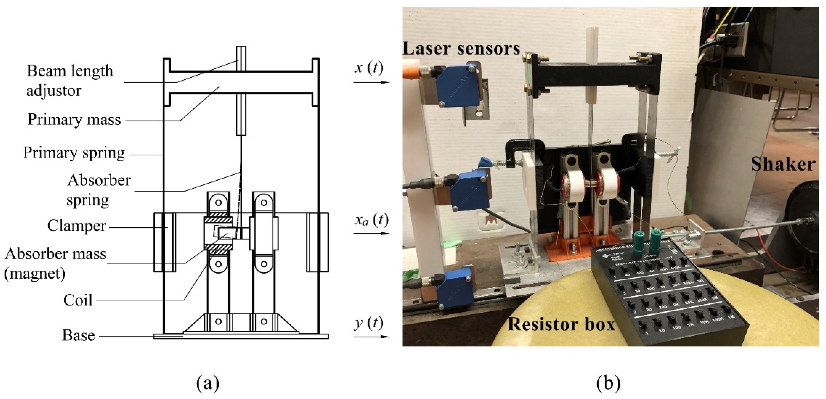
Real Life Visualisation

Slide 8
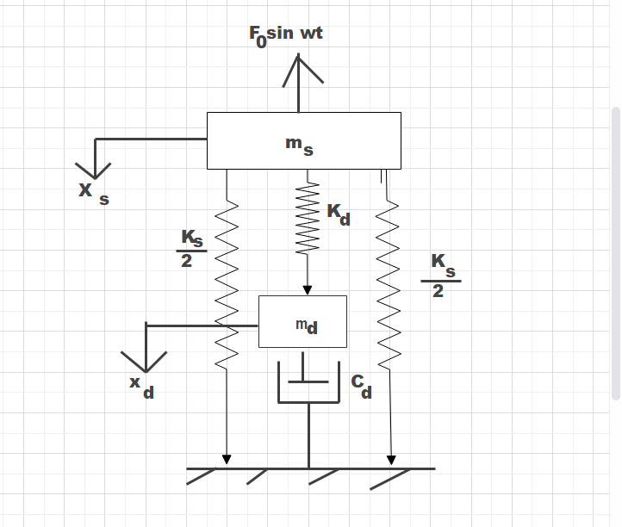
Non Traditional Vibration Absorber
Absorber mass directly connected to ground instead of the structural mass as in Traditional Vibration absorber

Slide 9
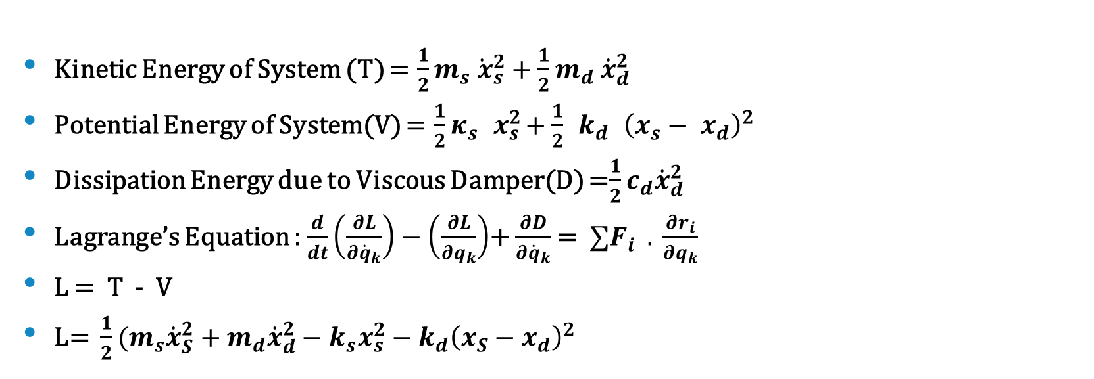
Derivation of Equation of Motion using Lagrange Method
Kinetic Energy of System (T) $=\frac{1}{2}m_{s}{\dot{ x}}_{s}^{2}+\frac{1}{2}m_{d} {\dot{x}}_{d}^{2}$
Potential Energy of System(V) $=\frac{1}{2}κ_{s}{ x}_{s}^{2}+\frac{1}{2}{ k}_{ⅆ} {\left(x_{s}− x_{ⅆ}\right)}^{2}$
Dissipation Energy due to Viscous Damper(D) =$\frac{1}{2}c_{d}{\dot{x}}_{d}^{2}$
Lagrange’s Equation : $\frac{ⅆ}{ⅆt}\left(\frac{∂L}{∂{\dot{q}}_{k}}\right)−\left(\frac{∂L}{∂q_{k}}\right)$+ $\frac{∂D}{∂{\dot{q}}_{k}}$= $∑F_{i} . \frac{∂r_{i}}{∂q_{k}}$
L = T - V
L= $\frac{1}{2}(m_{s}{\dot{x}}_{S}^{2}+m_{d}{\dot{x}}_{d}^{2}−k_{s}x_{s}^{2}−k_{d}{\left(x_{S}−x_{d}\right)}^{2}$

Slide 10
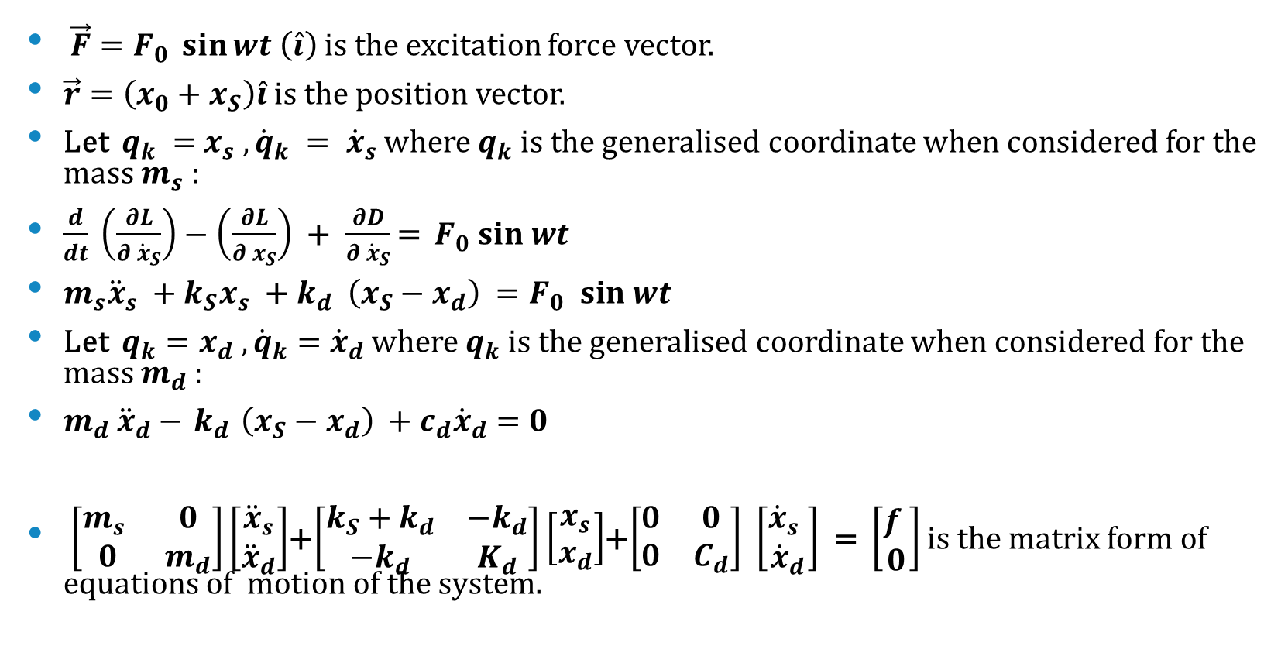
$\vec{F}=F_{0} \sin{wt \left(\hat{i}\right)}$ is the excitation force vector.
$\vec{r}=\left(x_{0}+x_{S}\right)\hat{i}$ is the position vector.
Let $q_{k} ={ x}_{s} ,{\dot{q}}_{k} = {\dot{x}}_{s}$ where $q_{k}$is the generalised coordinate when considered for the mass $m_{s}$ :
$\frac{ⅆ}{ⅆt} \left(\frac{∂L}{∂ {\dot{x}}_{S}}\right)−\left(\frac{∂L}{∂ x_{S}}\right)$+$\frac{∂D}{∂ {\dot{x}}_{S}}$= $F_{0} sin wt$
$m_{s}{\ddot{x}}_{s} +k_{S}x_{s}$ +${ k}_{d} {\left(x_{S}−x_{d}\right)}^{ }=F_{0} sin wt$
Let $q_{k}=x_{d} ,{\dot{q}}_{k}={\dot{x}}_{d}$ where $q_{k}$is the generalised coordinate when considered for the mass $m_{d}$ :
$m_{d}$ ${\ddot{x}}_{d}−{ k}_{d} {\left(x_{S}−x_{d}\right)}^{ }+c_{d}{\dot{x}}_{d}=0$
$\left[\begin{matrix}m_{s} & 0 \\ 0 & m_{d}\end{matrix}\right]\left[\begin{aligned}{\ddot{x}}_{s} \\ {\ddot{x}}_{d}\end{aligned}\right]$+$\left[\begin{matrix}k_{S}+k_{d} & −k_{d} \\ −k_{d} & K_{d}\end{matrix}\right]$ $\left[\begin{aligned}x_{s} \\ x_{d}\end{aligned}\right]$+$\left[\begin{matrix}0 & 0 \\ 0 & C_{d}\end{matrix}\right]$ $\left[\begin{aligned}{\dot{x}}_{s} \\ {\dot{x}}_{d}\end{aligned}\right]$ = $\left[\begin{aligned}f \\ 0\end{aligned}\right]$ is the matrix form of equations of motion of the system.
Eq. (1)
Eq. (2)

Slide 11
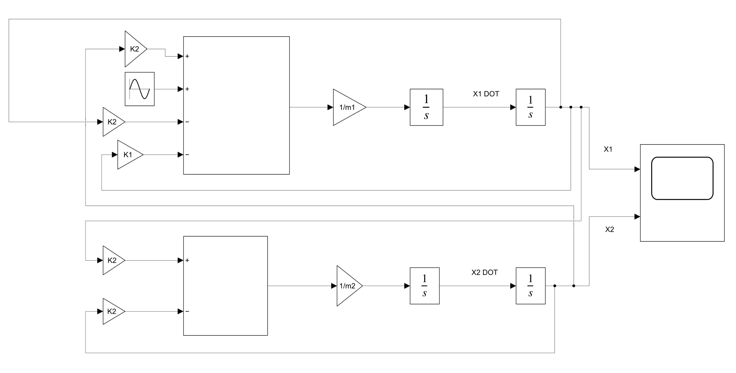
Simulink model for Traditional Vibration Absorber

Slide 12
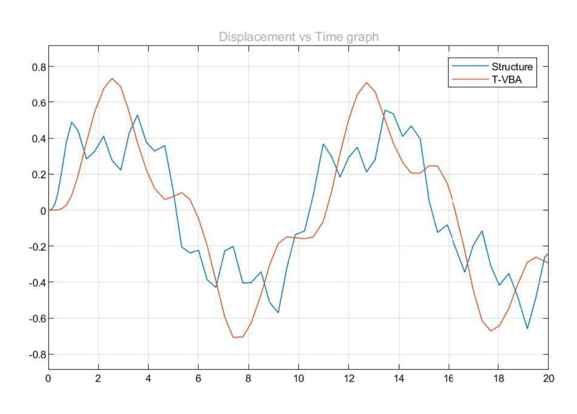
T-VBA Disp Vs Time Plot

Slide 13
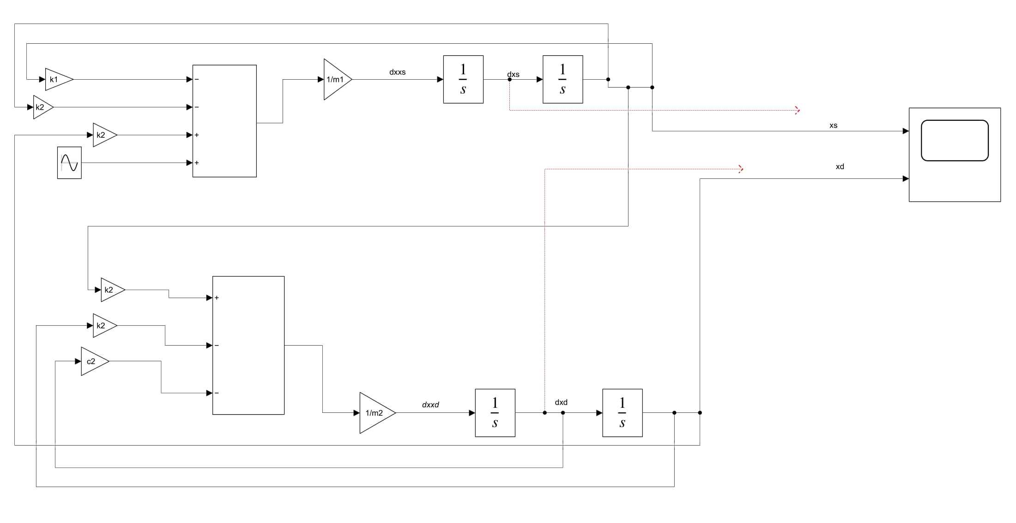
Simulink model for Non-Traditional Vibration Absorber

Slide 14
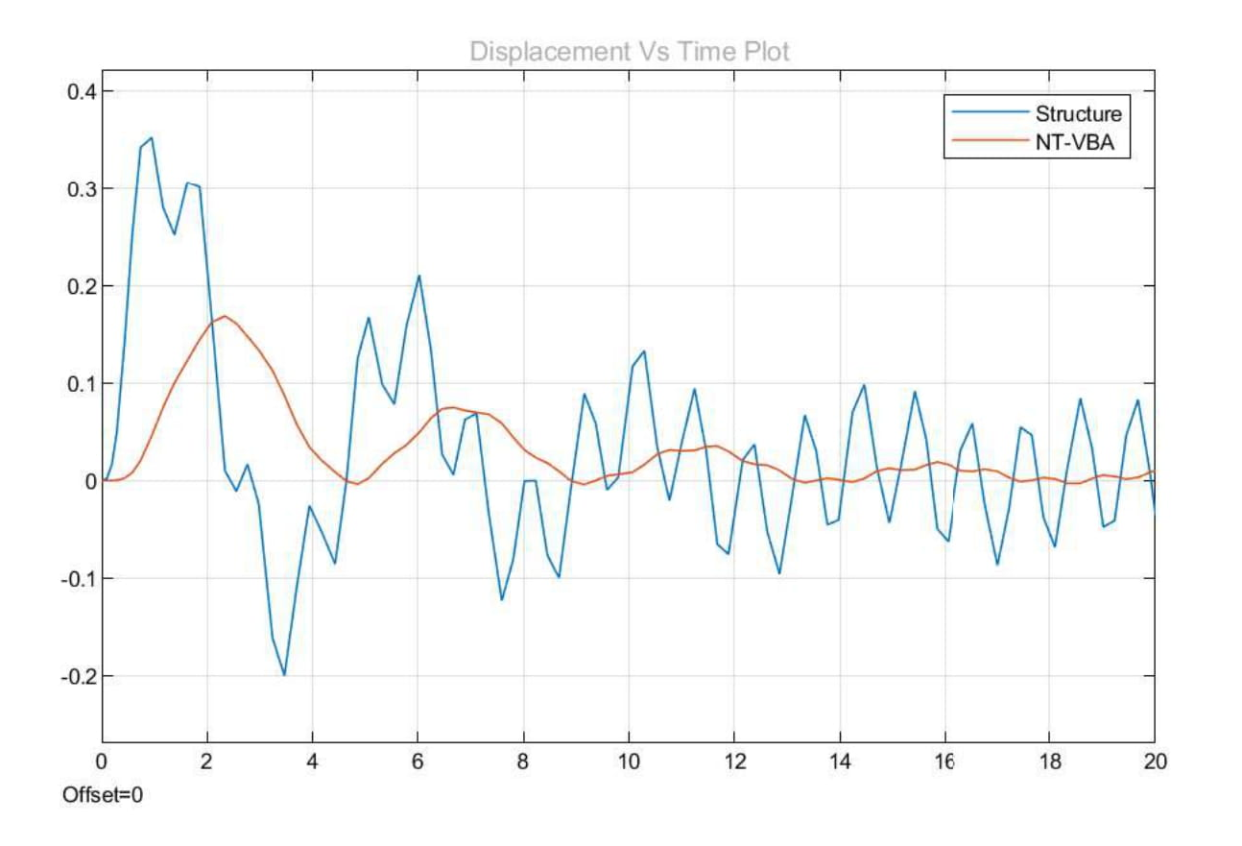
NT-VBA Disp Vs Time Plot

Slide 15
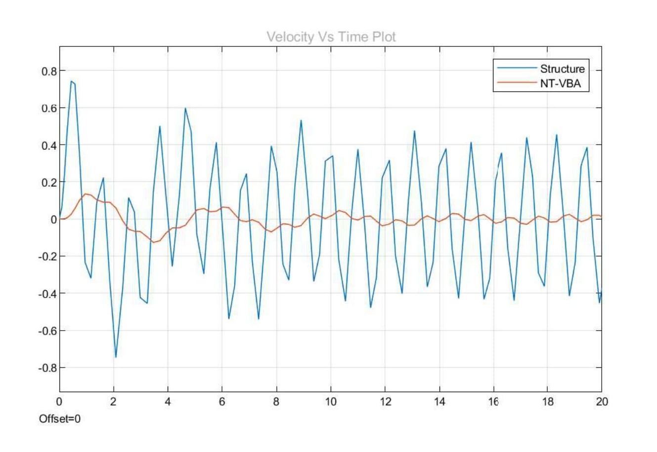
NT-VBA Velocity Vs Time Plot

Slide 16
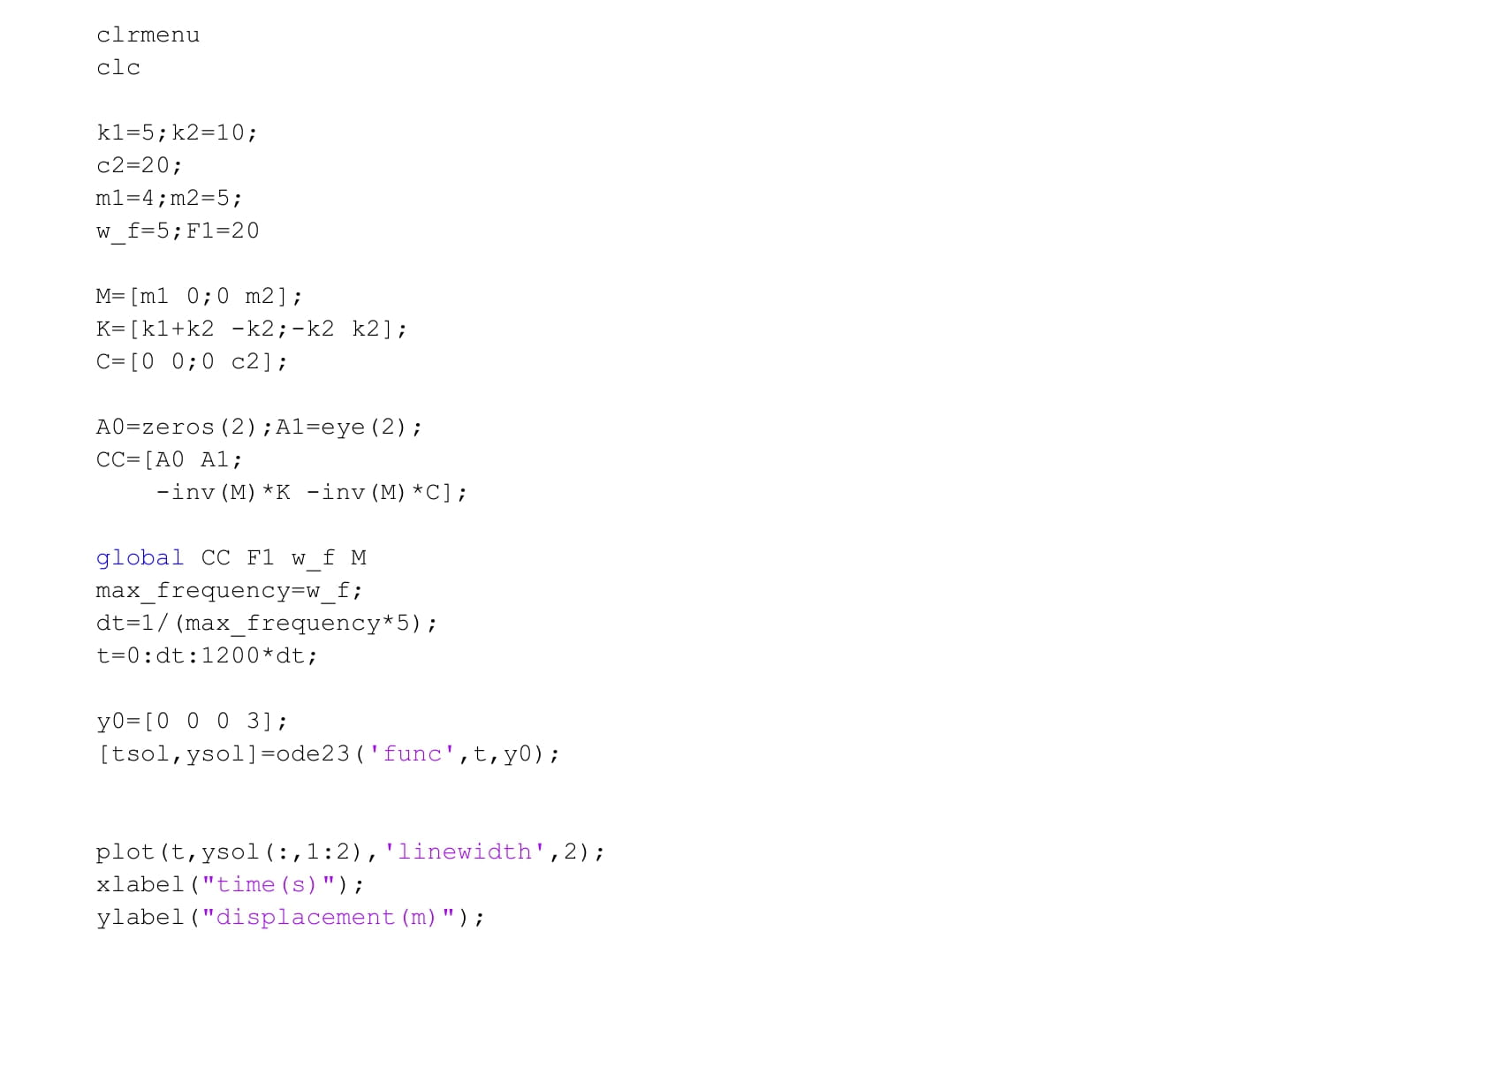
MATLAB code for Non-Traditional Vibration Absorber

Slide 17
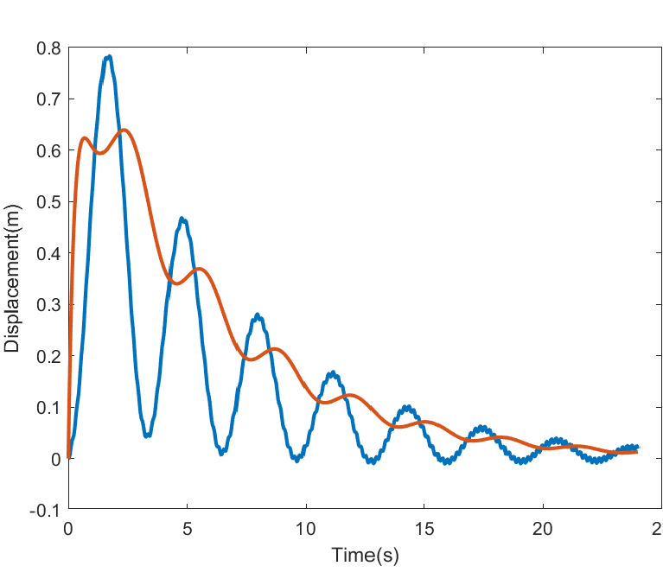
NT-VBA Disp Vs Time Plot through MATLAB

Slide 18
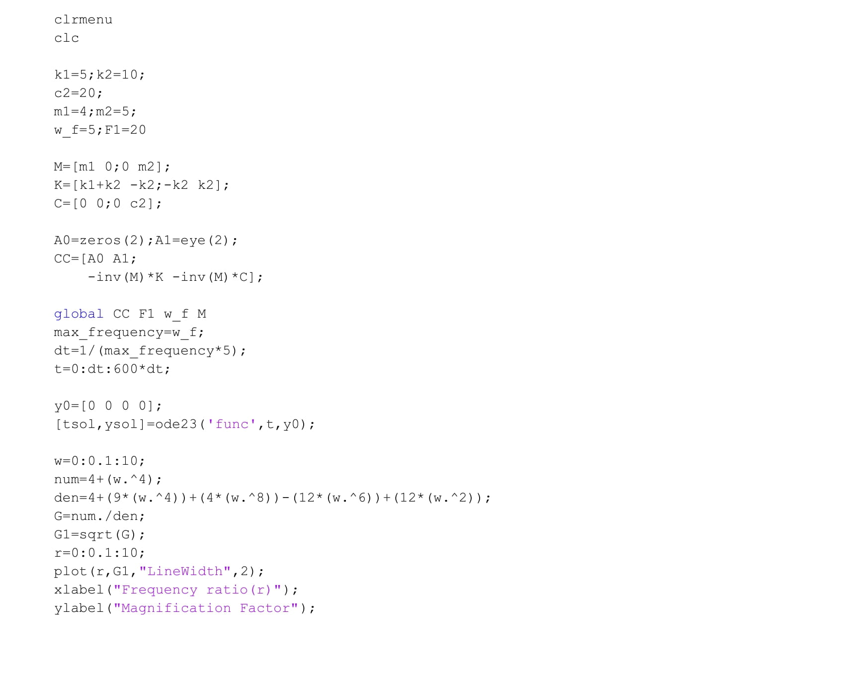
MATLAB code for Non-Traditional Vibration Absorber

Slide 19
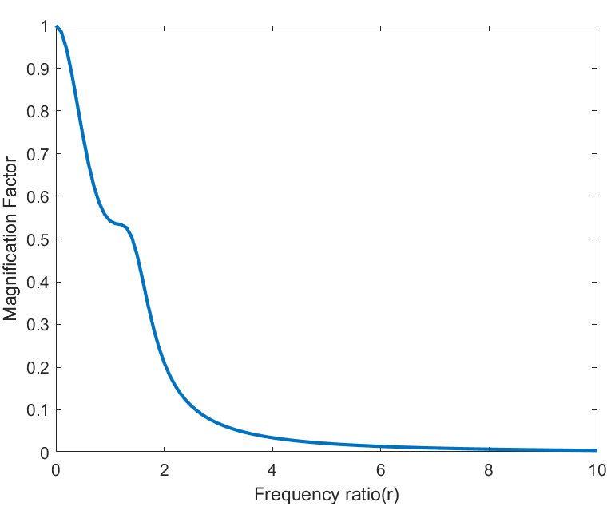
NT-VBA MF Vs Frequency Ratio Plot

Slide 20
Files for reference
Traditional Vibration Absorber :
Simulink Models :
Non Traditional Vibration Absorber :
Simulink Models :
MATLAB Codes :

Slide 21
Journals (References)
1. Frahm H. Device for damped vibration of bodies. US Patent 989958, 30 October 1909.
2.Design of a non-traditional dynamic vibration absorber…The Journal of the Acoustical Society of America 126, 564 (2009) By Y. L. Cheung and W. O. Wong
3.Design of non-traditional dynamic vibration absorber for damped linear structures
By N. Anh, Nx Nguyen,Published 1 January 2014, Proceedings of the Institution of Mechanical Engineers, Part C: Journal of Mechanical Engineering Science.

Slide 22
Conclusion
A number of numerical analyses are carried out to investigate the effectiveness of non-traditional DVAs attached to a damped main structure due to harmonic excitation. The conclusions can be summarized as follows:
1.The optimum values obtained for NT-DVA are greater than those obtained for DVA.
2. The increase in the mass ratio increases the tuning ratio of NT-DVA while decreases the tuning ratio of DVA.
3. The increase in the mass ratio causes the damping ratios of both control devices to increase.

