Slide 1
krISHIKA ai Agent for smart farming advice
CAPSTONE PROJECT
Presented By:
Hrishita Dey Purkayastha
MVJ College of Engineering
Department of Computer Science and Engineering

Slide 2
OUTLINE
Problem Statement
Proposed System/Solution
System Development Approach (Technology Used)
Algorithm & Deployment
Result (Output Images)
Conclusion
Future Scope
References

Slide 3
Problem Statement
Small-scale farmers lack access to localized, real-time agricultural advice.
Existing solutions are often not multilingual or region-specific.
Traditional sources are outdated, unstructured, or difficult to access.
Language and literacy barriers limit the adoption of smart farming tools.
There's a need for AI-driven, easily accessible, farmer-friendly guidance.

Slide 4
Proposed Solution
The proposed AI Agent aims to bridge the gap between farmers and expert agricultural knowledge using IBM Watson’s powerful machine learning capabilities. It enables intelligent interactions by retrieving and presenting relevant farming guidance in a conversational manner. The system consists of the following components:
Data Collection:
Curated a domain-specific dataset (farming.txt) covering crops, weather, soil, and pest-related knowledge.
Focused on real-time farming problems and multilingual adaptability.
Data Preprocessing:
Cleaned and formatted text data for ingestion by Watsonx Agent.
Removed noise, standardized formats, and ensured clarity for better retrieval and generation.
AI Agent Implementation:
Used IBM Watsonx Assistant with RAG (Retrieval Augmented Generation) architecture.
Enables contextual responses by combining prompt-tuning and document indexing.
Supports multilingual queries (e.g., English, Hindi, Bengali).
Deployment:
Deployed the model in IBM Watsonx Cloud environment.
Accessible via multiple programming environments: curl, Python, Java, JavaScript, and Scala.
Deployment includes IAM token-based authentication with public and private endpoints.
Evaluation :
Real-world testing with sample farming queries.
Verified multilingual support and contextual relevance.
Easily adaptable for mobile/web frontend integration.

Slide 5
System Approach
Platform: IBM WatsonX (AI Agent + Deployment Space)
Backend: Auto-generated WatsonX runtime (Python 3.11)
RAG integration: Uploading domain-specific farming.txt corpus for smarter responses
Asset Types: AI services deployed as public APIs
Snippet APIs: Supported in multiple languages for scalable integration
Versioning: IBM’s runtime-24.1-py3.11
Documentation & Export: GitHub repository with all code snippets and deployment steps

Slide 6
Algorithm & Deployment
Algorithm Approach:
Utilizes LLM-based agent hosted on IBM WatsonX platform.
Augmented using RAG by uploading farming knowledge documents.
Trained dynamically with cloud context and optimized for multilingual understanding (English, Hindi, Bengali).
Deployment Steps:
Create a deployment space on IBM WatsonX.
Create an AI agent.
Integrate RAG by uploading domain documents.
Deploy the agent.
Use generated public API with authentication.
Reference api_snippet_* files for multi-language integration.

Slide 7
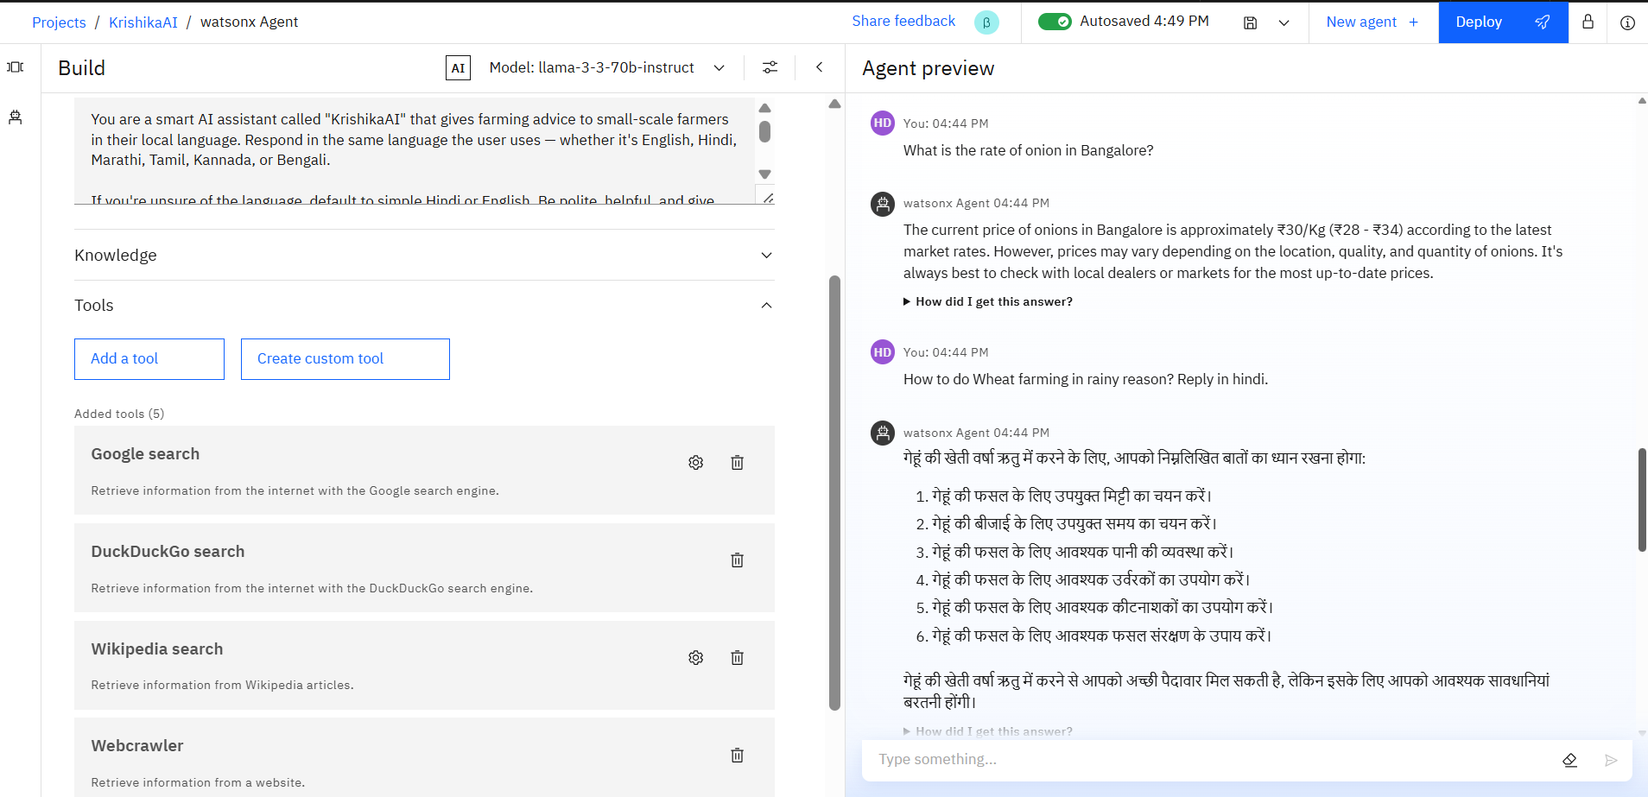
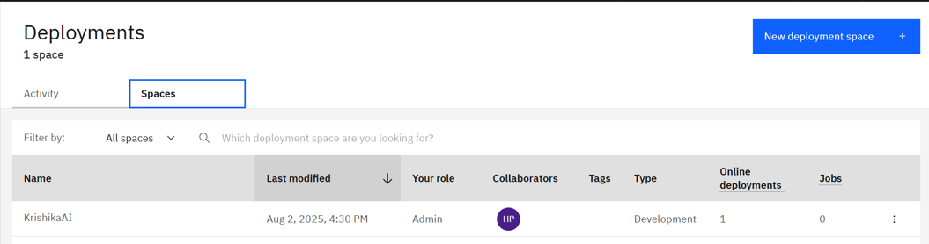
Result
https://github.com/Hrishita007/KrishikaAI.git

Slide 8
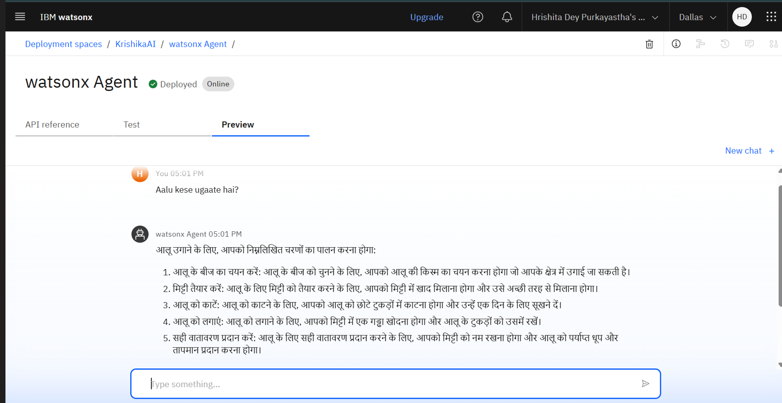
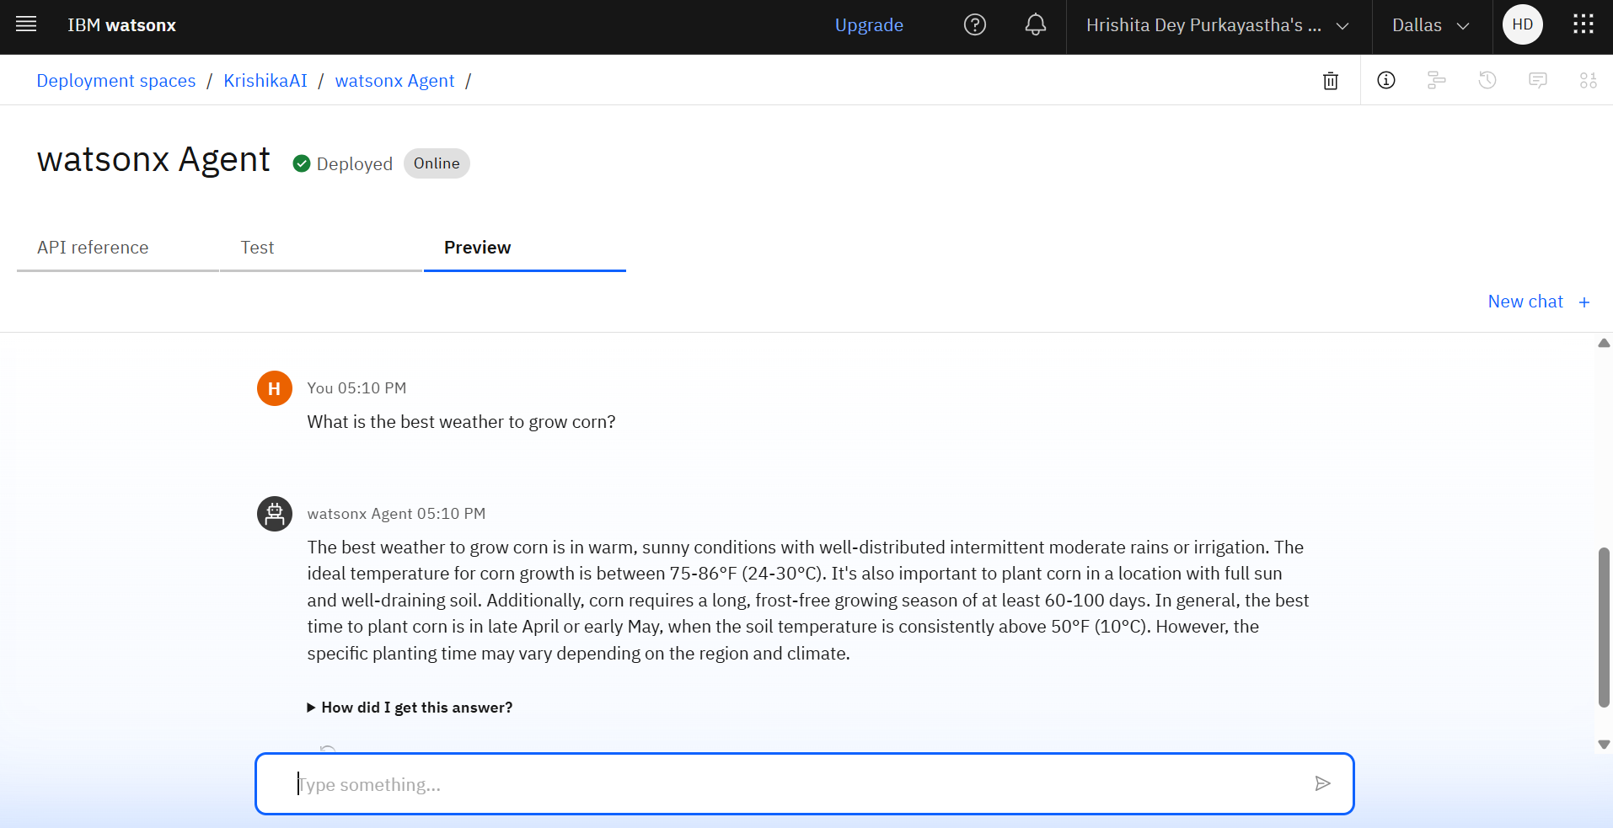
Result

Slide 9
Conclusion
The AI agent provided accurate, real-time farming advice using Watsonx and RAG.
It supported multilingual queries and could answer location-specific crop and market questions.
Faced challenges like limited customization in IBM Lite tier and RAG data formatting issues.
Improvements include adding voice support, expanding knowledge base, and connecting to live APIs.
The solution shows strong potential to empower rural farmers with accessible, smart agriculture tools.

Slide 10
Future scope
Expand Data Sources: Integrate live APIs from Agmarknet, IMD (weather), and local agri-departments for real-time mandi rates, rainfall, and soil updates.
Algorithm Optimization: Enhance response quality with fine-tuning, feedback loops, and advanced LLM prompt engineering for more accurate and contextual replies.
Regional Expansion: Scale the agent to support farmers across multiple Indian states with local dialect and crop-based customization.
Advanced ML Techniques: Incorporate transformer-based models or hybrid ML pipelines for better intent recognition and context handling.
Edge + Offline Support: Leverage edge computing for offline access in low-connectivity areas, ensuring continuous support to rural farmers.

Slide 11
References
IBM Watsonx Documentation –
https://www.ibm.com/cloud/watsonx
IBM Developer Guide: Building RAG-based Agents –
https://developer.ibm.com/articles/what-is-rag/
Agmarknet – Ministry of Agriculture & Farmers Welfare (for mandi data structure) –
https://agmarknet.gov.in
Research Paper:
“Retrieval-Augmented Generation for Knowledge-Intensive NLP Tasks” Lewis et al., arXiv:2005.11401
https://arxiv.org/abs/2005.11401
IBM Cloud Tutorials and Lite Tier API Deployment –
https://cloud.ibm.com/docs
Chatbot Design Best Practices for Multilingual Systems – ACM Computing Surveys, Vol. 53, No. 1, Article 2, 2021
https://www.researchgate.net/publication/323149920_Chatbots_and_conversational_agents_A_bibliometric_analysis

Slide 12
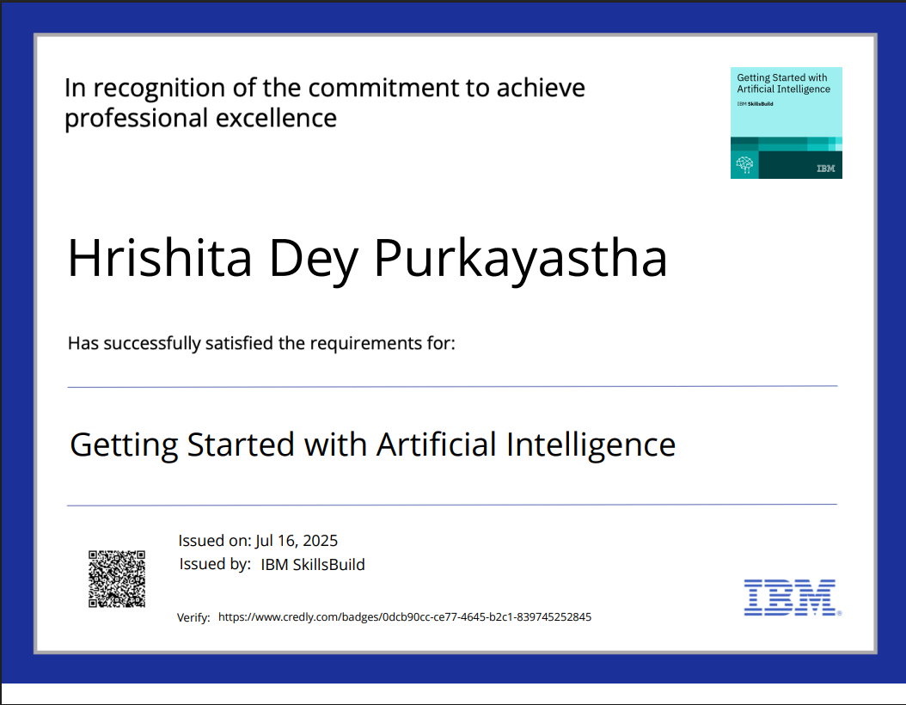
IBM Certifications
Screenshot/ credly certificate( getting started with AI)

Slide 13
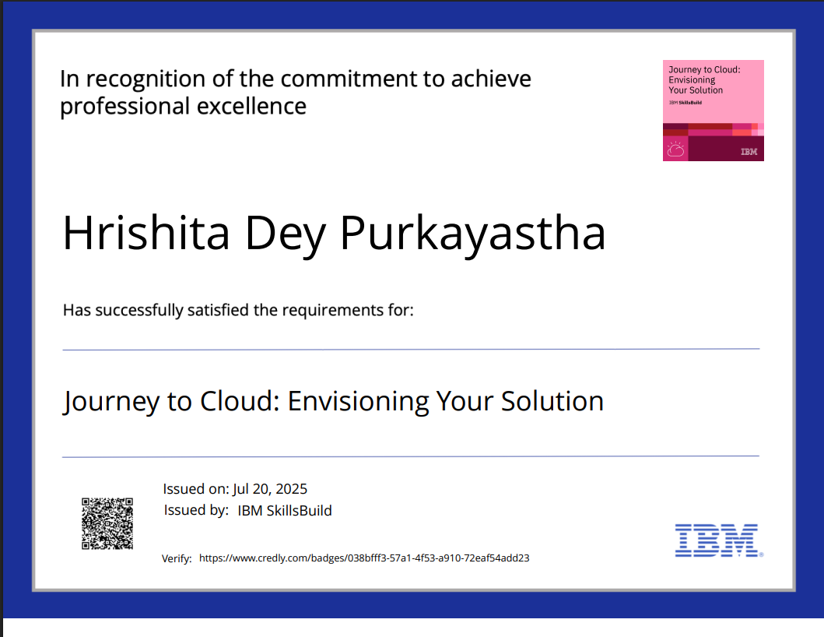
IBM Certifications
Screenshot/ credly certificate( Journey to Cloud)

Slide 14
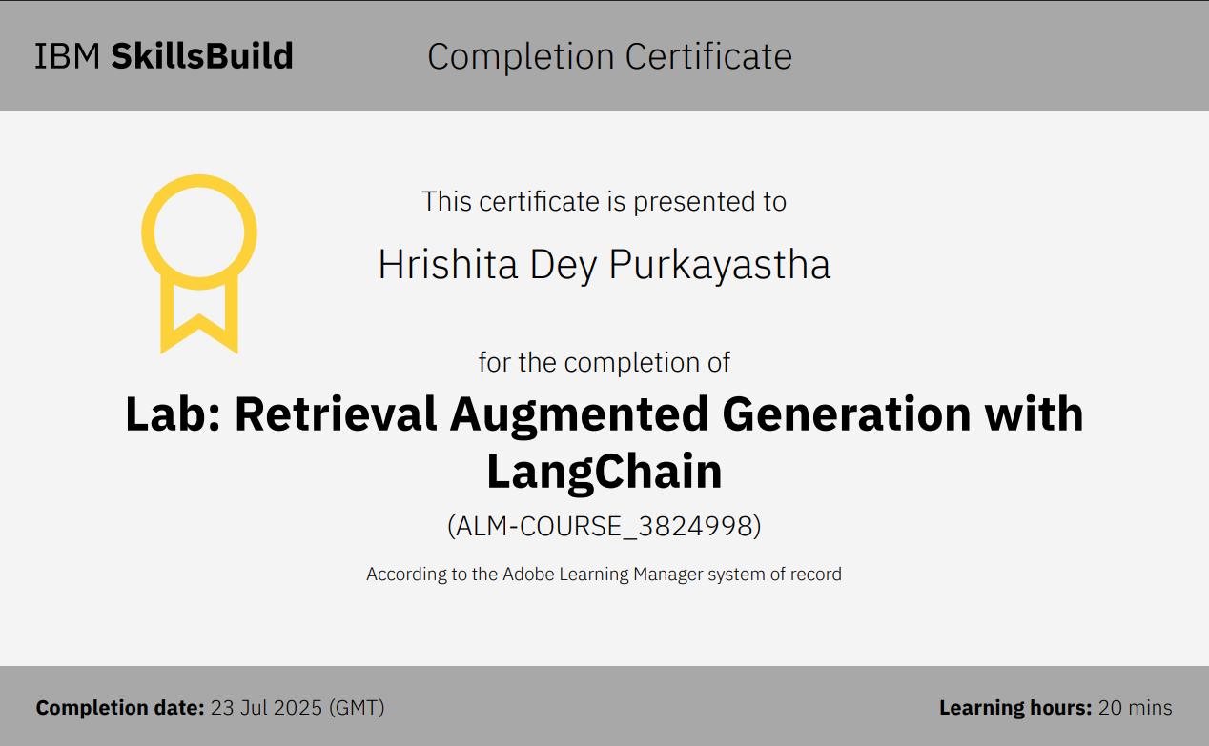
IBM Certifications
Screenshot/ credly certificate( RAG Lab)

Slide 15
THANK YOU

