Slide 1


Carolina Accounting & Tax Solutions Offsite Training
Business Tax Organizer
PER 13 Financials, Review Checklist & Business Questionnaire
Less chaos. More checkmarks.
Bijal Khatiwala
October 2, 2026

Slide 2




Business Tax Organizer – Bijal
Agenda
01
02
03
04
Review Purpose and Use of Biz Tax Organizer
Requesting Biz Tax Information from Client
Biz Organizer Letter & Customization, Attachments
Fixed Asset Considerations – Capitalize vs. Expense
Review Sample Questions
Per 13 Checklist – Overview

Slide 3
List of Documents Required for Tax return:
Signed & Completed Business Tax Questionnaire
1
Supporting documents
7
Completed Per 13 Review checklist for 2026
2
Loan statements with ending balance as of Dec 31st, 2026
Supplemental information completed – If accrual based or Home Office deduction
Fixed Asset DGL, Asset Purchase docs, Asset Disposal Information.
Out of pocket expenses emails/spreadsheet if any.
Mileage information, if any.
Prior year’s Financials tied out with 2026 Balance sheet
3
Annual Reports (either filed by us or client)
Even if tax extensions are filed, Annual Reports are still due by April 15, 2027
4
1099’s issued & W-2’s issued
5
2026 Financials – Complete & Final (Meaning no suspense A/C items & Loans tied out)
6
Maintain records of where we are with the client during Feb, Mar & April on CID!

Slide 4
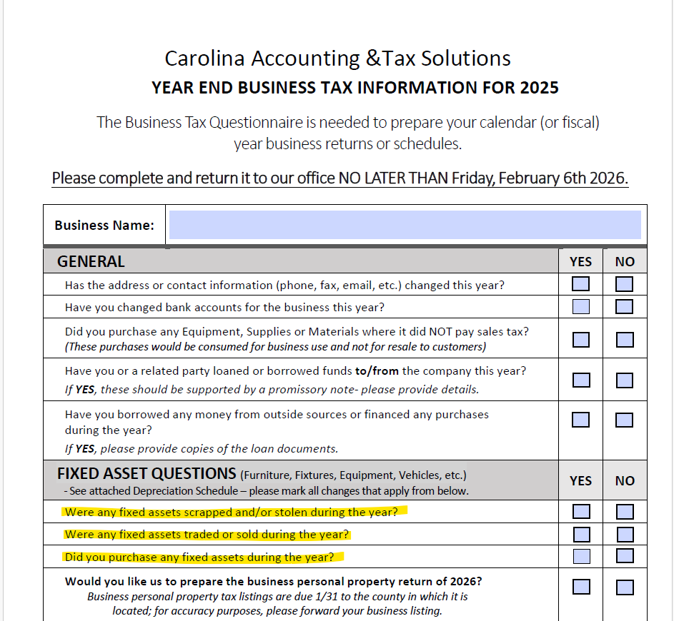
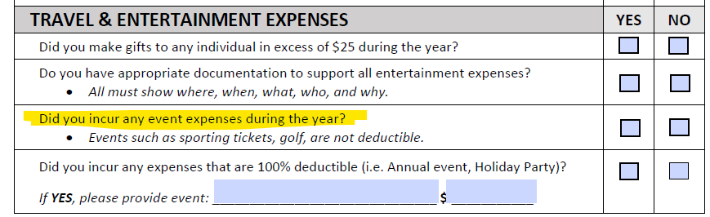
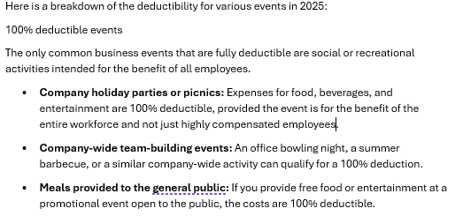
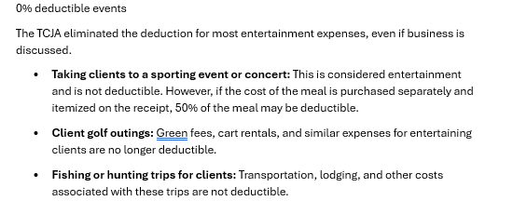

Slide 5
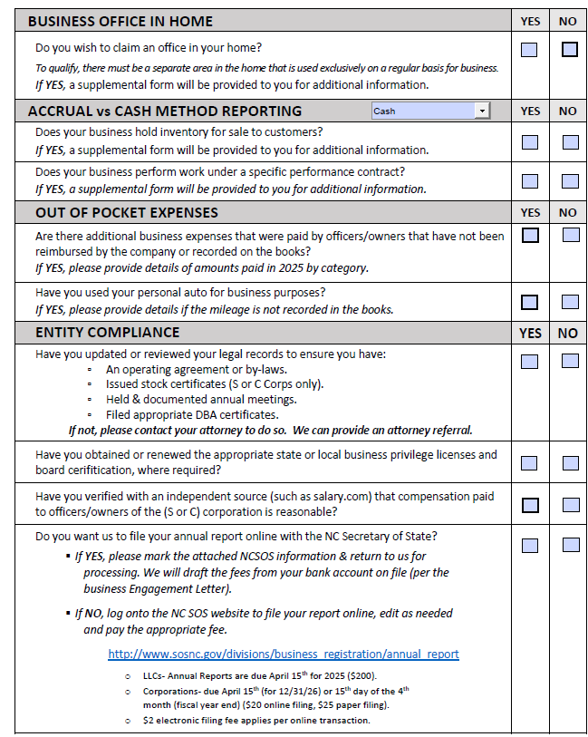

Slide 6
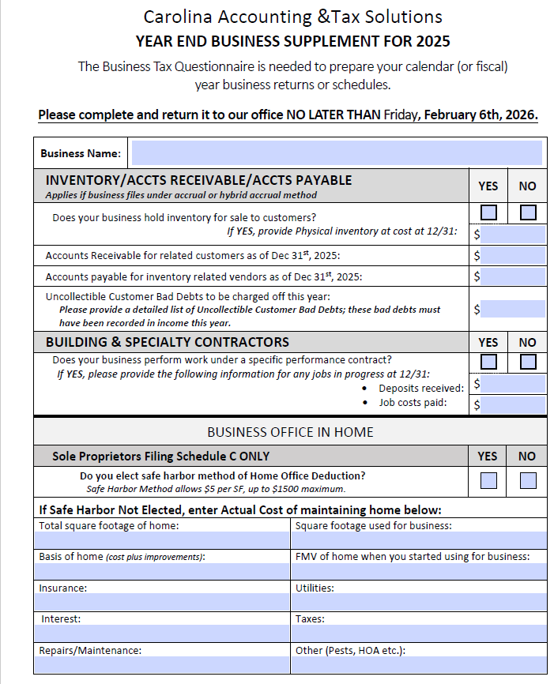
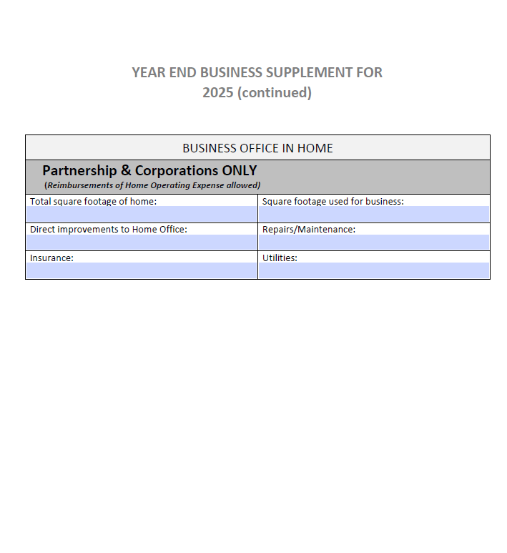

Slide 7

?
?
Questions/Concerns/
Points for Discussion???
?
?

Slide 8
Few things to Double Check for 2026
Meals & Entertainment & Travel Expenses
Most of entertainment expenses are non-deductible.
Travel expenses – If questionable, flag it on Per 13 review checklist
NCPTE –
2025- PY BS Item
2026- CY P&L Item
1
2
Loans tied out- Interest booked
Client not responding doesn’t help ☹
Other taxes
3
4
Vehicles:
Not on company books - did we ask for mileage?
Gas/Auto repair expenses on books:
Check to make sure vehicles are on company books
5
6
Small Tools
We will discuss Small tools in detail in next few slides
7

Slide 9
What is the de minimis safe harbor election!
§ 1.263(a)-1(f)
De minimis – Allows you to deduct smaller expenses that would otherwise need to be capitalized
1
$2,500
2
12 months
The cost does not exceed $2,500 ($500 for amounts incurred prior to January 1, 2016) per invoice or per item
or
The economic useful life of the property does not exceed 12 months. Additional rules and exceptions apply.

Slide 10










Exceptions to de minimis safe harbor election
Real Estate
Leasehold Improvements
Intangible Assets
Materials
Land
Inventory/Parts purchased for resale (held for customers)
Auto
Any other property that doesn't qualify under the de minimis safe harbor

Slide 11





Example.
Alex buys two computers for her business at $2,000 each for a total cost of $4,000, as shown on the invoice. By using the de minimis safe harbor, she can deduct the entire $4,000 expense in a single year, provided the requirements to use the safe harbor are satisfied.
Example.
Shelby buys a $2,000 camera and uses it 50% of the time for her photography business and 50% of the time for personal purposes. She can deduct $1,000 of the cost using the de minimis safe harbor. But she couldn't deduct the camera using the safe harbor election if it cost more than $2,500
Example.
Alex buys a desk for her office for $3,000. She tells the store to separately bill her $250 for each of the four desk drawers and $2,000 for the rest of the desk. Because a desk usually includes drawers as part of a single unit, the IRS adds the cost of each component to determine that the actual cost is $3,000. So, the desk doesn't qualify for the de minimis safe harbor.
Deduct $4,000
Deduct $1,000
Doesn’t qualify

Slide 12
Answers:
Call it out before you click!
Normal repair and maintenance on the manufacturing facility:
1
Expensed
Cost of taxes on new equipment used in business operations:
2
Capitalized
Shipping costs on new equipment used in business operations:
3
Capitalized
Cost of a minor repair on existing equipment used in business operations:
4
Expensed
Land next to the production facility held for use next year as a place to build a warehouse:
5
Fixed Asset-Property, plant, and equipment
Land held for future resale when the value increases:
6
Investment
Equipment used in the production process:
7
Fixed Asset-Property, plant, and equipment
Desk for $2,000 and a printer for $2,400 and they are both on the same invoice:
8
Expensed

Slide 13
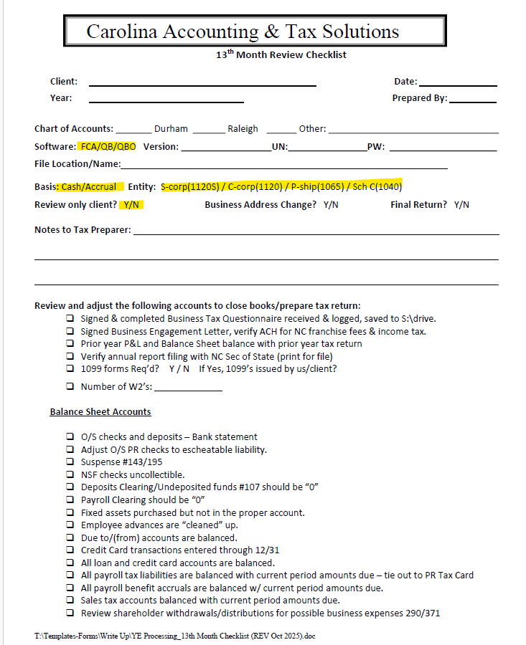
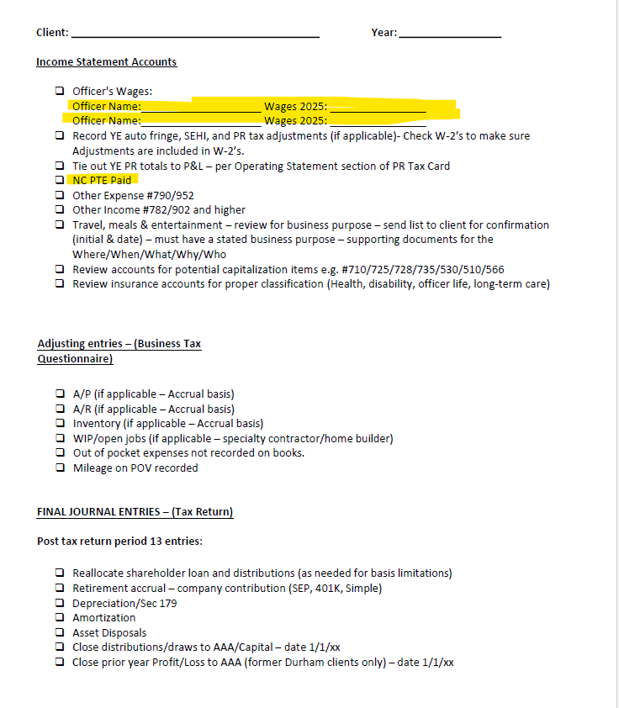

Slide 14
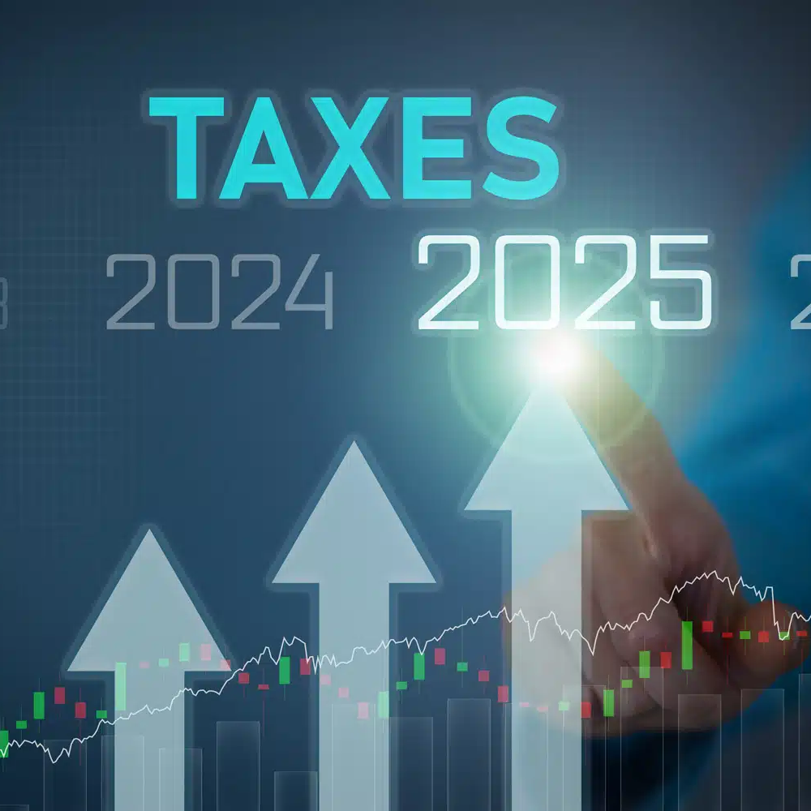
Thank You!
Happy filing!

