Slide 1
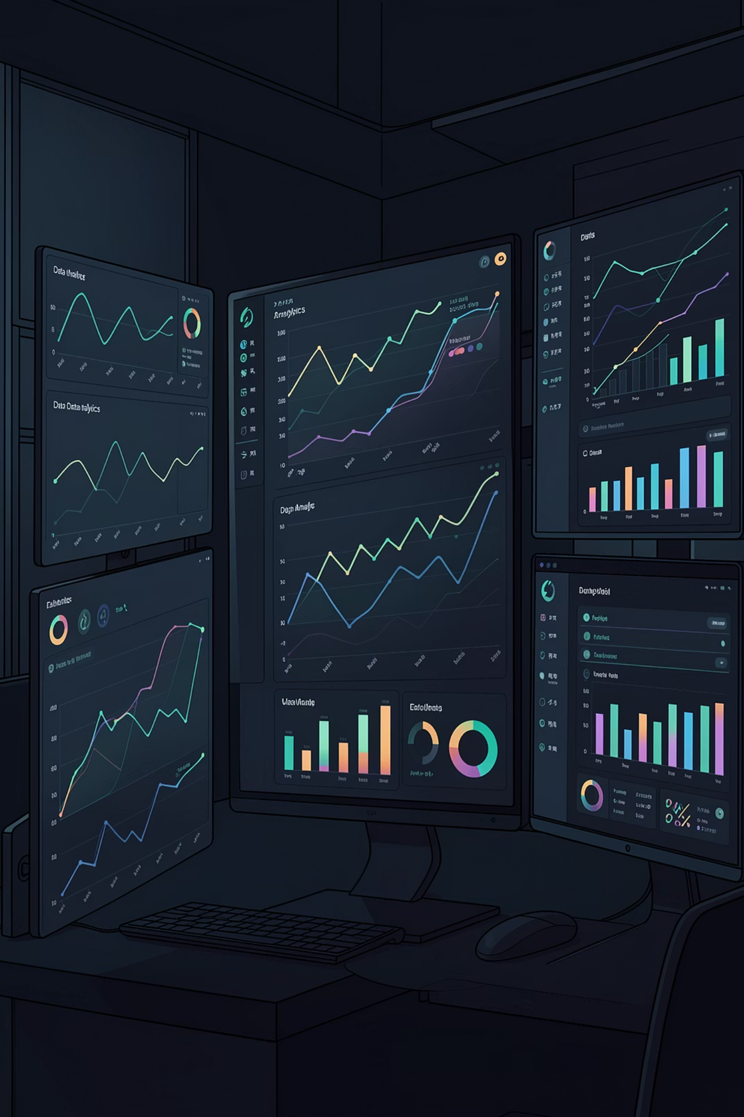
Customer Behavior Analysis
An end-to-end data pipeline transforming raw transactional data into actionable business insights — built with Python, PostgreSQL, and Power BI.
DATA ENGINEERING
ANALYTICS
BUSINESS INTELLIGENCE

Slide 2
Project Overview
From Raw Data to Business Impact
This project analyzes customer purchasing behavior to drive decisions across four strategic areas.
Revenue Optimization
Customer Segmentation
Identify high-value categories and spending patterns
Group customers by age, behavior, and subscription status
Product Performance
Subscription Growth
Rank categories by revenue, ratings, and demand
Surface conversion opportunities among non-subscribers

Slide 3
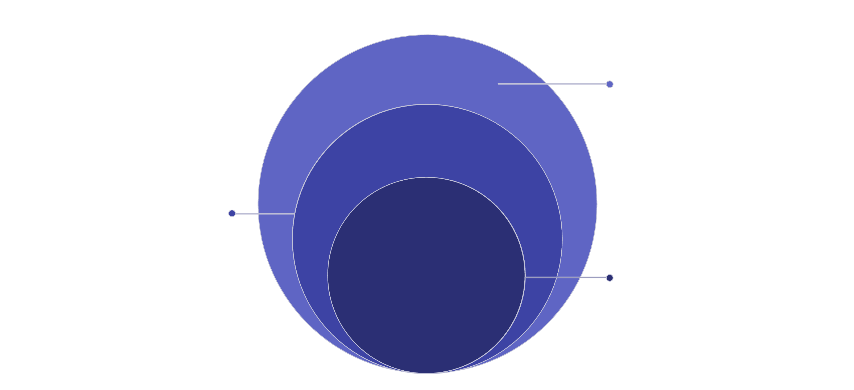
Architecture
Three-Layer Pipeline Design
Visualization
Power BI dashboards, STAR schema, DAX measures
Data Storage
PostgreSQL tables, SQL analysis, query optimization
Data Processing
Cleaning, transform, feature engineering with Pandas
Each layer has a clear responsibility — ensuring data quality at ingestion, analytical power at storage, and business clarity at presentation.

Slide 4
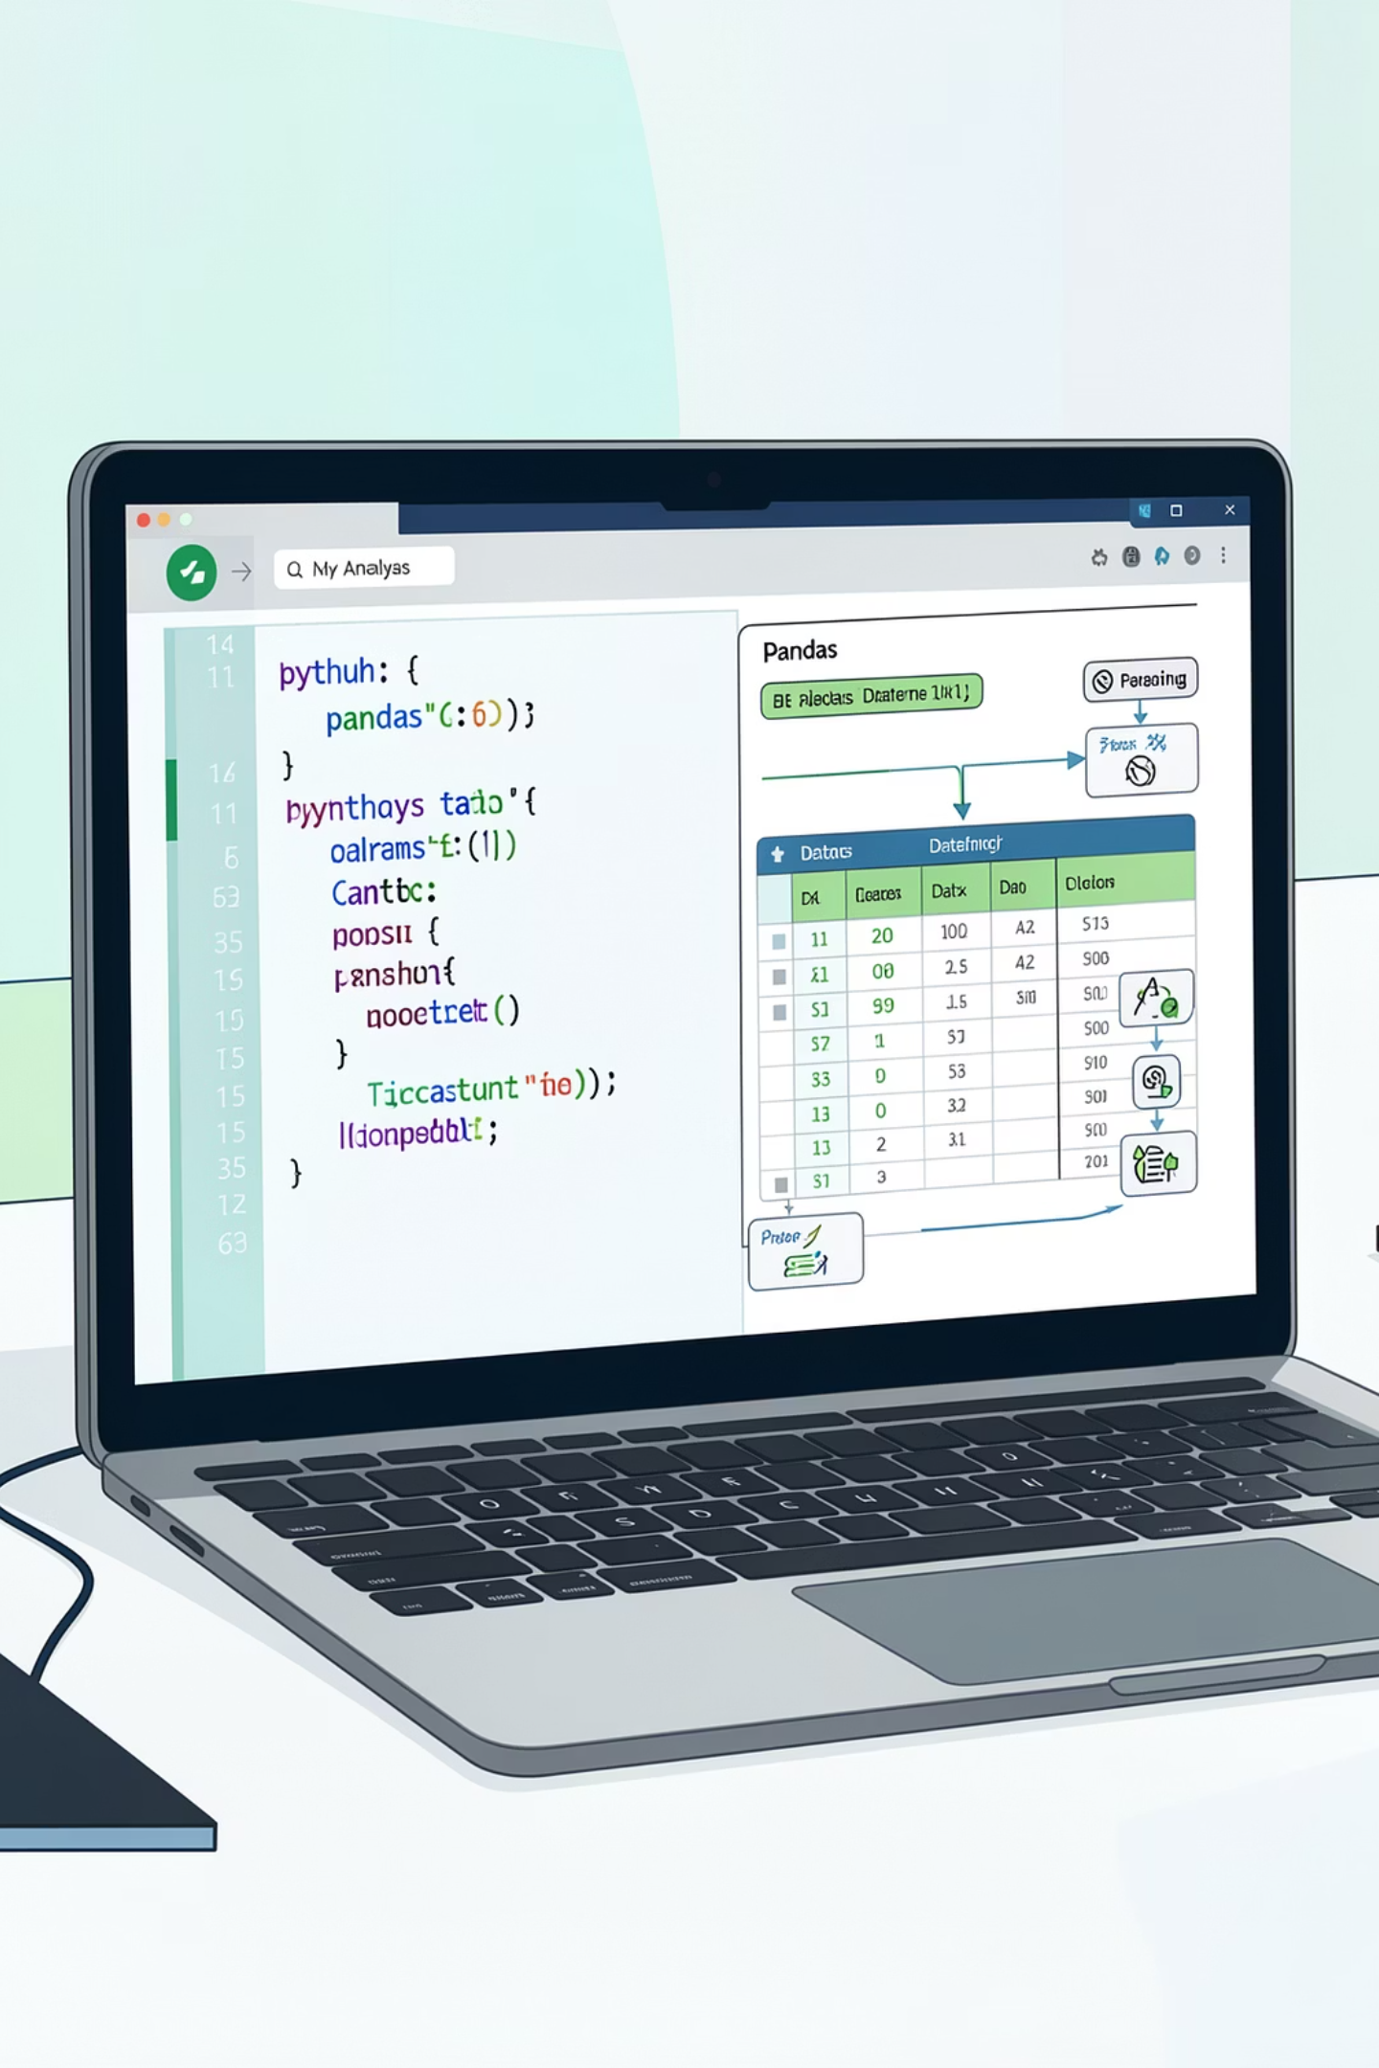
Layer 1 — Python & Pandas
Data Preprocessing & Feature Engineering
Data Cleaning
Handled missing values with fillna(), removed duplicates, and standardized inconsistent category names.
Data Transformation
Converted strings to categorical types and parsed dates into proper datetime format for time-based analysis.
Feature Engineering
Derived Age Groups (Young Adult, Adult, Middle-aged, Senior), subscription status flags, and shipping type categories.

Slide 5
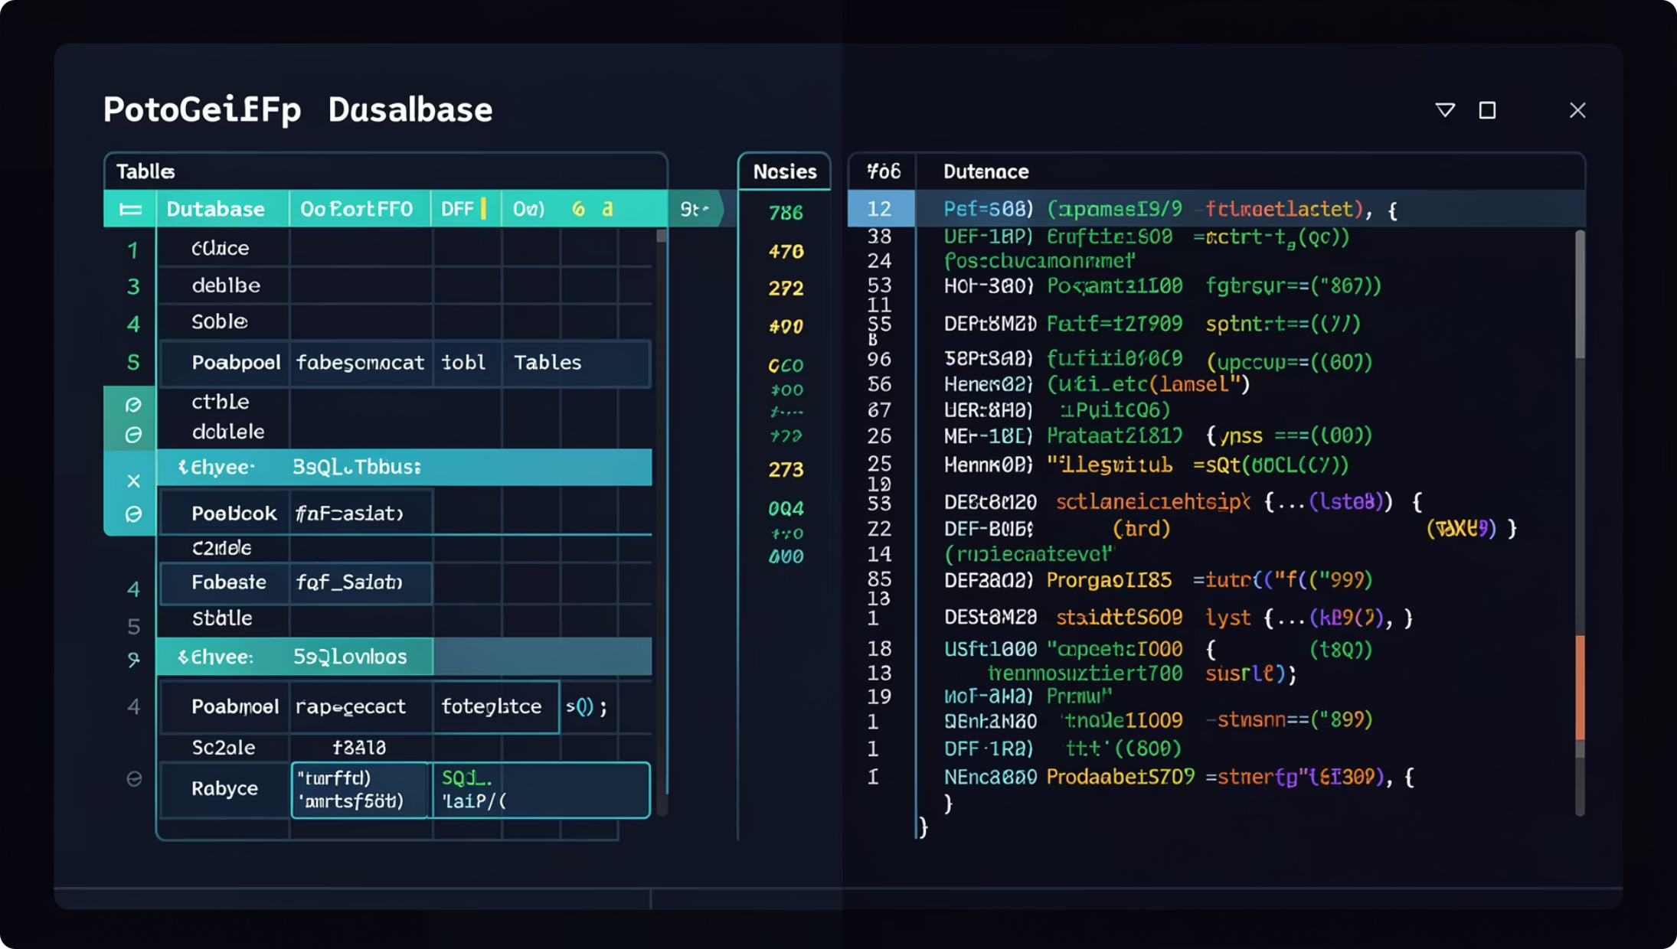
Layer 2 — PostgreSQL
Structured Storage & SQL Analysis
Database Design
Relational tables built on STAR schema principles with primary and foreign keys for referential integrity.
Key SQL Analyses
Revenue by Gender — GROUP BY aggregation
High-Value Discount Users — subqueries + filtering
Top Products by Rating — AVG() + ORDER BY
Shipping vs Spending — WHERE + GROUP BY

Slide 6
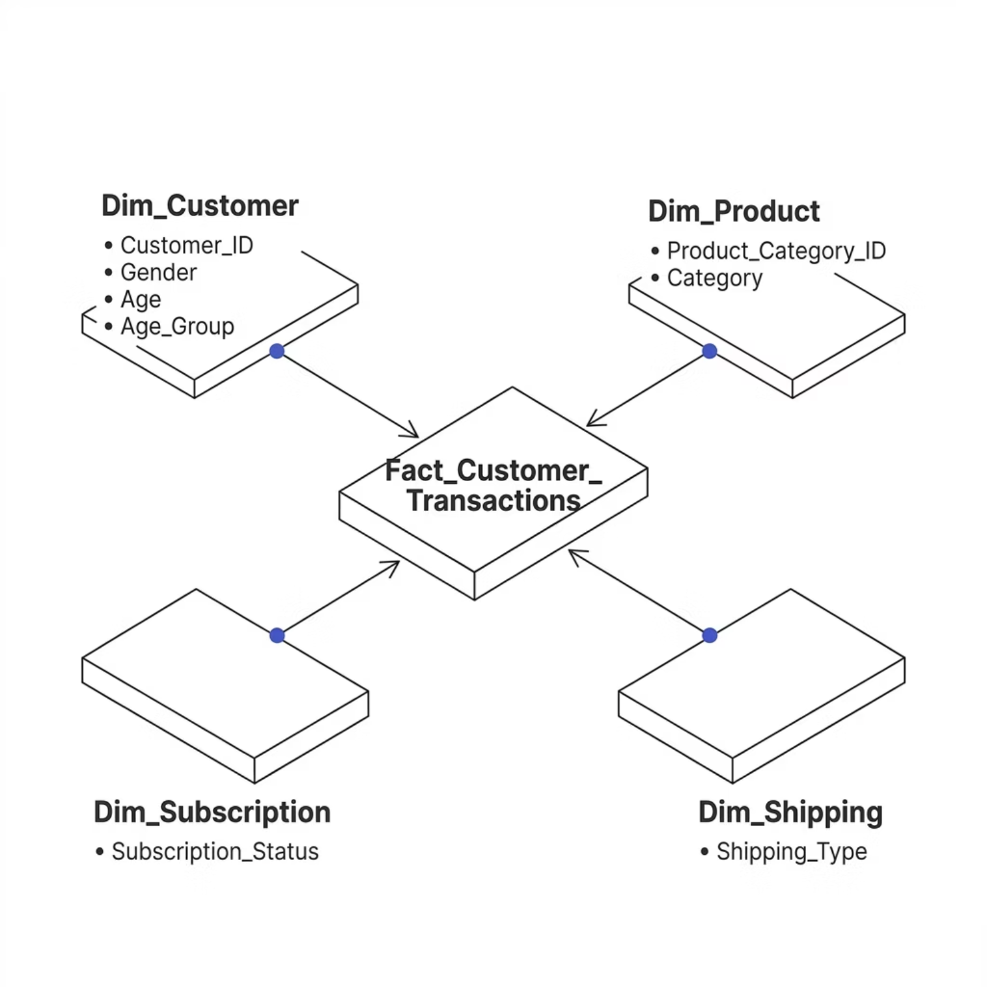


Layer 3 — Power BI
STAR Schema Data Modeling
Fact Table
Fact_Customer_Transactions — measurable events: Purchase_Amount, Quantity, Review_Rating, Subscription_Status, Shipping_Type.
Dimension Tables
Dim_Customer — Gender, Age, Age_Group
Dim_Product — Category
Dim_Subscription — Subscription_Status
Dim_Shipping — Shipping_Type
1:N relationships from dimensions to fact table optimize dashboard performance and simplify analysis.

Slide 7
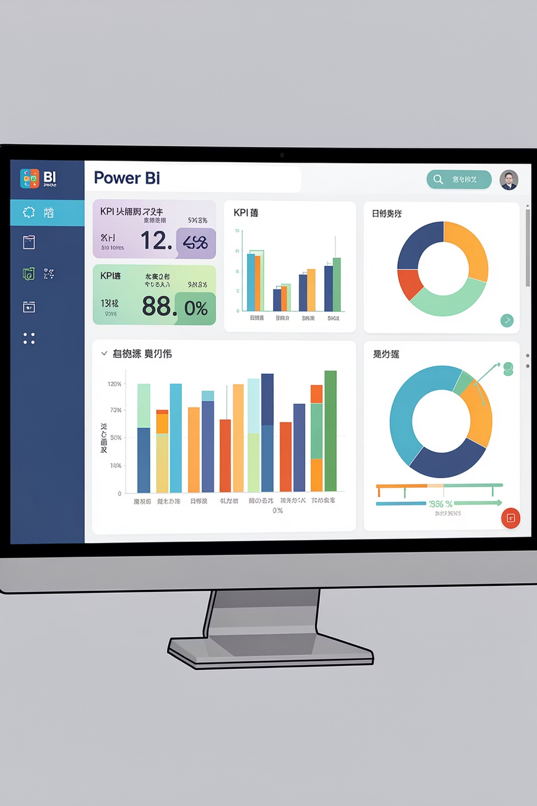
Layer 3 — Power BI
Dashboard Development & DAX Measures
4,000+
$59.76
Total Customers
Avg Purchase
3.75
Avg Rating
Visualizations include a donut chart (subscription distribution), bar charts (revenue by category), and slicers for Gender, Category, and Shipping Type. Core DAX measures: Total Revenue, Average Purchase, Customer Count, and Average Rating.

Slide 8



Insights
What the Data Revealed
Customer Behavior
Product Performance
Spending Patterns
Young Adults contribute 30–35% of revenue. 73% of users are non-subscribers — a major untapped segment.
Clothing dominates with 40%+ of revenue. Accessories rank second; Footwear and Outerwear underperform.
Discount users still spend ≥ $59.76 average. Shipping type meaningfully influences purchase value.

Slide 9
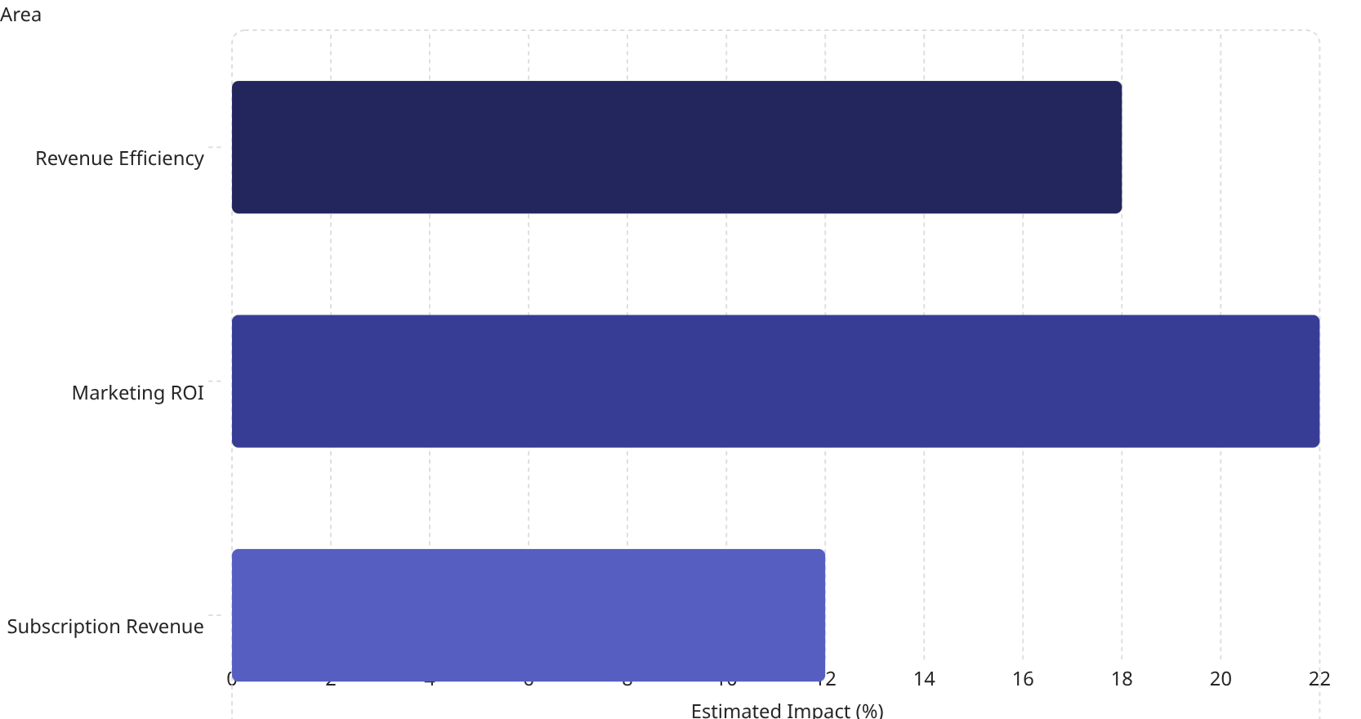
Business Impact
Translating Insights into Action
1
2
Revenue Focus
Marketing ROI
Prioritize Clothing → 15–20% better revenue efficiency
Target Young Adults → 20–25% higher campaign returns
3
4
Subscription Uplift
Cost Optimization
10% conversion of 2,920 non-users → 10–15% revenue increase
Remove or improve low-performing categories to reduce operational waste

Slide 10


Reflection & Roadmap
Challenges, Limitations & What's Next
Challenges Overcome
Known Limitations
Dirty data → Cleaned and standardized via Pandas
No time-series analysis (missing Date table)
No profit or margin metrics
Limited customer segmentation depth
Schema design → Implemented STAR schema for scalability
Future Enhancements
RFM segmentation and cohort analysis
Time-based trend modeling
Profitability and margin analysis
Query performance → Optimized with indexed SQL
This project demonstrates end-to-end pipeline development, SQL analytical thinking, STAR schema modeling, and business-focused dashboard creation — converting raw data into actionable insights.

