Slide 1


NEHRU INSTITUTE OF ENGINEERING AND TECHNOLOGY (An Autonomous Institution, Affiliated to Anna university, Chennai)
DEPARTMENT OF INFORMATION TECHNOLOGY
A SMART AGRICULTURE FRAMEWORK FOR LEAF
DISEASE DETECTION AND AUTOMATED FERTILIZER
RECOMMENDATION USING DEEP LEARNING AND
EDGE COMPUTING
GUIDE:
DOMAIN NAME: MACHINE LEARNING
TEAM MEMBERS:
EZHILARASAN A [721422205021]
JAYAPRADPA J [72142205027]
NAGENDHIRAN V [72142220538]
Mrs. T COWSALYA Assistant Professor Department of Information Technology NIET
SRINATH N [721422205050]
1

Slide 2
ABSTRACT
❖
Agriculture productivity is highly affected by plant diseases, which reduce crop quality and yield if not detected early. This project proposes an automated leaf disease detection system using image processing
and artificial neural network techniques.
❖
The system captures leaf images, processes them, and identifies the disease based on extracted features. After detecting the disease, the system recommends the appropriate fertilizer for treatment. Based on the identified disease, the system automatically activates the fertilizer spraying pump.
❖
This approach helps farmers detect diseases early and apply the correct productivity and reducing manual monitoring efforts.
treatment, improving crop
2

Slide 3
INTRODUCTION
❖
Agriculture plays a vital role in food production and economic development. However, plant diseases significantly affect crop growth and reduce agricultural productivity.
❖
Early identification of leaf diseases is essential to prevent crop damage and ensure healthy plant growth.
With the help of modern technologies such as image processing and artificial intelligence, plant diseases
can be detected automatically.
❖
This project focuses on detecting leaf diseases and recommending suitable fertilizers for treatment. The system also activates a fertilizer spraying mechanism to support efficient and timely crop management
3

Slide 4
EXISTING SYSTEM
In the existing system, plant disease detection is mainly performed using basic image processing techniques. A study titled Plant Leaf Disease Detection Using Image Processing by S. Arivazhagan (2016) explains that leaf images are captured and processed using segmentation and feature extraction methods to identify disease symptoms. The system analyzes color, texture, and pattern variations on the leaf surface to classify diseases. However, this approach mainly focuses only on disease identification and does not provide automatic treatment or fertilizer recommendation. It also requires manual monitoring and does not include any automated fertilizer spraying
mechanism, which limits its practical use in real-time agricultural applications
DISADVANTAGE
❖ ❖ ❖ ❖
Only detects disease
–does not provide treatment or fertilizer suggestions.
No automation Needs manual monitoring
–fertilizer or pesticide spraying is not automatic.
– farmers must continuously check and capture images.
Less accurate
–basicimage processing may give incorrect results under different lighting conditions.
4

Slide 5

LITERATURE SURVEY
Year of publication, Vol No., Issue
Journal Name /
S. No
Paper Title
Authors
Methodology
Merits/Demerits
No., PP
1.
Plant Disease Detection
Leaf
2024
Author: Abu Laskar
Journal:
Md Deep learning model Merits:
Bakar
(YOLO-based detection) is used to
High detection accuracy Fast disease identification
et
al.
LC
Using Learning.
Deep
identify diseases from Demerits:
leaf extracting features and
them
International
Journal
STEM
images
by
Requires large training dataset Needs high processing power
of
classifying
automatically.
5

Slide 6

LITERATURE SURVEY
S. No
Paper Title
Authors & Publications
Methodology
Merits/Demerits
2.
Deep Learning
for Automated Diagnosis of Plant Diseases
2024
Convolutional
Neural Merits:
Network (CNN) models Automatic disease
Author:
Ashok are used to analyze leaf detection
Kumar, Pankaj Kumar
images and automatically Improves crop monitoring
classify plant diseases.
Demerits: Sensitive to image quality Requires large training
data
Journal:
Journal
of
Electrical Systems
6

Slide 7

LITERATURE SURVEY
Yearof
publication, Vol No., Issue No.,
Journal Name / Authors
S. No
Paper Title
Methodology
Merits/Demerits
PP
3.
Plant
Disease
2025
Author: Zunaira Zainab, Rabbia
Deep learning algorithms
analyze plant leaf images to detect disease patterns and classify infected leaves.
Merits: Accuratedisease classification
Detection
Using Learning Techniques
Deep
Early disease detection Demerits: Computationally expensive Requires high-quality datasets
Mahum
Journal: ICCK Journal Image Analysis and
of
Processing
7

Slide 8

LITERATURE SURVEY
S. No
Paper Title
Authors & Publications
Methodology
Merits/Demerits
4.
Advancing Plant Leaf Disease Detection Integrating Machine Learning and Deep Learning
2025
Combines machine learning Merits:
and techniques
deep
learning extract
Improved accuracy Effective feature extraction
to
features from plant leaf Demerits:
images and classify diseases automatically.
Complex system design Requires large dataset
8

Slide 9
PROPOSED SYSTEM
This proposed paper offers a candid and computationally resourceful manner which is useful in the leaf disease detection and selection of fertilizers using artificial neural network. This proposed system involves different concepts related to image processing such as image acquisition, image preprocessing, feature extraction, artificial neural network based training, classification, diagnosis and treatment by using artificial neural network. In this performance, database is a accumulation of different texture features of some leaves. In this project it is possible to get the disease name and also we can get the fertilizer which is precise for that disease. But in previous attempts it was not happen so because of this we proposed this project, it is
better and gives good performance compared to other processing system.
ADVANTAGE
Accurate Disease Detection : Uses ANN to identify leaf diseases correctly.
Provides Fertilizer Suggestion : Suggests the correct fertilizer for each detected disease.
Saves Time and Effort : Reduces manual checking by farmers.
Better than Existing Systems : Detects disease and gives treatment, unlike older methods.
9

Slide 10
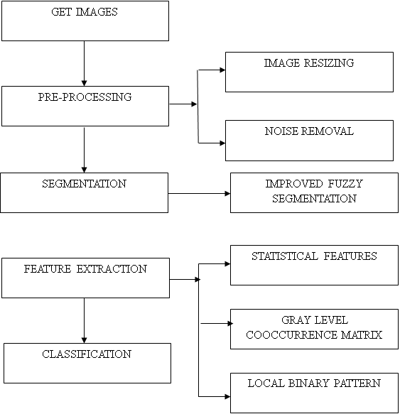
BLOCK DIAGRAM
10

Slide 11
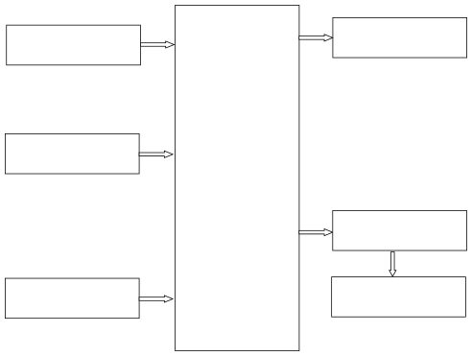
ARCHITECTURE DIAGRAM
POWER SUPPLY
LCD DISPLAY
SOIL MOISTURE
SENSOR
ESP32
RELAY MODULE
INPUT FROM IMAGE
DC PUMP
PROCESSING
11

Slide 12
SYSTEM REQUIREMENTS
❖
4.1 HARDWARE REQUIREMENTS
➢
➢ ➢ ➢
ESP32 MICROCONTROLLER
POWER SUPPLY RELAY MODULE DC PUMP
❖
4.2 SOFTWARE REQUIREMENTS
➢
Operating System: Windows Server
➢ ➢
Programming Language: M scripts Machine Learning Models: ANN
12

Slide 13
MODULES
•Image Acquisition Module •Image Pre-processing Module •Feature Extraction Module •Disease Classification Module
•Fertilizer Recommendation Module •Automatic Fertilizer Spraying Module
13

Slide 14
MODULE DESCRIPTION
1. Image Acquisition Module
This module is responsible for capturing images of plant leaves using a digital camera or mobile camera. The captured images serve as the input for the disease detection system. Clear and high-quality images help in improving the accuracy of disease identification. 2. Image Pre-processing Module
In this stage, the captured images are processed to remove noise and improve image quality. Techniques such as filtering, resizing, and color enhancement are applied. This step ensures that the image is suitable for further analysis.
14

Slide 15
MODULE DESCRIPTION
3. Feature Extraction Module
This module extracts important features from the processed leaf images. Features such as color, texture, and shape of the leaf are analyzed. These characteristics help in identifying the symptoms of plant diseases. 4. Disease Classification Module
In this module, machine learning or neural network algorithms are used to classify the type of disease affecting the leaf. The system compares the extracted features with the trained dataset to identify the specific disease.
15

Slide 16
MODULE DESCRIPTION
5. Fertilizer Recommendation Module
After identifying the disease, the system determines the appropriate fertilizer or treatment required for that particular disease. This helps farmers apply the correct fertilizer for plant recovery. 6. Automatic Fertilizer Spraying Module
This module automatically activates the fertilizer spraying pump based on the detected disease. The system controls the pump using a controller and relay circuit to spray the required fertilizer on the affected plants.
16

Slide 17
SAMPLE CODE
clc clear all close all % Get The Image [FN,PN]=uigetfile('.jpg'); IM1=imread([PN FN]); figure,imshow(IM1) title('Input Image'); % pre processing % 1. Resizing IM2=imresize(IM1,[256,256]); figure,imshow(IM2) title('Resized Image');
17

Slide 18
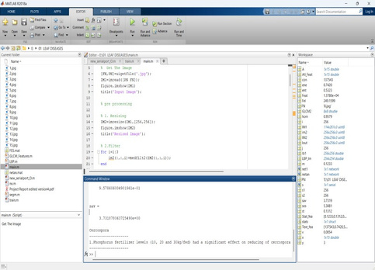
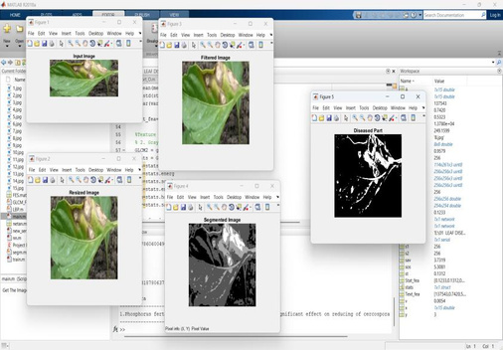
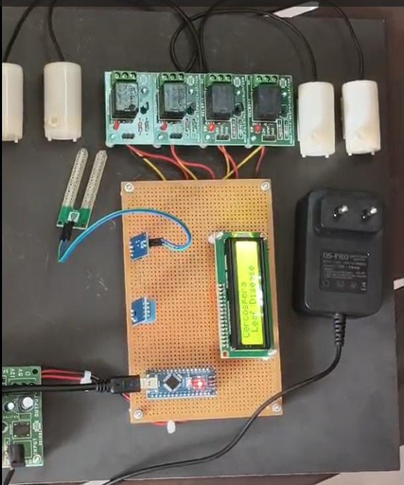
SAMPLE OUTPUT
18

Slide 19
CONCLUSION
•
The proposed system effectively detects plant leaf diseases at an early stage using image processing techniques. Early detection helps prevent the spread of disease and protects the overall health of the plant.
• The developed method provides accurate identification of different leaf diseases and suggests appropriate fertilizer for treatment. This helps farmers take timely action and improve crop productivity.
the
• The use of image processing, feature extraction, and classification techniques improves the efficiency and reliability of the system. As a result, the system provides better disease detection and supports smart agricultural practices.
19

Slide 20
FUTURE ENHANCEMENT
In the future, the system can be improved by integrating IoT technology to monitor plant health remotely through mobile or web applications. This will allow farmers to receive real-time alerts about plant diseases. • Advanced machine learning and deep learning algorithms can be used to increase the accuracy of disease detection and support identification of a larger number of plant diseases. • The system can also be expanded to control automatic irrigation and fertilizer management, making it a
complete smart agriculture solution for improving crop productivity.
20

Slide 21
REFERENCES
[[1] S. P. Mohanty, D. P. Hughes, and M. Salathé, “Using Deep Learning for Image-Based Plant Disease Detection,”
Frontiers in Plant Science
,vol. 7, pp. 1–10, 2016.
[2] K. P. Ferentinos, “Deep learning models for plant disease detection and diagnosis,” Computers and Electronics in Agriculture, vol. 145, pp. 311–318, 2018.
[3] S. Sladojevic, M. Arsenovic, A. Anderla, D. Culibrk, and D. Stefanovic, “Deep Neural Networks Based
Recognition of Plant Diseases by Leaf Image Classification,” Computational Intelligence and Neuroscience, pp. 1–11,
2016.
[4] P. Picon, A. Bereciartua, A. Alvarez-Gila, et al., “Deep Convolutional Neural Networks for Mobile Capture
Device-Based Crop Disease Classification in the Wild,”
Computers and Electronics in Agriculture
,vol. 161, pp. 280–
290, 2019. [5] A. Kamilaris and F. X. Prenafeta-Boldú, “Deep learning in agriculture: A survey,”
Agriculture, vol. 147, pp. 70–90, 2018.
Computers and Electronics in
21

Slide 22
REFERENCES
[6] J. Too, L. Yujian, S. Njuki, and L. Yingchun, “A comparative study of fine-tuning deep learning models for plant disease identification,” Computers and Electronics in Agriculture, vol. 161, pp. 272–279, 2019.
[7] H. Durmuş, E. O. Güneş, and M. Kırcı, “Disease detection on the leaves of the tomato plants by using deep
learning,” International Conference on Agro-Geoinformatics, pp. 1–5, 2017.
[8] R. P. Pooja and S. K. Bhatia, “IoT Based Smart Agriculture Monitoring System,” International Journal of
Engineering Research and Technology, vol. 8, no. 6, pp. 623–626, 2019.
[9] S. R. Ramesh and D. Vydeki, “Recognition and classification of paddy leaf diseases using deep neural
networks,” Journal of Intelligent and Fuzzy Systems, vol. 36, no. 6, pp. 5985–5995, 2019.
[10] M. Barbedo, “Impact of dataset size and variety on the effectiveness of deep learning and transfer learning for
plant disease classification,” Computers and Electronics in Agriculture, vol. 153, pp. 46–53, 2018.

Slide 23
THANK YOU
23

