Slide 1
Intro to Reinforcement Learning

Slide 2

Who am I?
- 7 years of experience with ML/CV
- my colleagues are pretty good with RL

Slide 3
What will we learn
What is RL
Successes
Hard parts
Taxonomy
Active research subfields
Case studies – chess
Case studies - ChatGPT

Slide 4
0. Hype
That’s the future of AI
Active research right now
Still in it’s infancy
A lot more to come

Slide 5
1. What is RL
What is RL
Successes
Hard parts
Taxonomy
Active research subfields
Case studies – chess
Case studies - ChatGPT

Slide 6
1. What is RL
What is RL
  Supervised learning vs. Unsupervised learning vs. RL
  Terminology
  How does it work

Slide 7
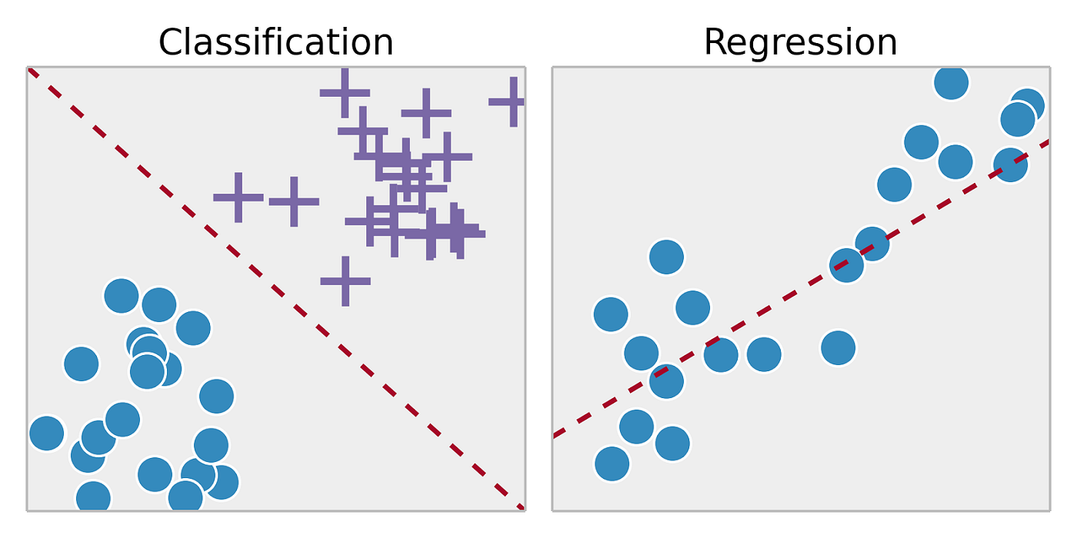
Supervised vs. Unsupervised learning

Slide 8
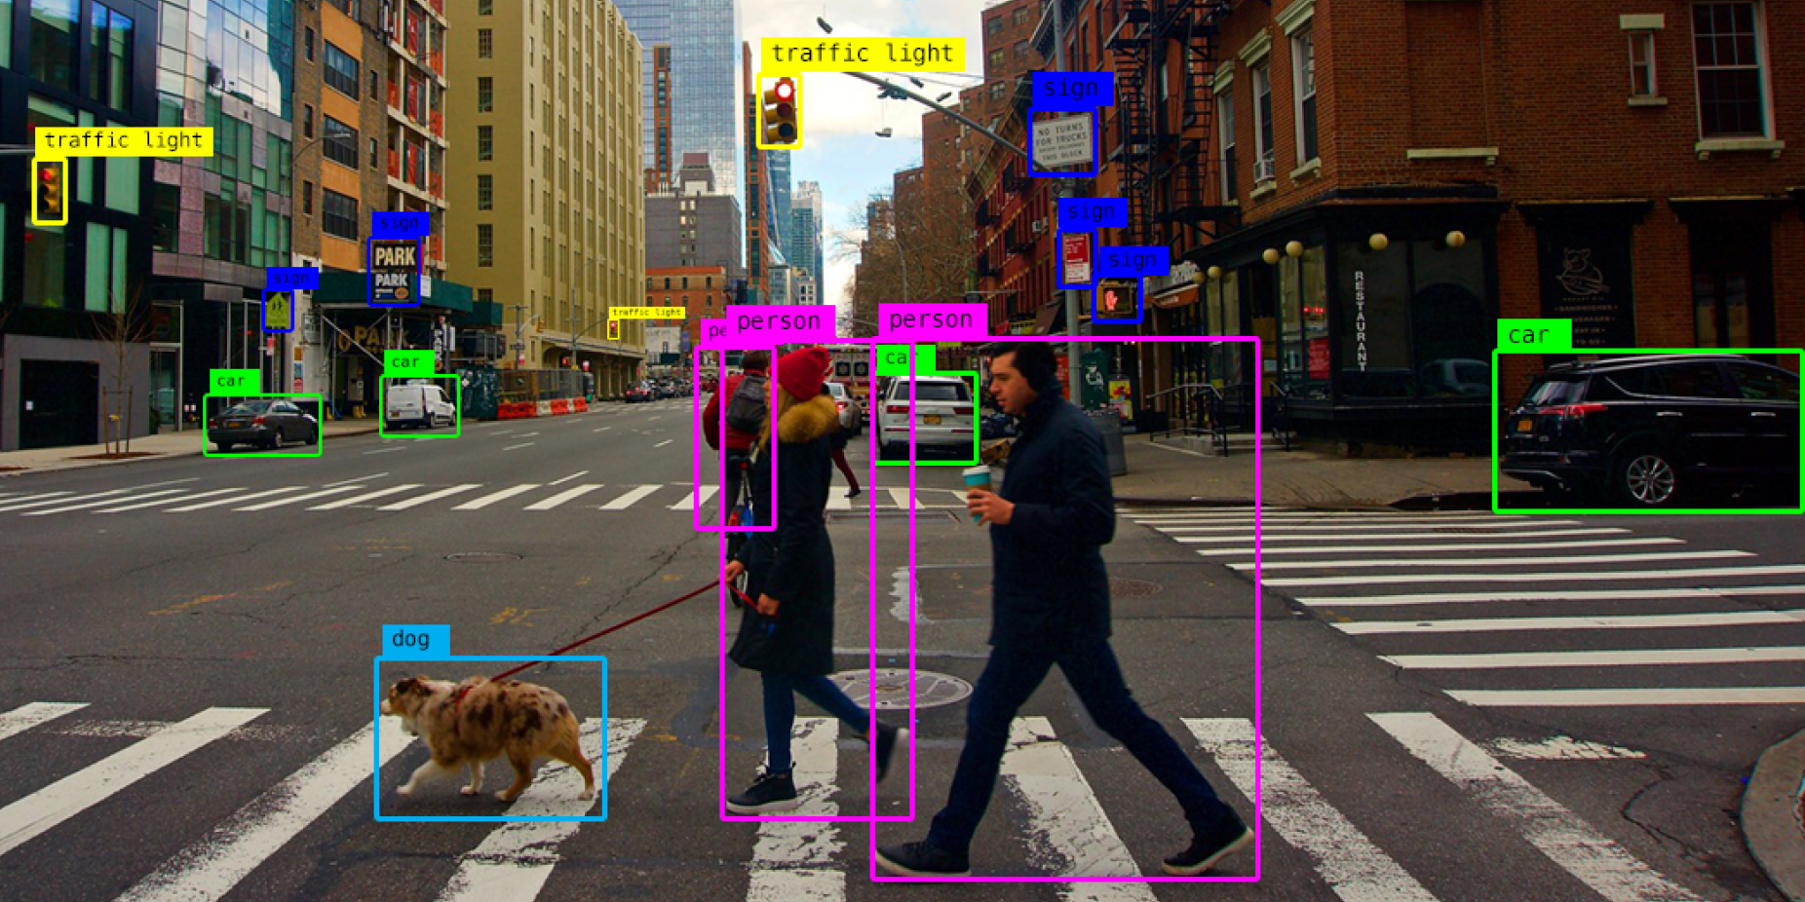
Supervised vs. Unsupervised learning

Slide 9
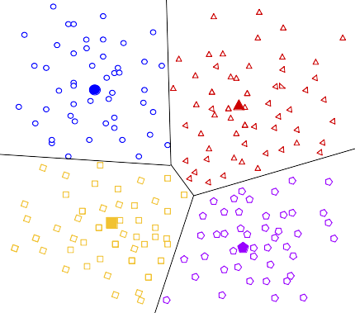
Supervised vs. Unsupervised learning

Slide 10
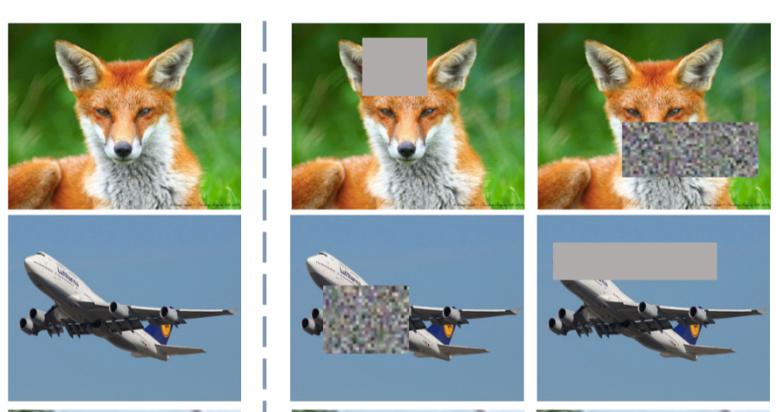
Supervised vs. Unsupervised learning

Slide 11
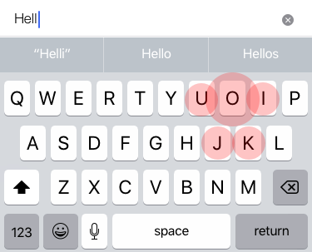
Supervised vs. Unsupervised learning

Slide 12
Reinforcement Learning
Reinforcement Learning problems are sequential decision-making problems. I.e. you must repeatedly make decisions.
You learn from interacting with an environment that gives you feedback.
Typically, you only get feedback very rarely.

Slide 13
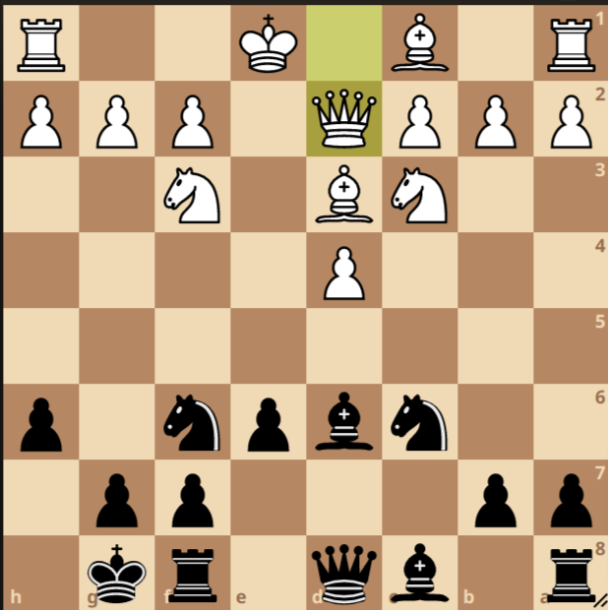
What is RL

Slide 14
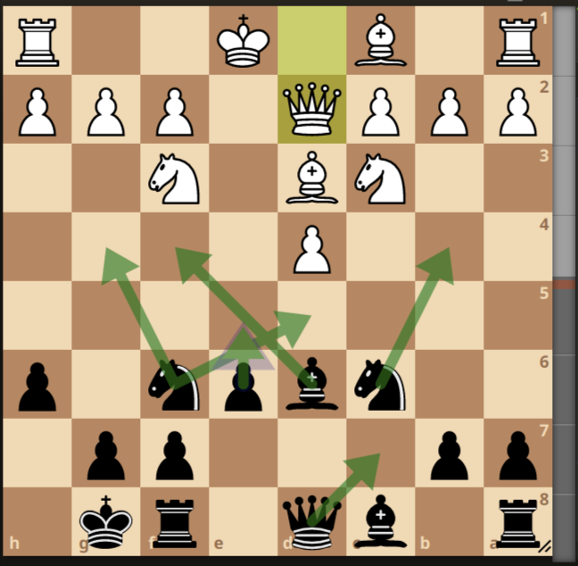
What is RL

Slide 15
SL vs. UL vs. RL
1. You start with some data (and some labels?)
2. You train the model
vs.
1. Model collects it’s own data
2. Data are highly correlated
3. Multiple decisions for each label

Slide 16
1. What is RL
What is RL
  Supervised learning vs. Unsupervised learning vs. RL
  Terminology
  How does it work

Slide 17
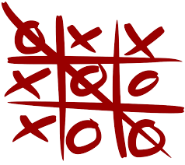
Example – Tic Tac Toe

Slide 18
1. What is RL
State - S
Observation
Actions - A
Reward - r
Agent
Policy - π
Episode

Slide 19
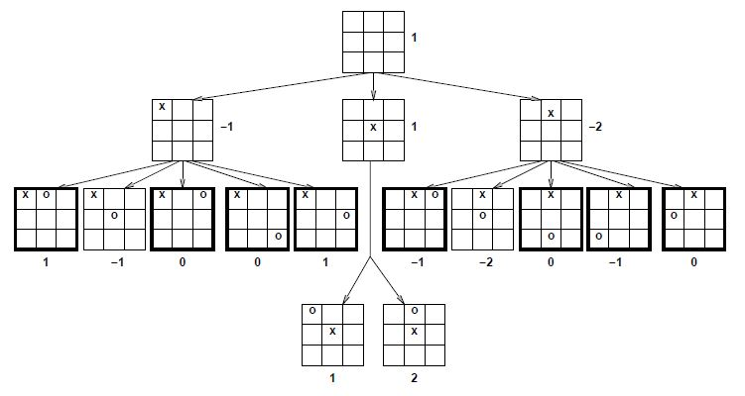
Example – Tic Tac Toe

Slide 20

Example – Flappy bird

Slide 21
1. What is RL
What is RL
  Supervised learning vs. Unsupervised learning vs. RL
  Terminology
  How does it work

Slide 22
What is RL
At each timestep t, the agent takes an action a, the state s updates as a result of this action and a reward, r, is given.

Slide 23
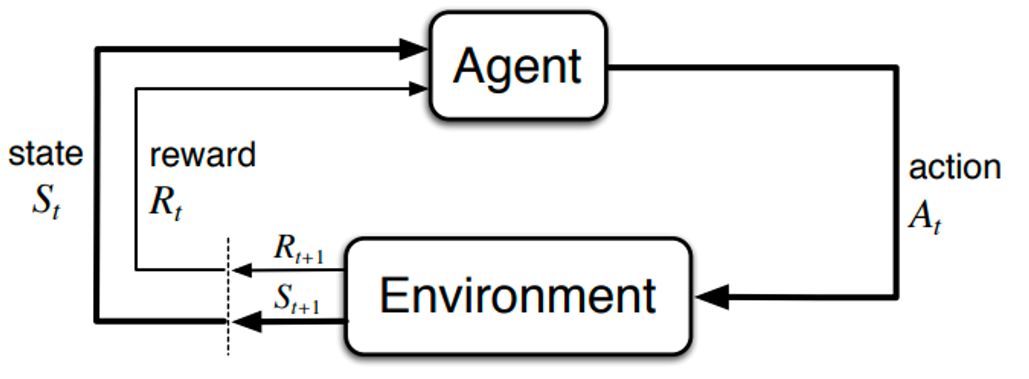
What is RL

Slide 24
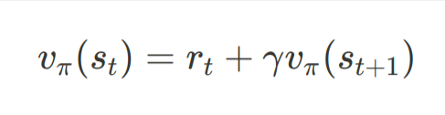
Aside: discounted rewards
“A bird in the hand is worth two in the bush”
Do you prefer $100 now, or $100 2 weeks from now?
Do you prefer $90 now, or $100 2 weeks from now?

Slide 25
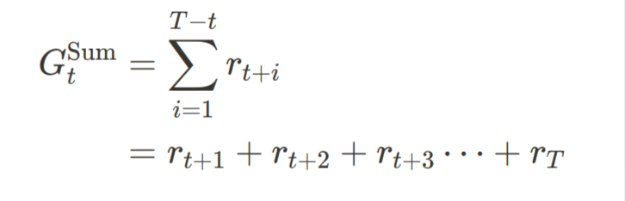
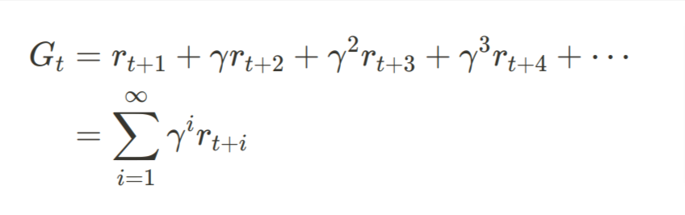
Aside: discounted rewards

Slide 26
First real algorithm – Q-learning
Define “Value function” V(s) – function that maps the state S_{t} to the predicted (discounted) total reward G_{t}, when following policy π
Decide on the value of gamma
Recursively improve the estimation of the value function:

Slide 27
First real algorithm – Q-learning
Demo 1: Labyrinth

Slide 28
What will we learn
What is RL
Successes
Hard parts
Taxonomy
Active research subfields
Case studies – chess
Demo -

Slide 29
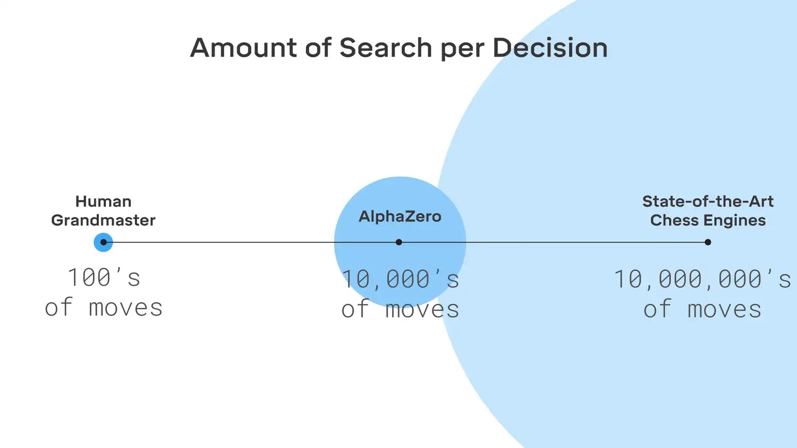
2.1 AlphaZero

Slide 30
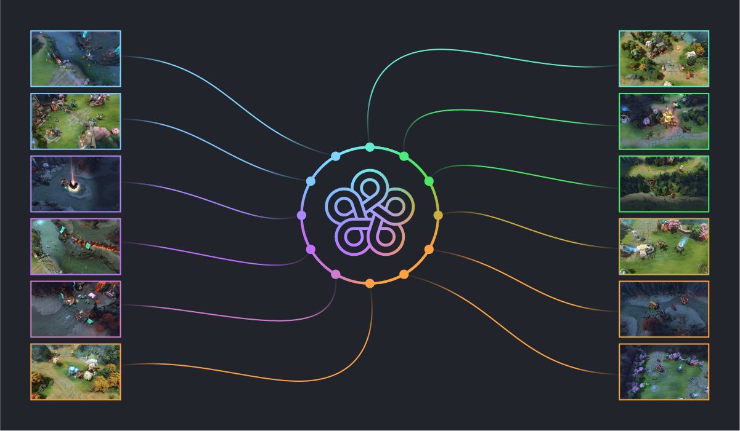
2.2 OpenAI Five

Slide 31
2.3 Robotics
https://www.youtube.com/watch?v=RbyQcCT6890

Slide 32
2.4 Other games
Go
CS
RoboLeague
Starcraft
Poker
Scrabble
Many many others

Slide 33
2.5 Non-games
Finance: portfolio management
Logistics
Travelling salesman problem + solvers
Recommender systems
Autonomous vehicles
Chip design
ChatGPT

Slide 34
2.6 Bulgarian teams using RL
1. Ocado - https://www.youtube.com/watch?v=4DKrcpa8Z_E
2. Dynamic pricing
3. Siviko - https://siviko.com/

Slide 35
What will we learn
What is RL
Successes
Hard parts
Taxonomy
Active research subfields
Case studies – chess
Demo -

Slide 36
3. Hard parts
Sparse reward
Exploration-exploitation
Sample efficiency
Stability

Slide 37
3. Hard parts
Sparse reward
Exploration-exploitation
Sample efficiency
Stability

Slide 38
3. Hard parts
Sparse reward.
Exploration-exploitation
Sample efficiency
Stability

Slide 39
3. Hard parts
Sparse reward.
Exploration-exploitation
Sample efficiency
Stability

Slide 40
3.3 Sample efficency
Dota2 – 180 years
Chess – 44 million games
Rubic’s cube – 32 V100 GPUs, 400 workers with 32 CPU cores, several months. Equivalent to 13 thousand years.

Slide 41
3. Hard parts
Sparse reward.
Exploration-exploitation
Sample efficiency
Stability

Slide 42
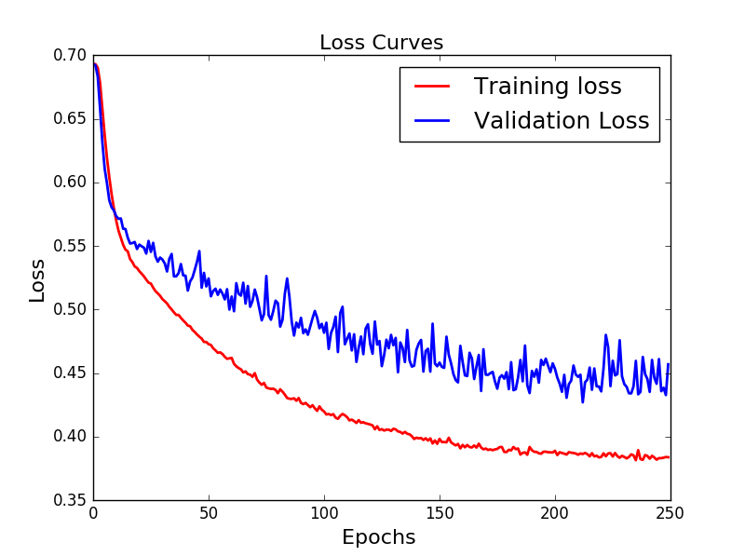
3.4 Stability

Slide 43
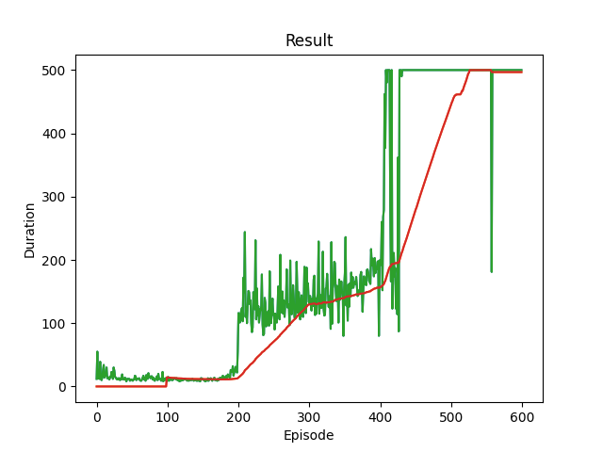
3.4 Stability

Slide 44
What will we learn
What is RL
Successes
Hard parts
Taxonomy
Active research subfields
Case studies – chess
Demo -

Slide 45
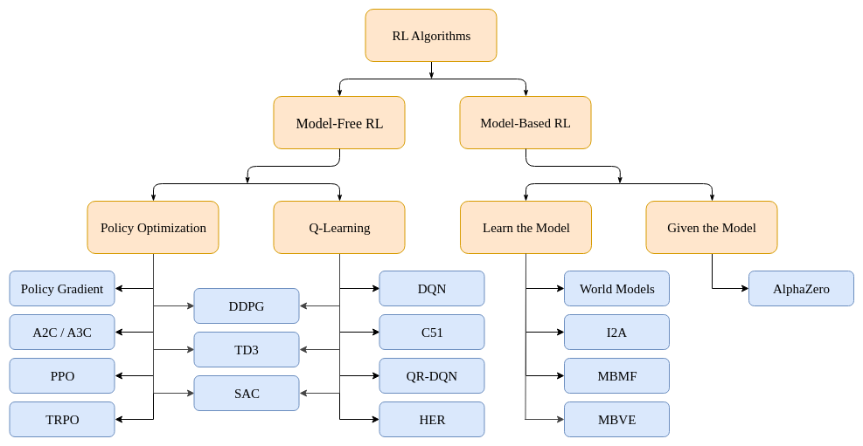
4. Taxonomy

Slide 46
4. Taxonomy
1. Model-based vs. model-free
2. On-policy vs. off-policy
3. Optimize value function (or Q function) vs. optimize policy directly

Slide 47
5. Active research subfields
Multi-agent RL (MARL)
Hierarchical RL (HRL)
Inverse RL (IRL)
Transfer and multi-task learning
Off-policy learning
Model-based RL

Slide 48
6. Case studies - chess
Model-based
Policy optimization + value funtion for normalization
On-policy
Monte Carlo Tree Search
Further work:
  MuZero
  AlphaGoZero
  KataGo

Slide 49
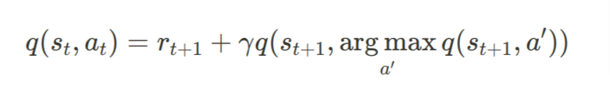
7. Demo 2: Cartpole

