Slide 1
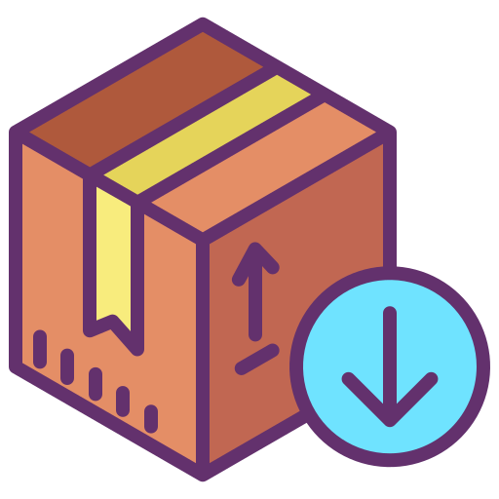
Modules
Python packages
SoftUni Team
Technical Trainers
Software University
http://softuni.bg
Notes:
© Software University Foundation – http://softuni.org
This work is licensed under the Creative Commons Attribution-NonCommercial-ShareAlike license.
<number>

Slide 2
Table of Contents
1. Definition
Where are modules stored?
Why use them?
2. Built-in modules
3. External modules
PIP
4. Custom modules
<number>
Notes:
© Software University Foundation – http://softuni.org
This work is licensed under the Creative Commons Attribution-NonCommercial-ShareAlike license.
<number>

Slide 3
Have a Question?
sli.do
#python-advanced
<number>

Slide 4

What are modules?
<number>

Slide 5
What are modules ?
Simply put, a module is a file consisting of Python code
They are stored in packages
A package is a collection of Python modules
Why use modules ?
Keep Python files short and simple
Reuse code across multiple files by importing
<number>

Slide 6

Built-in Modules
Notes:
<number>
© Software University Foundation – http://softuni.org
This work is licensed under the Creative Commons Attribution-NonCommercial-ShareAlike license.

Slide 7
Definition
The Python interpreter has a number of built-in modules
They are pre-installed and we can call them at any given time
In order to call them we use the keyword - import
import random
fruits = ["apple", "banana", "cherry"]
random.choice(fruits)
random.shuffle(fruits)
<number>

Slide 8
Different Ways to Import
import random as module_name
module_name.randint(1, 10)
from random import choice as gimme_one, shuffle as mix
gimme_one(["coke", "steak", "chips"])
mix(["coke", "steak", "chips"])
from random import choice as gimme_one, shuffle as mix
gimme_one(["coke", "steak", "chips"])
mix(["coke", "steak", "chips"])
from math import *
sqrt(pi)
<number>

Slide 9
Problem: Calculate Logarithm
Write a program that prints the calculated logarithm of any given number
You will receive 2 inputs
The number (integer)
The base (if it is the word "natural" find the natural logarithm)
Format the result up to the 2nd decimal digit and print it
10
natural
2.30
<number>

Slide 10
Solution: Calculate Logarithm
from math import log number = int(input()) base = input() if base == "natural": print(f"{log(number):.2f}") else: print(f"{log(number, int(base)):.2f}")
<number>

Slide 11

External Modules
PIP
Notes:
<number>
© Software University Foundation – http://softuni.org
This work is licensed under the Creative Commons Attribution-NonCommercial-ShareAlike license.

Slide 12
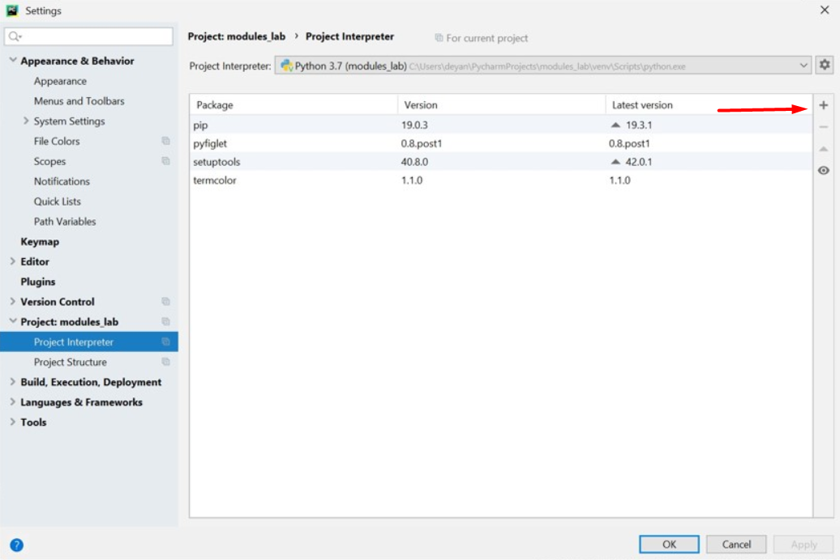
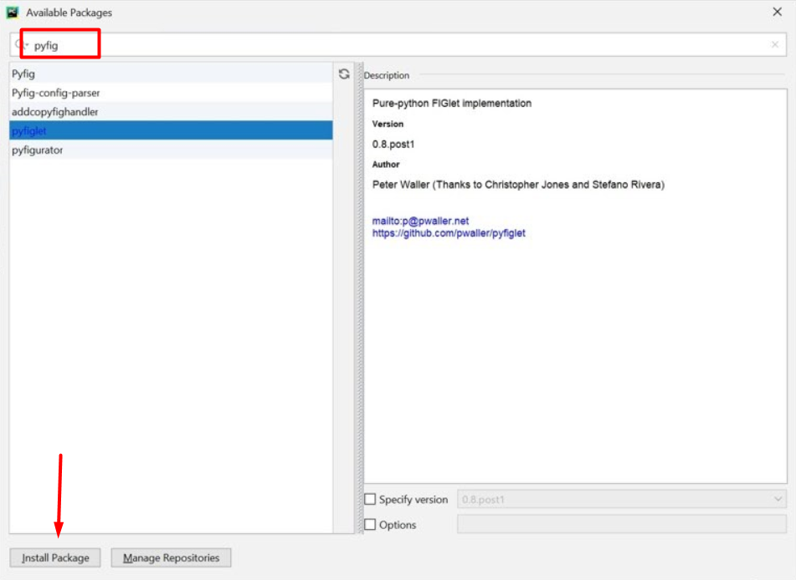
Package Management System (PIP)
External modules are downloaded from the internet by using pip
In PyCharm you have pip already installed, so you can jump straight to installing them
<number>

Slide 13
Some External Modules
Termcolor
PyFiglet
from termcolor import colored text = colored('Hello World!', 'red', attrs=['bold', 'underline']) print(text) # Hello World!
from termcolor import figlet_format text =figlet_format("Python",font="isometric1") print(text)
<number>

Slide 14
Problem: ASCII Art
Using the pyfiglet package write a program that encryps given words by using the characters: "-|_/\()" to structure the word.
from pyfiglet import figlet_format def print_art(msg): ascii_art = figlet_format(msg) print(ascii_art) msg = input("What would you like to print? ") print_art(msg)
<number>

Slide 15

Custom Modules
Notes:
<number>
© Software University Foundation – http://softuni.org
This work is licensed under the Creative Commons Attribution-NonCommercial-ShareAlike license.

Slide 16
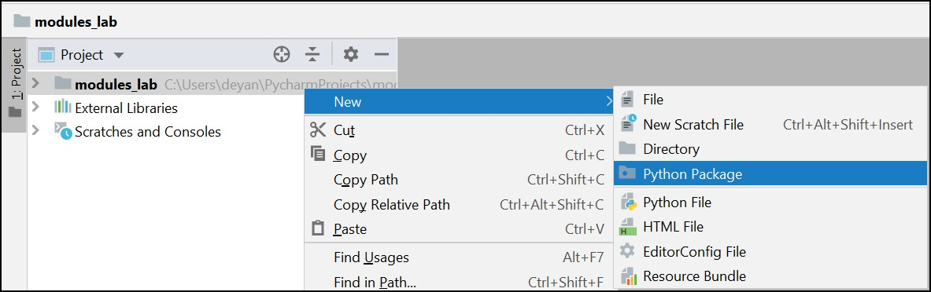
Creating a module (Through PyCharm)
Any .py file can be imported and used as a module
In PyCharm there is a separate option to create a package(module)
<number>

Slide 17
Problem: Triangle
Create a module for printing a triangle
You will receive an integer number which is the size of the triangle
1
1 2
1 2 3
1 2
1
1
1 2
1 2 3
1 2 3 4
1 2 3
1 2
1
3
4
<number>

Slide 18
Solution: Triangle
def print_triangle(size):
for row in range(1, size + 2):
print(*[col for col in range(1, row)])
for row in range(size, 0, -1):
print(*[col for col in range(1, row)])
from triangle import * size = int(input()) print_triangle(size)
<number>

Slide 19

Practice
Live Exercise in Class (Lab)

Slide 20

Summary
A module is a file consisting of Python code
There are a couple of ways to import a module:
Modules make our code short, simple and reusable
import <module_name>
from <module_name> import <module_attribute>
import <module_name> as <custom_name>
<number>
Notes:
© Software University Foundation – http://softuni.org
This work is licensed under the Creative Commons Attribution-NonCommercial-ShareAlike license.
<number>

Slide 21
Questions?
Notes:
<number>
© SoftUni – https://softuni.org. Copyrighted document. Unauthorized copy or reproduction is not permitted.

Slide 22












SoftUni Diamond Partners
<number>
Notes:
<number>
© SoftUni – https://softuni.org. Copyrighted document. Unauthorized copy or reproduction is not permitted.

Slide 23




SoftUni Organizational Partners
<number>
Notes:
<number>
© SoftUni – https://softuni.org. Copyrighted document. Unauthorized copy or reproduction is not permitted.

Slide 24

License
This course (slides, examples, demos, exercises, homework, documents, videos and other assets) is copyrighted content
Unauthorized copy, reproduction or use is illegal
© SoftUni – https://softuni.org
© Software University – https://softuni.bg
<number>
Notes:
<number>
© SoftUni – https://softuni.org. Copyrighted document. Unauthorized copy or reproduction is not permitted.

Slide 25
Trainings @ Software University (SoftUni)
Software University – High-Quality Education, Profession and Job for Software Developers
softuni.bg, softuni.org
Software University Foundation
softuni.foundation
Software University @ Facebook
facebook.com/SoftwareUniversity
Software University Forums
forum.softuni.bg
<number>
Notes:
<number>
© SoftUni – https://softuni.org. Copyrighted document. Unauthorized copy or reproduction is not permitted.

