Slide 1

Passive RF Drone Detection Using Machine Learning
Capstone Project

Slide 2
Organisation
Guide
Prof. Ralph Samuel Thangaraj
Group Members
17BEC – Shashank Gupta
17BLC1156 - Hritik

Slide 3
Motivation
The world is in a chaos after the pandemic, and to counter the debilitating situation, people have started to inculcate technology in their day-to-day life. Inspired from the rise of technological penetration in human lives it is likely that drones will be ubiquitous as well.
Although handy, its application does pose a threat to lives of people in terms or privacy and transporation of illicit products as a means of propaganda or manuvering to locations that are off-limits. In order to prevent that, there must be an efficient and easy way to detect the presence of drones or the means to find if it is entering a secure location.

Slide 4

Objective
The broad objective of this project is to passively detect the presence of a drones entering any airspace by using Radio Frequency waves.

Slide 5
Literature Review
Author/ Date​ | Topic/ Focus​ | Concept Theoretical Model​ | Paradigm/ Method​ | Context Setting/ Sample​ | Findings​ | Future research​
Matthan: Drone Presence Detection by Identifying Physical Signatures in the Drone’s RF Communication​ | ​ | ​ | ​ | ​ | ​ | ​
CSI-HC: A WiFi-Based Indoor Complex Human Motion Recognition Method | ​ | ​ | ​ | ​ | ​ | ​
Detection and Classification of UAVs Using RF Fingerprints in the Presence of Interference | ​ | ​ | ​ | ​ | ​ | ​
Detection and Classification of UAVs Using RF Fingerprints in the Presence of Wi-Fi and Bluetooth Interference​ | ​ | ​ | ​ | ​ | ​ | ​
Uncover the Power of Multipath : Detecting NLOS Drones Using Low-Cost WiFi Devices​ | ​ | ​ | ​ | ​ | ​ | ​
Blind Detection: Advanced Techniques for WiFi-based Drone Surveillance | ​ | ​ | ​ | ​ | ​ | ​
Through-the-wall Sensing of Personnel Using Passive Bistatic WiFi Radar at Standoff Distances | Sensing personnel through the walls using RF | A series of experiments are conducted to investigate the viability of exploiting IEEE 802.11 (WiFi) transmissions as an illuminator of opportunity for TTW uncooperative detection of personnel at standoff distances. The experimental data are also employed to test and evaluate a new (Direct Signal Interference)DSI and clutter suppression technique based on the CLEAN algorithm. | ​The common location of WiFi access point(s) (AP) within many building interiors gives a significant advantage to TTW passive WiFi radar systems over their active counterparts. When positioned outside of a building, conventional TTW systems typically receive strong specular reflections from the wall exterior. These primary wall reflections can mask the responses from low-radar-cross-section targets such as personnel, introduce false target profiles that arise from reflections within cavities or between multiple layers that make up the wall, and increase the likelihood of receiver saturation. | ​A moving personnel target located within the storage building was illuminated by WiFi signal transmissions from an AP 4 m away. Two synchronized receivers outside of the building were used to record the reflections from the target. The receivers formed two identical mirror image. One receiver monitored the target response through the wall of the building, while the other monitored the target response directly. Two large stationary clutter targets were located on the right-hand side of the building. | ​Measured SNRs of the target response between the LoS and nLoS surveillance channels for four identical experiments in which a person ran toward an actively transmitting WiFi AP. The average difference between the two channels is 37 ± 4 dB. Detections for the TTW surveillance channel when the 24-dBi gain narrow-beamwth antenna on the WiFi AP was replaced with its own 15-dBi wide-beamwidth flat-plate antenna. | ​Further work will include assessment of other wireless transmission sources such as WiMAX, investigation of standoff transmit and receive configurations, and further development of the signal processing to further enhance detection capability and move toward real-time imaging
Shadow Wi-Fi: Teaching Smartphones to Transmit Raw Signals and to Extract Channel State Information to Implement Practical Covert Channels over Wi-Fi | ​ | ​ | ​ | ​ | ​ | ​

Slide 6
Work Done
Extracting information of the Wi-Fi card

Slide 7
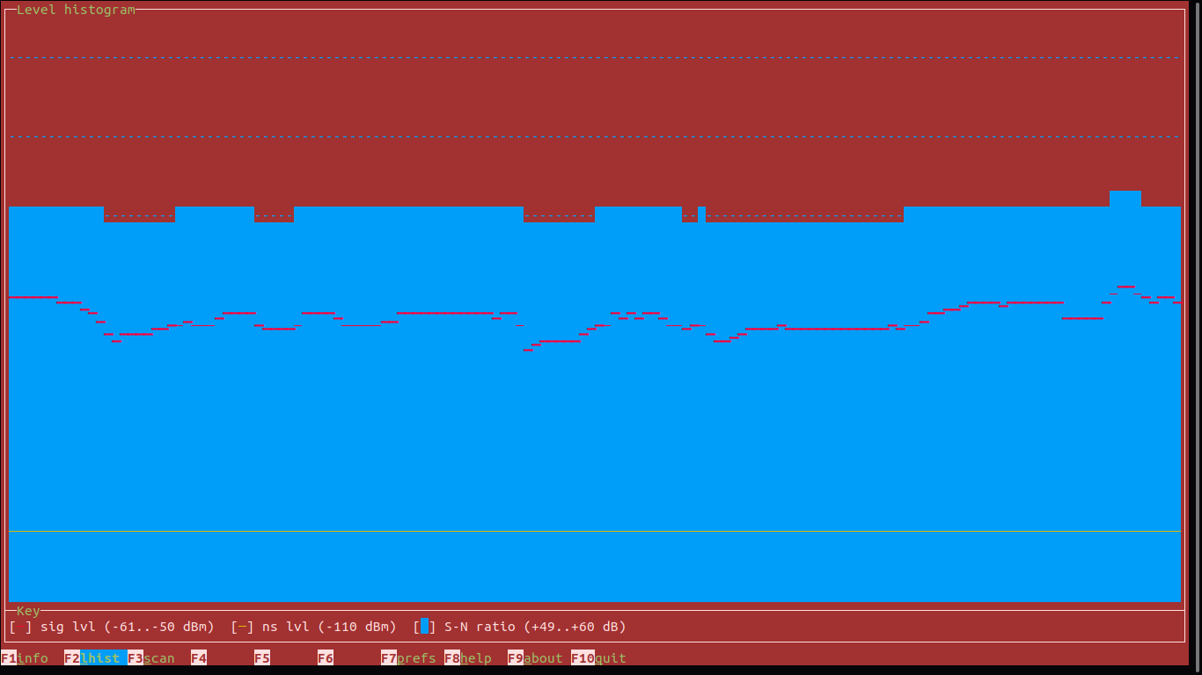
Signal Graph
WF card Radio Frequency Data Graph

Slide 8
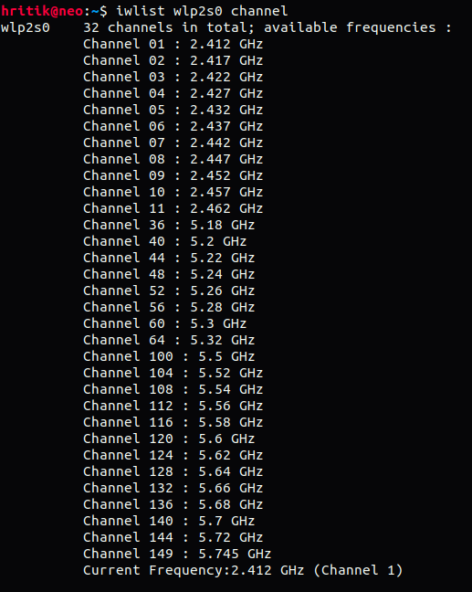
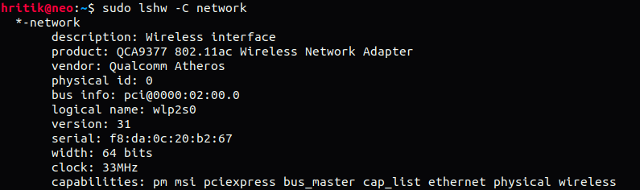

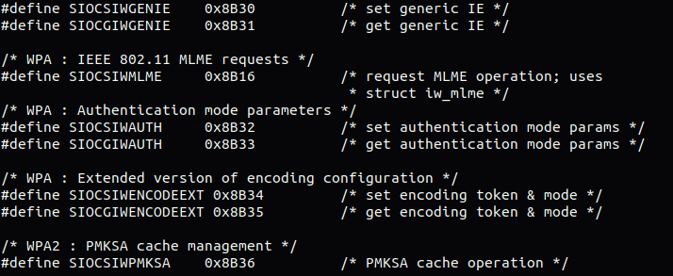

Slide 9
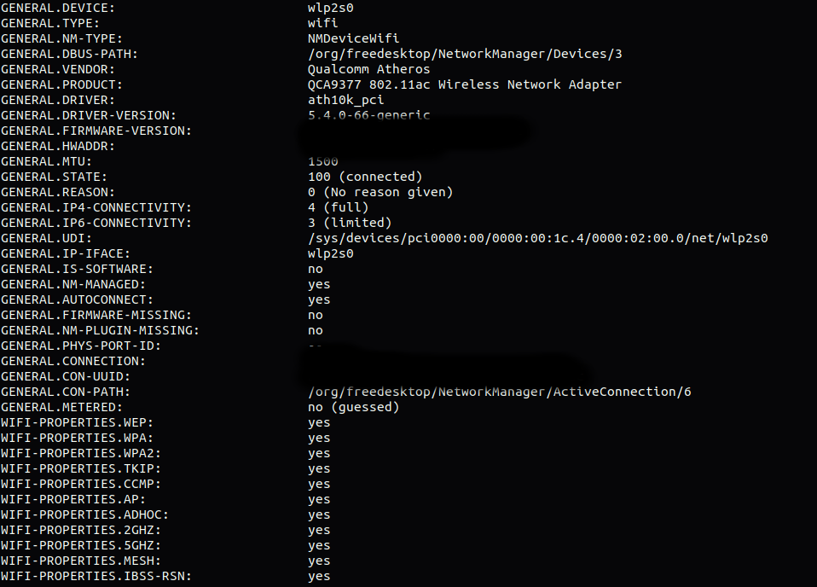

Slide 10
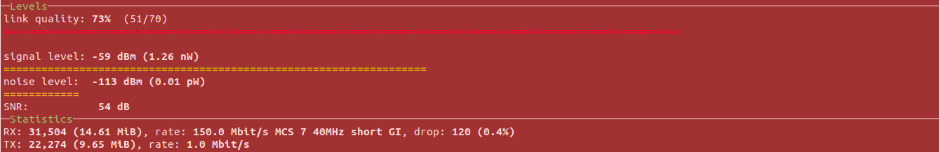
Graphical Link Level info for the card

Slide 11

Expected Outcome
A prototype solution to recognize the presence of drones using machine learning in any airspace by means of using a rudimentary networking source such as a wireless card.

Slide 12

Software/Hardware
Python

Slide 13
Time-Line
I Review
- Literature Survey
II Review
- Testing and Validation
III Review
- Integration
Final

Slide 14
References
[1] CSI-HC: A WiFi-Based Indoor Complex Human Motion Recognition Method
[2] Detection and Classification of UAVs Using RF Fingerprints in the Presence of Interference
[3] Detection and Classification of UAVs Using RF Fingerprints in the Presence of Wi-Fi and Bluetooth Interference
[4] Drone Presence Detection by Identifying Physical Signatures in the Drone’s RF Communication
[5] Uncover the Power of Multipath : Detecting NLOS Drones Using Low-Cost WiFi Devices
[6] Blind Detection: Advanced Techniques for WiFi-based Drone Surveillance

