Slide 1
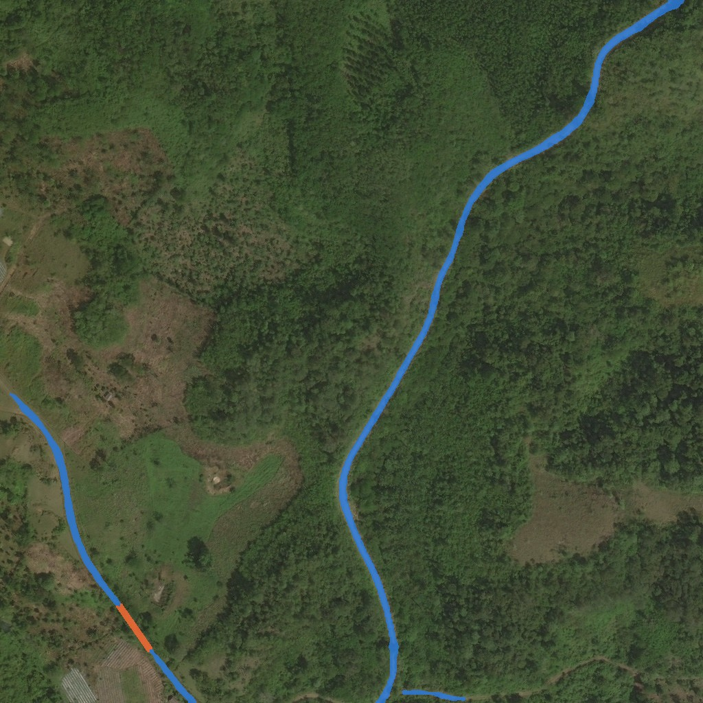
RESEARCH PROJECT
Topology-Aware Rural Road Extraction from Satellite Imagery
A 1.6 M-parameter MobileViT v2 pipeline that maps rural roads, is designed to keep them connected where canopy breaks them, and runs on a laptop CPU.
DeepGlobe Road Extraction · PyTorch · ONNX Runtime
Model output on DeepGlobe tile 100034 (blue: predicted road, orange: bridged gap)
Notes:
This project builds a lightweight deep-learning pipeline that turns a satellite image tile into a connected road map, with particular attention to rural roads hidden under trees. The image on the right is the real output of the final model on a DeepGlobe tile: blue pixels are predicted road.

Slide 2
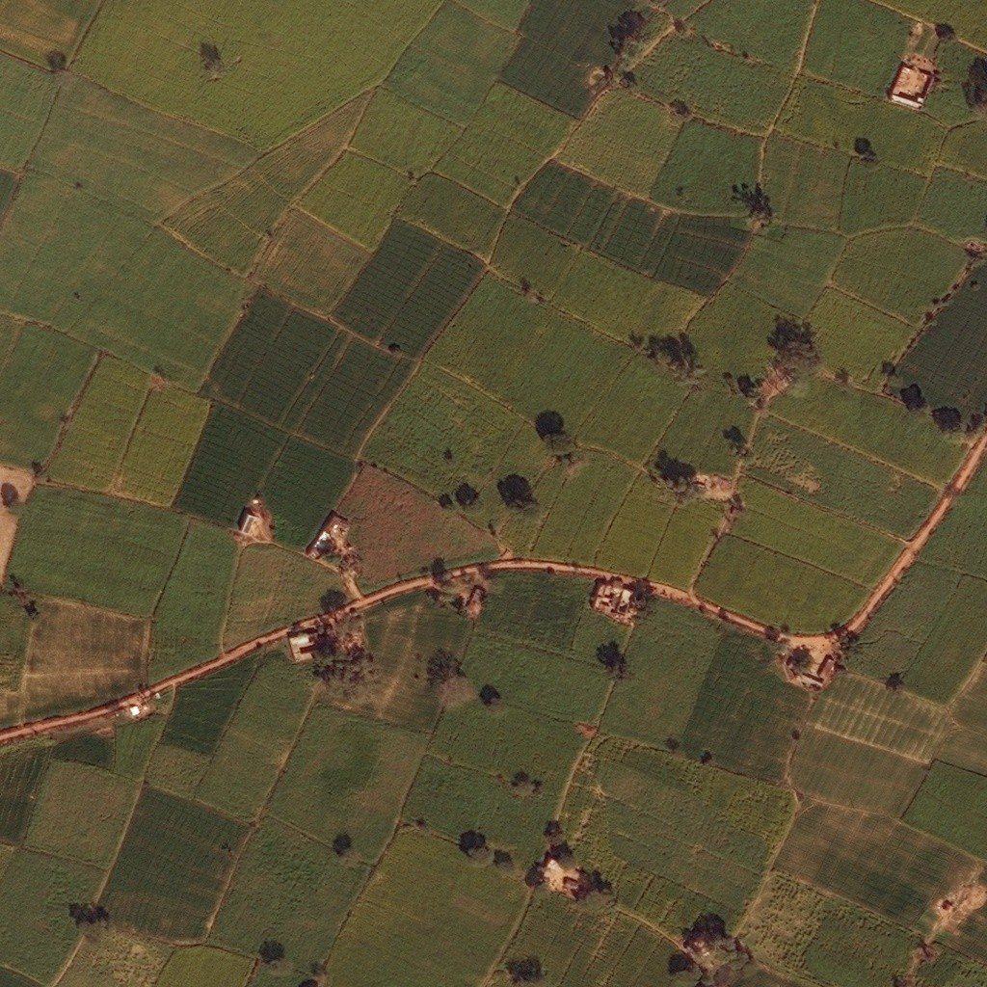
01 · PROBLEM
Rural roads are hard to map from above
Programmes such as India’s PMGSY need frequent, large-area audits of rural roads — today largely done through manual ground surveys.
Satellite imagery (0.5 m per pixel) could map roads at scale, automatically.
Rural roads are narrow, unpaved and close in colour to fields and field boundaries.
Tree canopy and shadows hide stretches of road, so pixel classifiers return broken, disconnected fragments instead of a usable network.
Surveys happen in the field: the model has to run on modest hardware without a GPU.
Goal turn a satellite tile into a connected road network — even where trees cover the road.
DeepGlobe tile 115714: an unpaved road among fields whose boundaries look much like roads.
2
Notes:
Rural road auditing is slow when done on the ground. High-resolution satellite imagery covers large areas, but rural roads are thin, unpaved, and low-contrast against farmland, and trees or shadows often hide parts of them. A standard segmentation model then produces broken pieces rather than a network you could navigate or audit. The tile shown is a real DeepGlobe sample: a dirt road through farmland, where field boundaries have almost the same colour and shape as the road.

Slide 3
02 · CHALLENGES & APPROACH
Four challenges, four design responses
1
2
3
4
Thin, irregular roads
Canopy & shadow occlusion
Severe class imbalance
Edge-hardware limits
Roads are a few pixels wide and wind through fields.
Trees hide stretches of road, breaking connectivity.
Roads cover only a few percent of pixels.
Field devices have no GPU and little memory.
OUR RESPONSE
OUR RESPONSE
OUR RESPONSE
OUR RESPONSE
Strip convolutions (1×3 then 3×1) act as directional road detectors.
Topology-aware clDice loss in training; canopy-gap bridging at inference.
Weighted BCE + soft Dice, with checkpoint selection guarded against collapse.
MobileViT v2 with linear-cost attention: 1.6 M parameters, ONNX export.
3
Notes:
Each challenge maps to a specific design choice. Thin roads motivate directional strip convolutions. Occlusion motivates a topology-aware loss (clDice), which rewards predictions that preserve the road's centerline, plus a geometric gap-bridging step after inference. Class imbalance motivates weighted BCE and Dice, and - as we learned the hard way - a checkpoint-selection rule that cannot be fooled by a model that predicts road everywhere. Edge constraints motivate a small MobileViT v2 backbone.

Slide 4
03 · EXISTING APPROACHES
What exists, and where it falls short here
Approach | Key idea | Limitation for rural roads on the edge | Params* | GFLOPs*
U-Net (Ronneberger et al., 2015) | Encoder–decoder with skip connections | Heavy; pixel-wise loss ignores connectivity | 31.0 M | 1,541
D-LinkNet34 (Zhou et al., 2018) | ResNet-34 + dilated centre; DeepGlobe 2018 winner | Heavy; no explicit connectivity objective | 31.1 M | 213
DeepLabV3 / LR-ASPP + MobileNetV3 | Lightweight mobile segmentation heads | No topology prior for thin structures | 3.2–11.0 M | 16–79
Vision Transformers (Dosovitskiy et al., 2021) | Global context via self-attention | Attention cost grows quadratically with image size | — | —
clDice loss (Shit et al., 2021) | Overlap measured on skeletons (centerlines) | A loss, not a model; can reward over-prediction (seen here) | — | —
RoadTracer / Sat2Graph (2018 / 2020) | Predict the road graph directly | Iterative or multi-stage inference; complex to deploy | — | —
This work | MobileViT v2 + strip conv + clDice + gap bridging | — | 1.6 M | 61
* Measured on the same CPU (Intel i5-1035G4) per 1024² tile with untrained models: compute cost only. Accuracy of the reference models was not measured.
4
Notes:
Standard CNN segmenters like U-Net and D-LinkNet (the DeepGlobe 2018 road-challenge winner) work well on clear roads but are heavy and optimise pixels, not connectivity. Mobile segmentation heads are light but have no notion of thin, connected structures. Transformers give global context but plain self-attention is expensive at high resolution. clDice is a loss that measures agreement on skeletons. Graph methods predict the road network directly but are complex. The parameter and FLOP columns were measured on the same laptop CPU for every model - these are compute numbers only, since the reference models were not trained here.

Slide 5
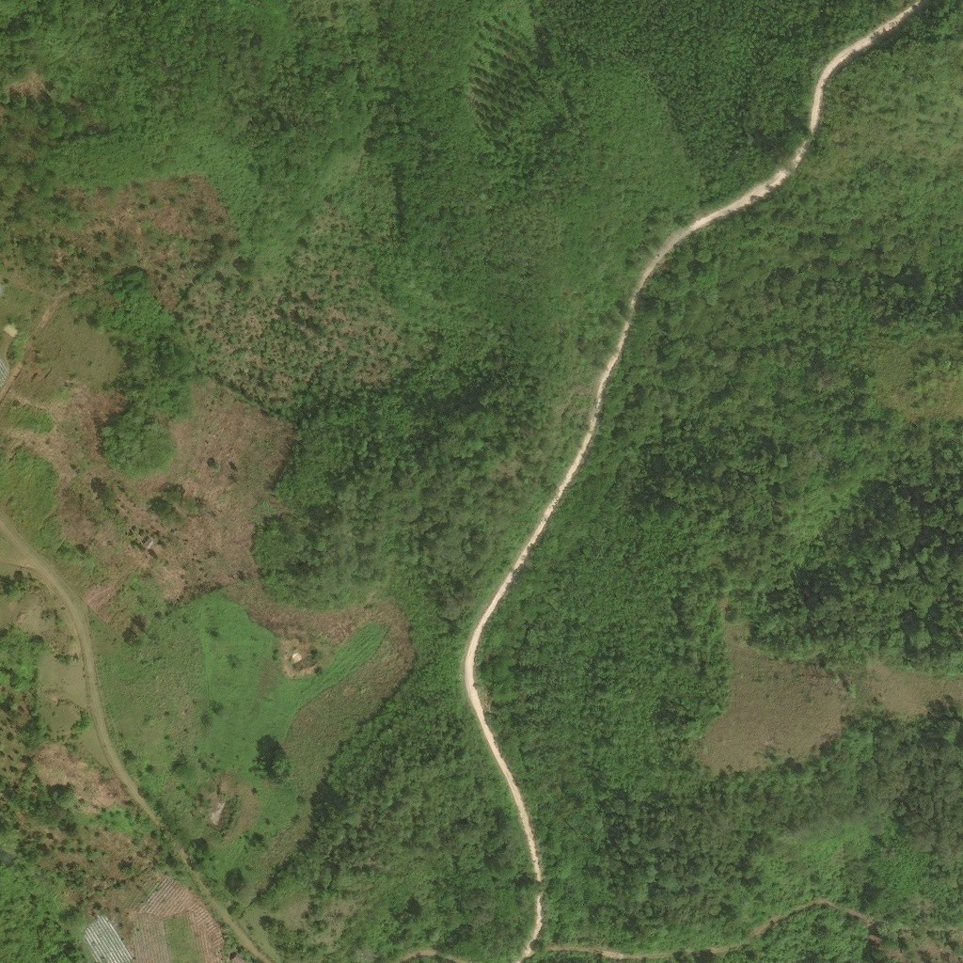
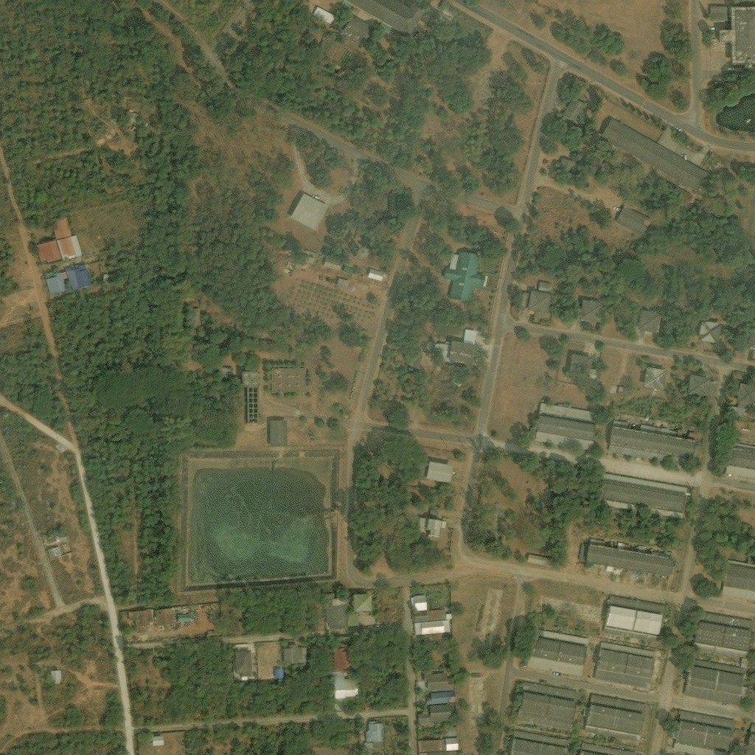
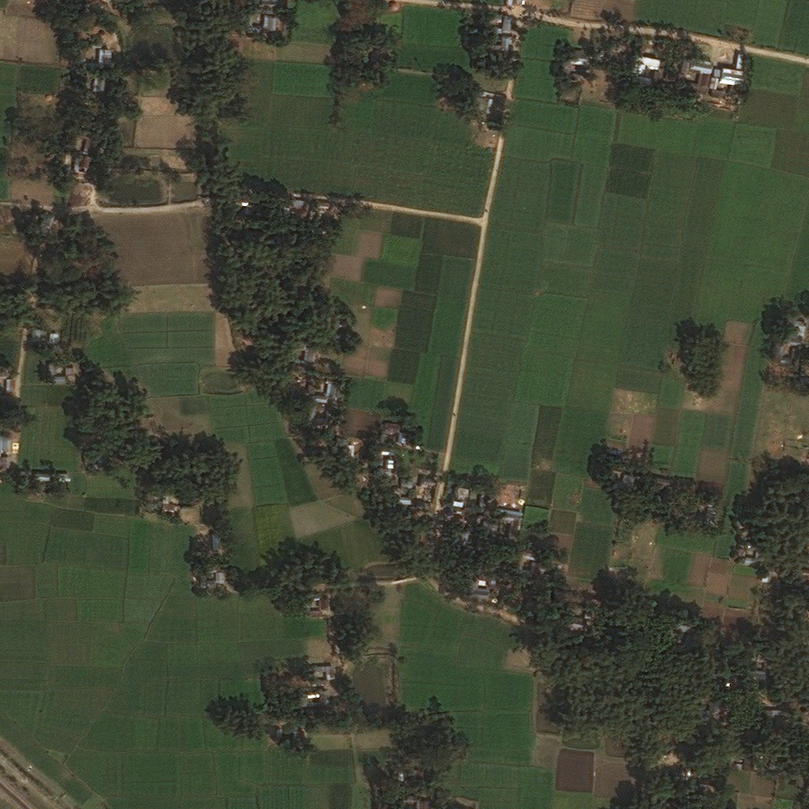
04 · DATA
DeepGlobe Road Extraction dataset
6,226
1024²
labelled satellite tiles
pixels per tile
0.5 m
5,604 / 622
ground distance per pixel
train / validation tiles
Tile 100034
Tile 102408
Demir et al., CVPR Workshops 2018; imagery of Thailand, Indonesia and India with binary road masks.
The official validation and test sets have no public masks, so a held-out 10% of the labelled set (seed 42) is used for validation.
Training samples random 256² crops at native resolution, with flips and brightness / colour jitter.
Tile 115714
Tile 117991
5
Notes:
DeepGlobe provides 6,226 labelled 1024x1024 tiles at 50 cm per pixel. Because the official validation and test masks were never released, every training run held out a fixed 10% of the labelled tiles (622 tiles, seed 42) for validation. The four tiles shown are real samples used throughout the slides: forest road, dense settlement, farmland, and a village with tree cover.

Slide 6
05 · METHOD OVERVIEW
From satellite tile to connected road network
TRAINING
DeepGlobe tiles
(5,604)
Augment
256² crops, flips
MobileViT v2
encoder–decoder
Composite loss
BCE + Dice + clDice
Select checkpoint
val IoU + collapse gate
INFERENCE
Satellite tile
(any size ÷32)
4-flip test-time
augmentation
Road probability
map
Hysteresis
+ closing
Canopy-gap
bridging
Connected
road mask
Deployment the trained network is exported to ONNX and runs with ONNX Runtime + OpenCV only — no PyTorch or GPU needed on the field device.
6
Notes:
Training: tiles are cropped to 256x256 at native resolution and augmented; the network is trained with a loss that combines pixel accuracy (BCE, Dice) and topology (clDice); the checkpoint is chosen by validation IoU with a hard gate that rejects collapsed epochs. Inference: a full tile goes through the network four times (original plus three flips) and the probabilities are averaged; the map is thresholded with hysteresis, closed morphologically, and then dead-end road segments that face each other across a gap are bridged. The highlighted boxes are the project's two core components.

Slide 7
06 · MODEL
MobileViT v2 encoder–decoder — 1.60 M parameters
ENCODER
Input
3 · H
Strip-conv stem
32 · H/2
MV2 ↓
64 · H/4
MobileViT v2
64 · H/4
MV2 ↓ +
MobileViT v2
96 · H/8
MV2 ↓ +
MobileViT v2 ×3
128 · H/16
Strip convolution
1×3 then 3×1 filters: directional, ~33% fewer weights than a 3×3.
Channel shift
25% of channels shifted ±2 px in four directions: wider context, zero parameters.
DECODER
1×1 head
1 · H
Decoder
32 · H/2
Decoder
64 · H/4
Decoder
96 · H/8
Separable self-attention
MobileViT v2 attention: global context at linear cost in image size.
Dashed: skip connections, each filtered by an attention gate. Channels · resolution for an H×H input.
Attention gates
Learned masks on skip connections suppress roof and field-edge clutter.
1.60 M
61
6.1 MB
parameters
GFLOPs per 1024² tile
weights (fp32)
7
Notes:
The encoder mixes cheap convolutional blocks with MobileViT v2 blocks, which add global context through separable self-attention whose cost grows linearly with image size rather than quadratically. A channel shift in front of each transformer block widens the receptive field for free. The decoder upsamples back to full resolution using strip convolutions, and each skip connection passes through an attention gate that learns to suppress clutter such as roof edges and field boundaries. Parameter and FLOP counts are measured from the trained checkpoint.

Slide 8
07 · TRAINING
Loss that rewards connected roads, trained with guard rails
Composite loss
Loss weights over training
L = α(e)·BCE + 0.35·Dice + (0.65 − α(e))·clDice
BCE (road pixels weighted ×2) and soft Dice teach where roads are.
clDice compares skeletons, penalising breaks in a road’s centerline.
α starts at 0.50 and decays to 0.15 by epoch 40, shifting weight to clDice.
Setting | Value
Optimiser | AdamW, lr 1e-3, cosine decay
Batch | 16 × 256² crops, mixed precision
Initialisation | Warm start from June baseline
Early stopping | Patience 35 on validation IoU
Best checkpoint | Epoch 53 (0-indexed)
Epoch (0-indexed). Schedule computed from the training hyper-parameters.
8
Notes:
The loss combines three terms. BCE with road pixels weighted twice as heavily, and soft Dice, both reward getting road pixels right. clDice, from Shit et al. 2021, compares the predicted and true road skeletons and penalises breaks in the centerline - the property we care about under canopy. Early in training BCE dominates so the network first learns where roads are; alpha then decays so clDice takes over. The model was warm-started from the earlier June baseline and trained on a Kaggle GPU; the best checkpoint by validation IoU was epoch 53. Note: a canopy-shadow augmentation exists in the code, but we found its constructor call silently disabled it on newer albumentations versions, so we do not claim it was active during training; the bug is now fixed.

Slide 9
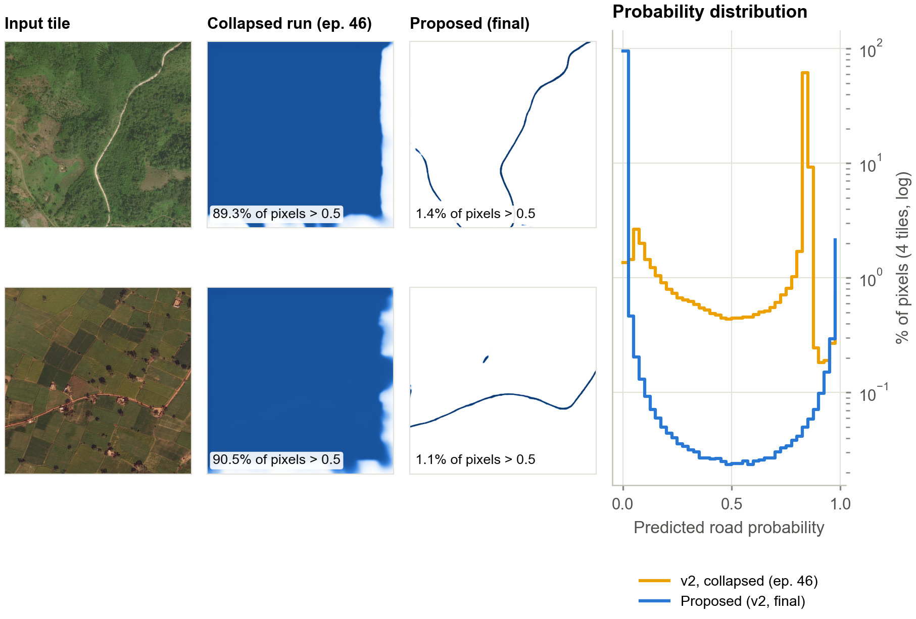
08 · A FAILURE WE FIXED
Diagnosing a training collapse
SYMPTOM
The collapsed checkpoint marked 81% of pixels as road on the sample tiles (fixed model: 3.2%).
CAUSE
Road pixels were weighted ×3, pushing a freshly initialised decoder toward “everything is road”; checkpoints were chosen by soft clDice, which scores a blanket prediction well.
FIX
Weight ×2; select checkpoints by IoU; reject any epoch predicting >20% road; warm-start from the working baseline.
The collapsed run’s logged validation clDice loss was 0.215 — better-looking than the fixed model’s 0.701 — which is why it was saved as “best”.
9
Notes:
An earlier version of the model converged to predicting road almost everywhere - about 90% of every tile. Two things combined: the positive-class weight of 3 made 'everything is road' a cheap way to reduce the loss for a freshly initialised decoder, and the training script kept whichever epoch had the lowest soft clDice loss. clDice's sensitivity term saturates when the prediction covers the whole image, so the collapsed epoch looked like the best one. We lowered the weight to 2, switched checkpoint selection to IoU, added a hard gate that rejects any epoch predicting more than 20% road, and warm-started from the working baseline. The plots show real outputs of both checkpoints on the same tiles.

Slide 10
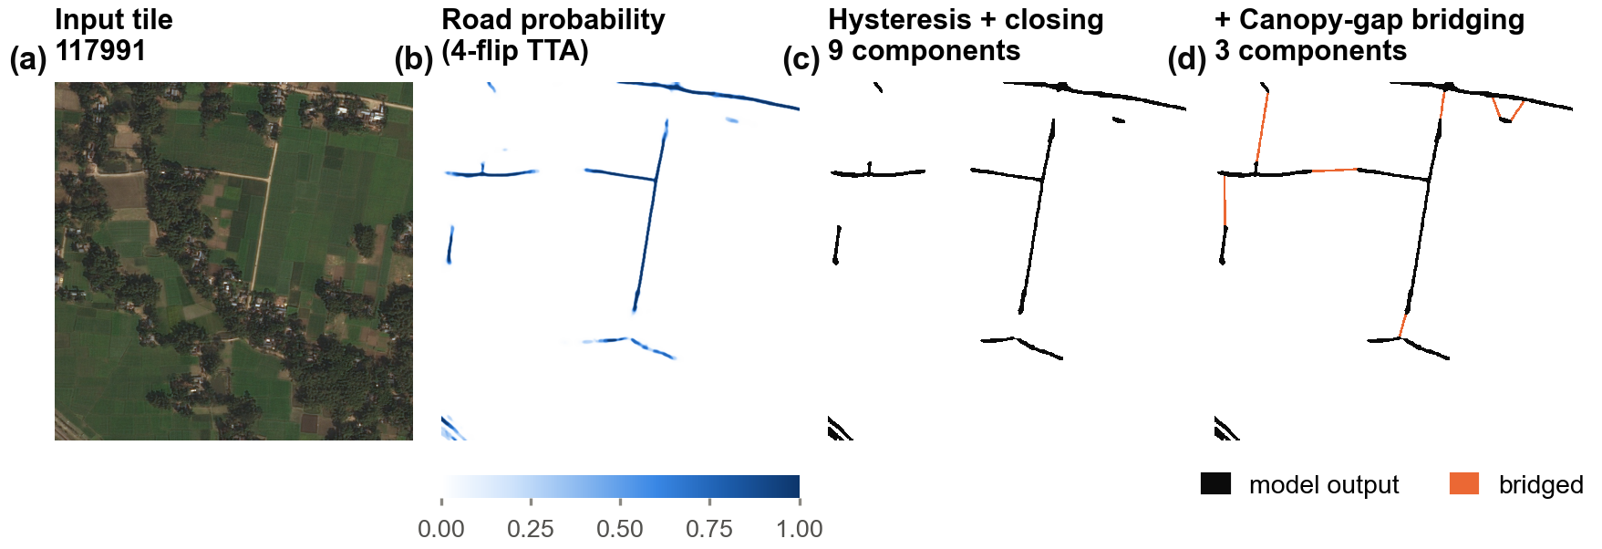
09 · INFERENCE
Reconnecting fragmented roads
1
Hysteresis threshold
2
Morphological closing
3
Canopy-gap bridging
Keep weak road pixels (0.12–0.35) only where they touch confident ones (≥0.35).
A 5×5 closing seals hairline breaks in the mask.
Skeletonise, find dead ends, and join pairs that face each other within 220 px and 65°; complete T-junctions. Road exits at the tile border are ignored.
10
Notes:
This is a real tile (117991) processed by the deployed pipeline. The averaged probability map is thresholded with hysteresis, which keeps faint road evidence (such as partially occluded road) as long as it connects to confident road. Closing seals tiny breaks. Bridging then skeletonises the mask, finds dead ends, and joins pairs that point at each other across a gap. On this tile the number of separate road pieces drops from 9 to 3. While preparing these slides we found that the original bridging also joined roads that simply leave the tile, drawing fake roads along the border; endpoints near the border are now ignored. Bridging can still add false links, which the ground-truth evaluation measures.

Slide 11
10 · TOOLS
Technology stack
1
2
3
4
PyTorch
Albumentations
OpenCV · scikit-image
ONNX · ONNX Runtime
Model definition, training with mixed precision
Crops, flips, colour and canopy-shadow augmentation
Thresholding, morphology, skeletons, gap bridging
Export and PyTorch-free inference on CPU / edge
5
6
7
8
Kaggle GPU notebooks
NetworkX
Streamlit
Matplotlib
Training and held-out evaluation
Converting road masks into graphs
Interactive demo application
All figures, from measured data
11
Notes:
The model and training loop are written in PyTorch; augmentation uses Albumentations. Post-processing uses OpenCV and scikit-image. The trained network is exported to ONNX so field devices only need ONNX Runtime and OpenCV. Training and evaluation ran in Kaggle GPU notebooks. A Streamlit app provides an interactive demo.

Slide 12
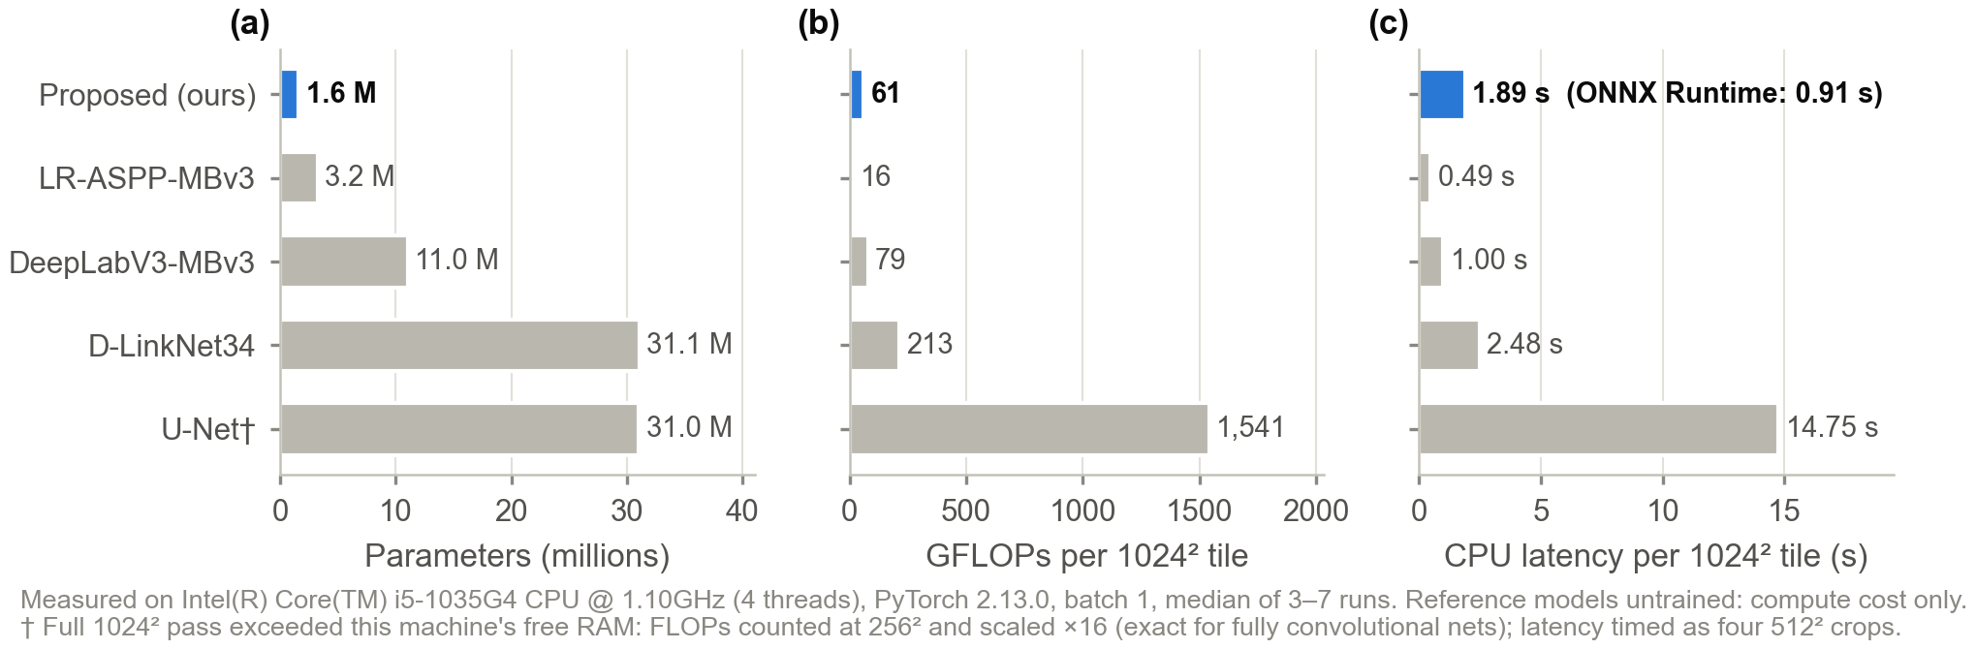
11 · RESULTS: EFFICIENCY
Measured compute cost
1.6 M
61
0.91 s
6.9 MB
parameters — 19× fewer than U-Net
GFLOPs per 1024² tile — 25× fewer than U-Net
per tile with ONNX Runtime on a laptop CPU
deployable ONNX model (graph + weights)
12
Notes:
All of these numbers were measured on the same laptop CPU (Intel(R) Core(TM) i5-1035G4 CPU @ 1.10GHz), batch size 1, on a full 1024x1024 tile. The proposed model has 1,604,657 parameters and needs 61 GFLOPs per tile, far below U-Net and D-LinkNet. Honest caveat: LR-ASPP with MobileNetV3 is cheaper still (16 GFLOPs, 0.49 s), so our efficiency advantage is over U-Net-class models, not over every mobile network - and its accuracy on this task was not measured. The deployable ONNX model is 6.9 MB: a small graph file plus a separate weights file that must ship with it.

Slide 13
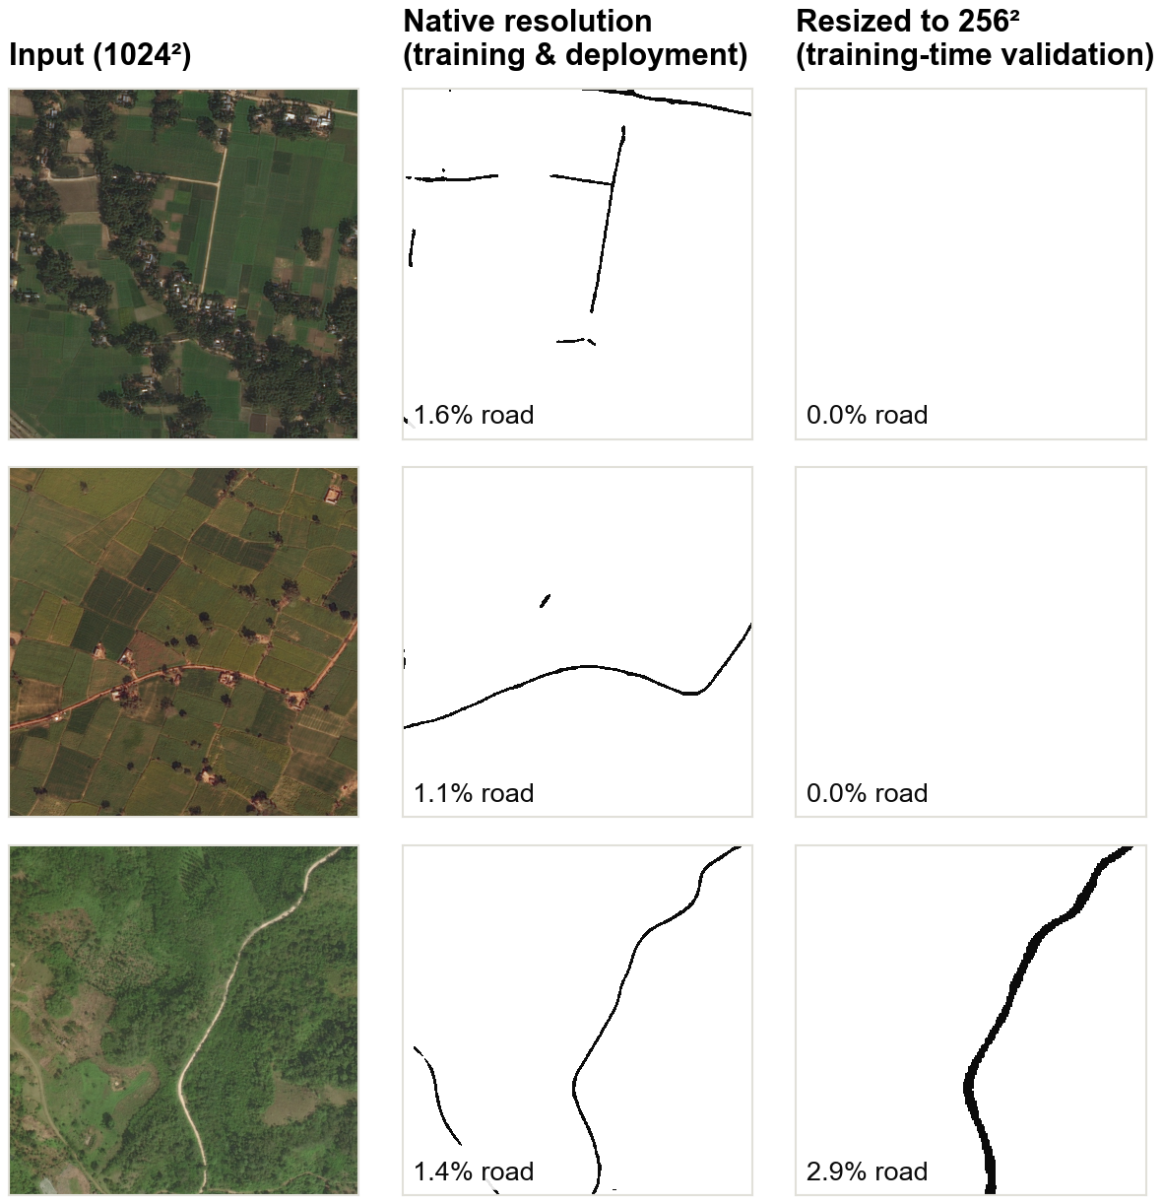
12 · RESULTS: VALIDATION
Training-time validation, and what it missed
Checkpoint | Epoch | Val IoU | Precision | Pred. road | clDice loss
June baseline (no gates) | 17 | not logged | — | — | 0.798
v2 collapsed run | 46 | not logged | — | — | 0.215
v2 run 1 | 18 | 15.9% | 50.3% | 4.1% | 0.715
v2 final | 53 | 16.8% | 49.4% | 4.9% | 0.701
Values stored in each checkpoint, measured during training on the 622 validation tiles resized to 256².
Finding: the validation protocol under-measured the model
Validation shrank each 1024² tile to 256², making roads 4× thinner than anything seen in training.
On 2 of 3 sample tiles the model then finds no road at all, while at native resolution it does (right).
The logged IoU of 16.8% therefore understates the deployed model; the evaluation notebook measures it at native resolution on the same held-out tiles.
13
Notes:
These are the validation metrics saved inside each checkpoint during training. The final model reached 16.8% IoU and about 49% precision at epoch 53. But while preparing the results we found that validation resized each 1024 pixel tile down to 256 pixels, whereas training used native-resolution crops. Roads become four times thinner than anything the model trained on, and on two of the three tiles shown it finds nothing at all. The same model at native resolution - how it is actually deployed - finds the roads. So the logged IoU understates real performance, and checkpoint selection was also made at the wrong scale. The validation code is now fixed.

Slide 14
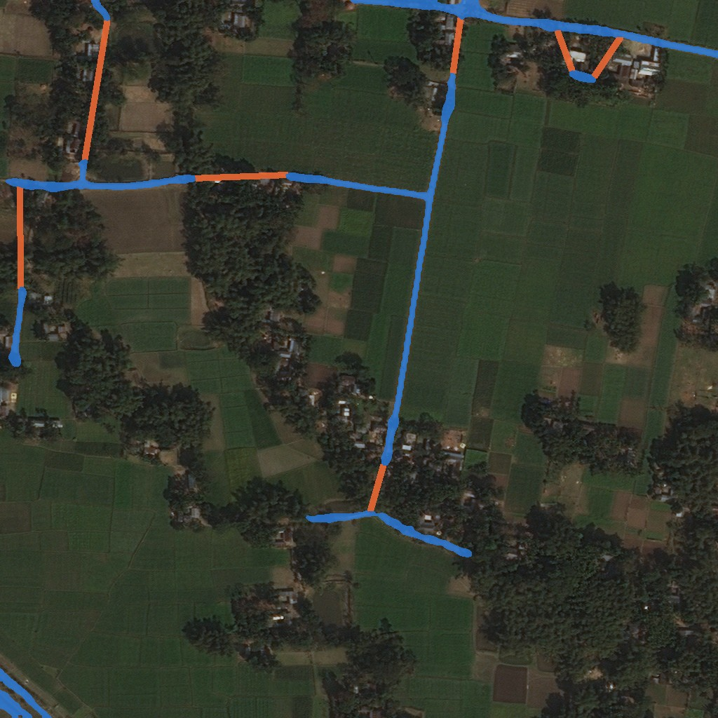
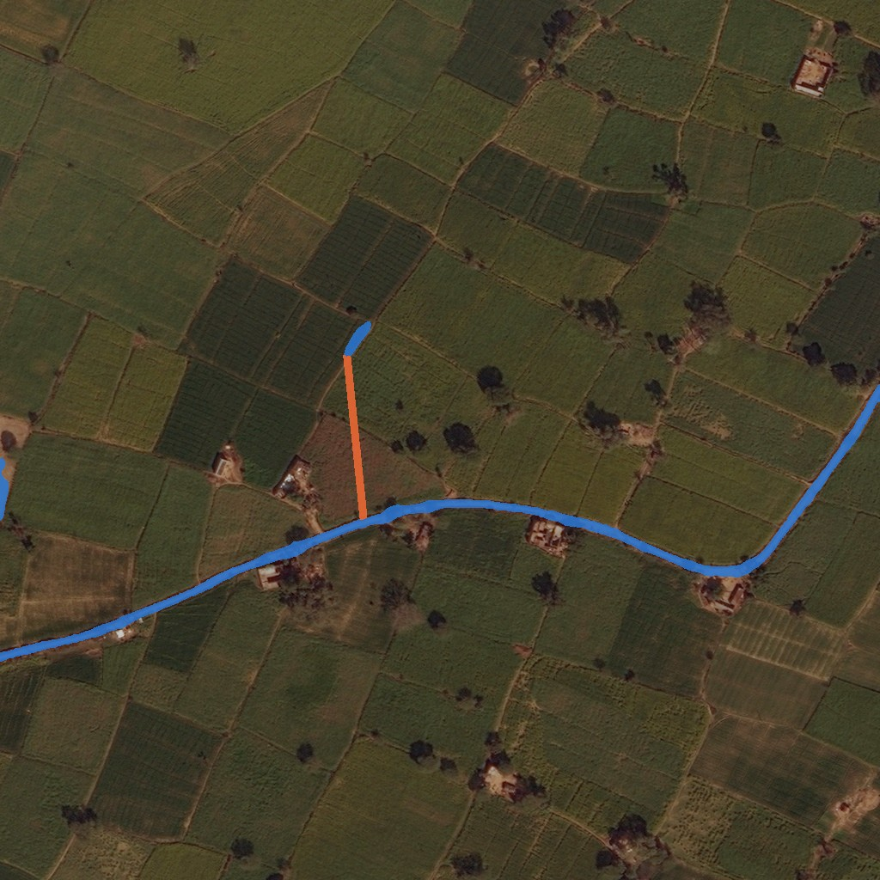
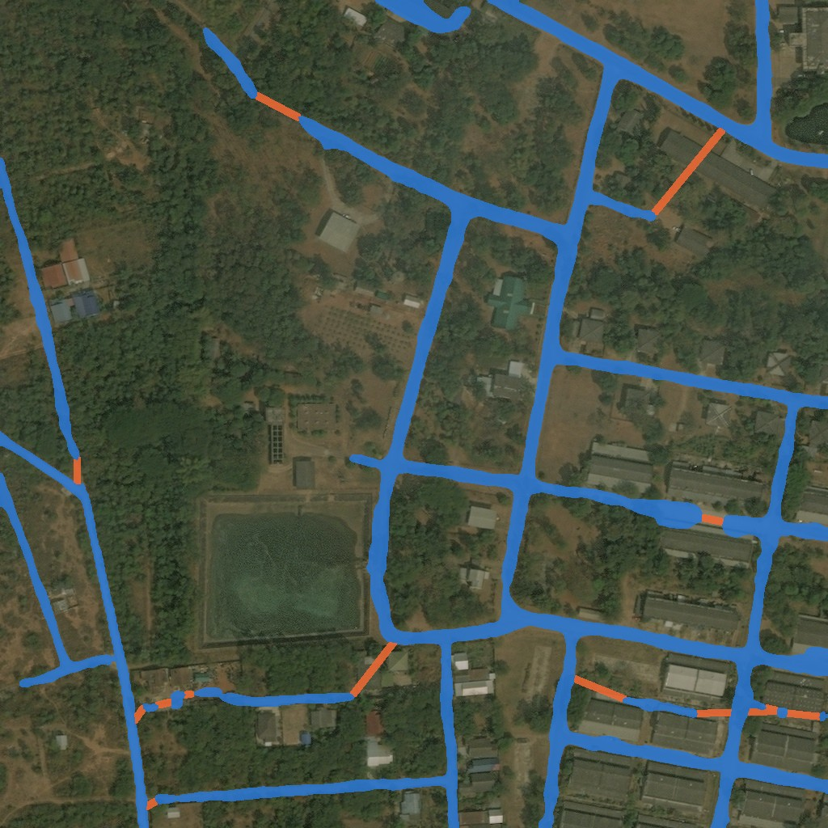
13 · RESULTS: OUTPUTS
Deployed pipeline on real tiles
Tile 100034 · 1.8% road
Tile 117991 · 2.7% road
Tile 115714 · 1.4% road
Tile 102408 · 11.4% road
predicted road
added by canopy-gap bridging
Sample tiles without ground truth — accuracy is measured on the held-out split.
Continuous where the road is visible
Field boundaries still fool it
Dense areas need ground truth
The forest road (100034) and the farm road (115714) are traced end to end in a single piece.
On 115714 a field boundary is bridged into a short spur off the main road — a likely false positive.
In the settlement (102408) the street grid is plausible, but some bridges may join paths between buildings.
14
Notes:
These are real outputs of the final model with the full deployed pipeline: four-flip test-time augmentation, hysteresis thresholding, closing and gap bridging. Blue is predicted road, orange marks segments added by bridging. The forest road on the left is traced continuously. These sample tiles have no ground truth, so they show behaviour, not accuracy.

Slide 15
14 · DEPLOYMENT
Runs without PyTorch on field hardware
PyTorch
checkpoint
ONNX export
sigmoid in graph,
dynamic H × W
Parity check
vs PyTorch
ONNX Runtime
+ OpenCV
Connected
road mask
6.9 MB
0.91 s
< 10⁻⁶
5
model on disk
per 1024² tile, Intel i5-1035G4
max |difference| vs PyTorch output
Python packages on the device
Picks the best available execution provider: CUDA / TensorRT (Jetson), CoreML (Apple), NNAPI (Android), or CPU.
Same hysteresis and gap-bridging post-processing as the PyTorch path; four-flip TTA is optional (about 4× the time).
A Streamlit app wraps the ONNX model for interactive demonstrations.
15
Notes:
For deployment the network is exported to ONNX with the sigmoid inside the graph and dynamic height and width, so any tile size divisible by 32 works. The export script checks the ONNX output against PyTorch and the maximum difference was below one millionth. On the device, only ONNX Runtime, OpenCV, NumPy, SciPy and scikit-image are needed. The latency shown is a single pass; test-time augmentation multiplies it by about four.

Slide 16
16 · CONCLUSION
What we built, what we learned, what’s next
Outcomes
Limitations & next steps
A 1.6 M-parameter road extractor that runs in 0.9 s per tile on a laptop CPU via ONNX.
Diagnosed and fixed a training collapse caused by class weighting plus a gameable selection metric.
Gap bridging reconnects fragmented predictions (e.g. 9 → 3 pieces on a sample tile); its effect under canopy is measured against ground truth.
Found and fixed three pipeline bugs: validation scale mismatch, a silently disabled augmentation, and bridging along tile borders.
Retrain with native-resolution validation, so checkpoints are selected at the scale the model is used.
Report held-out accuracy from the evaluation notebook; the 16.8% IoU logged in training likely understates native-resolution performance.
Tune gap bridging against ground truth — it can also create false links.
Train a mobile CNN (LR-ASPP) on the same data for a fair accuracy–cost comparison; report APLS with the official SpaceNet code.
16
Notes:
To summarise: the pipeline works end to end and is light enough for field hardware. The most valuable lessons came from failures - a collapse hidden by a flattering metric, a validation step run at the wrong scale, an augmentation that silently never ran, and a bridging rule that invented roads along tile borders. Each is now fixed. Next steps are a retrain with native-resolution validation and a fair comparison against a trained mobile CNN.

Slide 17
Thank you
Questions and discussion
github.com/Hrithik-Bhattacharya/Satellite-Imagery-based-Road-Network-Extraction

