Slide 1



SMART INDIA HACKATHON 2026
TITLE PAGE
Problem Statement ID – 26172
Problem Statement Title- Low Latency and
Efficient Voice Activator for Edge Devices
Theme - Smart Automation
PS Category- Hardware
Team ID-
Team Name (Registered on portal) - TRINETRA

Slide 2
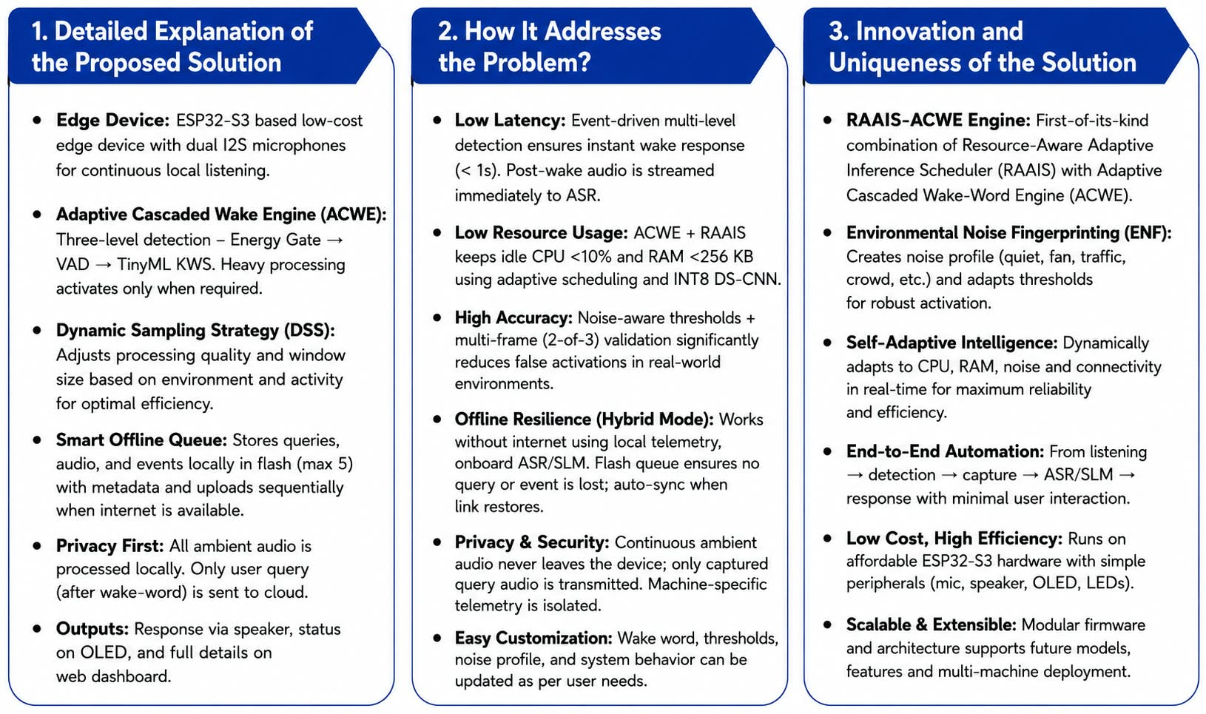
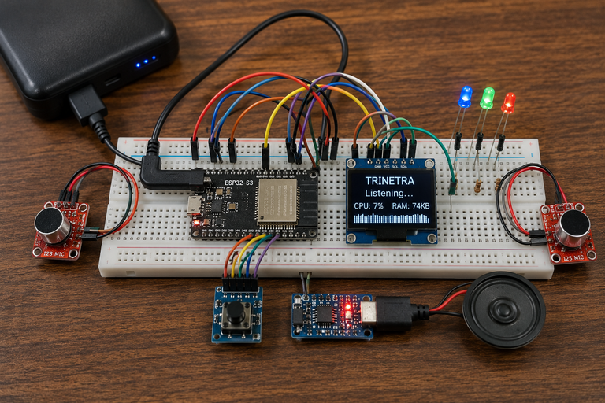
TRINETRA – Adaptive Edge Intelligence for Low-Latency Voice Activation
TRINETRA
Proposed Solution (Describe your Idea/Solution/Prototype)
2
Notes:
2

Slide 3
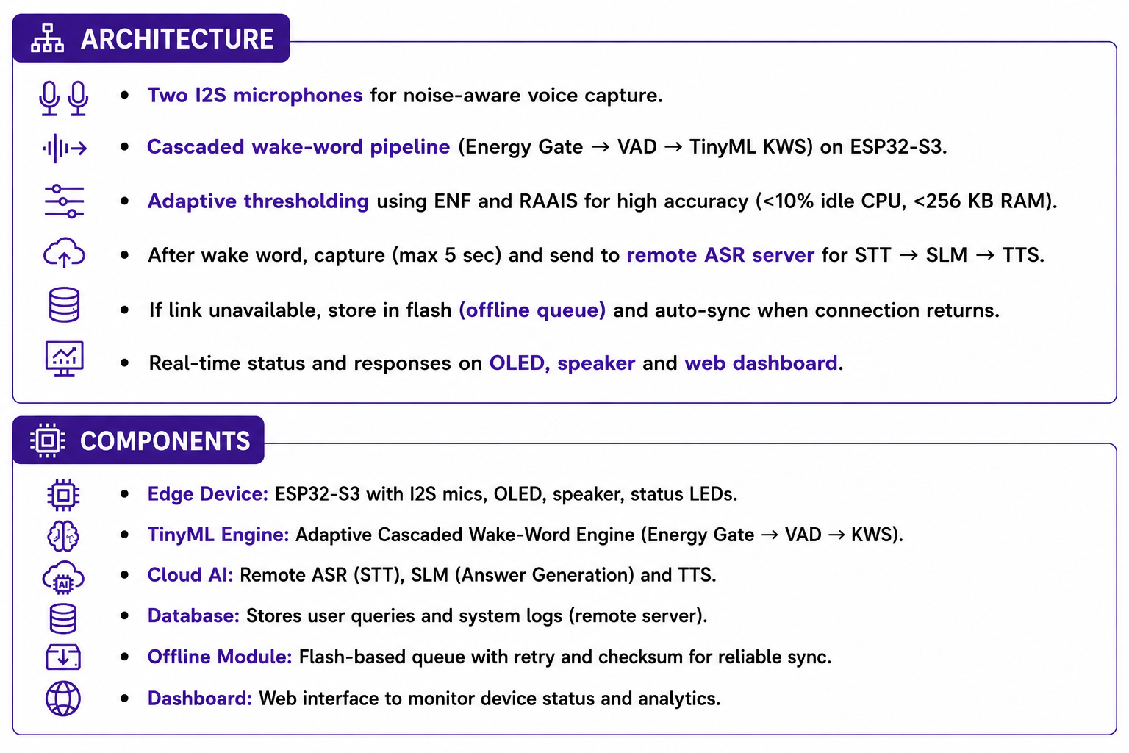
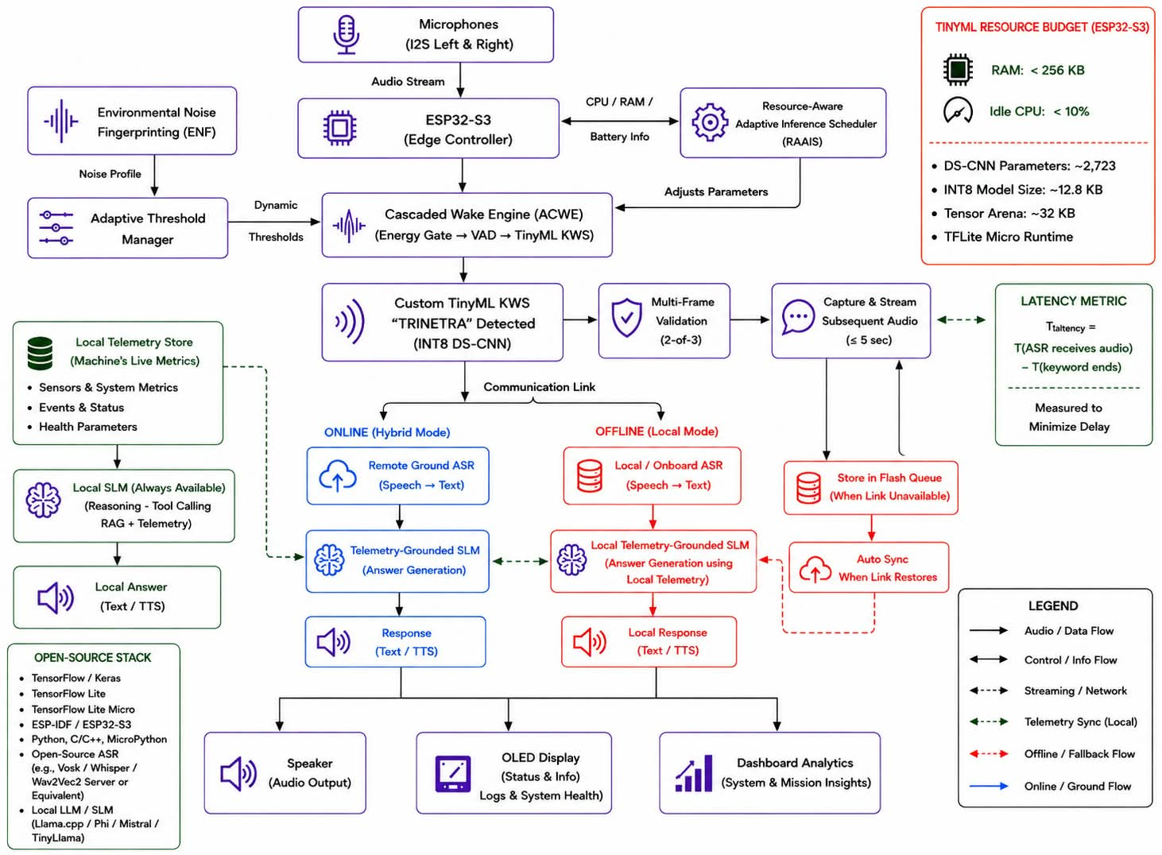
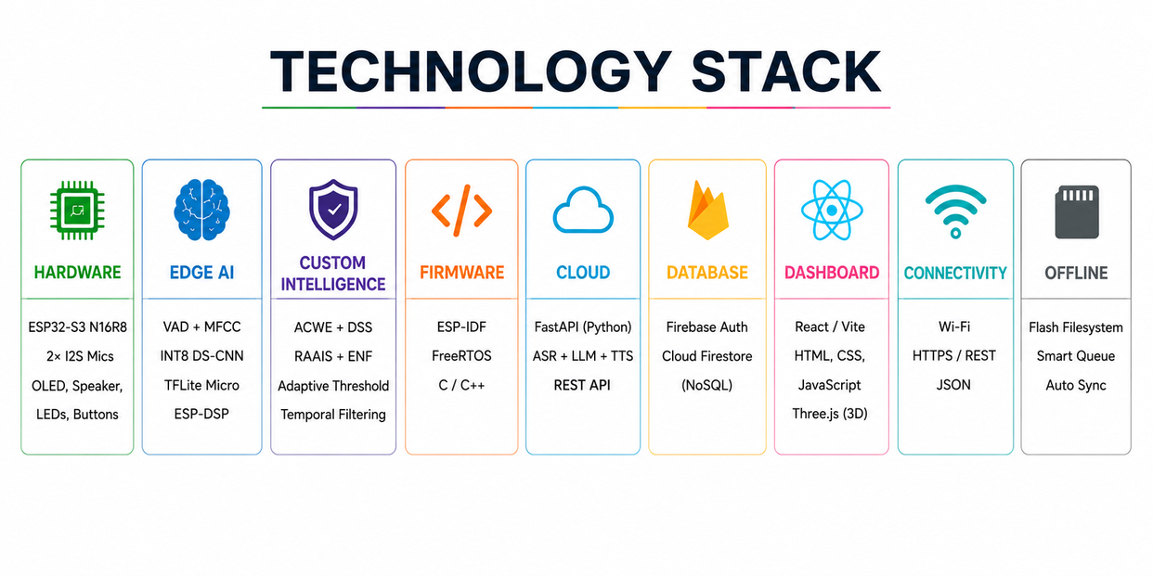
TECHNICAL APPROACH
TRINETRA
3
Notes:
3

Slide 4
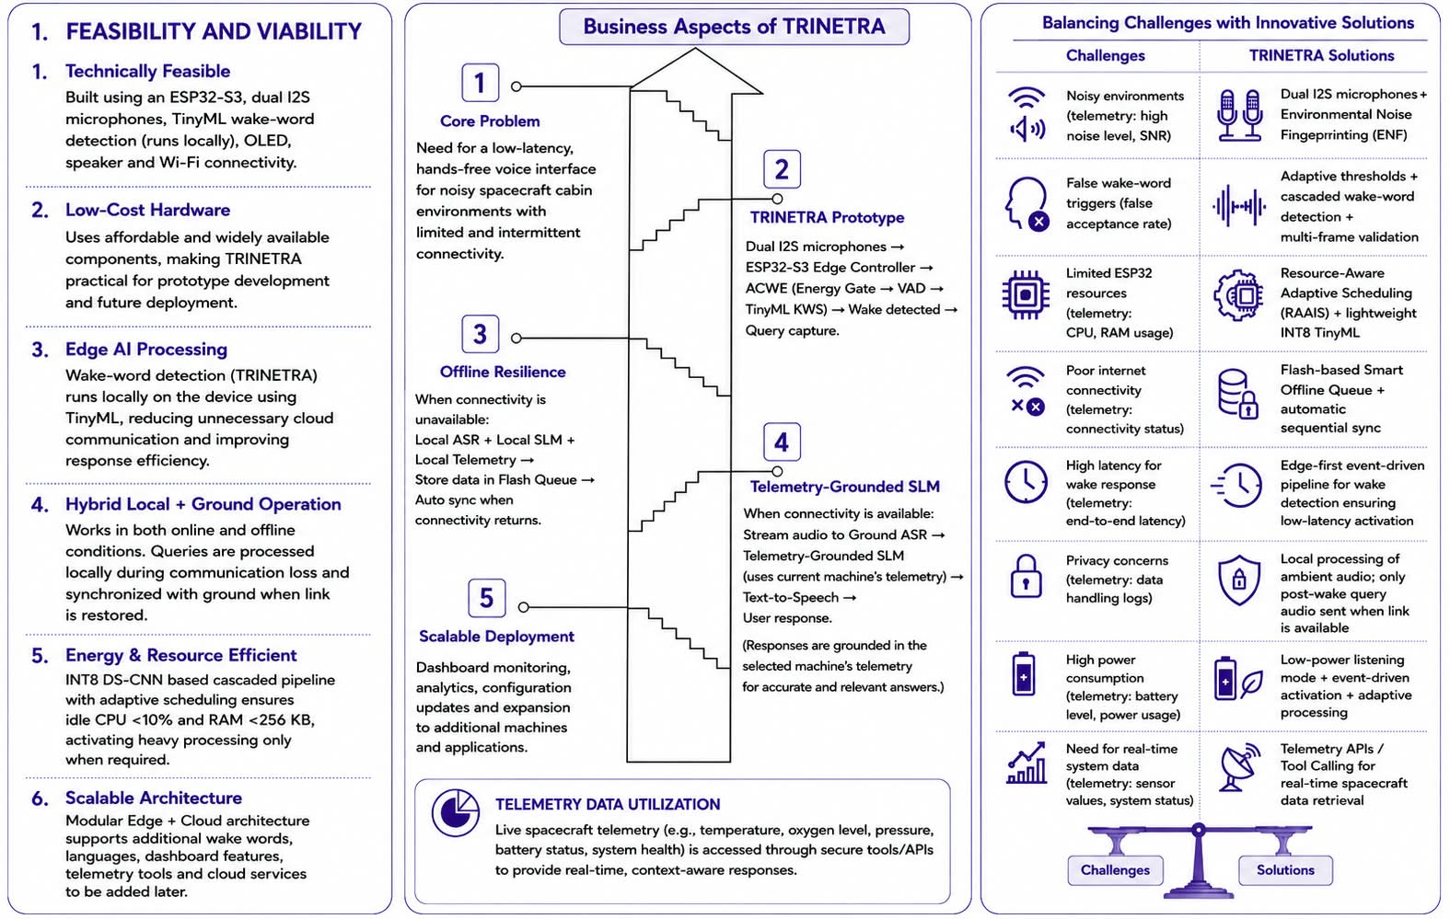
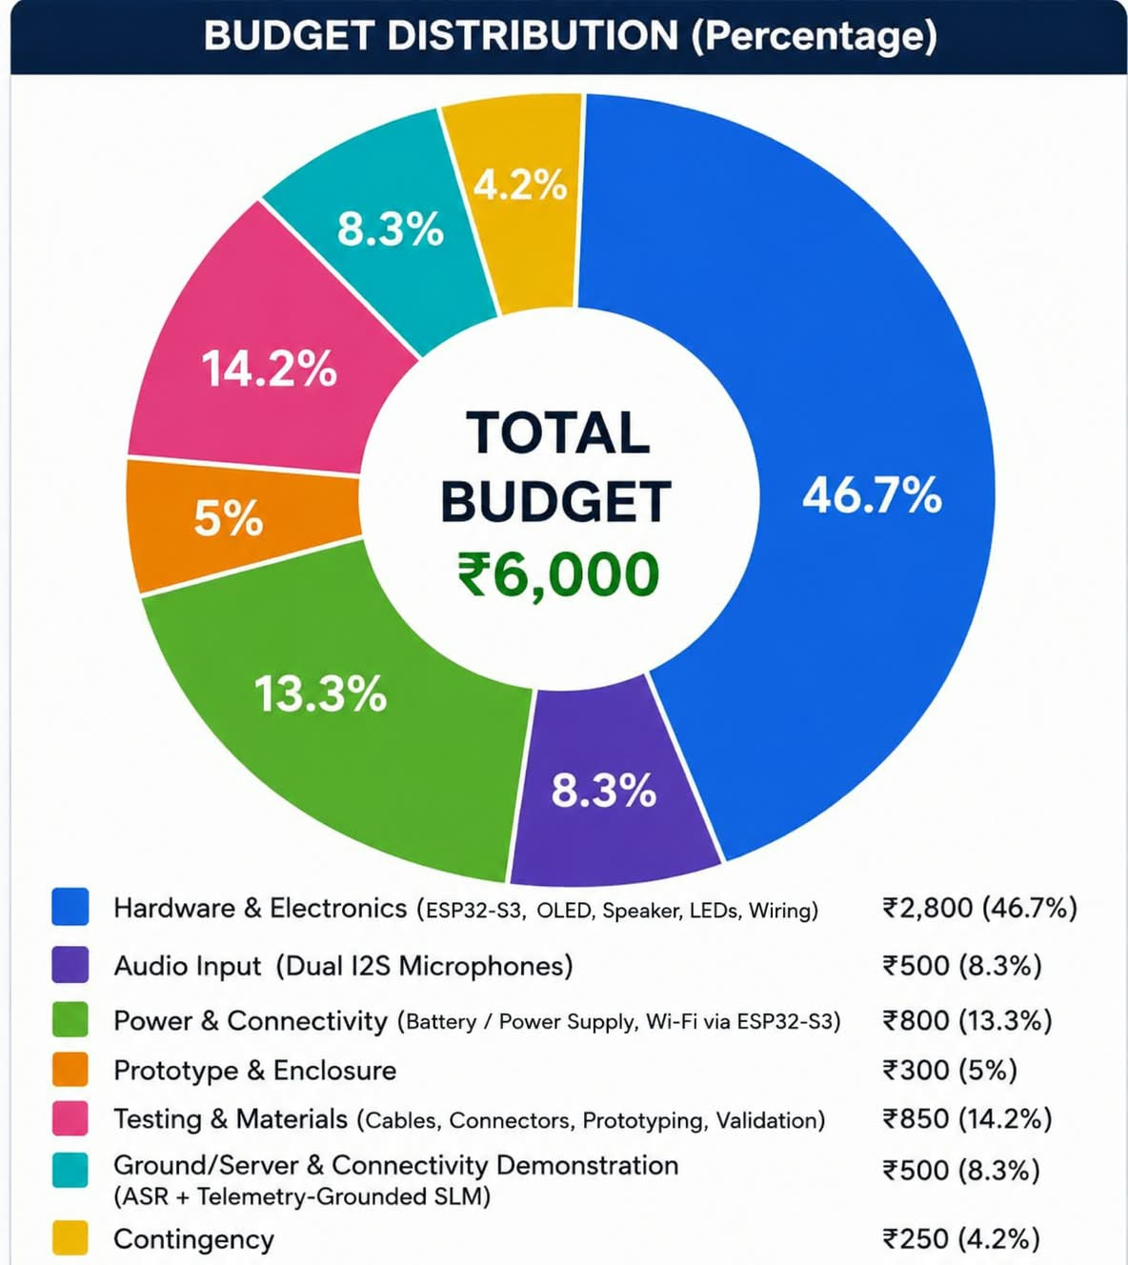
FEASIBILITY AND VIABILITY
TRINETRA
4
Notes:
4

Slide 5
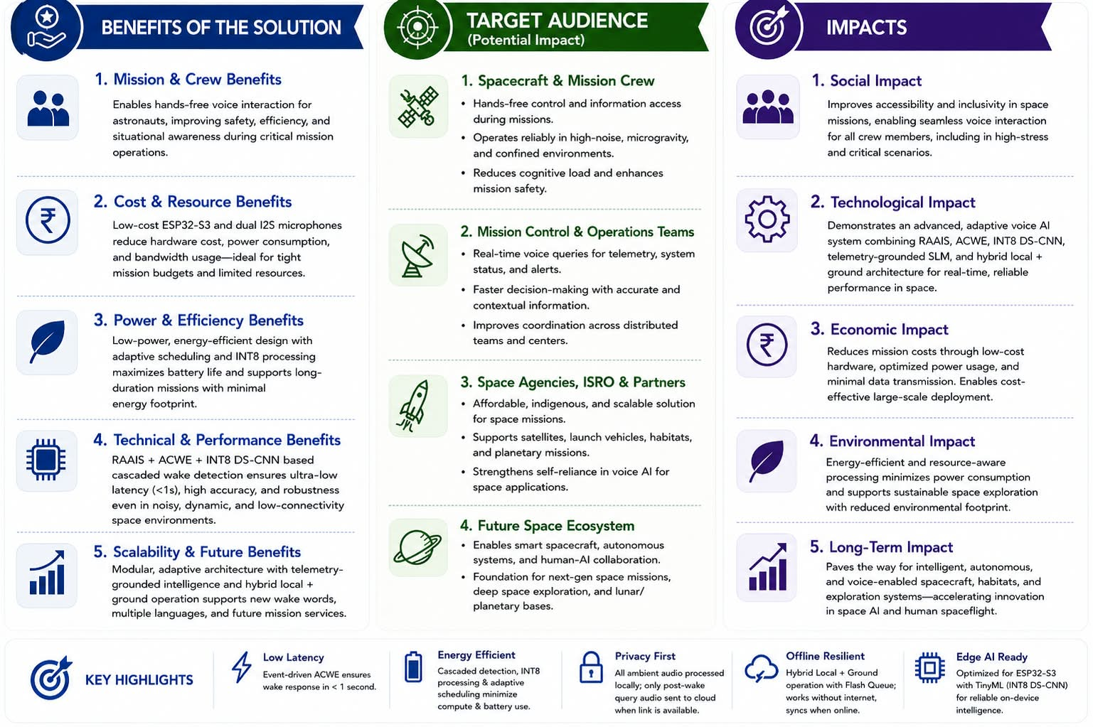
IMPACT AND BENEFITS
TRINETRA
5
Notes:
5

Slide 6
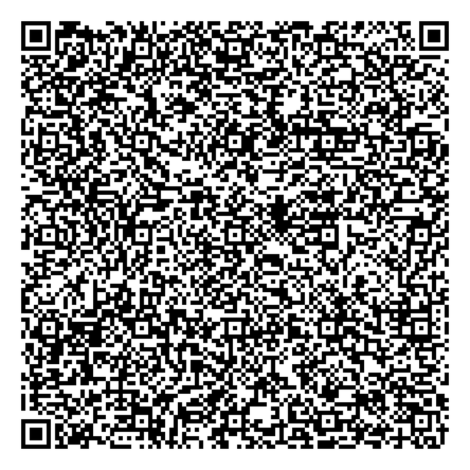
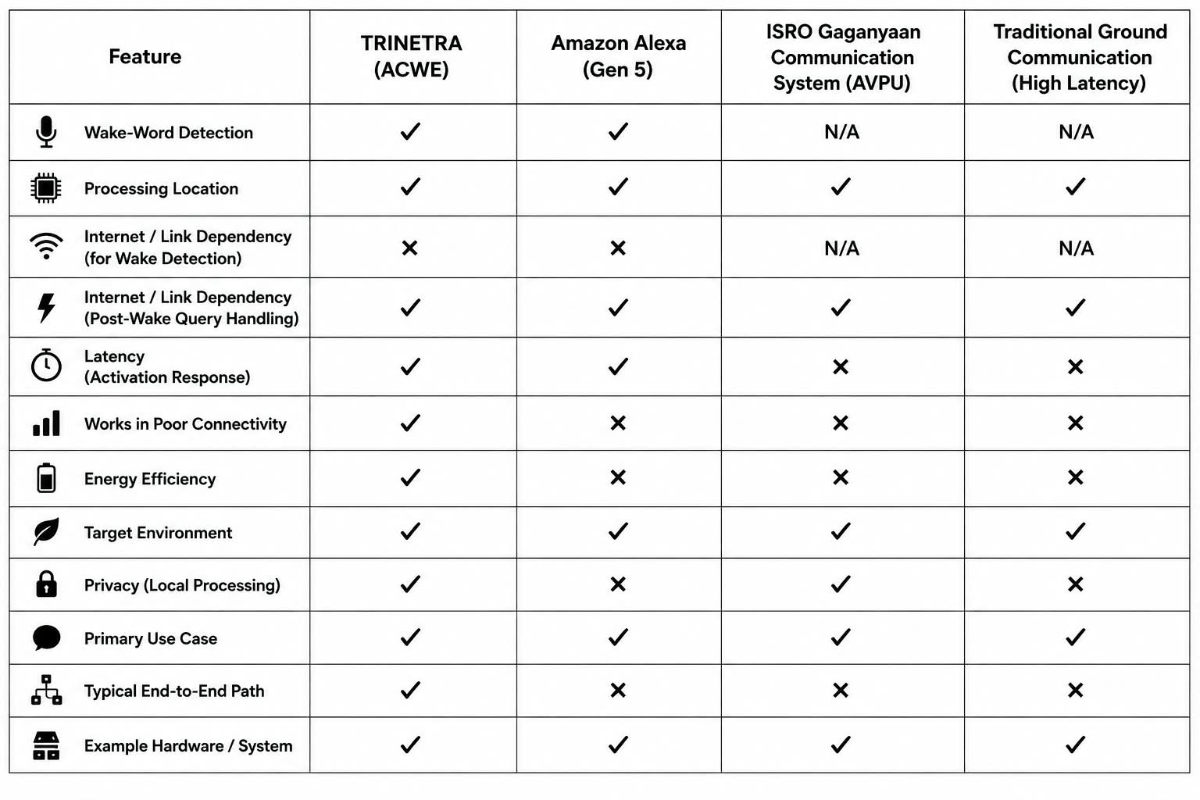
RESEARCH AND REFERENCES
TRINETRA
Comparision with Existing System
ESP32-S3 I2S Documentation
TensorFlow Lite for Microcontrollers
Edge Impulse Documentation
6
Notes:
6

