Slide 1

AtliQ Hospitality Analysis
Designed and Presented By
Hrithik Moger

Slide 2
AtliQ

Slide 3
AtliQ

Slide 4
AtliQ
Bangalore
Delhi
Mumbai
Hyderabad

Slide 5
AtliQ
Bangalore
Delhi
Atliq Bay
Atliq Blu
Atliq City
Atliq Exotica
Atliq Grands
Atliq Palace
Mumbai
Hyderabad
Atliq Bay
Atliq Blu
Atliq City
Atliq Grands
Atliq Palace
Atliq Bay
Atliq Blu
Atliq City
Atliq Exotica
Atliq Grands
Atliq Palace
Atliq Seasons
Atliq Bay
Atliq Blu
Atliq City
Atliq Exotica
Atliq Grands
Atliq Palace

Slide 6
Dataset Details
We are provided 3 moths booking details data of all the atliq hotels.
Dataset contains 5 excel files.
  Dim_date
  Dim_hotels
  Dim_rooms
  Fact_aggregated_bookings
  Fact_bookings
Metric list excel file
Mock-up Dashboard

Slide 7
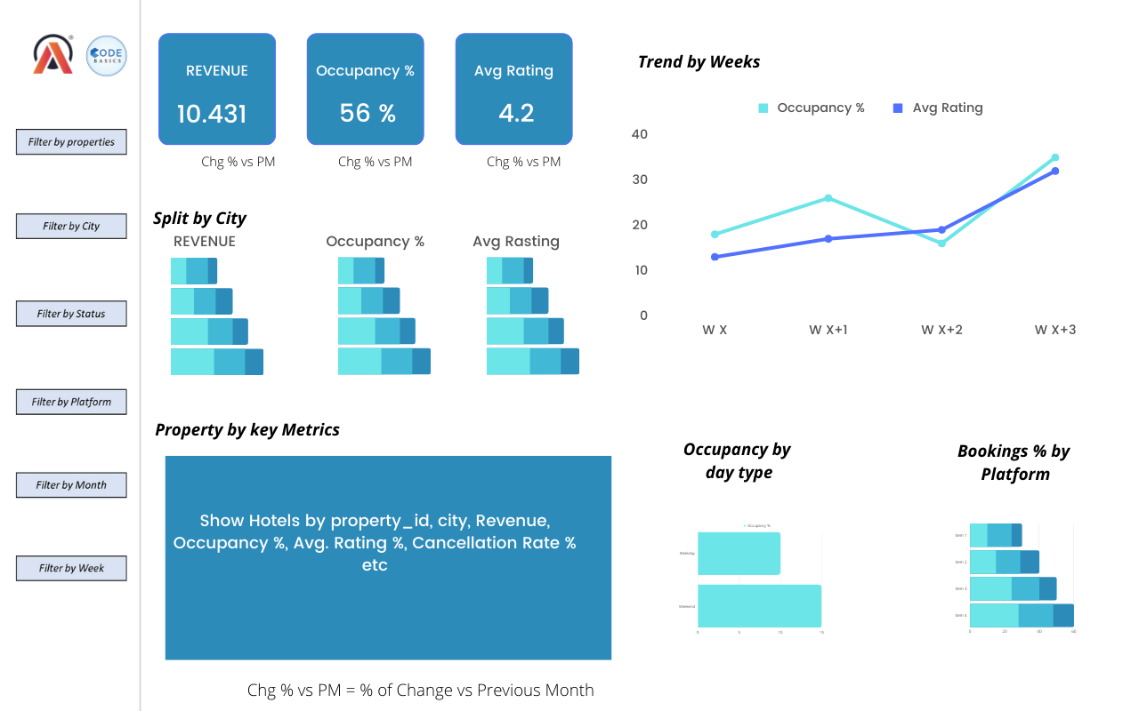
Mock-up Dashboard

Slide 8
Expected outcome after this analysis?
Regain their market share in the luxury/business hotels category.
Understanding the revenue trend by week/month/day
To get insights where business is failing and what can be done to tackle them

Slide 9
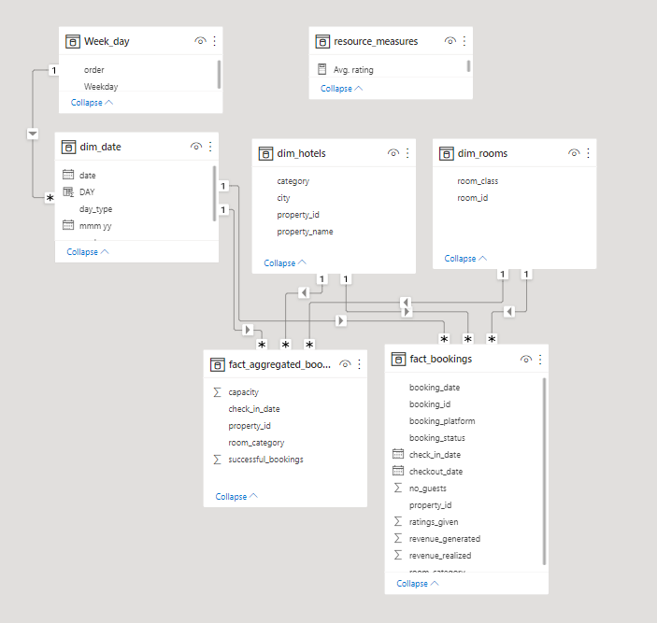
Data Model

Slide 10
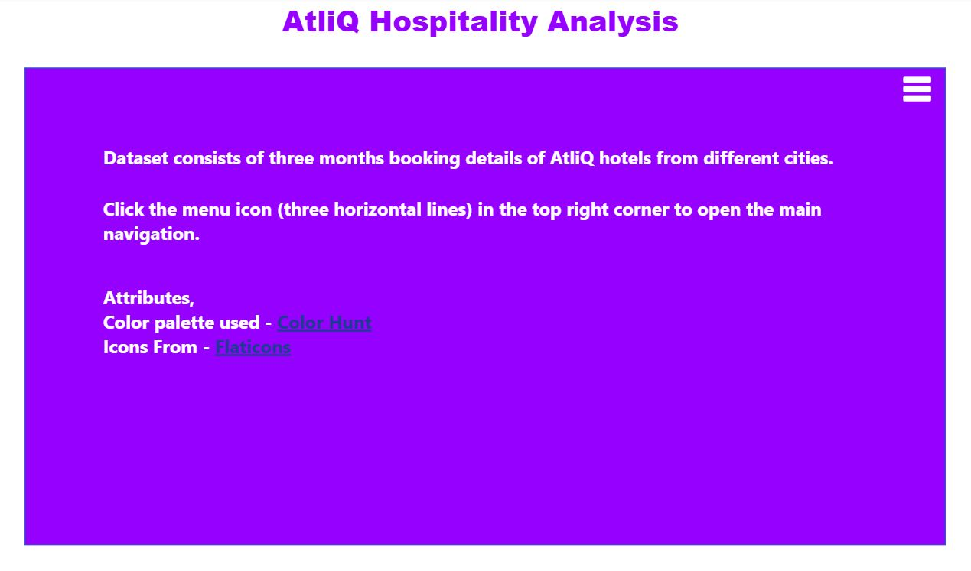
Home Page

Slide 11
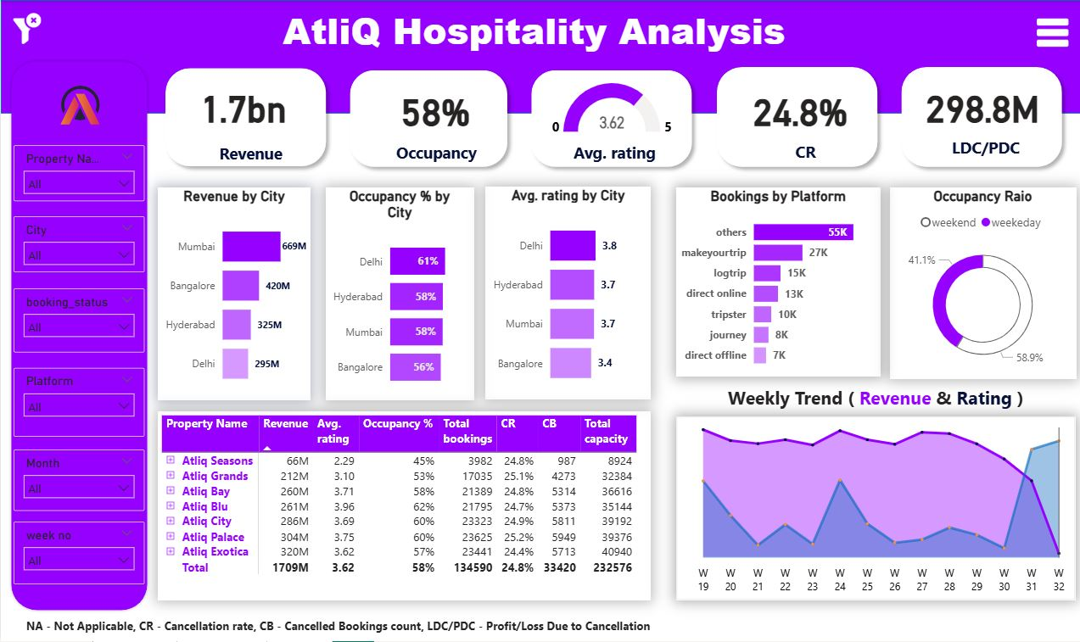
Overall View

Slide 12
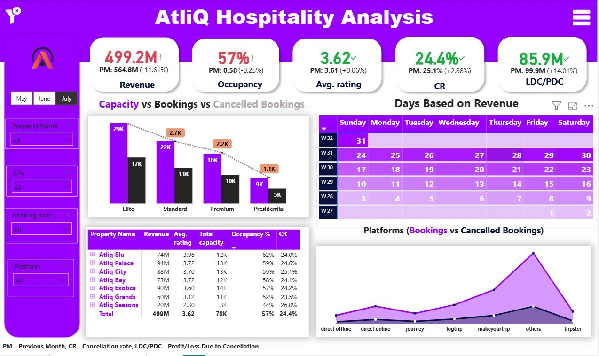
Monthly View

Slide 13


