Slide 1
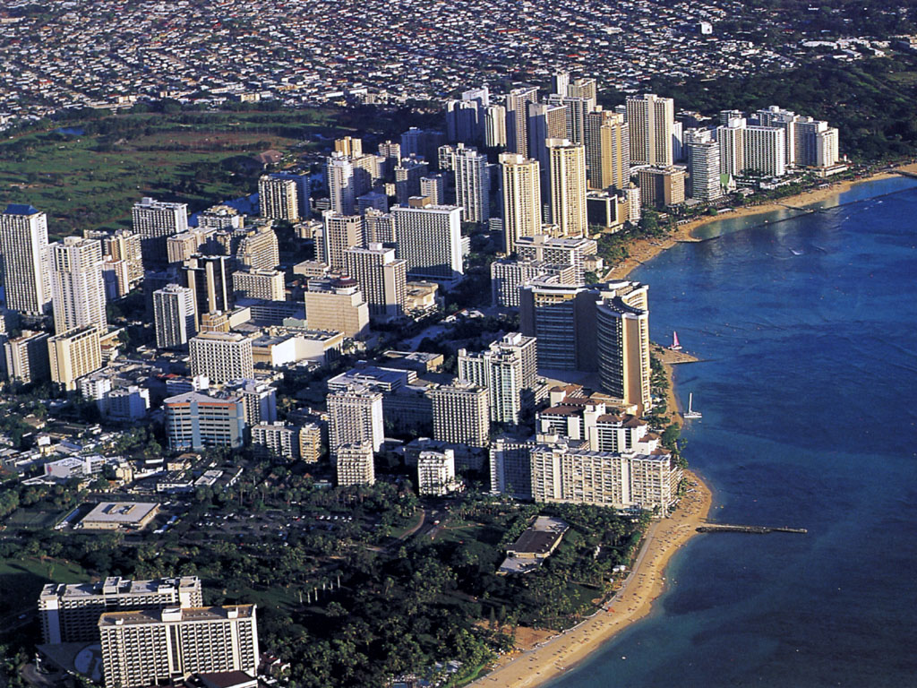
Marine Pollution

Slide 2
Marine Pollutants
Petroleum hydrocarbons
Plastics
Pesticides
Heavy metals
Sewage
Radioactive waste
Thermal effluents

Slide 3
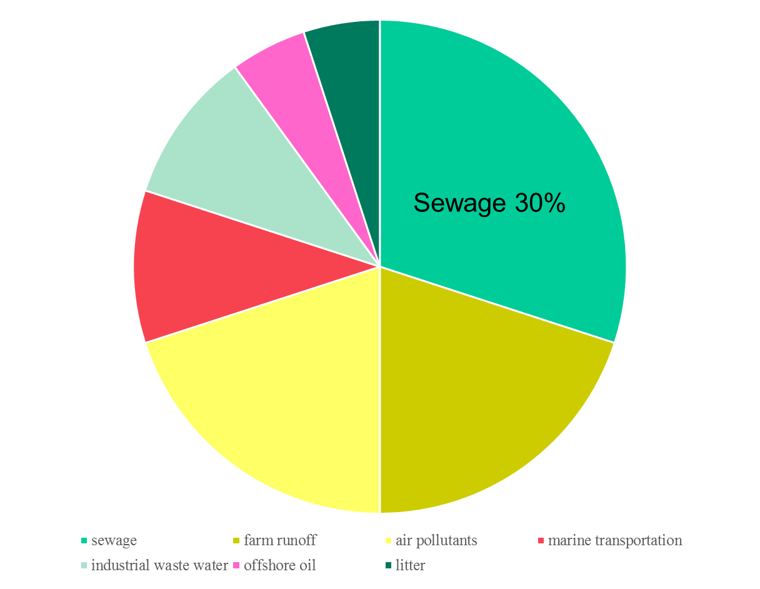
Pollutants Entering the Ocean
Industrial
wastewater
5%
Litter 5%
Offshore oil
10%
Marine
transportation
10%
Air pollutants
20%
Farm runoff 20%

Slide 4
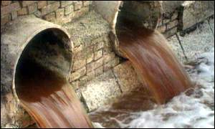
Point Source Pollution
Sewage
Causes disease outbreaks
Contributes to eutrophication

Slide 5
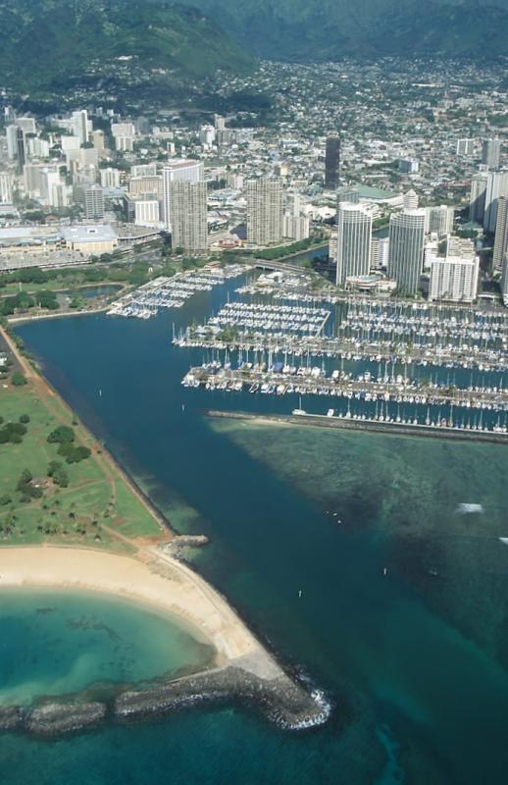
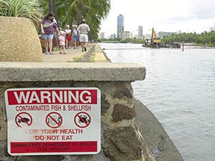
Non-Point Source Pollution
Constructed 1920-28 to reduce mosquitoes, but failed.
Ala Wai

Slide 6
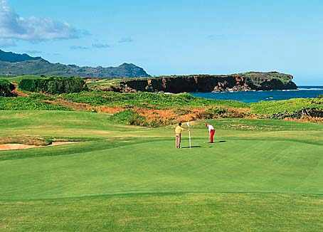
Types of Non-Point Source Pollution
sediments from coastal urban and agricultural development
nutrients from detergents, fertilizers, leaky septic tanks, and domesticated animals
pesticides (home use, agricultural, & golf courses)

Slide 7
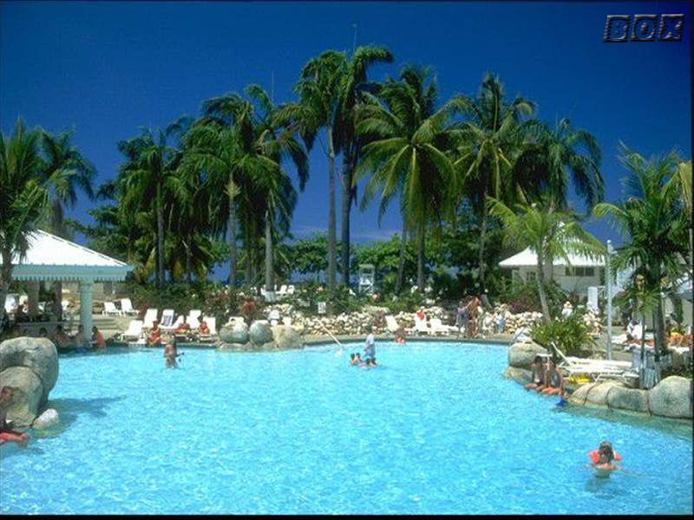
Types of Non-Point Source Pollution
automobile wastes such as combusted motor oil, tire rubber, brake pad dust, coolant, etc.
waste water from swimming pools and aquaculture ponds

Slide 8
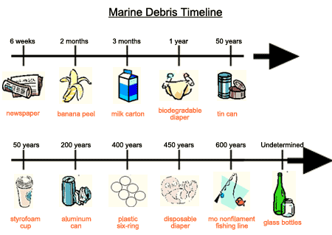
Notes:
Marine Debris
We can all help our ocean friends
The dramatic and destructive impacts of ocean dumping are illustrated by these mind-boggling statistics:
During the one-day Hawaii beach cleanup in October 1995, 3,564 people covered 82 miles of beaches. They picked up 32,200 pounds of garbage from our beaches.
On Maui alone during the 1995 cleanup, 724 volunteers covered 16.2 miles, picking up 100,381 bags of debris. In addition, each year between 1987-1994, the military, Pacific Whale Foundation, Community Work Day and the Protect Kahoolawe Ohana removed between 6-8 tons of debris from a single uninhabited beach on Kahoolawe.
People dump more than 14 billion pounds of garbage each year into the world's oceans.
People dump more than 650,000 plastic bottles into the oceans each day.
People dump an additional 100,000 metric tons of mono-filament lines and fishing gear into the ocean each year. Worldwide estimates of lost netting translate this amount into anywhere from 12,400 to 135,000 miles annually.
Plastics make up most of the debris collected during beach cleanups.
Cigarette butts were the most abundant debris item collected in 1995.
The U.S. produced six billion tons of plastic disposable packaging in 1986. Plastic package manufacturing increases four to six percent each year.
The U.S. produces twice as much plastic as it does steel, copper and aluminum - combined. Plastic production has doubled since 1975. Oil is the main ingredient of plastic.
The Effects What happens to our ocean's wildlife through our use and disposal of plastics? These statistics tell the sad tale:
At least 50 different seabird species are known to ingest plastic debris, primarily Styrofoam pellets.
An extremely high incidence of young turtles fall prey to ingested plastics. Young turtles commonly mistake floating debris for food. The debris accumulates in the open ocean drift lines (formed by winds and currents) where young turtles forage for plankton.
About 30,000 northern fur seals die each year from getting tangled in lost nets and plastic debris. This represents a four to eight percent decrease in the population each year.
Thousands of commercial shrimp fishermen - from North Carolina to Texas - catch nearly 50,000 endangered sea turtles in their nets each year. About 12,000 turtles die as a result.
The endangered Hawaiian Monk Seal is observed entangled on its haul-out and breeding beaches every year. Lisianski Island, in the Northwest Hawaiian Islands, has the greatest accumulations of netting debris in the leeward islands. It is the primary monk seal birthing and weaning area. Weaned monk seal pups are observed entangled the most.
A 1980 Fish & Wildlife service study showed 45 of 50 albatrosses (90 percent) on Midway Island had plastics in their intestines.
Sea-borne plastic is deadly to marine life. Whales, dolphins, turtles and seabirds have died from ingesting or getting tangled in all types of common plastic products:
Balloons
Six-pack holders
Strapping and packing materials
Fishing lines and nets
Plastic debris eaten by marine life can clog the digestive tract, causing starvation. Sea turtles mistake plastic bags for jellyfish, and birds eat bits of Styrofoam. When fish, turtles, and birds ingest plastic, it blocks their intestines. They slowly die of starvation. Plastic debris is like a silent time bomb, waiting to kill marine life. Plastic persists in the environment: it does not decompose (break down) for hundreds and hundreds of years. What plastic breaks down into is smaller and smaller pieces of plastic - which are increasingly attractive to smaller and younger sea life. You Can Help! Here Are Some Suggestions:
Participate in the nation-wide beach clean-up held every October.
Don't litter.
Help clean up our beaches.
Dispose of your garbage properly.
Don't take your groceries home in plastic bags.
Purchase items in bulk instead of small, convenience sizes.
Recycle (reuse) boxes, envelopes, newspapers and packing materials.
Purchase items packaged in card board or paper instead of plastic or styrofoam.
Take cans, bottles, used motor oil, batteries and newspapers to recy cling centers.
Recycle stationery and paper by using the backs for lists and scratch
Hold onto your balloons! paper.
Buy recycled products.
Hold onto your balloons! NEVER release balloons on purpose - they eventually pop, and may end up in the ocean where they can be mistaken for food by hungry turtles and other marine life.

Slide 9
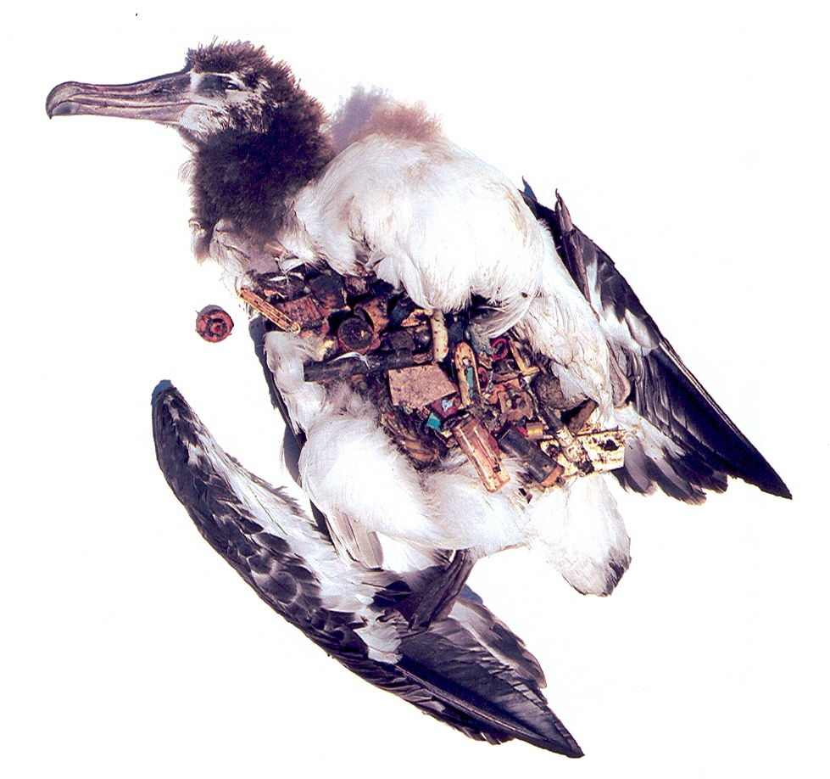
Albatross Chick

Slide 10
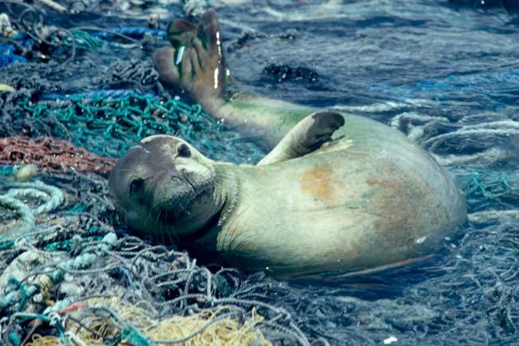
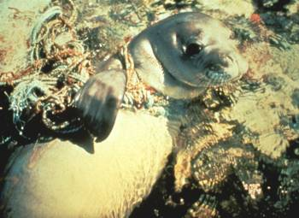
Plastics
100,000 marine mammals & 2 million sea birds die each year after ingesting or being trapped in plastic debris
WHOI 1987 survey off N.E. coast of U.S.: found 46,000 pieces of plastic floating on surface

Slide 11
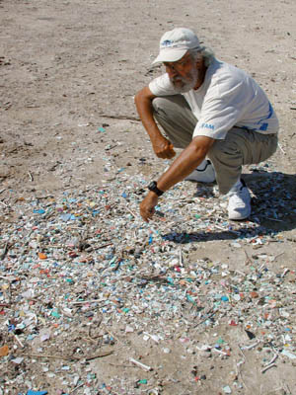
Bits and pieces of plastic are collected at sea and deposited on the Laysan Lake shoreline

Slide 12
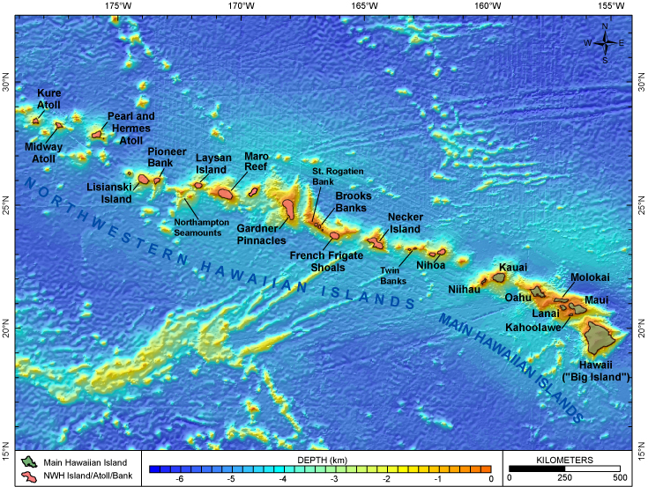
Marine pollution: nets and plastic debris
Papahānaumokuākea Marine National Monument

Slide 13
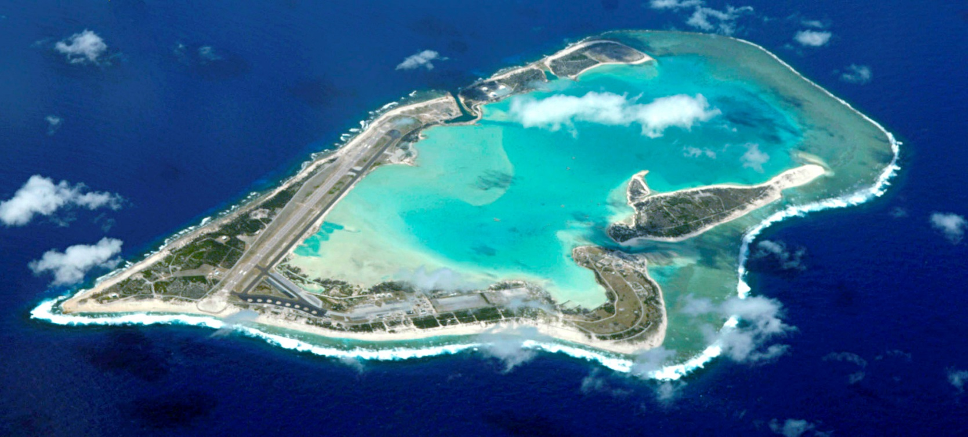
Marine pollution: nets and plastic debris
Laysan Island
hypersaline lake (120-140º/_{oo})
Large bird rookery and guano mining
In 1857, reported 800,000 birds.
Notes:
In some ways Laysan Island is the most fascinating and in some ways the most unfortunate of all the tiny dots of land in the "little end of Hawaii." In former days it supported the largest albatross rookery of the entire chain. Although at no time during its recorded history did it reach an elevation of more than fifty feet above sea level, still in it once grew groves of sandalwood trees, dense thickets of bushes, and native fan palms, beneath whose shade there evolved five species of land birds, endemic to this island and not known elsewhere. And all this on an area of but two square miles of sand and coral.
As a result of all the sea bird life, great beds of valuable guano were deposited. This material was formed by the chemical interaction between coral sand and the droppings of myriads of birds during countless years. Man found that guano was a fine fertiliser for his crops. So when guano deposits were located on Laysan, man soon found the way there to dig and ship it; and, as usual to upset the nicely adjusted balance which Nature had established there.

Slide 14
Oil spill
Oil spill is the release of a liquid petroleum hydrocarbon into the environment, especially the marine ecosystem, due to human activity, and is a form of pollution
The term is usually given to marine oil spills, where oil is released into the ocean or coastal waters, but spills may also occur on land.
Oil spills at sea are generally much more damaging than those on land, since they can spread for hundreds of nautical miles in a thin oil slick which can cover beaches with a thin coating of oil.
Spilled oil can also contaminate drinking water supplies. For example, in 2013 two different oil spills contaminated water supplies .
Heavily furred marine animals are affected in many ways,they can also blind an animal .The ingestion of oil causes dehydration and impairs the digestive process.

Slide 15
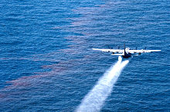
Cleanup and recovery from an oil spill is difficult and depends upon many factors, including the type of oil spilled, the temperature of the water (affecting evaporation and biodegradation), and the types of shorelines and beaches involved.[1] Physical cleanups of oil spills are also very expensive. However, microorganisms such as Fusobacteria species demonstrate an innovative potential for future oil spill cleanup because of their ability to colonize and degrade oil slicks on the sea surface
A U.S. Air Force Reserve plane sprays Corexit dispersant over the Deepwater Horizon oil spill in the Gulf of Mexico.

Slide 16
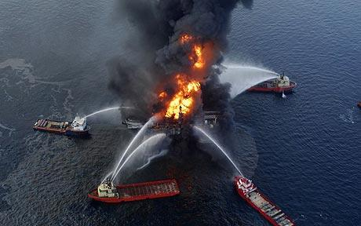
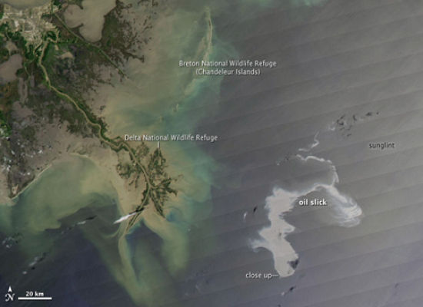
BP offshore drilling rig (Deepwater Horizon) April 20, 2010; 50 miles off Louisiana
Spilling 5,000 barrels/day = 200,000 gal/day

Slide 17
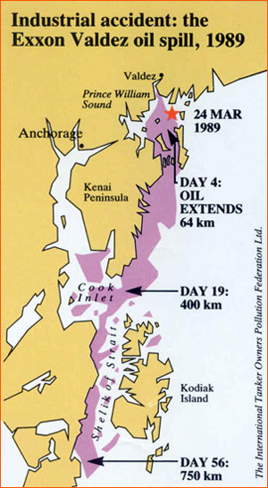
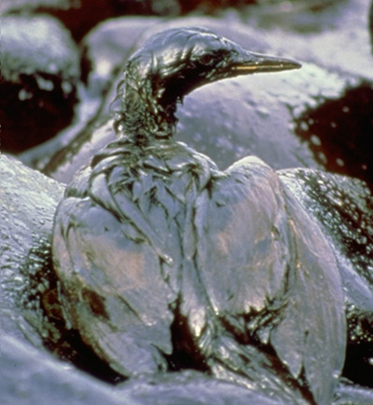
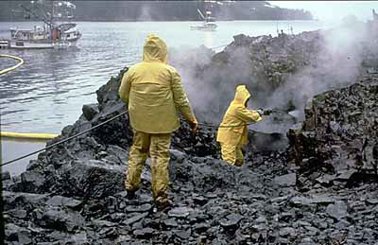
Exxon Valdez (1989)- Prince William Sound, Alaska
10 million gallons of oil spilled
400 miles of shore line affected
$3 billion and 2 summers cleaning

Slide 18
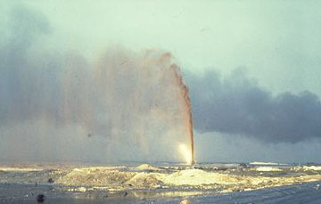
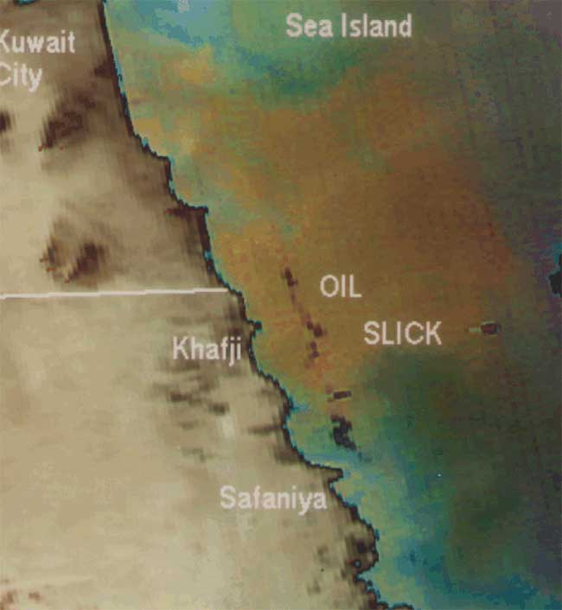
Persian Gulf War (1991)
240 million gallons of oil spilled

Slide 19
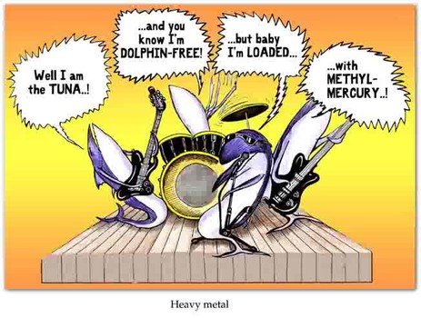
Toxic Metals
Heavy metals resist biodegredation
Natural occurrence- volcanoes
Mercury (Hg)
Copper (Cu)
Lead (Pb)
Cadmium (Cd)

Slide 20
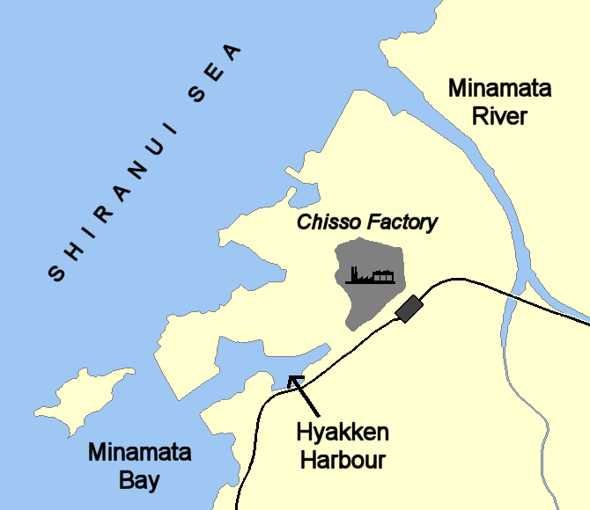
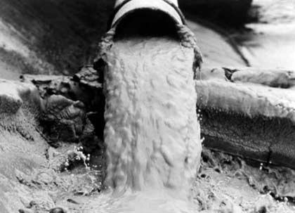
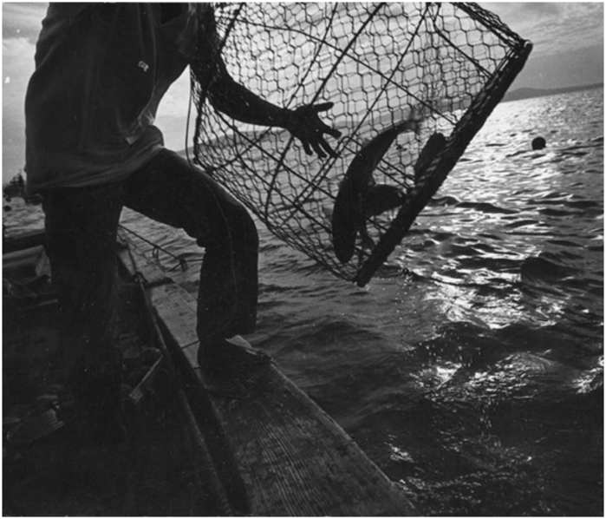
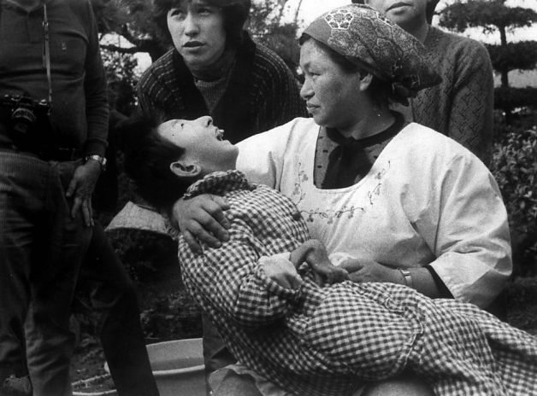
Mercury
Minamata Disease (1953-1960)– Japan
Notes:
Industrial pollution from plastic plant; dumped mercuric chloride into bay
Ingestion of Hg tainted shellfish → 43 dead and 700 permanently disabled
Symptoms: kidney damage, neuromuscular deterioration, birth defects,insanity, → → death
Bay is still unusable for fishing and shell fishing
Surviving victims received $24,200 as settlement
Minimata: the strange disease
20 June 2011
Author:
Becky Allen
Share on facebookShare on twitterShare on linkedinShare on email
Health
Almost 60 years ago pollution from an industrial plant in a quiet corner of Japan poisoned thousands. Minamata shaped the post-war history of a whole nation. Becky Allen reports.
Like many who lived around Minamata Bay, on Japan’s south-western fringe, Hamamoto Tsuginori made his living from the sea.
Those of his neighbours who did not fish worked in the local factory, owned by Chisso Corporation, producing acetaldehyde used to make synthetic resins and dyestuffs.
Tsuginori lived on the southern side of the bay, but kept the family boat in the tiny hamlet of Tsubodan, and usually walked between the two along the railway line.
Following the tracks one July day in 1955, Tsuginori tripped over a rail tie.
“[I thought] ‘That’s strange. Why would I trip on this and fall?’” he remembered.
“Then I fell again at the shore. Nakatsu Yoshio caught up with me from behind and said, ‘Tsuginori, are you feeling funny?’ and it was then that I first realised that the numbness and shaking in my hands was serious.”
He was not the first to suffer such symptoms. But before humans became ill, other changes were noticed in Minamata Bay.
Since the early 1950s, fishermen had found more and more dead fish; sea birds died, and so did pine trees near the shore.
Most bizarrely, local felines developed a strange and fatal malady, nicknamed “dancing cat disease” because of the unsteady gait they displayed before they died.
The disease, when it began affecting humans, was terrifying. Unable to speak or walk properly, sufferers developed tunnel vision — described as like looking down a length of bamboo — and convulsions.
In 1956 a local doctor realised they had an epidemic on their hands. By October researchers at nearby Kumamoto University Medical School had seen 40 patients with what became known as “a strange new disease” (and later, Mimimata disease), one-third of whom had already died.
Not knowing what it was, or how it was caused, health officials isolated victims and disinfected their homes; as fear of a contagious disease spread, sufferers became outcasts in their own villages.
In November, doctors concluded the disease was not infectious and in 1957 the hunt for the cause focused on its link with eating fish from the bay, and with heavy metals.
Manganese, thallium and selenium all fell under suspicion, until a visiting British neurologist examined some of the patients.
Douglas McAlpine’s paper in The Lancet described their symptoms as resembling Hunter-Russell syndrome, or methylmercury poisoning.
As researchers homed in on mercury, used by the Chisso factory in a catalyst for its acetaldehyde process, the plant’s owner became increasingly obstructive.
In four pamphlets issued in 1959 Chisso discredited the mercury theory, blaming ordnance supposedly dumped in the bay at the end of World War Two.
Dr Hosokawa Hajime, director of the hospital attached to the Chisso factory, began his own studies, feeding cats on factory wastewater.
After 12 weeks, cat no. 400 developed convulsions and died. But instead of acting on his findings, the firm stopped him studying the waste.
Working along the same lines Leonard Kurland, a scientist from the US National Institutes of Health, decided to test fish from Minamata.
Chisso blocked his efforts by buying up all the catches from local markets but Kurland obtained samples from the public health office and found them contaminated with methylmercury.
Finally, in November 1959, the Ministry of Health reported: “Minamata disease is a poisoning disease that affects mainly the central nervous system and is caused by the consumption of large quantities of fish and shellfish living in Minamata Bay and its surroundings, the major causative agent being some sort of organic mercury compound.”
Sympathy money
It had taken more than three years to identify the cause of the strange disease, but nailing its source and compensating its victims would take far longer.
In 1959, Chisso offered victims their first meagre compensation. Known as “sympathy money”, adult sufferers certified by the Ministry of Health received 100,000 yen a year (worth £99 at that time) — 30,000 yen for children (£30) and families of the dead one-off payments of 320,000 yen (£316).
Fishermen who were losing their livelihoods fared better.
A series of protests netted the local fishing cooperative 20 million yen (£19,800) from Chisso, which also established a fund to help the fishery recover. But everything the company did was too little, too late.
Following the ministry’s announcement, Chisso unveiled a new waste-treatment system, a cyclator purifier and, in a very modern piece of public relations, the company president drank a glass of the water from it.
But the cyclator was not receiving wastewater from the acetaldehyde process because it had not been designed to remove mercury.
Then in 1965, the disease broke out again, this time in Niigata on the Agano River where a factory owned by Showa Denko also used mercury as a catalyst to produce acetaldehyde.
When the Niigata victims opted to take the firm to court, Minamata followed suit.
Final admission
Not until September 1968, 12 years after the disease was discovered and four months after Chisso stopped using the mercury catalyst, did the Japanese government acknowledge its source: “Minamata disease is a disease of the central nervous system ... The causative agent is methylmercury. Methylmercury produced in the acetaldehyde acetic acid facility of Shin Nihon Chisso’s Minamata factory was discharged in factory wastewater.”
The fight for compensation — in and out of the courts — intensified. In 1973, after a trial lasting almost four years, a group of victims won their case against Chisso in Kumamoto District Court.
The company agreed single payments to certified victims of 16 to 18 million yen (£24,000 to 27,000), but the most dramatic moment of the trial came in 1970.
Dying from cancer, Chisso’s former hospital director Dr Hosokawa Hajime at last revealed the facts surrounding cat 400 and what the company had known more than a decade earlier about the cause of the disease.
Pressure to compensate uncertified victims continued until in 1995 some 11,000 people received 2.6 million yen (£17,615) each and Chisso and Showa Denko set up a fund worth 445 million yen (£3 million) for victims’ groups.
In 2001 the Osaka High Court ruled the Ministry of Health should have halted the pollution in 1959. Chisso was ordered to pay further damages and in 2004 the Supreme Court ordered the government to do likewise.
And in 2010 another 2123 victims, previously unrecognised, each received 2.1 million yen (£14,363) from Chisso and a monthly state allowance of up to 17,000 yen (£116).
Minamata’s costs are hard to calculate. Between 1978 and 2010, bonds issued by the prefectural government to support Chisso totalled 226 billion yen (£154.6 million) .
As well as compensation, the 14-year cleanup of the bay cost 48.5 billion yen and removed over 1.5 million cubic metres of contaminated sludge.
In 1997 nets around the bay were finally removed and fish declared safe to eat.
But not until 1998 did the last pieces of the jigsaw fall into place, when a former union leader at the factory uncovered internal company documents.
Why, people had asked, did the disease occur in the 1950s when Chisso had made acetaldehyde with mercury since 1932?
And why at only one of the six factories using a similar process?
The files showed that in 1951 Chisso had changed the process, substituting manganese oxide for impure nitric acid.
The latter, recycled from elsewhere in the factory, often foamed and the foam, loaded with organic mercury, was discarded.
In addition, the factory used water from the mouth of Minamata River, where salt in the brackish water produced a highly soluble form of mercury.
In the years following the change, organic mercury in factory waste ballooned from under 10kg a year to nearer 100kg a year.
Minamata ruined the lives of its many thousands of victims, but it changed Japanese society too.
US historian Dr Timothy George believes that “a society’s responses to an environmental disaster say a great deal about it.”
In his exhaustively researched book Minamata: pollution and the struggle for democracy in postwar Japan, he argues Minamata represents the Japanese people’s transformation from deferential subjects into citizens.

Slide 21
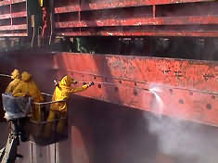
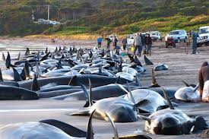
Copper
Tributyl tin (antifouling paint for boats)
Banned in U.S. 1980s
Acts as an immunosuppressor
Accumulations unusually high in small whales
May be associated with strandings
Notes:
Pac Baroness – freighter carrying 21,000 metric tons of finely powdered Cu sank in 448 m in 1987 of coast of central CA
Tainted water detected 41km down current of wreck
Major fishing zone for rock cod and Dover sole

Slide 22
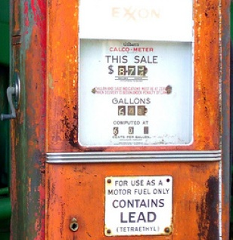
Lead
Leaded gasoline invented 1920’s
Enters water from automobile exhaust, runoff and atmospheric fallout of industrial waste and landfills, mines, dumps
Leaded gas banned in US in 1980’s has reduced pollution in ocean
Bioaccumulation → biomagnification

Slide 23
