Slide 1
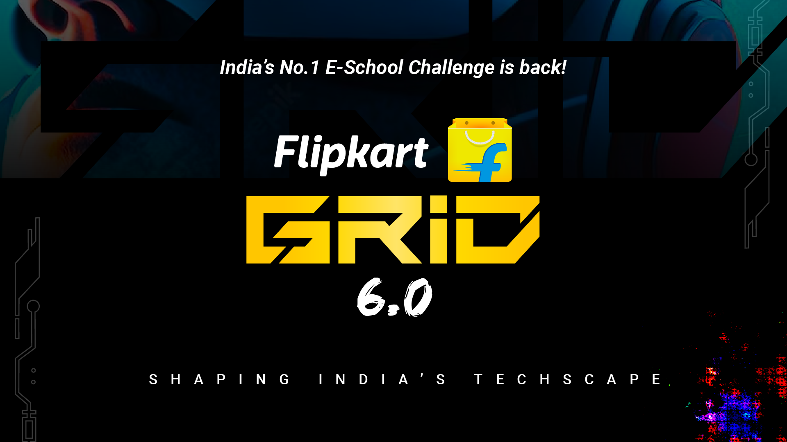
Notes:
#

Slide 2
About Team
Title: Smart Vision System + Team Sentinels (Robotics Challenge)
Team Name: Sentinels
Team Members:
Hrithik Reddy
Rishabh Sharma
Aditya Dargan
Ayush Kumar Singh Rathor
T M Adi Venu Gopala Reddy Padala
College/University:
Netaji Subhas University of Technology, Delhi: Rishabh Sharma, Ayush Kumar Singh Rathor
Delhi Technological University, Delhi: Aditya Dargan
SRM Institute of Science and Technology: Hrithik Reddy, T M Adi Venu Gopala Reddy Padala
Date: 20th October 2024

Slide 3
Executive Summary
The Smart Vision System leverages AWS cloud infrastructure and machine learning models to provide real-time video processing,image classification,object detection, object tracking ,OCR and Entity Extraction. The system is designed to securely stream video from a conveyor belt, analyze the footage for key insights, and display the results to operators through an intuitive dashboard
Input: Video streams from an on-premises camera monitoring a conveyor belt are securely transmitted to the cloud via a VPN gateway.
Processing:
Backend services running on EC2 instances (FastAPI) handle video processing.
Machine learning algorithms such as YOLOv11, MobileNetV2, Llama3.2-11B-vision and DeepSort are used for object detection, classification , OCR , object tracking and entity extraction .
Storage: Processed images are stored in S3 buckets, while structured data such as object tracking logs and entities are stored in DynamoDB.
Monitoring: AWS CloudWatch is used to log system metrics and ensure smooth operation.
Output: Operators interact with the processed data and video streams through a ReactJS frontend hosted on AWS Amplify.

Slide 4
Technical Approach
Teams to submit a solution proposal ppt that includes details on the technology used, hardware specifications, items used to train the model, and code, accompanied by a video simulation
Technology Stack:
Cloud Platform: AWS VPC, EC2 instances, S3 buckets, DynamoDB, AWS Bedrock ,AWS Sagemaker, AWS Amplify
Backend Framework: FastAPI for processing video and managing backend services(Server Sent Events for real time
processing )
Frontend Framework: ReactJS for the operator dashboard, hosted using AWS Amplify.
Hardware Specifications:
Camera: High-definition camera mounted on the conveyor belt to capture real-time footage.
Compute Power: EC2 instance and AWS Sagemaker GPU support (e.g., p3.2xlarge) for real-time video processing.
Storage:
S3 Buckets for image storage and long-term archival.
DynamoDB for storing logs and processed data entries.
Machine Learning Models:
YOLOv11: Used for object detection to identify items on the conveyor belt.
MobileNetV2: Used for classification tasks, such as determining object freshness or quality.
DeepSort: Used for object tracking to precisely track the objects on conveyor belt without duplicate entries
Llama3.2-11b-vision: Used for OCR and entity extraction from the detected objects

Slide 5
Technical Approach:
Teams to submit a solution proposal ppt that includes details on the technology used, hardware specifications, items used to train the model, and code, accompanied by a video simulation
4) Training Data:
Dataset: Imitated Conveyor belt and collected data manually for object detection, used the kaggle Fresh Fruits and Vegetable dataset for classification
https://app.roboflow.com/flipkart-grid-gqtdk/belt-nublw/2
https://www.kaggle.com/datasets/swoyam2609/fresh-and-stale-classification
Annotations: Manually annotated data for object detection in Roboflow annotator.
Training Tools:
Kaggle P100 GPU was used for training/fine-tuning the models used in the system.
Transfer Learning: Pre-trained models (e.g., MobileNetV2 and YOLOv11) fine-tuned with the custom dataset.
5) Simulation Video:
A simulation of the system demonstrates how the camera captures real-time footage, how the backend processes the video, and how the operator dashboard displays the results
6) Source Code:
https://github.com/Hrithik2212/Team-Sentinel
Video Link : https://www.youtube.com/watch?v=Z_sjBRmlVX8

Slide 6
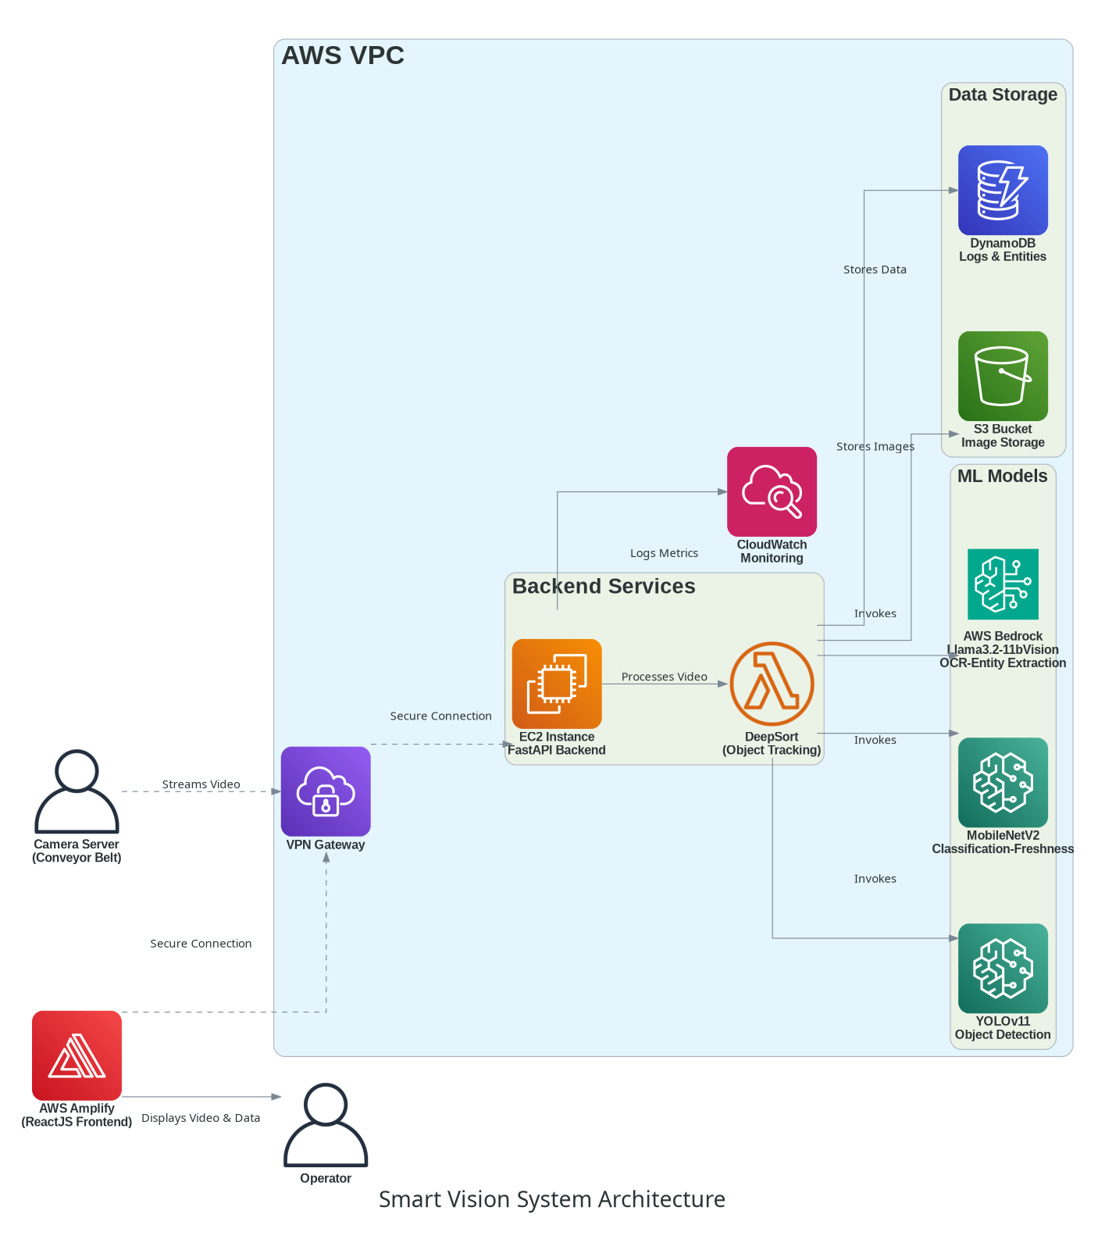
ARCHITECTURE
NOTE : Set Quality to 1080 for the video in the next slide , If the video is not available click the link in the previous tab

Slide 7

Video

Slide 8
Thank You

