Slide 1
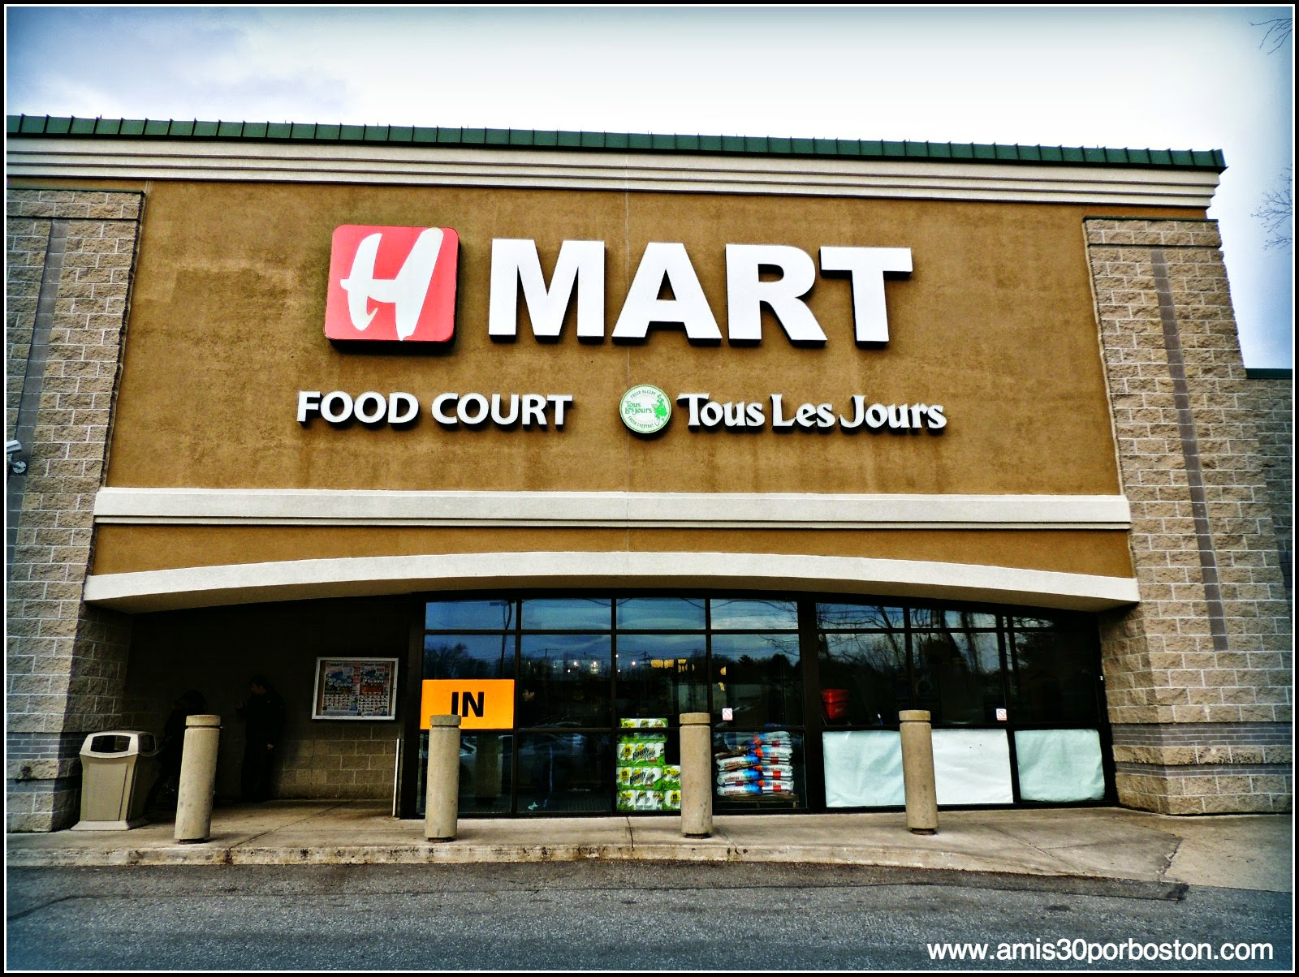
BIGMART SALES PREDICTION
Analyzing bigmart sales trends and predictive models using machine learning

Slide 2
Members of the Team:
D.Supraja (Y20ADS406)
G.Bhavani (Y20ADS407)
B.Hrithik (Y20ADS402)
P.RaghuGopi (L21ADS404)
Under the Guidance of
Mrs.G.V LEELA KUMARI

Slide 3
Definition of the Problem:
ABSTRACT:
Now a days shopping malls and Big Marts keep the track of their sales data of each and every individual item for predicting future demand of the customer and update the inventory management as well. These data stores basically contain a large number of customer data and individual item attributes in a data warehouse. Further, anomalies and frequent patterns are detected by mining the data store from the data warehouse. The resultant data can be used for predicting future sales volume with the help of different machine learning techniques for the retailers like Big Mart. In this , we propose a predictive model using Machine learning techniques Linear Regression, random Forest, Support vector Machines, Decision Trees,Gradient Boost Algo’s LightGBM,catBoost for predicting the sales of a company like Big Mart and that the model may produce better performance as compared to existing model XGBoost algorithm .A comparative analysis of the model with others in terms performance metrics is also explained in detail.

Slide 4
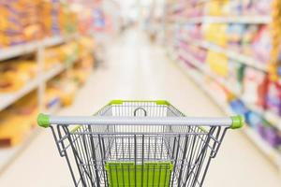

The goal of the BigMart sales prediction project is to create a smart computer system that can accurately guess how much of each product the stores will sell. By doing this, BigMart aims to avoid stocking too much or too little, making customers happier and saving the company money. In simpler terms, the project's main aim is to help BigMart predict what customers will buy so they can have the right amount of products on their shelves, making both the customers and the company happy.

Slide 5
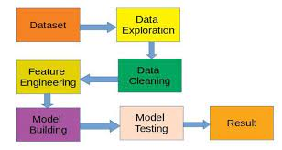
Block Diagram:

Slide 6
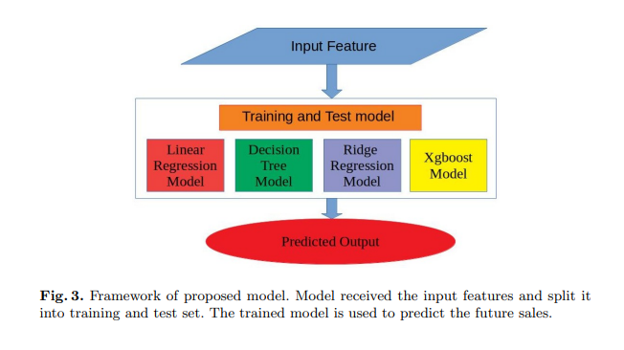
Implementation Aspects
All models received features as input, which are then segregated into training and test set.
The test dataset is used for sales prediction.
Then We are using all the machine Learning techniques including Linear regression, Decision Trees model, Ridge Regression Model ,XGBoost Model,Random Forest ,SVM etc..and
Predicting the outputs from those models based on the better Accuracy Values . This process Continues until we get satisfactory results or desired outputs.

Slide 7
Applications:
Market Basket Analysis
Understand the relationships between different products and customer purchasing behavior.This knowledge can be used to optimize product placement, bundle related items, and improve overall shopping experience.
Customer Satisfaction Improvement:
Ensure product availability by accurately predicting sales, reducing instances of out-of-stock items. This enhances customer satisfaction and loyalty, as customers can consistently find the products they need.
Seasonal Demand Planning:
Identify and prepare for seasonal variations in demand. This allows retailers to adjust inventory, marketing, and staffing levels to meet the unique challenges of each season.

Slide 8
Action Plan:
In Existing System they proposed XGBoost Algorithm and gained a lower MAE, RMSE values. Now We’re proposing a predictive model using all the ML techniques including Linear Regression, random Forest, Support vector Machines, Decision Trees,Gradient Boost Algo’s LightGBM, catBoost for predicting the sales of a company like Big Mart and found that the model produces better performance as compared to existing model XGBoost algorithm .A comparative analysis of the model with others in terms performance metrics is also explained in details

Slide 9
References:
1. Beheshti-Kashi, S., Karimi, H.R., Thoben, K.D., L¨utjen, M., Teucke, M.: A survey on retail sales forecasting and prediction in fashion markets. Systems Science & Control Engineering 3(1), 154–161 (2015)
2. Bose, I., Mahapatra, R.K.: Business data mining machine learning perspective. Information & management 39(3), 211–225 (2001)
3. Chu, C.W., Zhang, G.P.: A comparative study of linear and nonlinear models for aggregate retail sales forecasting. International Journal of production economics 86(3), 217–231 (2003)
4. Claypool, M., Gokhale, A., Miranda, T., Murnikov, P., Netes, D., Sartin, M.: Combing content-based and collaborative filters in an online newspaper (1999)

Slide 10
Future Enhancement:
Customer Segmentation Refinement:
Enhance customer segmentation models by incorporating more detailed customer behavior data. This can lead to more personalized marketing and sales strategies.
Forecasting for New Product Launches:
Develop a separate module for predicting sales of new products, considering factors like market trends, consumer preferences, and promotional activities surrounding the product launch.
Multi-Channel Sales Prediction:
Extend the prediction capabilities to cover multiple sales channels, including online sales, mobile app purchases for a comprehensive view of overall sales performance.
Integration with IoT Devices:
Explore the integration of Internet of Things (IoT) devices to capture real-time data from stores, such as foot traffic,and other environmental factors that impact sales.

Slide 11

Any Queries….....

Slide 12


