Slide 1
E-Commerce Sales & Customer Analytics
Final Capstone Project — Data Cleaning, EDA, Visualization & Power BI Dashboard
Aarav Sharma | Data Analytics Domain | Batch-03 | InternNova Internship

Slide 2
Objective & Problem Statement
Objective
Problem Statement
Apply the full data analytics lifecycle — cleaning, EDA, visualization, dashboarding, and version control — to a single real-world-style dataset, end to end.
An e-commerce business wants to understand which product categories and cities drive revenue, what factors influence order value and satisfaction, where returns concentrate, and what data-driven actions could improve revenue and reduce return-related losses.
Project Scope
Git & GitHub workflow (7 real commits across the project lifecycle)
Dataset selection, inspection & cleaning (403 raw rows -> 400 clean rows)
Exploratory Data Analysis: stats, correlation, per-category outlier detection
7 visualizations (line, bar, histogram, scatter, box, pie, heatmap)
Power BI-style interactive dashboard (4 KPIs, 5 visuals, 2 slicers)
Business insights & data-driven recommendations
E-Commerce Sales & Customer Analytics | InternNova Capstone
2

Slide 3
Dataset Overview
400
15
161
6
Clean Order Records
Columns
Distinct Customers
Product Categories
Key Columns
Intentional Data Quality Issues
order_id, order_date, customer_id
customer_age, customer_gender, customer_city
product_category, product_price, quantity
discount_pct, total_amount, payment_method
delivery_days, customer_rating, is_returned
Missing values across 4+ columns
3 duplicate rows (simulated double export)
1 invalid negative value (delivery_days)
2 genuine outliers (bulk order, delivery delay)
E-Commerce Sales & Customer Analytics | InternNova Capstone
3

Slide 4
Data Cleaning Process
Metric | Before | After
Rows | 403 | 400
Missing values | Present in 4+ columns | 0
Duplicate rows | 3 | 0
Invalid values | 1 (negative delivery_days) | 0
Steps Applied
Inspected shape, dtypes & missing values
Filled numeric gaps with column median
Removed 3 duplicate rows
Corrected 1 invalid negative value
Fixed data types (dates, integers, booleans)
Result: a fully clean, analysis-ready 400-row dataset with zero missing values and zero duplicates.
E-Commerce Sales & Customer Analytics | InternNova Capstone
4

Slide 5
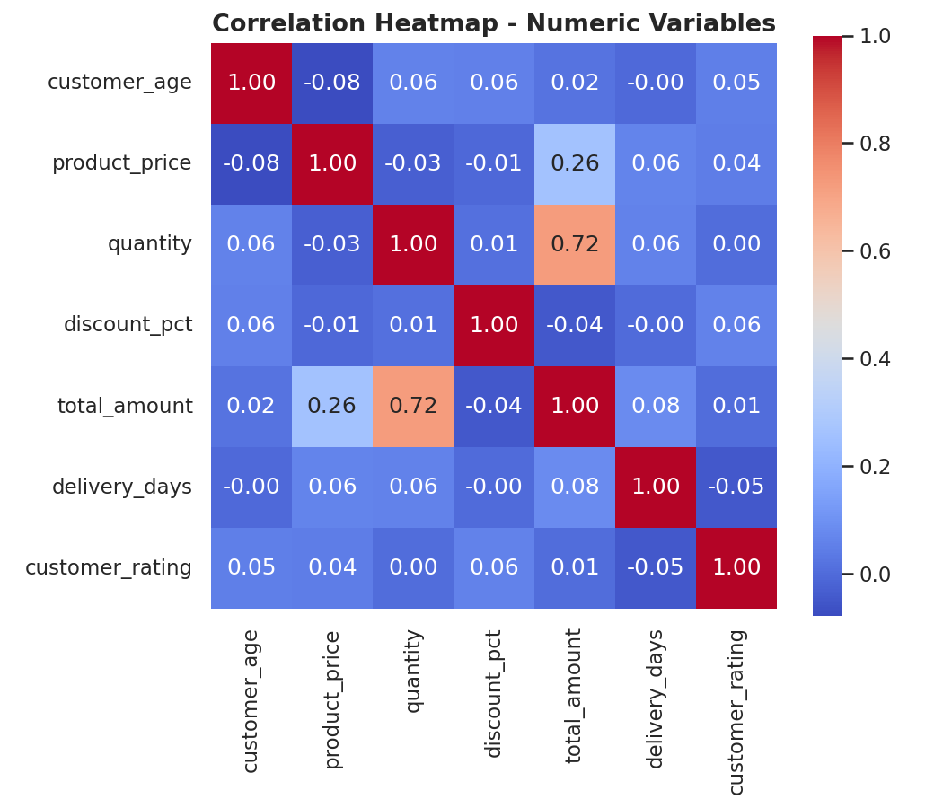
Exploratory Data Analysis — Key Findings
What the Data Shows
Quantity purchased correlates with order value far more strongly (r = 0.72) than unit price does (r = 0.26)
Outliers were detected using the IQR method — applied per product category, not globally, to avoid false-flagging naturally higher-priced Electronics orders
Sports has a return rate more than double the company average (20.0% vs 9.2%)
Delhi leads all cities in total sales (Rs.570,617)
March saw an unusual spike, partly driven by a single large bulk order
Correlation Heatmap — Numeric Variables
E-Commerce Sales & Customer Analytics | InternNova Capstone
5

Slide 6
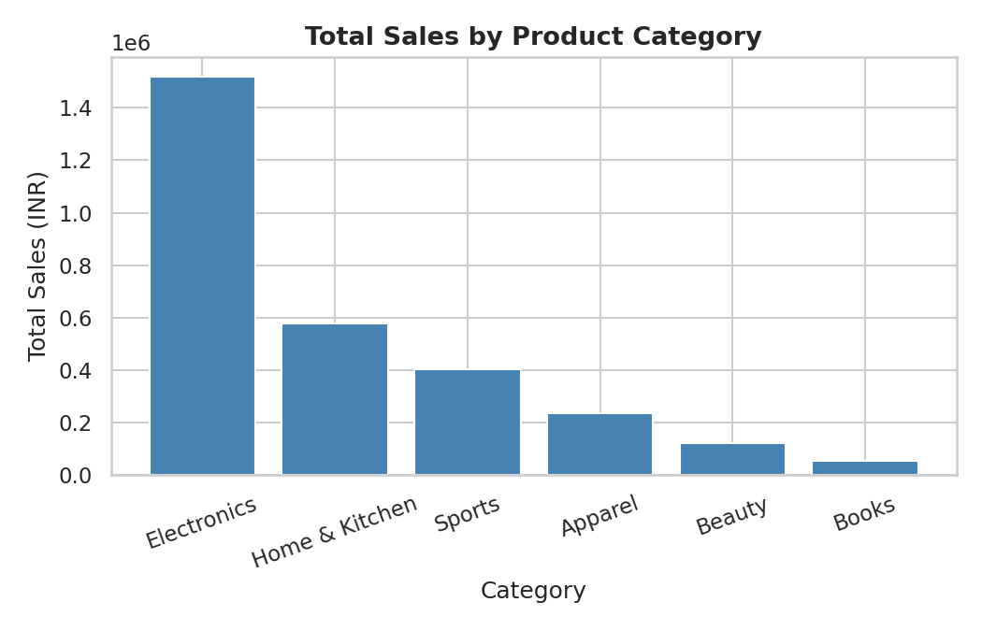
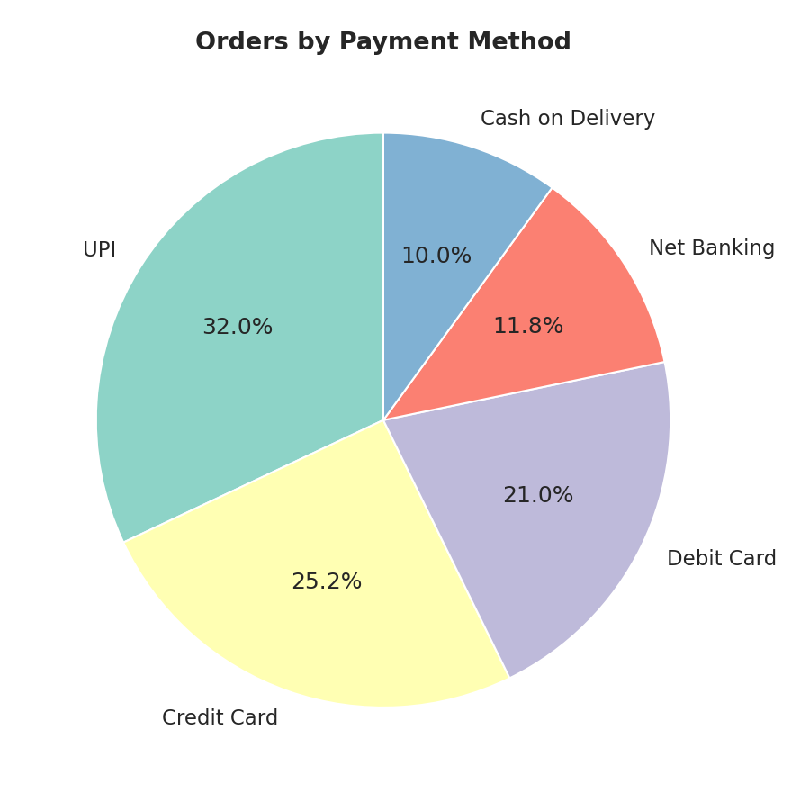
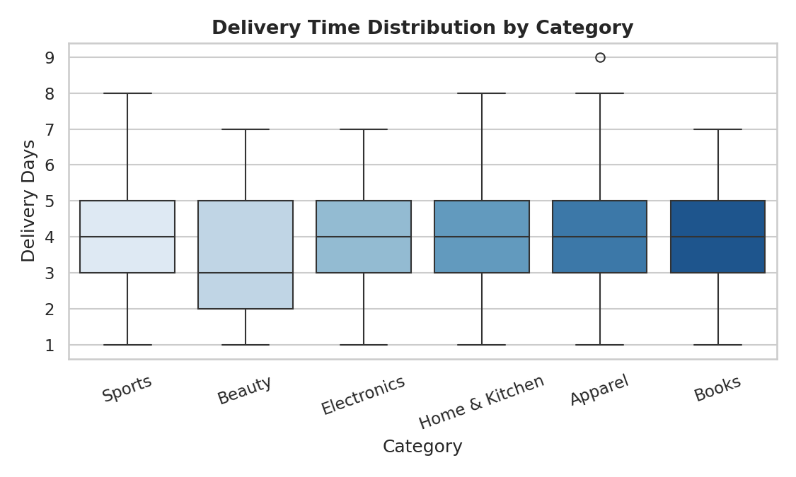
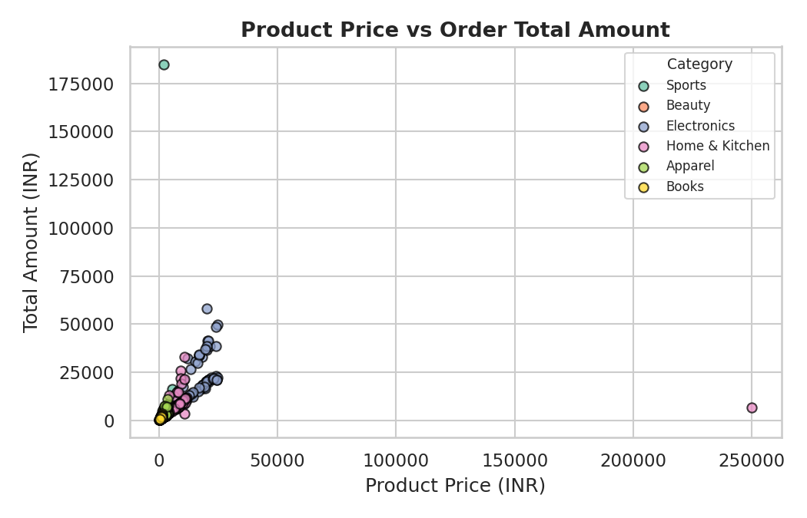
Visualizations
7 charts built with Matplotlib & Seaborn — exceeding the required 5
Total Sales by Category
Orders by Payment Method
Delivery Time by Category
Product Price vs Total Order Amount (by Category)
E-Commerce Sales & Customer Analytics | InternNova Capstone
6

Slide 7
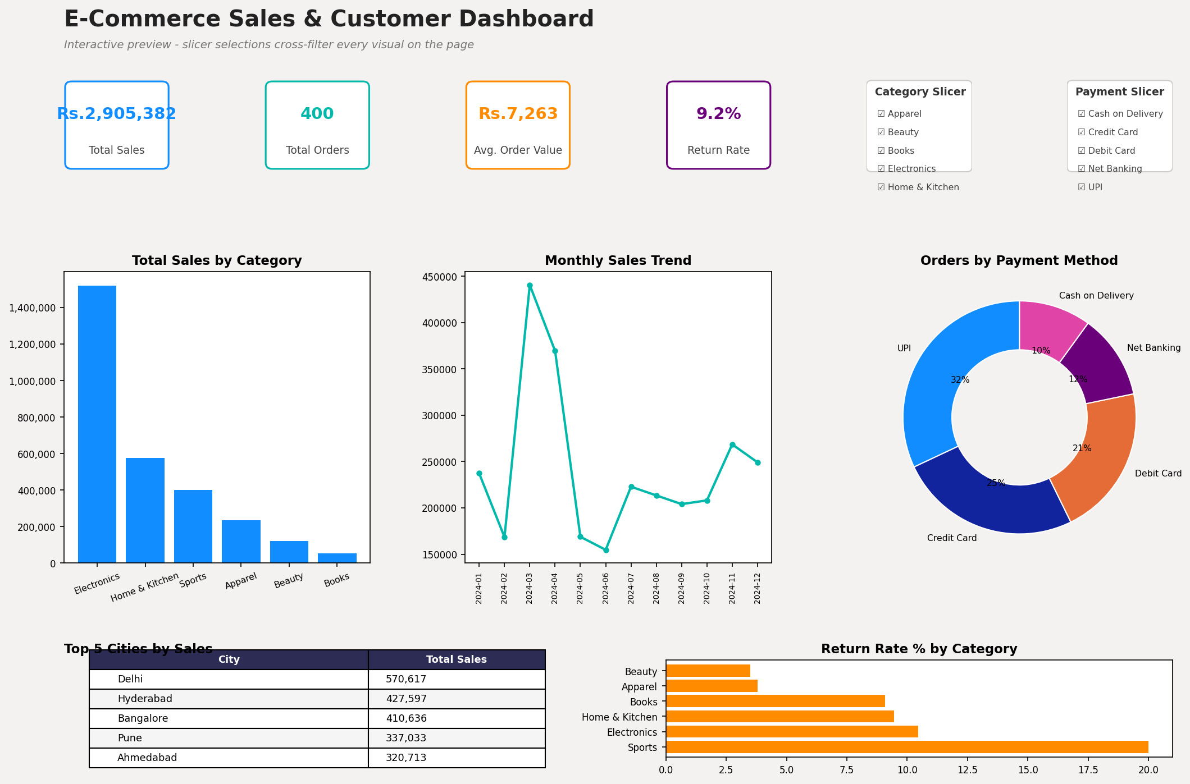
Power BI Dashboard
4 KPI cards, 5 visualizations, 2 slicers — target layout for the live, interactive report
E-Commerce Sales & Customer Analytics | InternNova Capstone
7

Slide 8
Key Business Insights
1
Electronics dominates revenue (Rs.1,519,856) despite lower order volume — driven by high per-unit prices
2
Quantity purchased matters more than unit price for order value (r=0.72 vs r=0.26) — bundling likely beats discounting
3
Sales are geographically concentrated — Delhi alone leads all cities at Rs.570,617
4
Sports has a notably high return rate (20.0%) vs the 9.2% company average
5
UPI is the dominant payment method (32% of orders), ahead of all card and cash options
E-Commerce Sales & Customer Analytics | InternNova Capstone
8

Slide 9
Recommendations & Conclusion
Business Recommendations
Promote bundle deals and multi-buy discounts rather than relying on per-item price discounting, since order quantity drives order value far more than price does
Investigate the elevated Sports return rate before scaling marketing spend in that category, to protect margin rather than just top-line sales
Double down on Delhi while piloting targeted campaigns in lower-performing cities to test whether the gap is demand or awareness
Conclusion
This project took a raw, imperfect e-commerce dataset through the complete analytics lifecycle — cleaning, exploration, visualization, dashboarding, and business storytelling. The most actionable finding — that basket size predicts order value far better than pricing does — directly challenges an intuitive assumption and points to a concrete, testable business action: bundling over discounting.
E-Commerce Sales & Customer Analytics | InternNova Capstone
9

