Slide 1
🚦 GRIDLOCK
Event-Driven Congestion Intelligence for Bengaluru Traffic
Forecast → Quantify Impact → Prescribe Deployment → Learn
Team TrafficSolvers
Ryan Bhan (Lead, IIIT-D) · Kanan Mittal (IGDTUW) · Aditya Rawat (IIIT-D) · Hrithik Raj (IIIT-D)
Flipkart Gridlock Hackathon 2.0 · Round 2
Built on the anonymized ASTraM incident dataset — 8,173 events × 46 fields

Slide 2
THE OPERATIONAL CHALLENGE
Events break the city — and we react blind
Rallies, festivals, sports, construction & sudden gatherings cause localized traffic breakdowns. Today the response is reactive and experience-driven.
① Impact is not quantified
No way to know in advance how bad an event will be, how long it will tie up the road, or which junctions it threatens.
② Deployment is guesswork
Officers, barricades and diversions are assigned from experience — not from data, and not optimized against a finite resource pool.
③ No post-event learning
Every event is handled fresh. Mistakes are never fed back; the system never gets smarter after the fact.
GRIDLOCK · Event-Driven Congestion Intelligence
Flipkart Gridlock 2.0 · 01

Slide 3
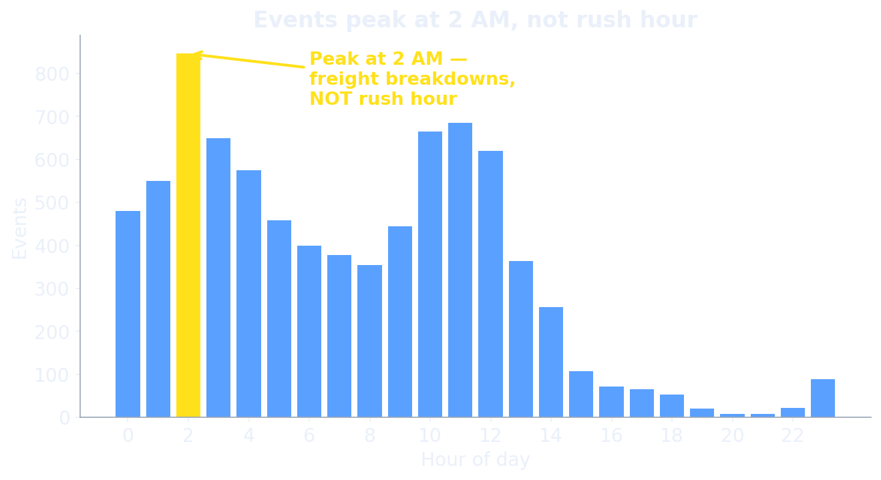
DATA INSIGHT MOST TEAMS WILL MISS
This is an incident log — not congestion data
There is NO speed / volume / delay field.
So the target — “traffic impact” — does not exist in the data. It must be engineered.
Events peak at 2 AM, not rush hour:
60% are vehicle breakdowns, driven by night-time freight movement. Teams that assume normal rush-hour patterns build the wrong model.
We turn this gap into our centrepiece.
GRIDLOCK · Event-Driven Congestion Intelligence
Flipkart Gridlock 2.0 · 02

Slide 4
OUR REFRAME
Not prediction — a decision-support system
Most teams stop at “predict congestion.” We deliver the full operational loop:
FORECAST
QUANTIFY
PRESCRIBE
LEARN
→
→
→
where / when / how many
Event Impact Score
manpower · barricades · diversions
post-event playbook
Two pipelines — Planned (proactive scheduling) and Unplanned (real-time triage) — exactly matching the problem statement.
GRIDLOCK · Event-Driven Congestion Intelligence
Flipkart Gridlock 2.0 · 03

Slide 5
SYSTEM ARCHITECTURE
Four layers on one data foundation
clean · leakage-safe features · H3 hex bins · EN+Kannada text
L0 · DATA FOUNDATION
LightGBM-Poisson corridor counts · empirical-Bayes hotspots · Hawkes self-excitation
L1 · FORECAST
clearance quantile regression + road-closure classifier → Event Impact Score
L2 · IMPACT (EIS)
manpower / barricades / diversions + city-wide officer optimization (ILP)
L3 · PRESCRIBE
predicted-vs-actual playbook · model-drift detection · retrain triggers
L4 · LEARN
GRIDLOCK · Event-Driven Congestion Intelligence
Flipkart Gridlock 2.0 · 04

Slide 6
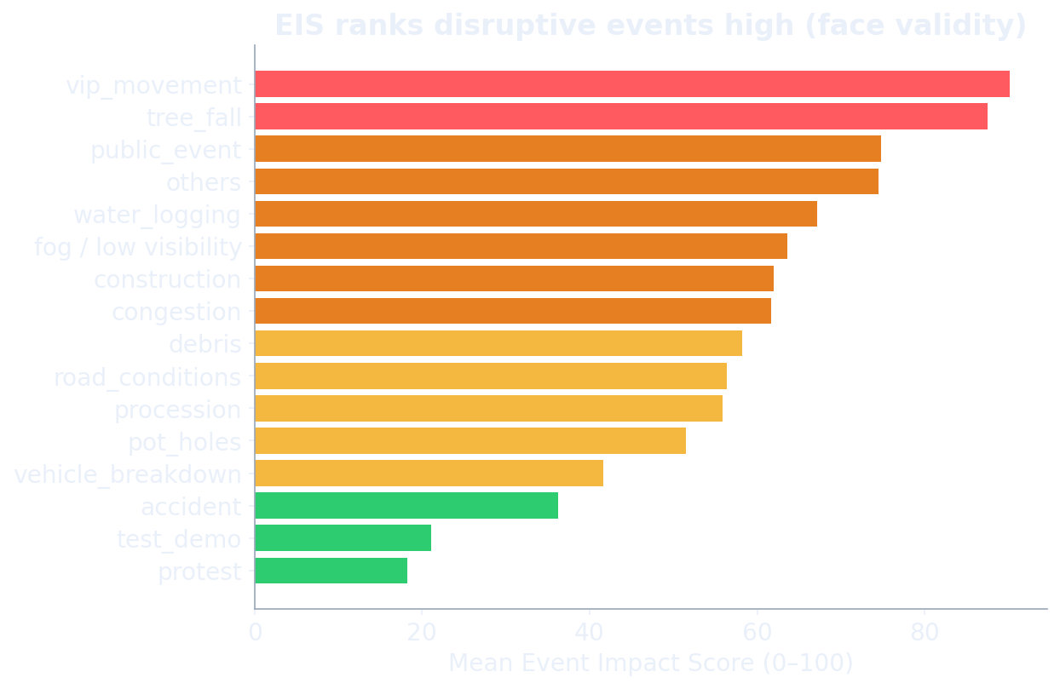
L2 · THE SPINE
Event Impact Score — engineering the missing target
Framed as expected vehicle-hours of delay:
EIS ≈ Clearance × Spatial reach × Baseline flow × Closure severity
• Clearance time is predicted (leakage-safe), not observed
• Robust percentile-rank scaling → Low / Medium / High / Critical
• VALIDATED against observed severity:
Spearman 0.70 · AUC 0.89 flagging top-10% impact events
GRIDLOCK · Event-Driven Congestion Intelligence
Flipkart Gridlock 2.0 · 05

Slide 7
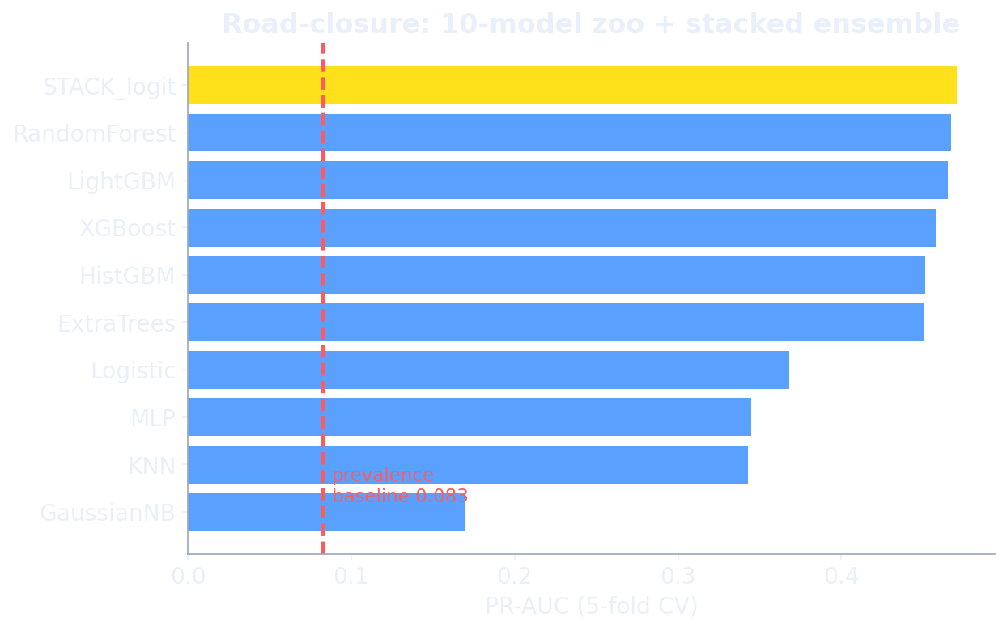
MODELLING RIGOUR (KAGGLE-GRADE)
10-model zoo · k-fold CV · leakage hunt · Optuna
Headline results
Clearance time MAE 2.88 h (blended)
Road closure PR-AUC 0.471 · +469% vs baseline
EIS validity Spearman 0.70 · AUC 0.89
Event forecast +16.7% over lag-7 baseline
Discipline that wins
• Time-split CV + spatial holdout (no leakage)
• Leakage hunt: dropped end-coords leaking @ AUC 0.976
• Priority shown ~location-circular — reported honestly
• Stacked ensemble + Optuna tuning
GRIDLOCK · Event-Driven Congestion Intelligence
Flipkart Gridlock 2.0 · 06

Slide 8
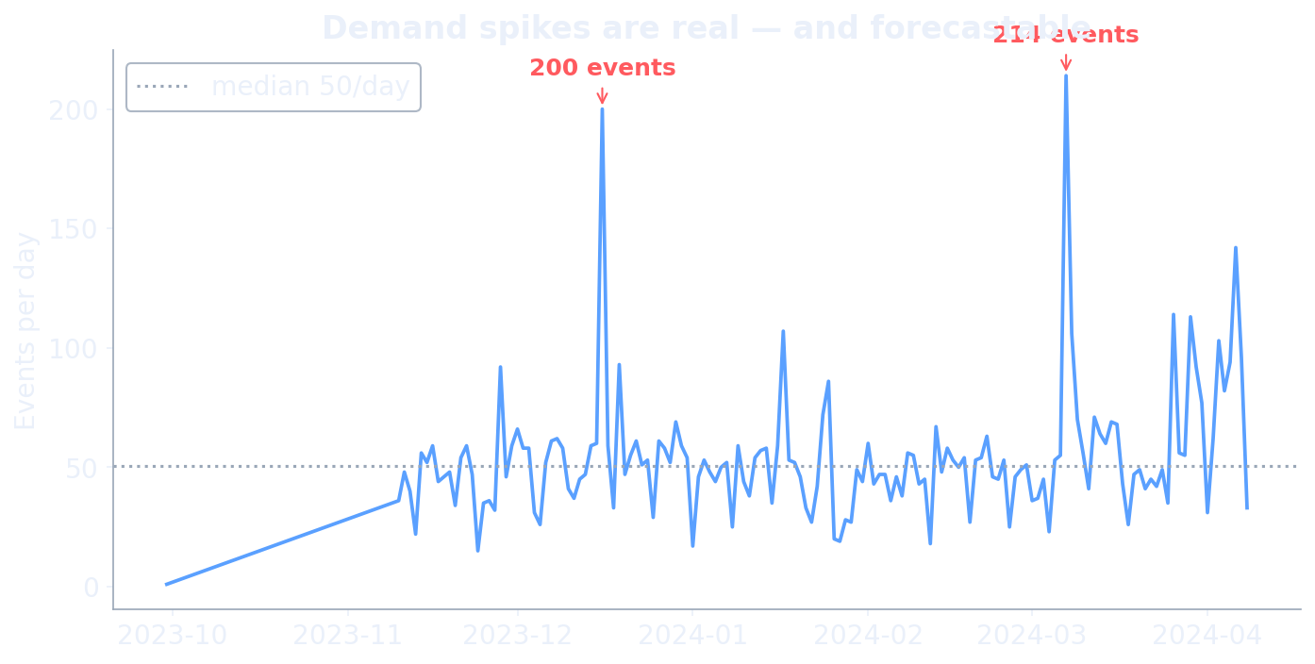
L1 · FORECAST
Where, when & how many events — ahead of time
LightGBM-Poisson
corridor × day event counts — 16.7% better than the lag-7 baseline.
Empirical-Bayes hotspots
recurring corridor × hour risk surface for pre-positioning.
Hawkes self-excitation
accidents cluster — branching ratio 0.31 — quantifying contagion.
GRIDLOCK · Event-Driven Congestion Intelligence
Flipkart Gridlock 2.0 · 07

Slide 9
L3 · PRESCRIBE + OPTIMIZE
The deliverable most teams never reach
Per-event plan
Officers, barricade units and a real road-network diversion (OSRM) — driven by the validated EIS tier + closure probability.
City-wide optimization
Finite officer pool allocated by ILP (PuLP) — two doctrines:
• Priority — cover highest-impact first (triage)
• Efficiency — maximize total mitigated impact
Surge day — 7 Mar 2024
214 events in one day
≈ 1,096 officers needed
vs ~120 available → a quantified deficit
The system tells the commander exactly which events to staff first and how many more officers to escalate for — turning guesswork into math.
GRIDLOCK · Event-Driven Congestion Intelligence
Flipkart Gridlock 2.0 · 08

Slide 10
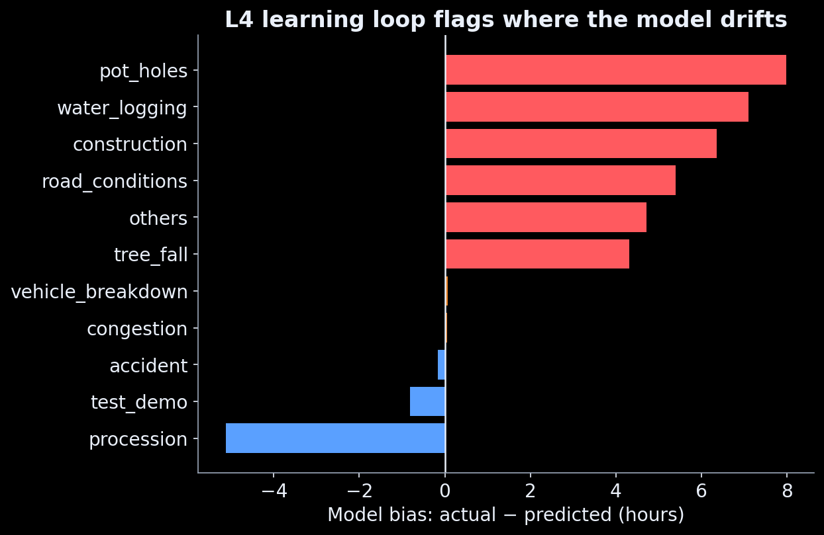
L4 · LEARN
The post-event loop the brief explicitly asks for
After events close,
we compare leak-free predictions with reality and build a playbook keyed by cause × H3 hex.
It self-diagnoses:
the model under-predicts infrastructure events — potholes by +8.0 h, water-logging +7.1 h — and flags those cells for retraining.
Closes the “no post-event learning” gap most teams ignore.
GRIDLOCK · Event-Driven Congestion Intelligence
Flipkart Gridlock 2.0 · 09

Slide 11
THE PRODUCT
A live decision-support dashboard
🎯 Event Simulator
score any what-if event → EIS, clearance P50/P90, full deployment plan
🗺️ City Risk Map
all 8,173 events on a Bengaluru map, coloured by impact tier
📅 Surge-Day Replay
replay a real day, set an officer budget → live allocation + deficit
📈 Forecast & Hotspots
corridor × hour risk heatmap, Hawkes, the 2-AM explainer
🔁 Learning Loop
predicted-vs-actual playbook + drift alerts
Live proof: the same breakdown scores EIS 17 at 2 AM vs 78 at 9 AM rush; a VIP movement scores 99.7 (Critical) with a real OSRM diversion drawn on the map.
GRIDLOCK · Event-Driven Congestion Intelligence
Flipkart Gridlock 2.0 · 10

Slide 12
WHY THIS WINS
Seven things the field won't have together
Correct reframe
incident log, not congestion data
Engineered + validated EIS
Spearman 0.70 — the missing target, proven
k-fold model zoo
10 models, stacking, Optuna — not one model
Prescription + ILP
we allocate scarce officers; others only predict
Post-event learning
L4 playbook + drift — the 3rd gap, solved
Real-ML simulator
runs the trained models, not random numbers
Honesty & rigor
leakage hunt, time-split CV, stated limits
GRIDLOCK · Event-Driven Congestion Intelligence
Flipkart Gridlock 2.0 · 11

Slide 13
IMPACT, ROADMAP & HONESTY
Operational value — and what we'd add next
Operational value
• Quantified impact before the event, not after
• Optimal, defensible resource deployment
• Faster clearance via right-sized response
• A city that gets smarter after every event
Roadmap
• Plug in live flow (Google/TomTom) to calibrate EIS
• Spatio-temporal GNN forecasting · officer-shift scheduling
Honest limitations (we say so)
• No ground-truth flow → EIS validated vs proxies
• Manpower data sparse (1.6%) → optimization + rules,
not over-claimed as learned
• 5 months of data → calendar priors mitigate seasonality
Stack
Python · LightGBM/XGBoost/CatBoost · scikit-learn · Optuna ·
H3 · PuLP · OSRM · Streamlit + pydeck
GRIDLOCK · Event-Driven Congestion Intelligence
Flipkart Gridlock 2.0 · 12

Slide 14
From reaction to anticipation.
Forecast the event · quantify the impact · deploy the optimal response · learn from every outcome.
Team TrafficSolvers
Ryan Bhan (Lead, IIIT-D) · Kanan Mittal (IGDTUW) · Aditya Rawat (IIIT-D) · Hrithik Raj (IIIT-D)
GRIDLOCK — Event-Driven Congestion Intelligence · Flipkart Gridlock Hackathon 2.0 · Round 2

