Slide 1
Web and Email Threats
CS 361S
SPRING 2021
Lecture Notes

Slide 2
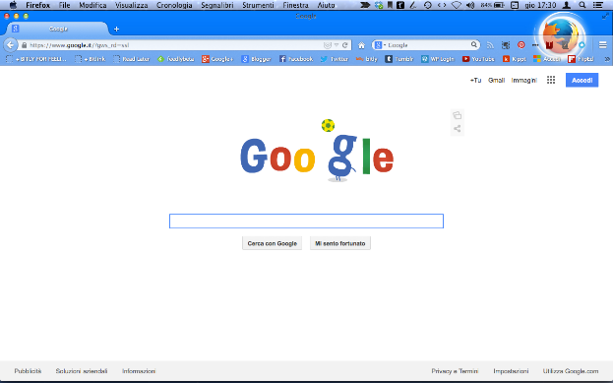

Browser to Website Security
TLS provides end-to-end security
What are the “ends”?
SECURE TLS CHANNEL
This Photo by Unknown Author is licensed under CC BY-SA
This Photo by Unknown Author is licensed under CC BY-SA
BROWSER
SERVER

Slide 3



Trusting the Server (Backend)
TLS doesn’t prevent the server
from sharing with 3rd parties…
Sharing with Government
Sharing with Criminals
This Photo by Unknown Author is licensed under CC BY-SA
SERVER
This Photo by Unknown Author is licensed under CC BY-SA

Slide 4
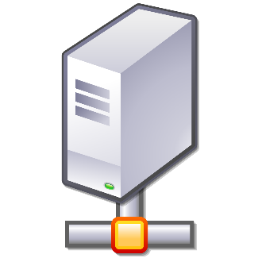
Trusting the Server (Frontend)
TLS doesn’t prevent the server
from directing your browser
to a third party server
This Photo by Unknown Author is licensed under CC BY-SA
SECURE TLS CHANNEL
This Photo by Unknown Author is licensed under CC BY-SA
This Photo by Unknown Author is licensed under CC BY-SA
BROWSER
SERVER

Slide 5
Webpage Construction
Very Basic HTML
<HTML>
<BODY>
<H1>Hello!</H1>
</BODY>
</HTML>

Slide 6
Multi-source Webpage
<HTML>
<BODY>
<IMG SRC=“http://otherwebsite/image.gif>
</BODY>
</HTML>
“IMG” is how you tell a page to put an image in the webpage. The source (SRC) or location can be any address reachable on the Internet

Slide 7
Visualized Multi-source
(1) Request initial webpage.
Begin displaying and
request other
elements
GET webpage
Server 1
LCD SCREEN
HTML with <IMG>
Browser
Program
GET image
IMG Server
(2) request image
Display image data
as it arrives
Image Data

Slide 8
Dynamic webpage can READ itself!
Downloaded content is not just “static”
Dynamic webpage can ask the browser about itself
“Browser, what is displayed on the webpage?”

Slide 9
Potential Problem!!
The following is NOT allowed:
GET webpage
Website
HTML with <IFRAME>
from adserver
Browser
GET ads IFRAME
EVIL IFRAME!!!
3rd Party Server (like ads)
Evil IFRAME could ask the
Browser for the contents
of the website, seeing/changing
Sensitive data

Slide 10
Preventing 3rd Party Attacks
IFRAMES are isolated. Cannot ask about the rest of the page
SAME ORIGIN POLICY:
Data from a website can only be sent back to that website
Prevents “cookies” from being stolen
Prevents some kinds of unexpected network connections

Slide 11
Websites CAN “Collaborate”
TLS doesn’t prevent the server
from directing your browser
to a third party server
This Photo by Unknown Author is licensed under CC BY-SA
SECURE TLS CHANNEL
This Photo by Unknown Author is licensed under CC BY-SA
This Photo by Unknown Author is licensed under CC BY-SA
BROWSER
SERVER

Slide 12
Conspiracy How-To
The main website creates an agreement with the 3rd party. “I’ll send you X data for Y dollars.” 3rd party provides a communication protocol.
Typically, a URL with the transmitted info
included as part of the URL!
1X1 tracking pixels, for example:
3rd Party
<IMG SRC=“http://third-party.com/shared-info>
Main Website

Slide 13
Broader Conspiracy
Normally, one 3rd party can’t share data with another. (Same origin policy). But, when they all work with one ad delivery platform, that platform coordinates sharing.
3rd Party 1
Website 1
Ad Delivery Platform
3rd Party 2
Website 2
Website 3
3rd Party 3

Slide 14
Drive-by Downloads
TLS also doesn’t protect against CORRUPTED SERVERS
A drive-by download is malware transmitted by a server
Usually, the server is corrupted by the attacker first
OR, it is sometimes inserted through an ad server
The web browser, when visiting the corrupted page, is attacked

Slide 15
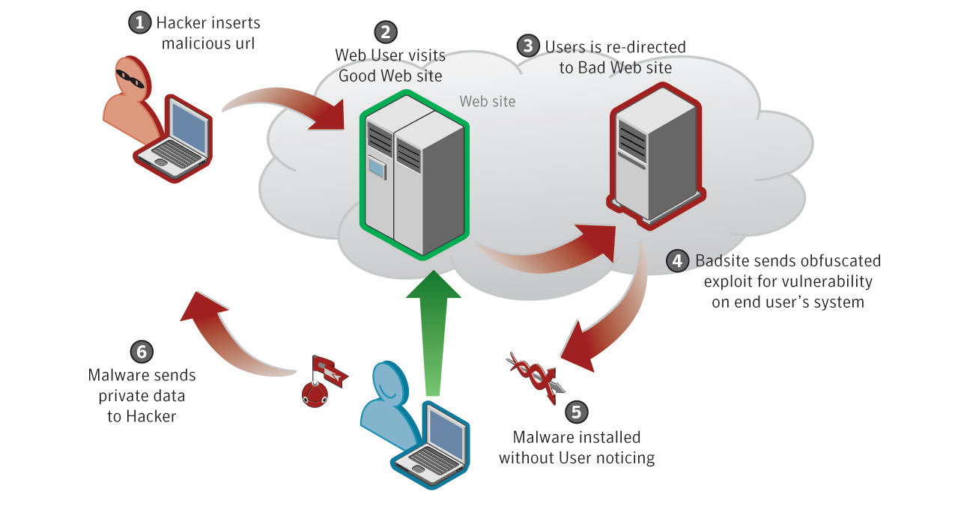
Drive-by Download Visual

Slide 16
Requires Browser Issues Too!
Browsers are designed to prevent malicious installs
Most Drive-by-Downloads DON’T WORK if the Browser is secure
Some do just ask a user to permit install (social engineering)
But the true “drive-bys” exploit vulnerabilities
THIS IS WHY YOU ALWAYS UPDATE YOUR BROWSER!

Slide 17
Profiling/Recon
How does attack code know what kind of browser you have?
Profiling; detects the type of browser/OS/etc
Customized attack code based on vulnerabilities
Can also be time, geographic, and demographic based

Slide 18
Web Logins
Browsers do not maintain a connection with servers
NEW CONNECTION each time you click on Amazon
How does Amazon keep you logged in? COOKIES
If your cookie is stolen, the thief can “log in” as you!

Slide 19
Cross-Site Scripting (XSS)
Thief tries to steal a user’s login cookie
Remember, Same Origin Policy?
Cookie should ONLY be sent to Origin server
Some XSS worked by exploiting bugs in browsers
But now, bigger problem is dynamically website generation

Slide 20
XSS Visualization
WEB SERVER
The Attacker gets Evils JavaScript inserted either through a “reflection” attack or “storage” attack. Once operational, it can impersonate the user, including all of their cookies and settings. Moreover, the Evil JS can communicate with the attacker for data exfiltration or ongoing real-time control.
HTTP Request w/ Cookie
HTTP Response
AUTHORIZED WEBPAGE
ATTACKER
Command and Control
EVIL JS
Exfiltrated:
Web server response
Cookies including session auth
User Browser

Slide 21
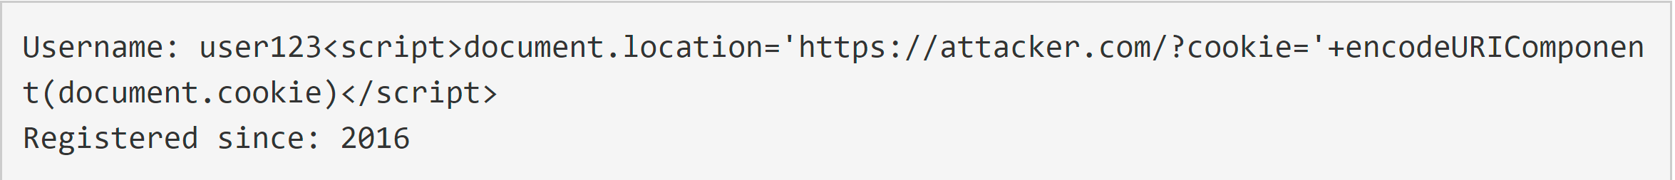
Example:
The User’s “name” has been corrupted to include a “script” that will run every time it is displayed
This is the Database
The script connects to the attacker’s website with the user’s cookie encoded as a parameter to the URL. This bypasses the Same Origin Policy (any URL is allowed)

Slide 22
XSS Visualization
WEB SERVER
The primary defense against XSS attacks is filtering inputs and escaping outputs. These defenses actually stop and eliminate the XSS attack altogether.
Secondary defenses mitigate XSS attacks by preventing XSS JS from exfiltrating some kinds of data. For example, cookies marked “HttpOnly” cannot be read by JavaScript in most modern browsers.
HTTP Request w/ Cookie
HTTP Response
AUTHORIZED WEBPAGE
ATTACKER
Command and Control
EVIL JS
Exfiltrated:
Web server response
Cookies including session auth
User Browser

Slide 23
XSS Visualization
WEB SERVER
Secondary defenses should not be substitutes for primary defenses. The goal is blocking XSS; once it’s running it will always be able to do some damage.
Circumvention also possible. In the mid 2000’s, cross-site-tracing could get around the HttpOnly exception (blocked in modern browsers)
HTTP Request w/ Cookie
HTTP Response
HTTP TRACE request
TRACE response including cookies
AUTHORIZED WEBPAGE
ATTACKER
Command and Control
EVIL JS
Exfiltrated:
TRACE response including cookies
User Browser

Slide 24
CSRF Visualization
WEB SERVER
Cross-Site Request Forgery is simpler than XSS. There is typically no JS and it is not typically two-way communication with the Attacker.
The idea is simply getting the victim to click on a link or otherwise transmit an HTTP request that causes an unauthorized transaction. For the attacker to succeed:
An inducible action
Cookie-based session handling
Predictable request parameters
HTTP Request w/ Cookie
HTTP Response
AUTHORIZED WEBPAGE
EVIL LINK
User Browser

Slide 25
CSRF Visualization
WEB SERVER
A CSRF-Token is some unpredictable value embedded in the webpage that is used for identifying authorized requests. For this to work:
CSRF Token cannot be a cookie
Must be unpredictable
Not easily interceptable
Typically issued from the server in a hidden form element. Automatically transmitted back when the form is submitted.
HTTP Request w/ Cookie
HTTP Response
AUTHORIZED WEBPAGE
(with CSRF Token)
EVIL LINK
User Browser

Slide 26
CSRF v XSS
WEB SERVER
CSRF tokens do not protect against XSS if the XSS request results in a valid form with a valid CSRF token. The XSS has two-way communication and can submit the form with the properly issued CSRF token.
XSS is very, very dangerous.
HTTP Request w/ Cookie
HTTP Response
AUTHORIZED WEBPAGE
ATTACKER
Command and Control
EVIL JS
User Browser

Slide 27
Browsers Can Also Be Bad!
“Man-in-the-Browser” Attack
The Browser is the “other end” of end-to-end
The Browser sees all the unencrypted data
If the Browser is evil, all data compromised
For example, if corrupted by malware

Slide 28
Or… the O/S?
Key logger?
Spyware?
Rootkit?
I worked on a spyware case once…

Slide 29
Email Threat: SPAM
You know what it is.
Why does it work?
Advertising
Pump and Dump
Malicious Payload/Malicious Links
Unregulated/Illegal Traffic

Slide 30
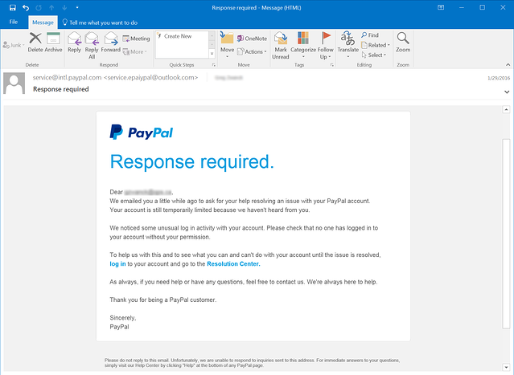
Email Threat: Phishing

Slide 31
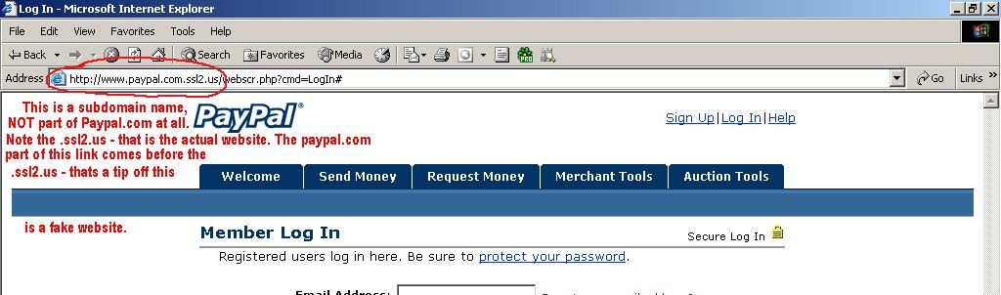
Phishing Links
Why do they need a fake URL?

Slide 32
Note About Phishing Training
I’ve yet to see it work.
Lots of companies try. Lots of products.
Word on the street is the users don’t learn

Slide 33
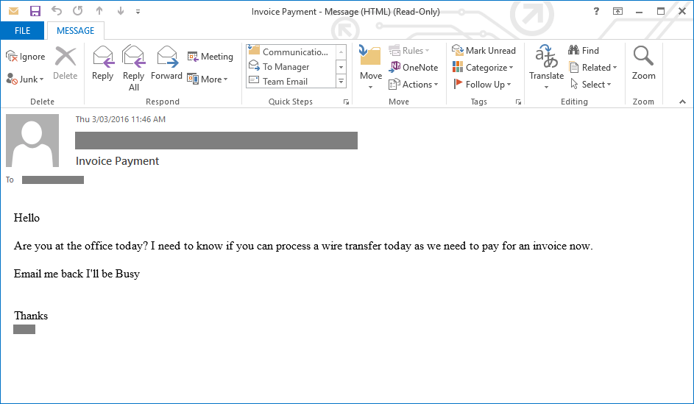
Spear Phishing Example 1

Slide 34
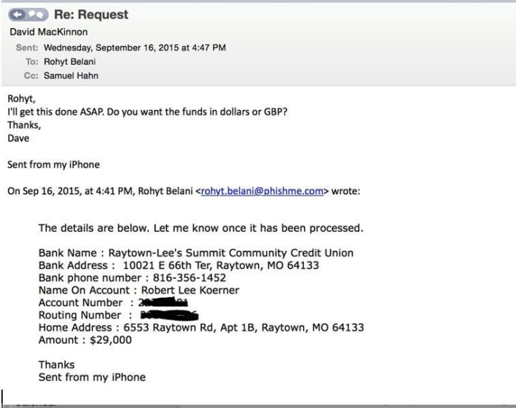
Spear Phishing Example 2

Slide 35
Spear Phishing Details
Often requires some recon (trusted email addresses or names)
Create fake, BUT CLOSE, email address:
REAL: seth.nielson@company.com
FAKE: seth.nielson@c0mpany.com
Or, just replace DISPLAY NAME:
REAL: Seth Nielson <seth.nielson@company.com>
FAKE: Seth Nielson <seth.nielson@not_even_close.com>
Target busy people

Slide 36
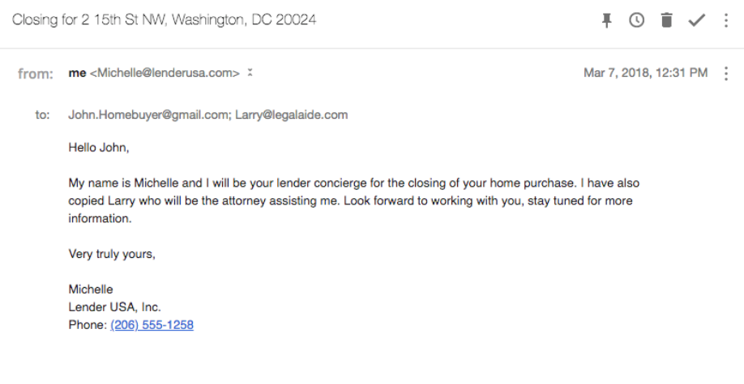
Real Estate Scams

Slide 37
Malicious Email and Psychology
Psychological Manipulation
Similar to Anderson’s example about pretexting
Emotional impulses drive the reactions
WE ARE ALL VULNERABLE TO THIS

Slide 38
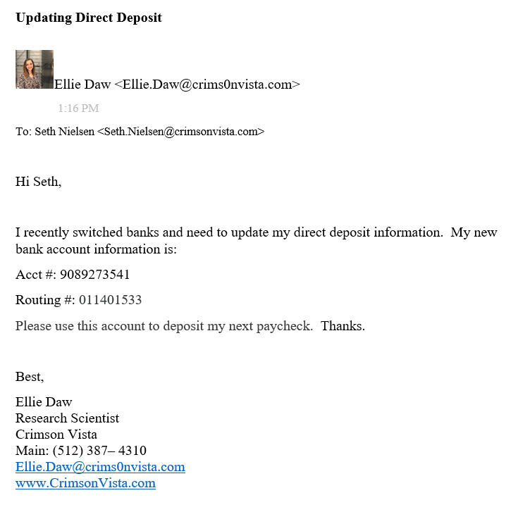
Phishing Competition Submission

