Slide 1

Minesweeper
Institute of Engineering and Technology
Devi Ahilya Vishwavidyalaya
Guided By – Mr. Manoj Pawaiya
Group members:
Hritik Sahu(18C7120)
Muskan Sharma(18C7130)
Vikalp Rusia(18C7163)
Branch - Computer Engineering
Section - B

Slide 2

Contents
Introduction
Problem Domain
Literature Survey
Solution Domain
Technology Stack
Use case Diagram
Database Design
Conclusion

Slide 3
Introduction
Minesweeper is a single-player puzzle video game. The objective of the game is to clear a rectangular board containing hidden "mines" or bombs without detonating any of them, with help from clues about the number of neighboring mines in each field.
There are some benefits of playing games like minesweeper:
Using Games to Teach Cognitive Skills – The use of games to attempt to teach cognitive skills goes back to ancient times. It is thought that the game now known as "Go," is possibly one of the first games that were used to teach mental ability. Chess also has a history of being used to teach thinking.
The Value of Logical Hypothetical Thinking - Hypothetical reasoning is a central topic in cognitive science. and is a major component of what is known in Dual Processing Theory as Type 2 Processing done by our brains.

Slide 4

Problem
Domain

Slide 5
Problem Domain
Minesweeper is a simple one−player computer game. The game consists of a 2-dimensional rectangular playing field (or board) where some known numbers of mines have been hidden. Initially, all the squares on the board are "covered up" and no information is given to indicate the location of the mines.
The player’s job is to either deduce or guess which board squares are clear of mines and step there to reveal a number. If successful, this number will indicate the number of mines to be found in the squares adjacent to the square with the number.
Obviously, the first move of the game must be a guess because no information has been provided. Since the board is a rectangular grid, each interior square has exactly 8 neighbouring squares, edge squares have 5 neighbours, and corner squares have 3 neighbours. Therefore, the number found under any given square will be in the range of 0 to 8 (inclusive).
Game play continues until the player has uncovered (or "stepped" on) each square that does not hide a mine, while avoiding all the mines. If the player can do this, they are considered to have won the game. However, if at any point the player attempts to uncover a square that contains a mine, the game immediately ends, and the player is said to have lost.

Slide 6
Literature Survey

Slide 7
The cell state is given two components. The first component indicates whether the cell is either covered, uncovered, or a mine. The second component, which is only available to the system if the cell is uncovered, is the number of mines adjacent to that cell. One limitation to the CA model is in the transition function which only accounts for two basic deductions in Minesweeper.
Kasper’s single point method determines safe moves deterministically by looking at individual squares, like CA. However, if no safe moves are discovered, a square is probed uniformly at random. This prevents the algorithm from becoming stuck.
Kasper Pederson offers an alternative strategy called limited search. This method utilizes depth-first search and backtracking on a small zone of interest around uncertain squares.

Slide 8
Solution Domain

Slide 9
To improve upon the game, there are several features that could be added. For example, adjusting the program to ensure that a bomb could not be uncovered on the first tap.
This could be done by generating the random row and column coordinates of the bomb locations in the gameboard array after the first touch had been recorded on the touch screen.
An if statement could be used in the code to prevent a bomb from being randomly placed in the location that corresponds to a location that was already touched by the user on the screen.
By generating the location of the bombs after the first touch has been made by the user, there is no way that the user could touch a bomb on the first touch. Then, the remaining logic of the code could still be applied.

Slide 10
Another recommendation for the game is that flags could be added to the game. this would involve adding a button board that could be used to select locations on the board that the user suspects to have a bomb.
Then, the user could tap these locations and a shape could be printed to that desired location. An if statement could be used to allow for the user to tap the space again to remove the shape. These changes could be implemented with more time.

Slide 11
Technology Stack
Java
Spring(Back-End)
HTML, CSS, JavaScript,JSON (Front-End)
MySQL(database)
Hibernate(ORM model) and JDBC (database connectivity)
C3p0 (database thread pooling)

Slide 12
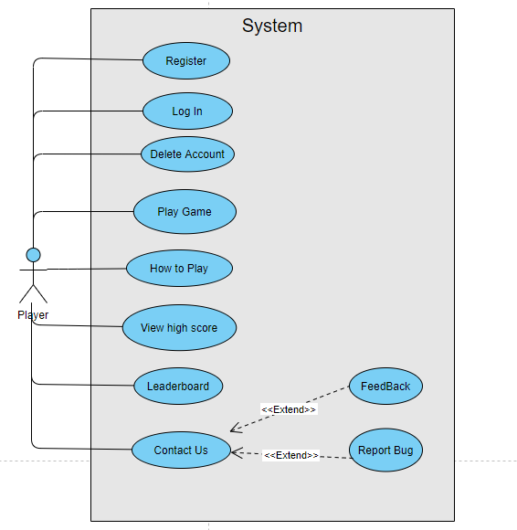
Use - Case Diagram

Slide 13
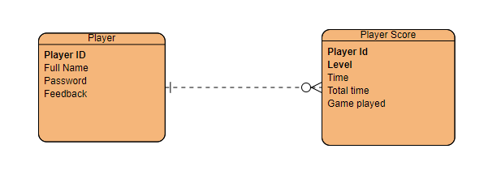
Database Design

Slide 14
Conclusion
There was difficulty in developing a way all of the surrounding locations of a selected location could be checked for mines. This problem was solved by making an if-else selection structure that could check the values of the surrounding locations in the array that represented the game board.
Another difficulty that was encountered was developing a method to win. This was done by changing the values in the game board array that correspond to touched locations to equal two. Once the sum is reached, the user has cleared the minefield and won the game. This solution took planning and trial by error.
The final difficulty that was encountered was difficulty in testing the game because the mines were randomly generated.

