Slide 1
Staff and Visitor Logging & Management System
Guided by: Dr. Manas Kumar Mishra
Team Members:
1. Abhijay Wadhwani(18BCE10005)
2. Hritik Ranjan(18BCE10117)
3. Utkarsha(18BCE10284)

Slide 2

Introduction
Face detection is a computer vision technology that helps to locate/visualize human faces in digital images. This technique is a specific use case of object detection technology that deals with detecting instances of semantic objects of a certain class (such as humans, buildings or cars) in digital images and videos.
This technology is being used all over the place from cameras that make sure faces are focused before you take a picture, to when it tags people automatically once we upload a picture.

Slide 3
Introduction
Face Detection and Face Recognition works as it extracts our face from an image then it compares the current face with the one it saved before during training and checks if they both match. If both the faces match with each other then it recognizes our identity and proceeds as specified.
A computer program that decides whether an image is a positive image (face image) or negative image (non-face image) is called a classifier. A classifier is trained on hundreds of thousands of face and non-face images to learn how to classify a new image correctly.

Slide 4
Existing Work With limitation:
In current system we have finger biometric for maintaining log of entry and exit, this system is ideal for registered users but for unknown person it does not provide any functionality.
The fingerprint sensor can lead to false rejections. The biometric device does not always read an individual’s fingerprint accurately, and could therefore refuse access. In certain cases, the finger may have not been placed in the right spot or placed finger other than the one which is identified and vice versa. When this happens fingerprint scanner falsely rejects the fingerprint.
There is one more disadvantage of fingerprint identification as they cannot be reset,once they have been compromised.

Slide 5
Proposed Work
The entire idea behind our Project is to build up a Facial Recognition System. Facial recognition is a biometric software application capable of uniquely identifying or verifying a person by comparing and analyzing patterns based on the person's facial features. Our system will be mostly used for office purposes, though there is increasing interest in other areas of use. In fact, facial recognition technology has received significant attention as it has potential for a wide range of Application. The data about a particular face is often called a face template and is distinct from a photograph because it’s designed to only include certain details that can be used to distinguish one face from another.

Slide 6
Real Time Usage
Our project is basically a system which provides a format for propagating operation of real time usage of computer vision. The actual real time usage of our project
is that when a staff member enters, then his entry time is recorded and stored in the csv file. Now, if any visitor enters in the block then his entity is registered and
stored in the database and the stored info is used for future use.

Slide 7
Hardware and Software Requirements
Software essentials:
Operating system
Python 3
Open cv 3.2 and above
Drivers for Camera
Hardware essentials:
1 GB of Ram and above
Processor
WEB Camera
Note:
OpenCV will run on anything. Even on a Raspberry Pi 1 (700MHz single core CPU, 256Mb memory)

Slide 8
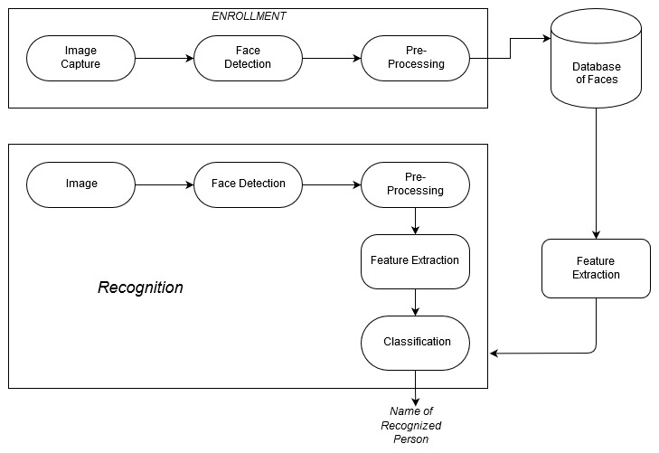
System Architecture Diagram

Slide 9
Modules and Explanation
Classifier:
A computer program that decides whether an image is a positive image (face image) or negative image (non-face image) is called a classifier. A classifier is trained on hundreds of thousands of face and non-face images to learn how to classify a new image correctly. OpenCV provides us with two pre-trained and ready to be used for face detection classifiers:
Haar Classifier
LBP Classifier
Using the Multiscale method of the classifier we get the coordinates of the face in a particular image, then using these coordinates we draw a rectangle around the detected faces.

Slide 10
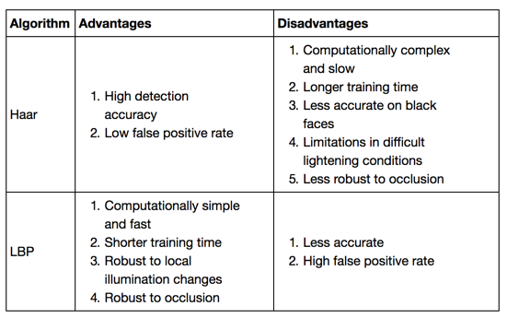
Comparison Between HAAR and LBP
Conclusion:
LBP is faster (a few times faster) but less accurate. (10-20% less than Haar).
For detecting faces on an embedded system, We think LBP is the choice, because it does all the calculations in integers. Haar uses floats, which is a killer for embedded/mobile systems.

Slide 11
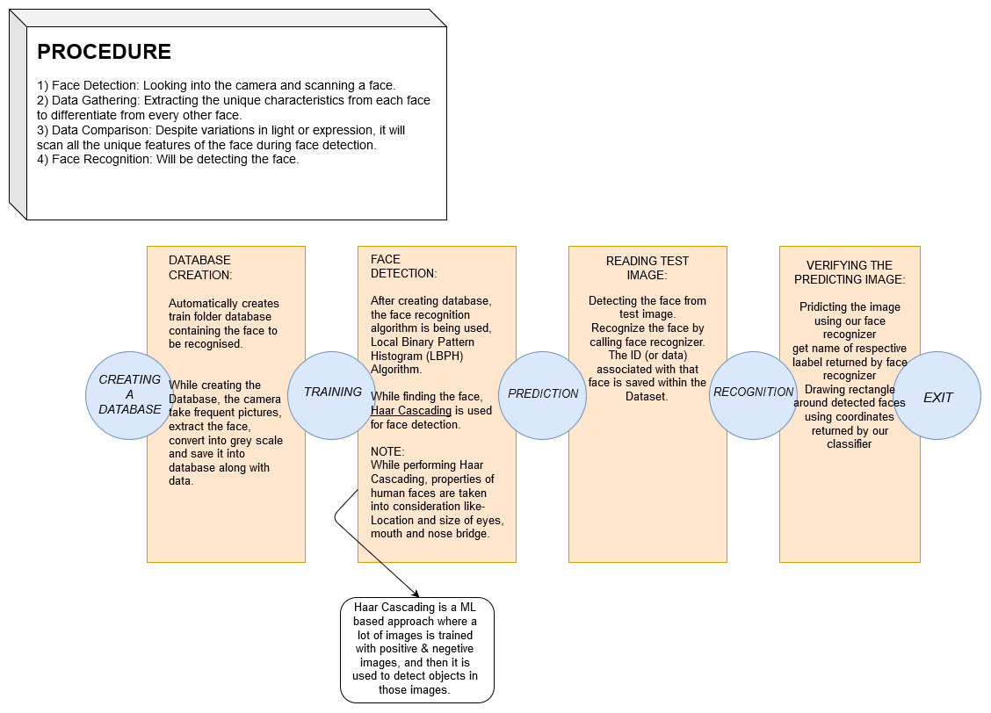

Slide 12
Project Timeline
09-08-2019
First Project Discussion
29-08-2019
1.Project Finalised
Face Detection in Real time is achieved
10-09-2018
Data Gathering
16-08-2019
2.Started working with Open CV Library
23-08-2018
26-09-2019
12-10-2019
20-10-2019
Face detection in static images is achieved
Testing our Recognizer on test images
Training the recognizer in order to identify images
Facial Recognition System to be deployed and tested

Slide 13
References
Face Detection with Python using OpenCV (article) - DataCamp
Cascade Classification — OpenCV 2.4.13.7 documentation
https://software.intel.com/en-us/node/754941
Rapid Object Detection using a Boosted Cascade of Simple Features
@inproceedings{Ali2012FaceRW, title={Face Recognition with Local Binary Patterns}, author={Ammad Ali and Shah Hussain and Farah Haroon and Sajid Hussain and Mohammad Farhan Khan}, year={2012} }
S. Chintalapati and M. V. Raghunadh, "Automated attendance management system based on face recognition algorithms," 2013 IEEE International Conference on Computational Intelligence and Computing Research, Enathi, 2013, pp. 1-5.
P. Viola and M. Jones, "Rapid object detection using a boosted cascade of simple features," Proceedings of the 2001 IEEE Computer Society Conference on Computer Vision and Pattern Recognition. CVPR 2001, Kauai, HI, USA, 2001, pp. I-I.

Slide 14
THANK YOU!

