Slide 1
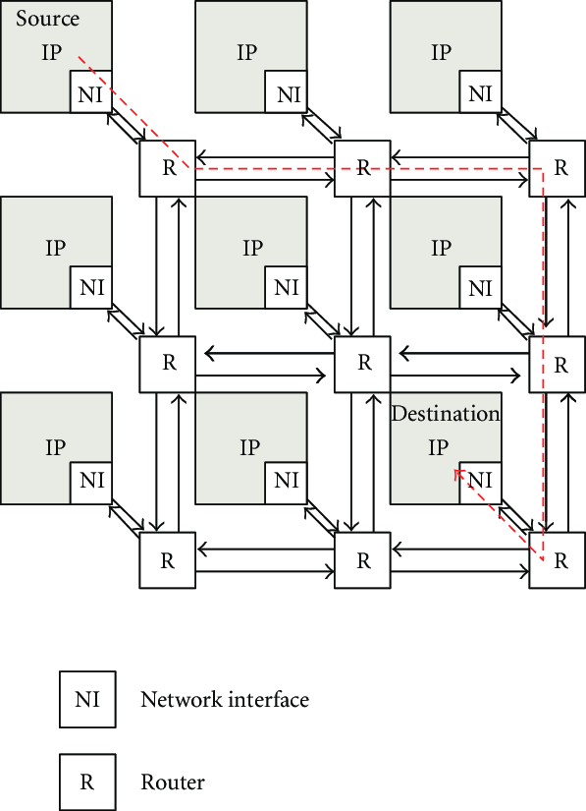
Study on GAN Inspired Routing on NOC
Objectives?
An efficient Routing algorithm.
Predict the shortest possible route using GAN.
Use Transfer Learning to generalize on various Topologies.

Slide 2
Study on GAN Inspired Routing on NOC
What is NoC?
Network On Chip
Network-based communications subsystem
Introduction!
Objectives?
An efficient Routing algorithm.
Predict the shortest possible route using GAN.
Use Transfer Learning to generalize on various Topologies.
Notes:
The main objectives were clear for the project i.e to implement an efficient routing algorithm, and to predict the shortest path between source and destination that we desired.
And also to apply transfer learning from the mesh topology to the other network topologies

Slide 3

What is NoC?
Objectives?
Introduction!
Network On Chip
Network-based communications subsystem
An efficient Routing algorithm.
Predict the shortest possible route using GAN.
Use Transfer Learning to generalize on various Topologies.
Consists of IP-Cores
Notes:
NoC in short also known as Network on chip.
used as a network based communication system.
consists of components like IP .(IP core) is a functional block of logic or data used to make a field-programmable gate .IP core or IP block is a reusable unit of logic.
NI – network interface the NoC controls the flow of data through the use of network interface (NI) modules. These modules are often used to transform data packets generated by the processor cores into fixed-length, flow-control digits. These digits allow the routers within the NoC to appropriately direct data to the desired functional block.
router- comprises a number of input ports, a number of output ports, a switching matrix connecting the input ports to the output ports, and a local port to access the IP core connected to this router.

Slide 4
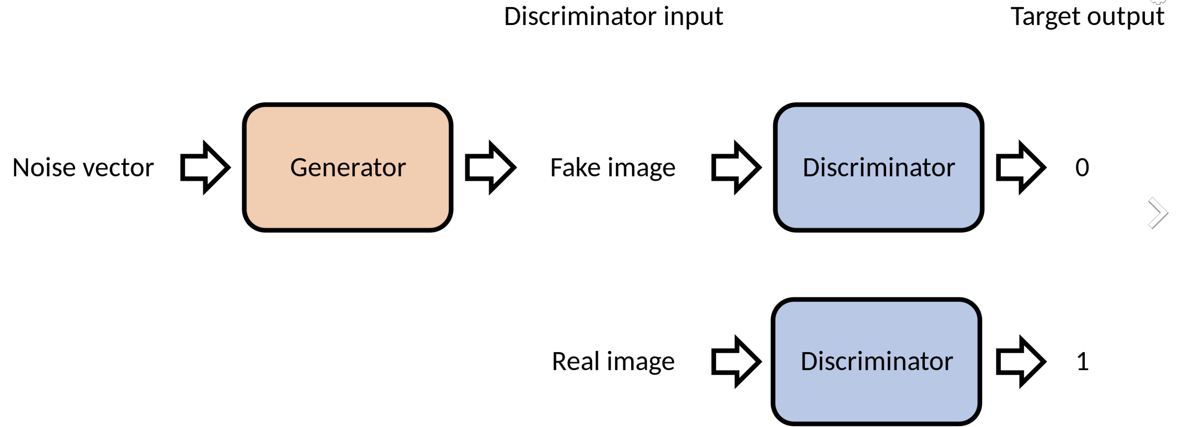
What is NoC?
Objectives?
Introduction!
Network On Chip
Network-based communications subsystem
Consists of IP-Cores
An efficient Routing algorithm.
Predict the shortest possible route using GAN.
Use Transfer Learning to generalize on various Topologies.
Notes:
NoC in short also known as Network on chip.
used as a network based communication system.
consists of components like IP .(IP core) is a functional block of logic or data and a reusable unit of logic.
NI – network interface the NoC controls the flow of data through the use of network interface (NI) modules. These modules are often used to transform data packets generated by the processor cores into fixed-length, flow-control digits. These digits allow the routers within the NoC to appropriately direct data to the desired functional block.
router- comprises a number of input ports, a number of output ports, a switching matrix connecting the input ports to the output ports, and a local port to access the IP core connected to this router.

Slide 5
What is NoC?
Network On Chip
Network-based communications subsystem
Consists of IP-Cores
Introduction!
GAN?
Generative Adversarial Network

Slide 6
What is NoC?
Network On Chip
Network-based communications subsystem
Consists of IP-Cores
Introduction!
GAN?
Generative Adversarial Network
Notes:
- A generative adversarial network (GAN) is a machine learning ([ML] model in which two [neural networks compete with each other by using DL methods to become more accurate in their predictions.
- The two neural networks that make up a GAN are referred to as the _generator_ and the _discriminator_. The generator is a cnn and the discriminator is a dcnn.
The goal of the generator is to artificially manufacture outputs that could easily be mistaken for real data. The goal of the discriminator is to identify which of the outputs it receives have been artificially created.

Slide 7
What is NoC?
Network On Chip
Network-based communications subsystem
Consists of IP-Cores
Introduction!
GAN?
Generative Adversarial Network

Slide 8
What is NoC?
Network On Chip
Network-based communications subsystem
Consists of IP-Cores
Introduction!
GAN?
Generative Adversarial Network

Slide 9
What is NoC?
Network On Chip
Network-based communications subsystem
Consists of IP-Cores
Introduction!
GAN?
Generative Adversarial Network

Slide 10

What is NoC?
Network On Chip
Network-based communications subsystem
Consists of IP-Cores
Introduction!
GAN?
Generative Adversarial Network

Slide 11

What is NoC?
Network On Chip
Network-based communications subsystem
Consists of IP-Cores
Related Works?
GAN?
Generative Adversarial Network
Xiang, J. Meng and D. Ma, "A Q-routing based self-regulated routing scheme for network-on-chip,”
Chaochao Feng, Zhonghai Lu, Axel Jantsch, Jinwen Li, and Minxuan Zhang. 2010. A reconfigurable fault-tolerant deflection routing algorithm based on reinforcement learning for network-on-chip.
J. Choudhary, S. J and L. R. Cenkeramaddi, "RAMAN: Reinforcement Learning Inspired Algorithm for Mapping Applications onto Mesh Network-on-Chip,”
Q. Chen, W. Huang, Y. Zhang and Y. Huang, "An ip core mapping algorithm based on neural networks”
T. Dong et al., "Generative Adversarial Network-Based Transfer Reinforcement Learning for Routing With Prior Knowledge,"

Slide 12
Proposed Methods!
Proposed Approaches!
Related Works?
Xiang, J. Meng and D. Ma, "A Q-routing based self-regulated routing scheme for network-on-chip,”
Chaochao Feng, Zhonghai Lu, Axel Jantsch, Jinwen Li, and Minxuan Zhang. 2010. A reconfigurable fault-tolerant deflection routing algorithm based on reinforcement learning for network-on-chip.
J. Choudhary, S. J and L. R. Cenkeramaddi, "RAMAN: Reinforcement Learning Inspired Algorithm for Mapping Applications onto Mesh Network-on-Chip,”
Q. Chen, W. Huang, Y. Zhang and Y. Huang, "An ip core mapping algorithm based on neural networks”
T. Dong et al., "Generative Adversarial Network-Based Transfer Reinforcement Learning for Routing With Prior Knowledge,"
GAN with Q-Learning
Training GAN with LSTMs
Notes:
. a Q-learning based congestion table dynamic adjusted NoC routing scheme is presented to optimize the effect of the transfer-delay of the packet on system performance. I
2. Jitesh - this paper proposes RAMAN: Reinforcement Learning (RL) inspired algorithm for mapping applications onto mesh NoC, a modified Q-Learning technique designed by RL, trying to achieve less communication cost.
3. Q Chen - a neural network-based application core mapping algorithm. The effectiveness of this task depends on the caliber of the training set.

Slide 13
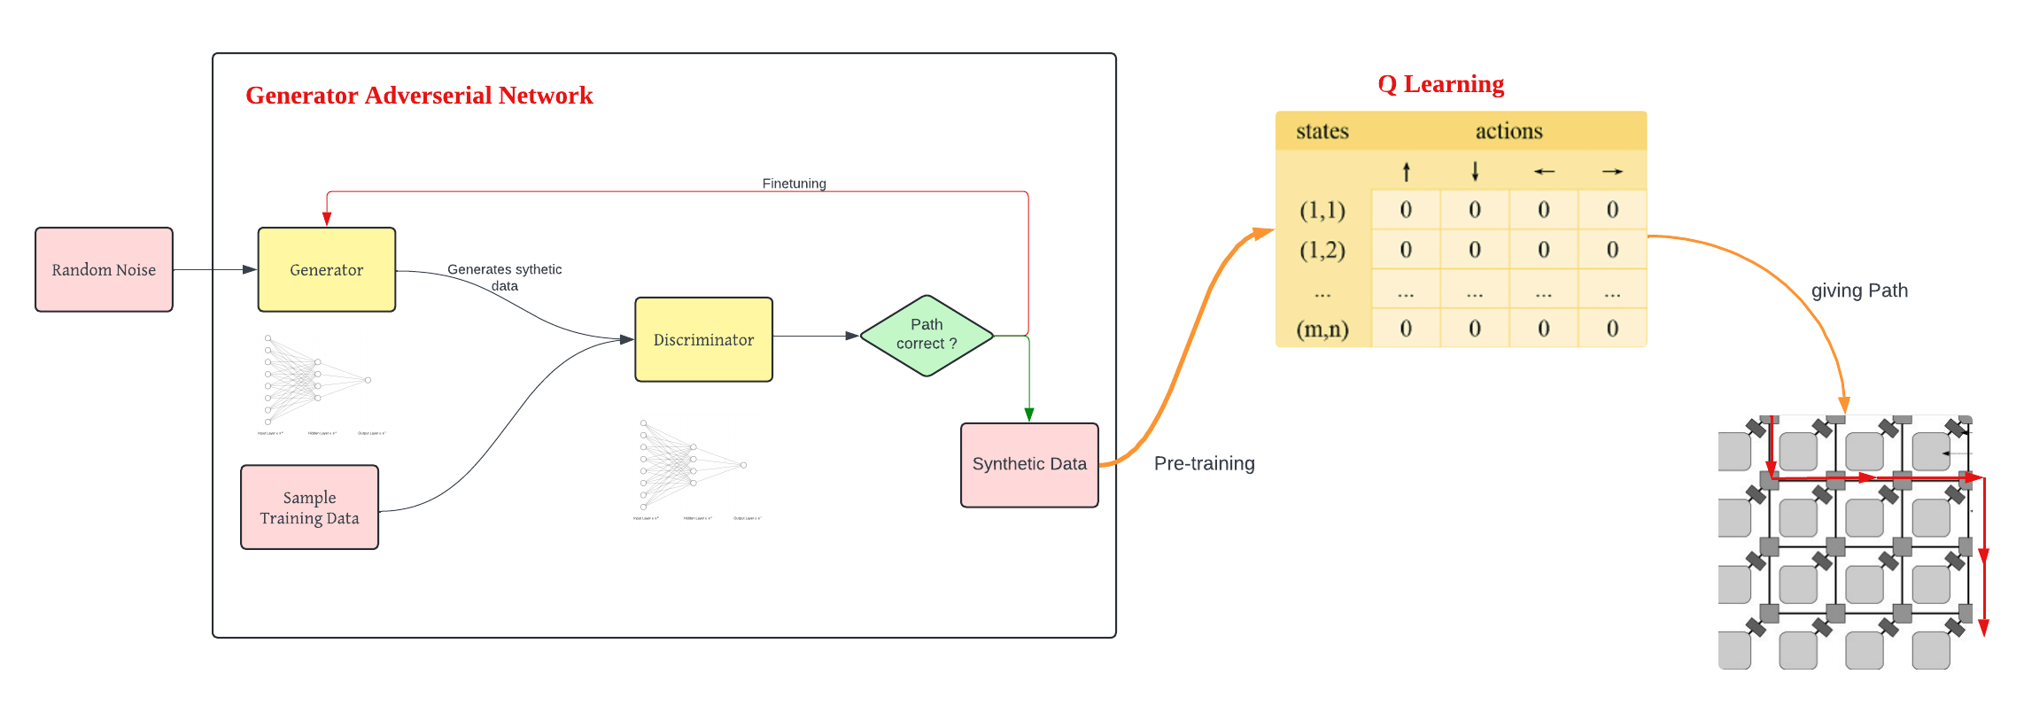
What is NoC?
Related Works?
Network On Chip
Network-based communications subsystem
Consists of IP-Cores
Proposed Methods!
GAN with Q-Learning
Training GAN with LSTMs

Slide 14
What is NoC?
Proposed Methods!
Related Works?
GAN with Q-Learning
Training GAN with LSTMs

Slide 15
What is NoC?
Proposed Methods!
Related Works?
GAN with Q-Learning
Training GAN with LSTMs

Slide 16
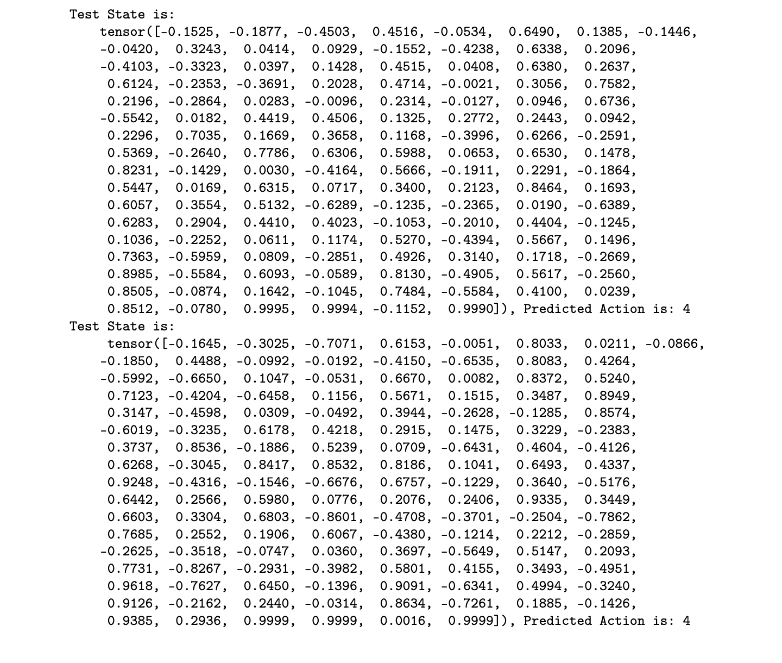
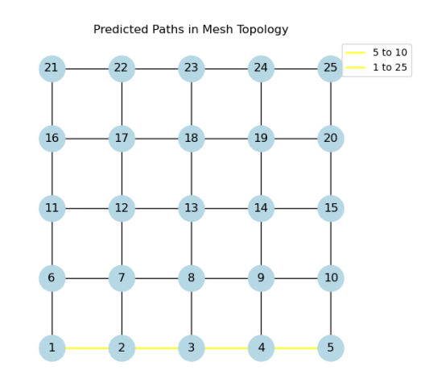
What is NoC?
Proposed Methods!
Related Works?
GAN with Q-Learning
Results
Training GAN with LSTMs

Slide 17
What is NoC?
Proposed Methods!
Related Works?
GAN with Q-Learning
Results
Training GAN with LSTMs

Slide 18
What is NoC?
Proposed Methods!
Related Works?
GAN with Q-Learning
Results
Training GAN with LSTMs

Slide 19
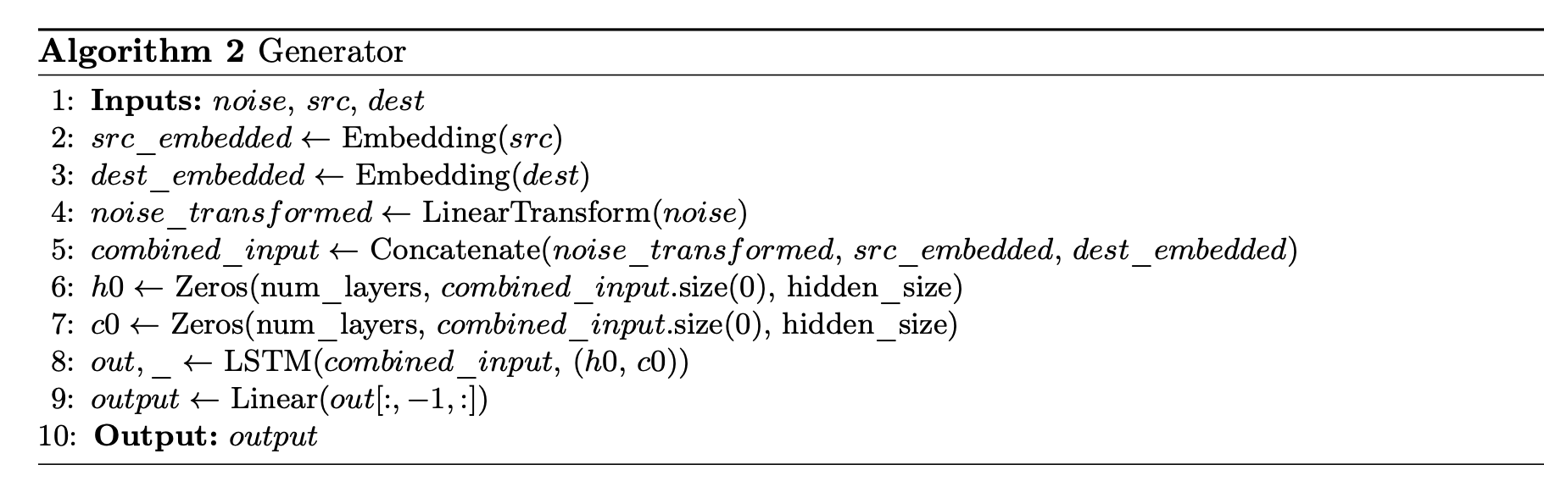
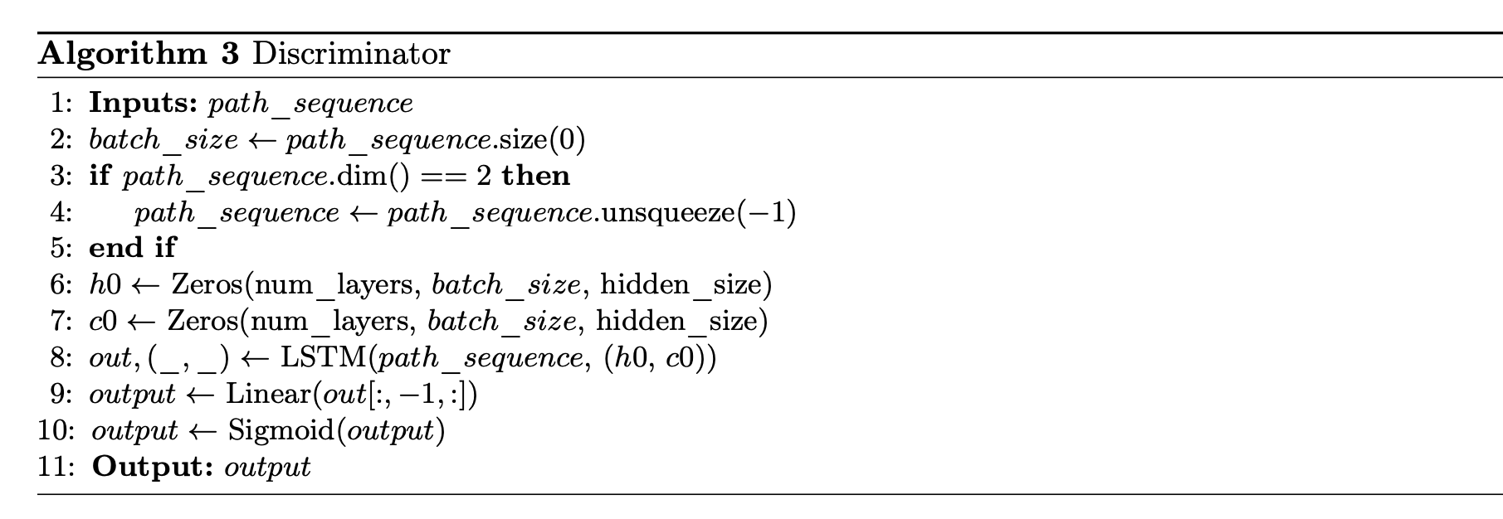
What is NoC?
Related Works?
Network On Chip
Network-based communications subsystem
Consists of IP-Cores
Step1: Generator
Proposed Methods!
GAN with Q-Learning
Training GAN with LSTMs
The generator takes noise vectors, source index and destination index as inputs,
embeds them and concatenates them to give it as a input to LSTM.
The LSTM computes and passed through a next linear layer to produce the o/p size.

Slide 20
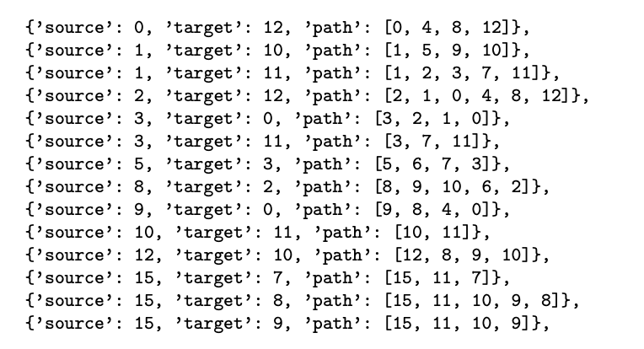
Proposed Methods!
Processes the input in the form of sequence of path nodes, embeds them to give it as a input to LSTM.
After processing the input, the LSTM generates an output, which is then sent through a sigmoid activation and,
A linear layer to provide a binary output that indicates whether the input path is real or not.
Training GAN with LSTMs
Step1: Generator
Step2: Discriminator
The generator takes noise vectors, source index and destination index as inputs,
Embeds them and concatenates them to give it as a input to LSTM,
The LSTM computes and passed through a next linear layer to produce the o/p size.
GAN with Q-Learning

Slide 21
Proposed Methods!
Training GAN with LSTMs
Results
Step1: Generator
Step2: Discriminator
Processes the input in the form of sequence of path nodes, embeds them to give it as a input to LSTM.
After processing the input, the LSTM generates an output, which is then sent through a sigmoid activation and,
A linear layer to provide a binary output that indicates whether the input path is real or not.
GAN with Q-Learning
The generator takes noise vectors, source index and destination index as inputs,
Embeds them and concatenates them to give it as a input to LSTM,
The LSTM computes and passed through a next linear layer to produce the o/p size.

Slide 22
Proposed Methods!
Step2: Discriminator
Training GAN with LSTMs
Results
Step1: Generator
GAN with Q-Learning
Processes the input in the form of sequence of path nodes, embeds them to give it as a input to LSTM.
After processing the input, the LSTM generates an output, which is then sent through a sigmoid activation and,
A linear layer to provide a binary output that indicates whether the input path is real or not.

Slide 23
Conclusion and Future Scope
Proposed Methods!
This work demonstrates the viability of merging GANs and RL for routing in NoCs,
Two methods were employed
There is a large scope of improvement
Will have to investigate more ways to add more real-world constraints
troubleshooting the model’s prediction paths t.
GAN with Q-Learning
Training GAN with LSTMs

Slide 24

Conclusion and Future Scope
This work demonstrates the viability of merging GANs and RL for routing in NoCs,
Two methods were employed
There is a large scope of improvement
Will have to investigate more ways to add more real-world constraints
Troubleshooting the model’s prediction paths.
The generator takes noise vectors, source index and destination index as inputs,
embeds them and concatenates them to give it as a input to LSTM.
The LSTM computes and passed through a next linear layer to produce the o/p size.

Slide 25
Thank you

