Slide 1
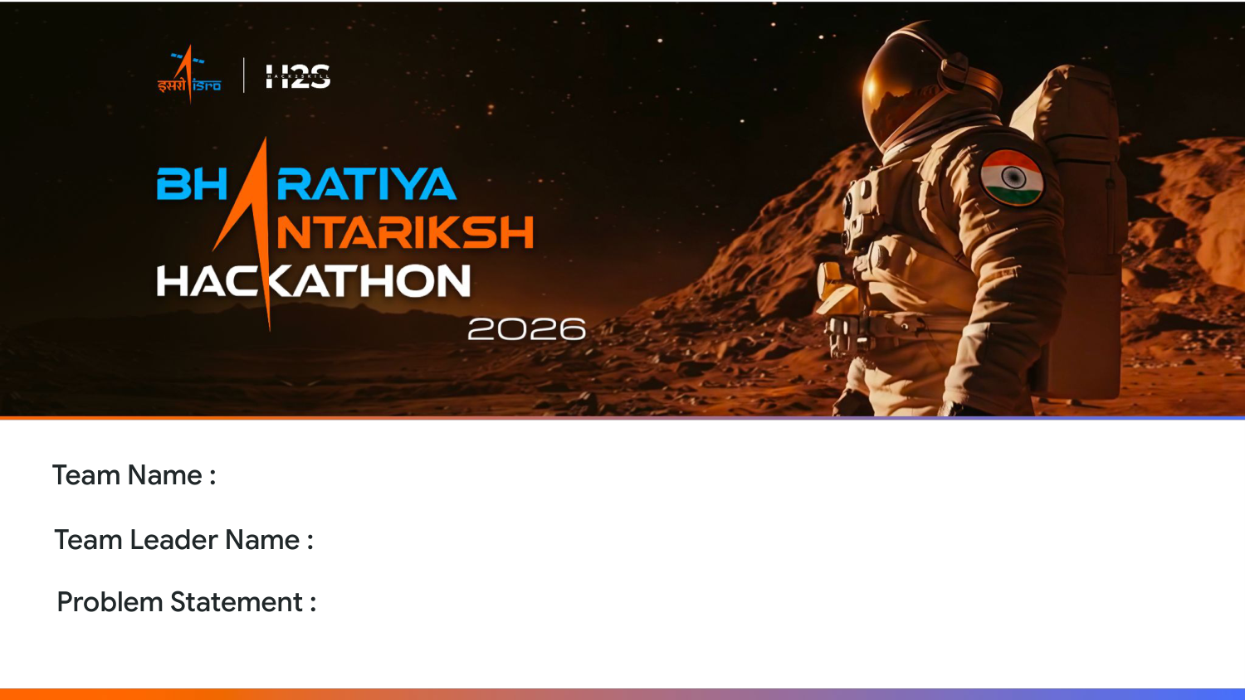
Loss Functions
Prakhar Shrivastav
PS-08: Discovery of Hidden Lunar Subsurface Ice

Slide 2
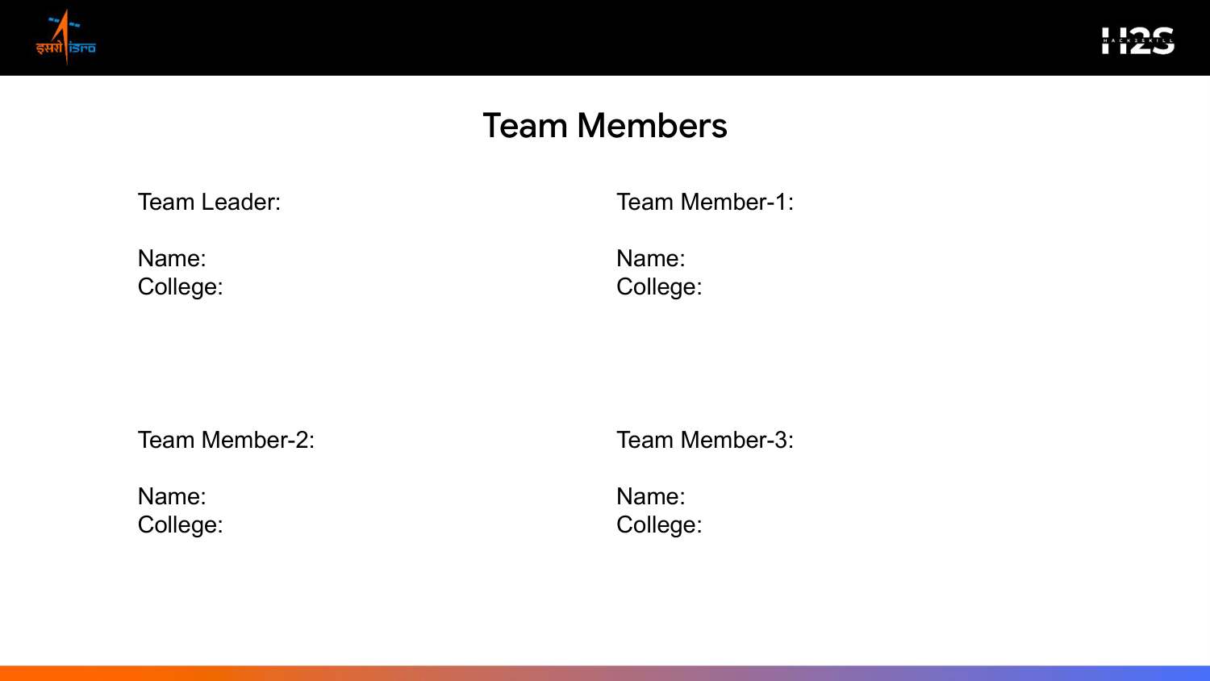
Prakhar Shrivastav
Sonu Sharma
IIIT Sonepat
IIIT Sonepat
Vinit Kumar
N/A
IIIT Sonepat
N/A

Slide 3
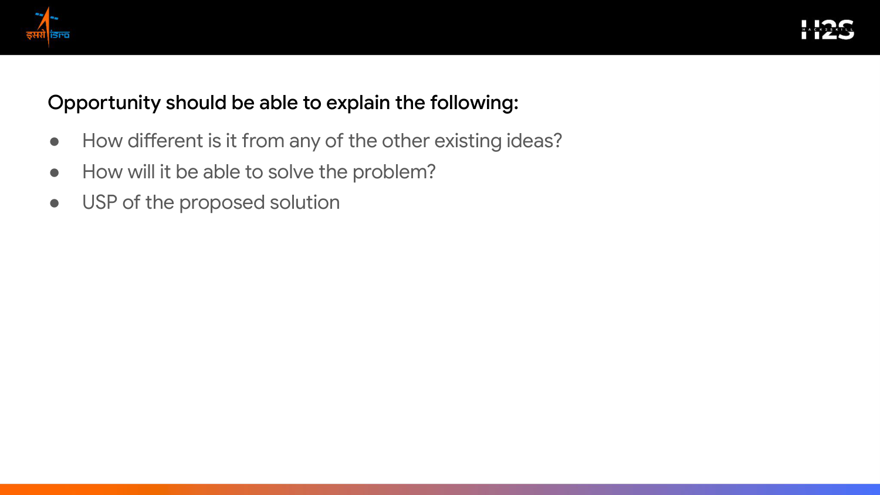
Our solution implements dual-frequency multi-sensor validation (DFSAR polarimetric Stokes parameters + OHRC optical imagery). This approach isolates subsurface ice dielectric constants and eliminates false positives caused by surface roughness that standard radar thresholding misses.
By calculating pixel-level CPR and DOP values to map ice boundaries, performing MCDA decision ranking to identify optimal landing sites, and simulating dynamic battery depletion grids using a custom D* Lite rover pathfinder.
Features an energy-aware traverse pathfinder that maps shadow progression over time, guaranteeing up to 70 hours of shadow survival for the rover, combined with an O(1) onboard lookup table for offline deployment.

Slide 4

1. Stokes Parameters Calculation
Generates high-resolution CPR and DOP maps from raw DFSAR radar grids.
2. MCDA Landing Evaluator
Uses AHP decision matrix to select safe landing zones based on slope and roughness.
3. Subsurface Dielectric Inversion
Quantifies composition and estimates water-ice volume up to 5 meters deep.
4. Energy-Aware Traversal Planner
Simulates solar shadow overlays, battery capacity decay, and optimal routing.
5. 3D Space Mission Portal
An interactive Three.js dashboard to explore craters and traverse plans in real-time.
[ 3D Lunar Craters Viewport Concept ]
+-----------------------------------------------+ | [ 3D Moon Surface Mesh Viewport ] | | - Shadow Overlay: Dark Blue Shaded | | - Subsurface Ice: Cyan Glow Points | +-----------------------------------------------+ | [ Dielectric Curve ] [ Rover Solar Telemetry ]| +-----------------------------------------------+

Slide 5
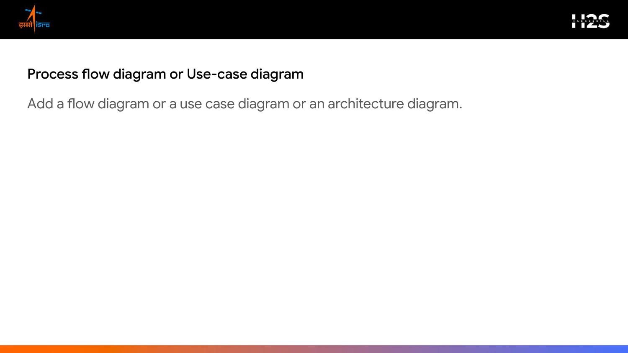
1. Ingestion (DFSAR, OHRC, DEM)
2. Processing (CPR, DOP, m-chi)
3. Landing MCDA (Slope & Boulder)
4. Simulation (D* Lite Pathfinder)
5. Out (Dielectric Report)
Pipeline Execution Details:
Our pipeline registers radar & camera layers -> extracts polarimetric Stokes parameters -> maps slope & landing safety metrics -> calculates energy-aware traverse lines -> outputs estimated subsurface ice volume.

Slide 6
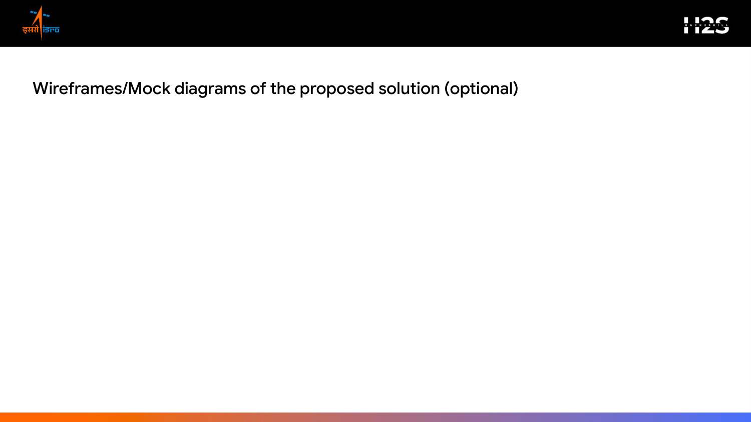
- 3D Viewport Interface
Visualizes the terrain elevation grid of Faustini Crater with interactive rotation and zooming. Highlights safe landing corridors and ice zones.
- Analytical Graphs Panel
Displays subsurface dielectric profiles, CPR histograms, and depth estimation curves up to 5 meters.
- Rover Status HUD
Shows battery levels, solar cell power metrics, traversal progress, and dynamic rerouting triggers.

Slide 7
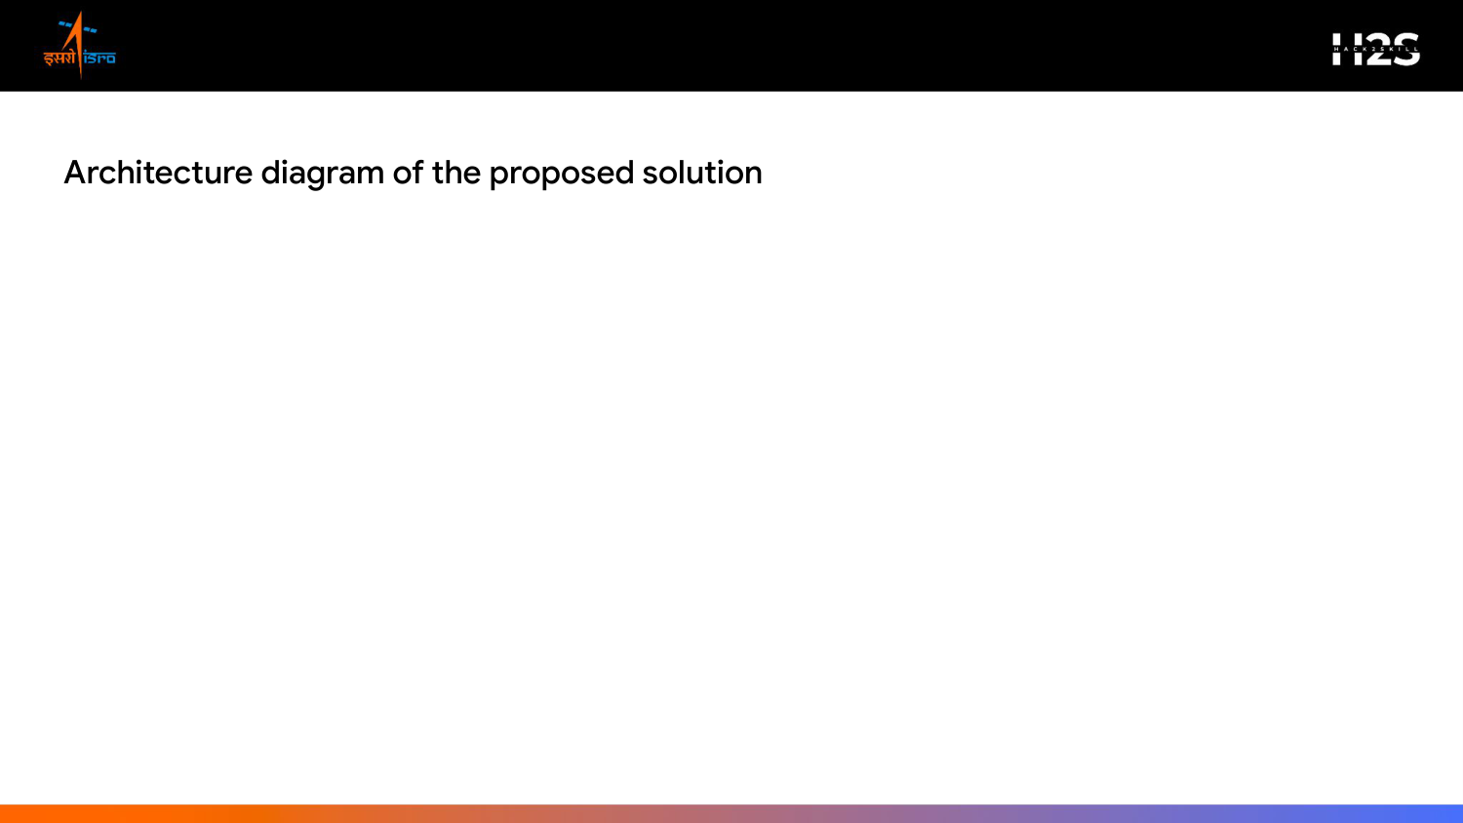
1. Data Ingestion Layer
DFSAR polarimetric radar granules + OHRC optical imagery + LOLA DEM elevation datasets
2. Physics-Informed Engine
Stokes Matrix parameter computation, polarimetric decomposition, and AHP-based landing MCDA solver
3. Traversal Simulation
O(1) look-up table ice classifier, D* Lite path planning, and solar/battery simulator
4. Presentation Dashboard
Interactive Three.js 3D viewport, real-time telemetry metrics, and traversal trajectory maps

Slide 8
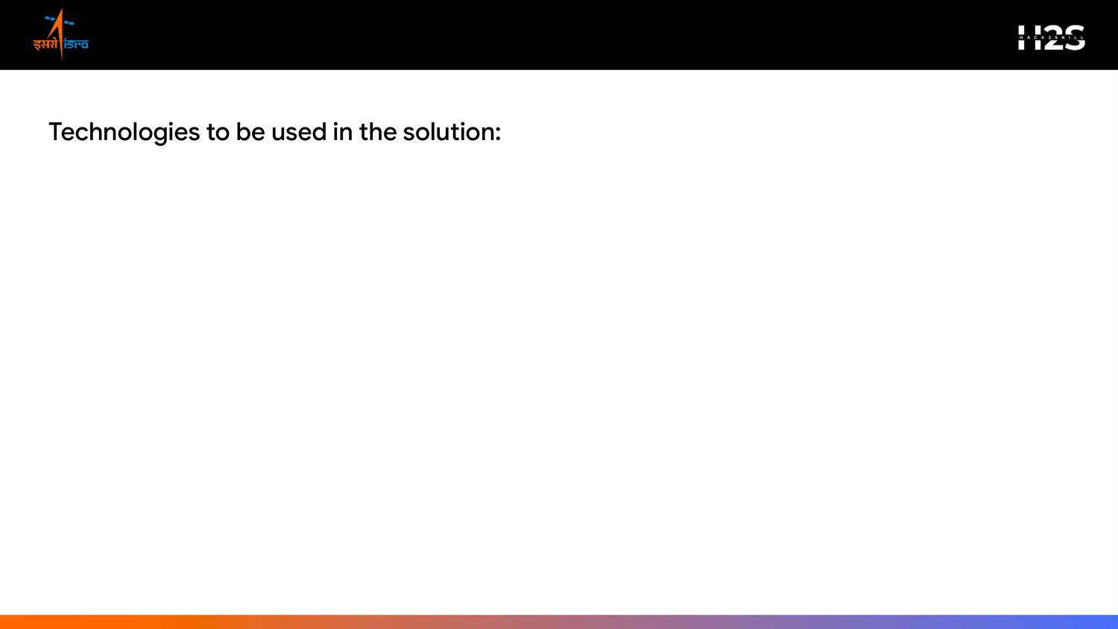
• Satellite Data Processing:
GDAL, Rasterio, PyProj (managing polar coordinates and geospatial tile transformations).
• Computing & Math Modules:
Python, NumPy, SciPy, Pandas (efficient processing of Stokes and backscatter matrices).
• Physics & Curve Fitting:
PyTorch, batman, emcee (dielectric constant inversion and confidence models).
• Network Routing & Pathing:
NetworkX (handling elevation graphs and obstacle cost matrices).
• API Serving & Docker:
FastAPI, Uvicorn, Docker (fast, containerized serving on micro-compute targets).
• Visual Presentation:
HTML5, CSS3, Three.js / React-Three-Fiber (rendering interactive 3D crater meshes in browser).

Slide 9
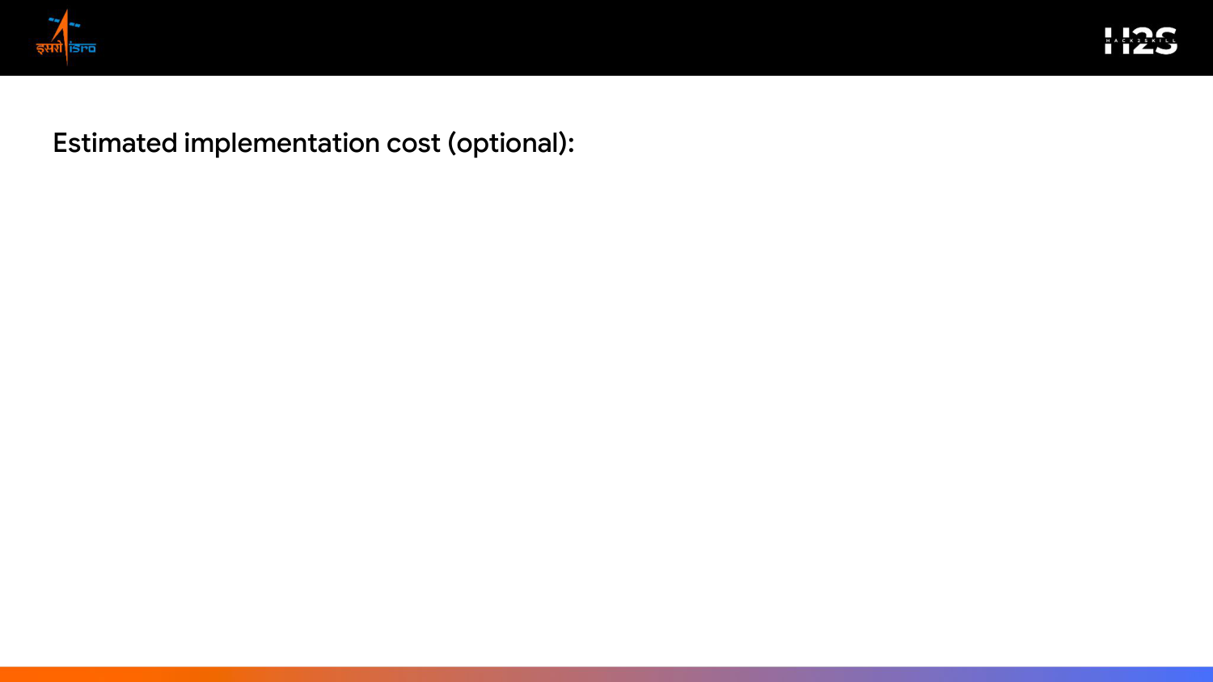
- Open-Source Licensing
₹0 — Built entirely using open-source tools (Python, GDAL, Three.js). No commercial licensing fees.
- Development Hardware
₹0 — The analytical pipeline is optimized to run on standard CPU workstations, avoiding expensive multi-GPU servers.
- Cloud Infrastructure (Hosting & Compute)
₹1,700 / month - High-speed storage (100 GB DFSAR tiles): ₹500/month (AWS S3 / Google Cloud Storage). - Web API hosting and CPU routing computation: ₹1,200/month (Google Cloud Run / AWS EC2).
- Scalability
Our lightweight architecture ensures minimal operational compute, making scaling to new lunar scenes extremely cost-effective.

Slide 10
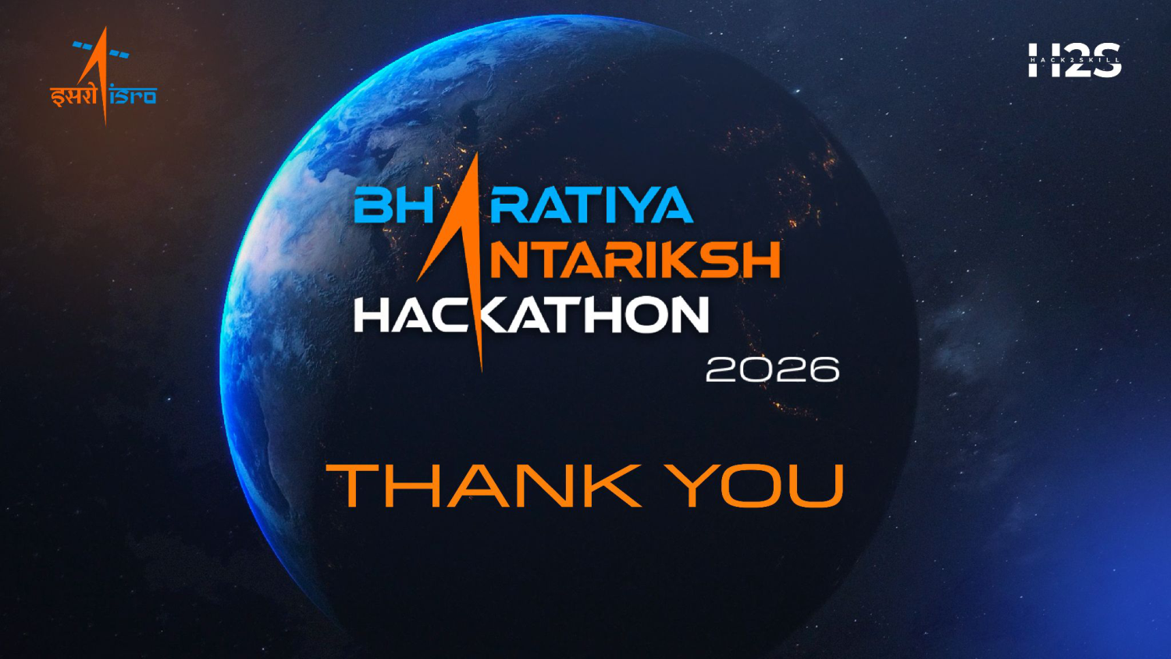
Team Name: Loss Functions | Contact: lossfunctions@iiitsonepat.ac.in

