Slide 1
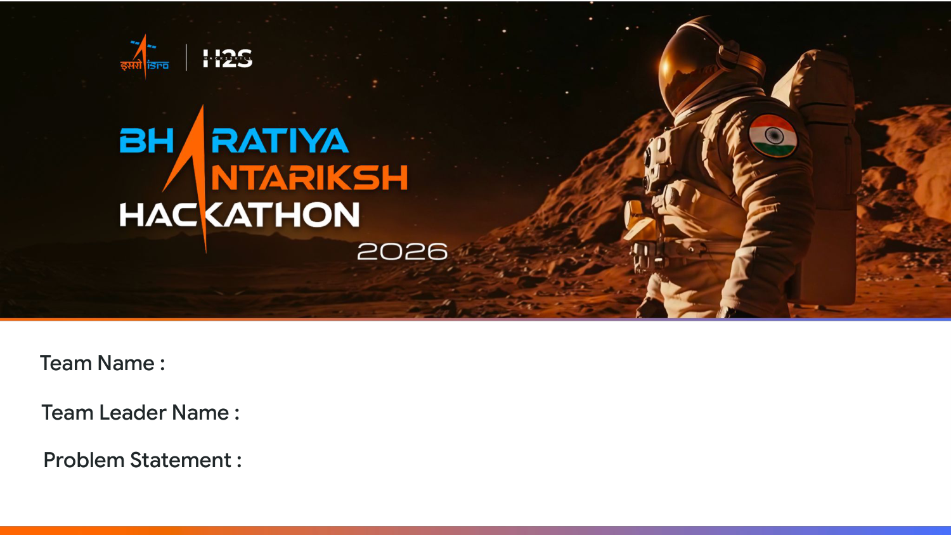
Loss Functions
Prakhar Shrivastav
Discovery of Hidden Lunar Subsurface Ice

Slide 2
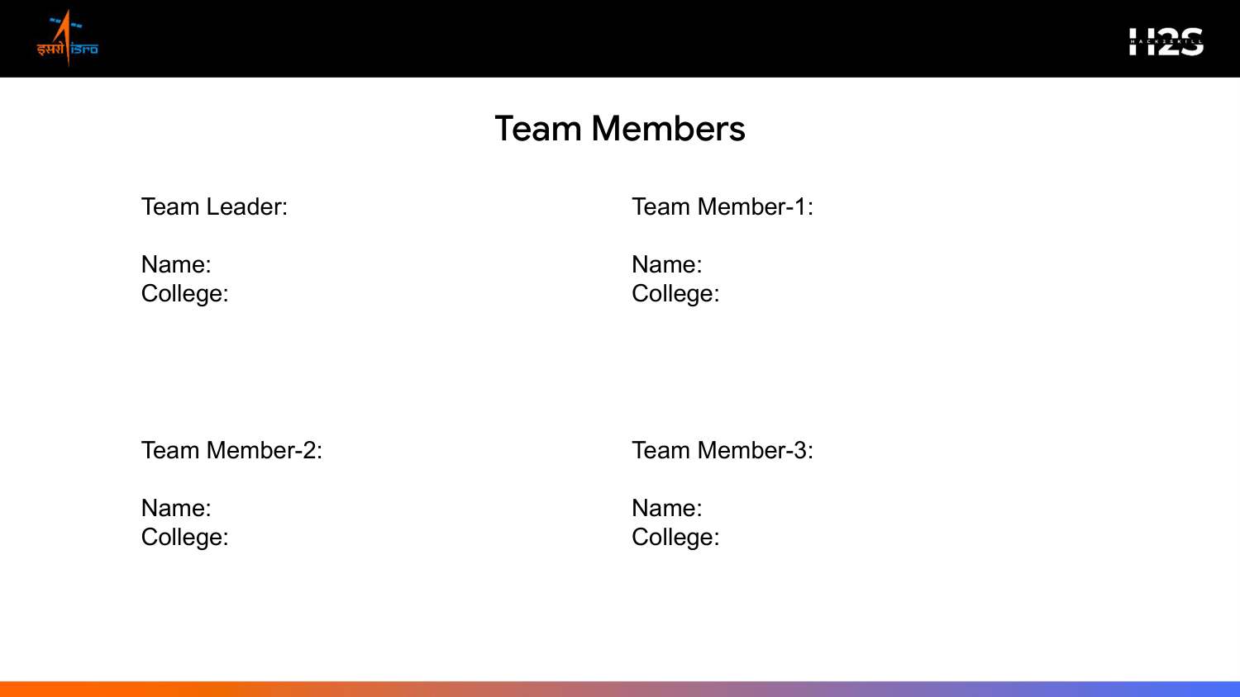
Prakhar Shrivastav
Sonu Sharma
IIIT Sonepat
IIIT Sonepat
Vinit Kumar
N/A
IIIT Sonepat
N/A

Slide 3
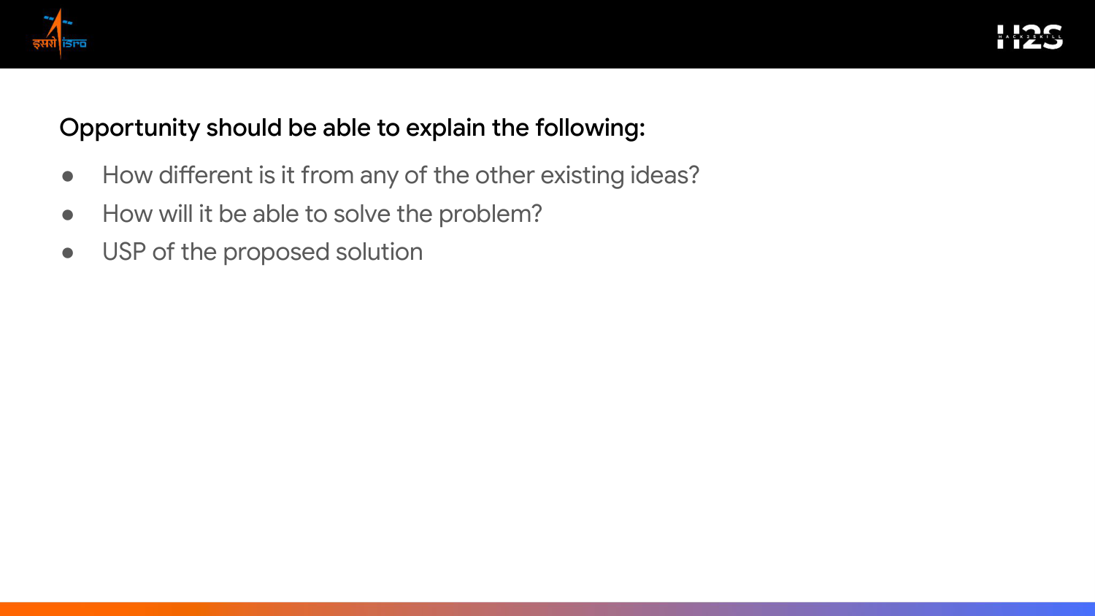
1. How different is it from existing ideas?
Instead of relying on simple, single-sensor radar backscatter thresholding (which easily misclassifies rocky layers as ice), our framework performs multi-sensor data fusion. We cross-verify polarimetric DFSAR radar Stoke parameters directly with High-Resolution Optical OHRC imagery to eliminate surface-roughness false positives.
2. How will it solve the problem?
It processes raw DFSAR matrices to compute CPR/DOP parameters, maps local elevation models to solve landing corridor safety constraints, and implements a real-time D* Lite rover pathfinding simulation to plot traversal paths.
3. USP of the proposed solution
An energy-aware routing engine that tracks shadow movements to keep the rover safe, ensuring 70-hour shadow survival inside craters, backed by an offline, O(1) look-up table classifier optimized for space-bound processors.

Slide 4

[ 3D Lunar Craters Viewport Concept ]
+-------------------------------------------------+ | [ 3D Moon Surface Mesh Viewport ] | | - Shadow Overlay: Dark Blue Shaded | | - Subsurface Ice: Cyan Glow Points | +-------------------------------------------------+ | [ Dielectric Curve ] [ Rover Solar Telemetry ] | +-------------------------------------------------+
1. Polarimetric Stokes Parameters
Fuses radar backscatter vectors to calculate CPR and DOP maps.
2. Landing MCDA Optimizer
Employs an AHP decision matrix to find safe slopes and landing zones.
3. Subsurface Depth Inversion
Uses dielectric equations to estimate water-ice volume up to 5 meters deep.
4. Dynamic Traverse Pathfinder
Routes traverse paths using D* Lite under solar battery depletion profiles.

Slide 5
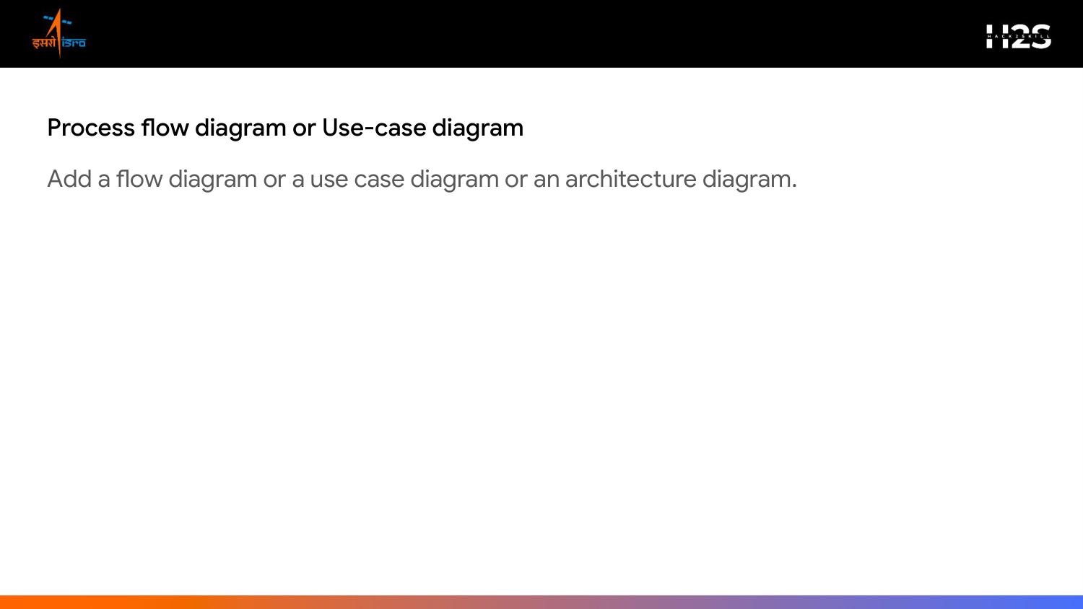
1. Ingestion (DFSAR, OHRC, DEM)
2. Processing (CPR, DOP, m-chi)
3. Landing MCDA (Slope & Boulders)
4. Simulation (D* Lite Pathfinder)
5. Output (Dielectric Report)
Pipeline Execution Details:
Our pipeline registers radar & camera layers -> extracts polarimetric Stokes parameters -> maps slope & landing safety metrics -> calculates energy-aware traverse lines -> outputs estimated subsurface ice volume.

Slide 6
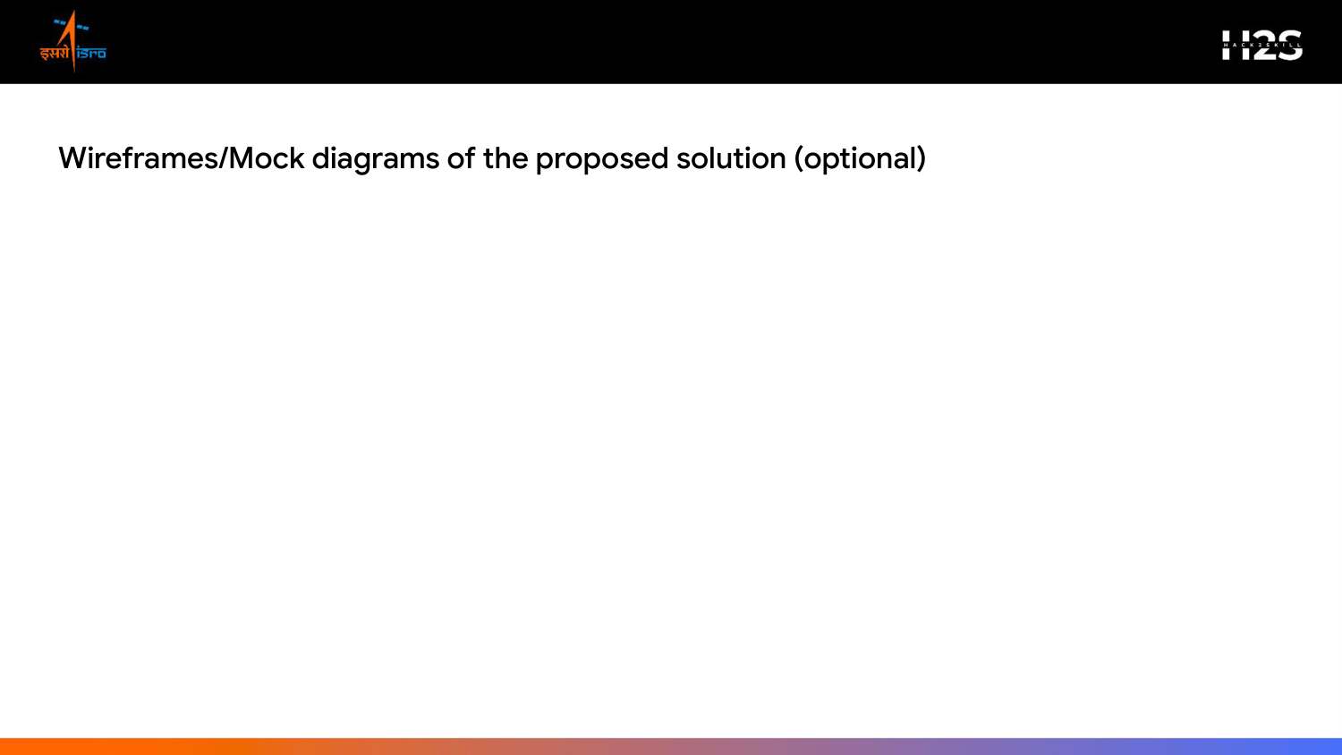
- Interactive 3D Viewport
Visualizes the terrain elevation grid of Faustini Crater with interactive rotation and zooming. Highlights safe landing corridors and ice zones.
- Analytical Graphs Panel
Displays subsurface dielectric profiles, CPR histograms, and depth estimation curves up to 5 meters.
- Rover Status HUD
Shows battery levels, solar cell power metrics, traversal progress, and dynamic rerouting triggers.

Slide 7
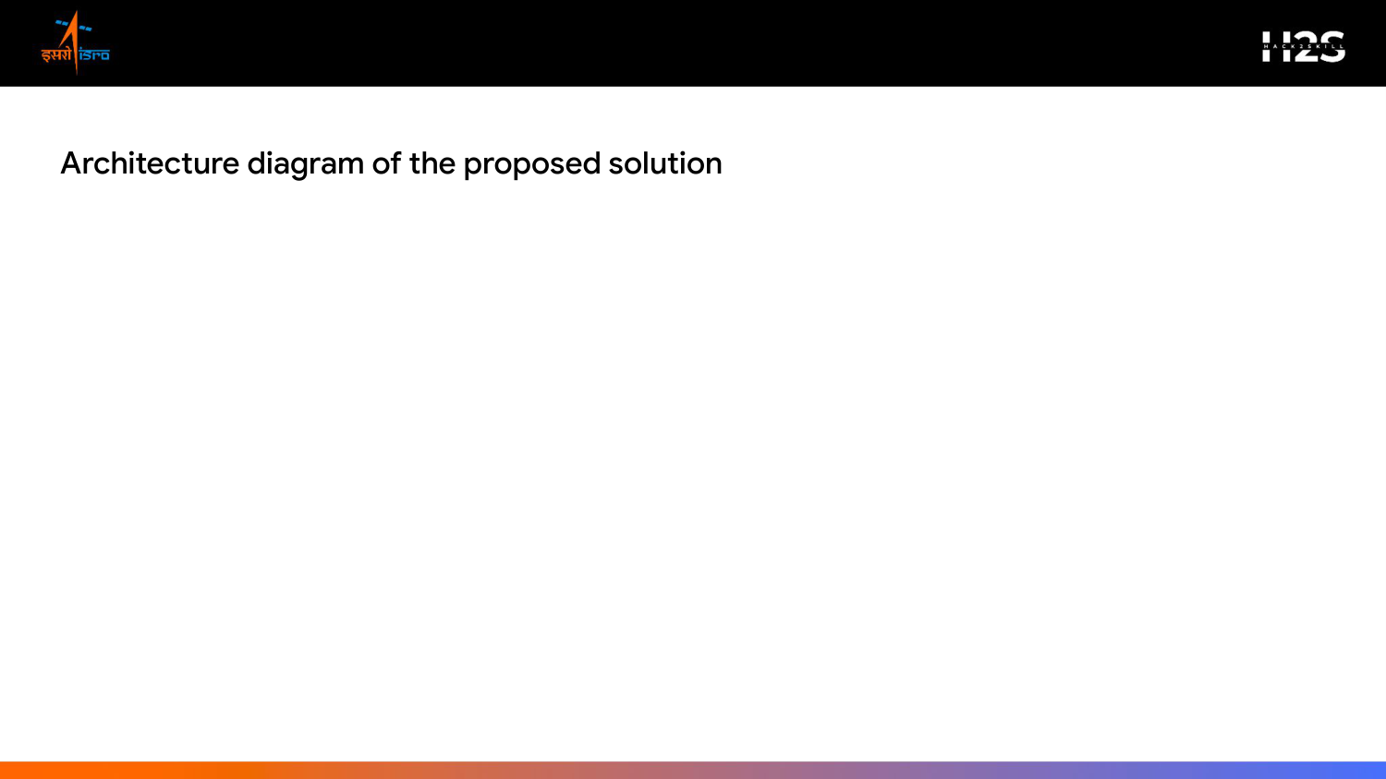
1. Data Ingestion Layer
DFSAR polarimetric radar granules + OHRC optical imagery + LOLA DEM elevation datasets
2. Physics-Informed Engine
Stokes Matrix parameter computation, polarimetric decomposition, and AHP-based landing MCDA solver
3. Traversal Simulation
O(1) look-up table ice classifier, D* Lite path planning, and solar/battery simulator
4. Presentation Dashboard
Interactive Three.js 3D viewport, real-time telemetry metrics, and traversal trajectory maps

Slide 8
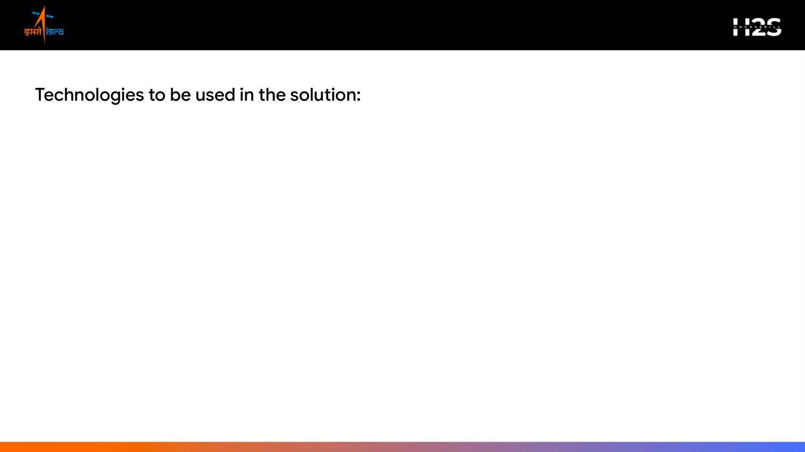
• Satellite Data Processing:
GDAL, Rasterio, PyProj (managing polar coordinates and geospatial tile transformations).
• Computing & Math Modules:
Python, NumPy, SciPy, Pandas (efficient processing of Stokes and backscatter matrices).
• Physics & Curve Fitting:
PyTorch, batman, emcee (dielectric constant inversion and confidence models).
• Network Routing & Pathing:
NetworkX (handling elevation graphs and obstacle cost matrices).
• API Serving & Docker:
FastAPI, Uvicorn, Docker (fast, containerized serving on micro-compute targets).
• Visual Presentation:
HTML5, CSS3, Three.js / React-Three-Fiber (rendering interactive 3D crater meshes in browser).

Slide 9
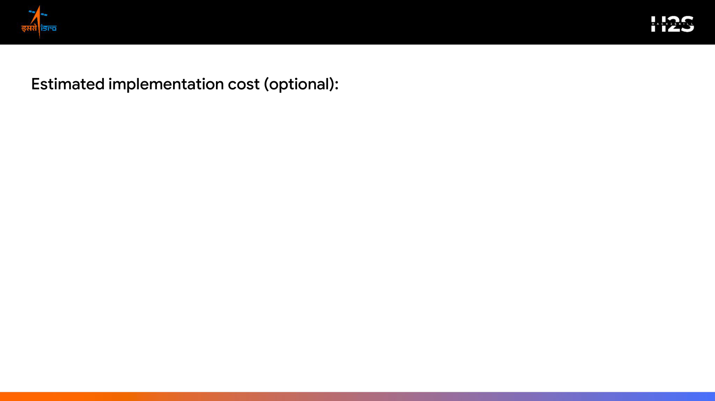
- Open-Source Licensing
₹0 — Built entirely using open-source tools (Python, GDAL, Three.js). No commercial licensing fees.
- Development Hardware
₹0 — The analytical pipeline is optimized to run on standard CPU workstations, avoiding expensive multi-GPU servers.
- Cloud Infrastructure (Hosting & Compute)
₹1,700 / month - High-speed storage (100 GB DFSAR tiles): ₹500/month (AWS S3 / Google Cloud Storage). - Web API hosting and CPU routing computation: ₹1,200/month (Google Cloud Run / AWS EC2).
- Scalability
Our lightweight architecture ensures minimal operational compute, making scaling to new lunar scenes extremely cost-effective.

Slide 10
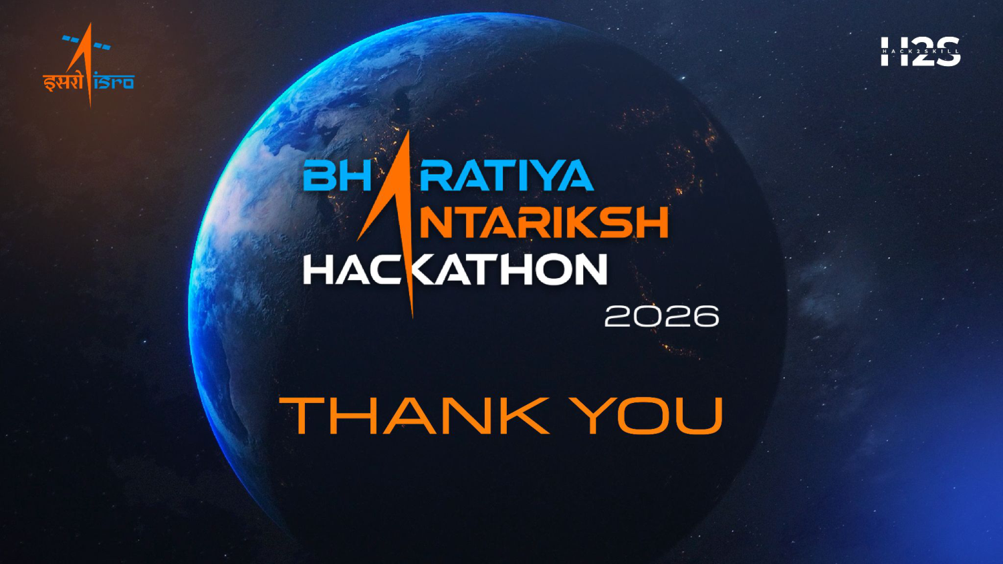
Team Name: Loss Functions | Contact: lossfunctions@iiitsonepat.ac.in

