Slide 1
ETL Pipe-line through SSIS

Slide 2

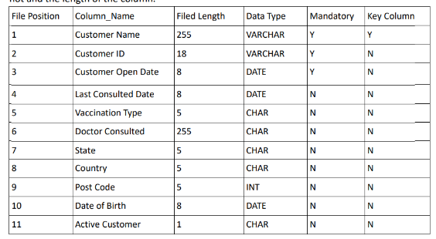
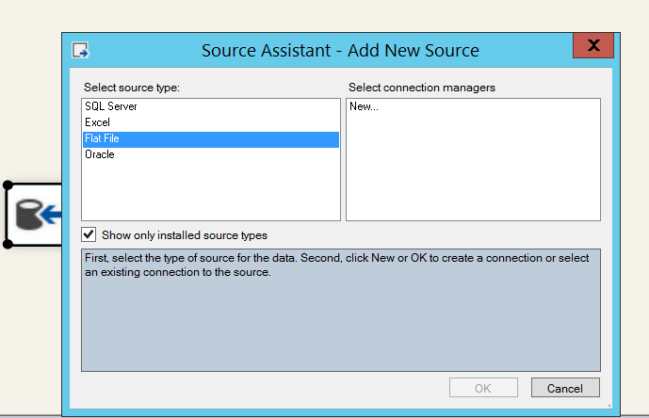
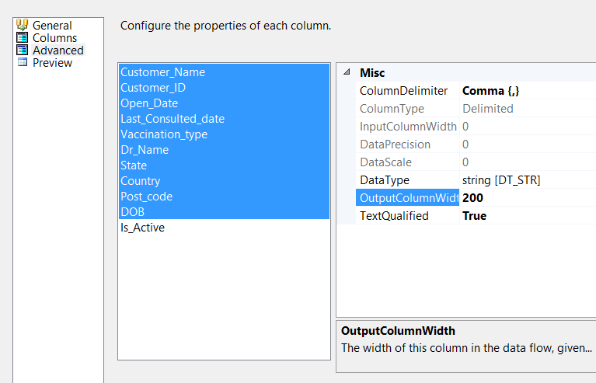
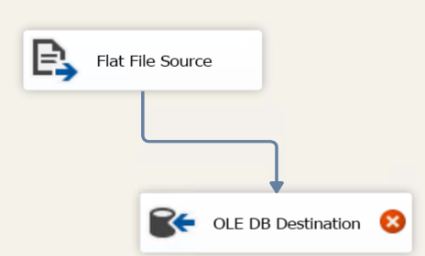
Steps:
1.Gathered sample data in pipe-delimited format (.csv) for the use as per given fields for the assessment. Below are the given column name for the reference:
2.To start with the creation of ETL pipeline through SSIS .Following are the steps followed:

Slide 3
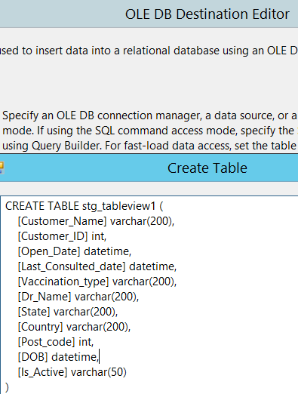
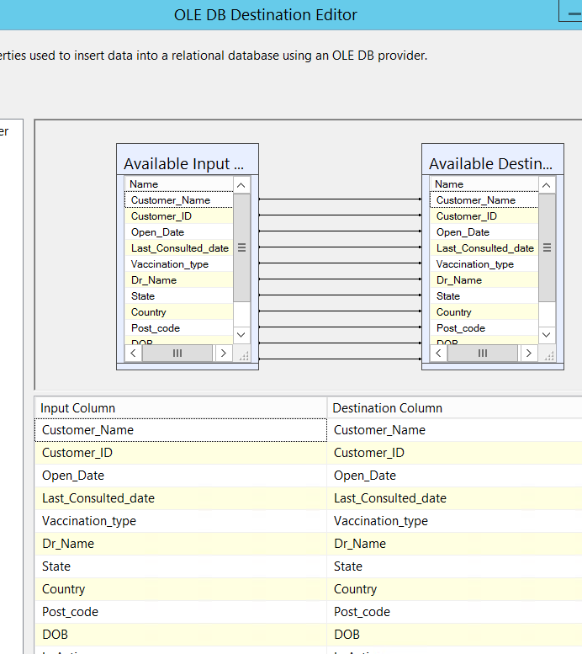
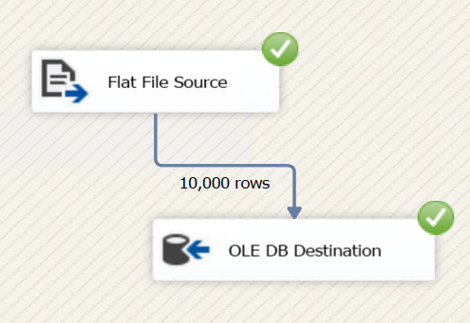

Slide 4
