Slide 1
STUDY OF TCP AND IT’S VARIANTS
GROUP 1
Gnanesh Patel (MT22030)
Hritika Shah (MT22101)
Kirti Vashishtha (MT22035)
.

Slide 2
PROBLEM STATEMENT
Despite being widely used, TCP experiences performance problems in many networks.
TCP variants are therefore developed to deal with network performance challenges including throughput, latency, and congestion.
But it is difficult to understand the strengths/weaknesses of each TCP variants for different networks.

Slide 3
MOTIVATION
Due to TCP’s widespread use in reliable data delivery, understanding of TCP's functionality and optimization is crucial for network engineers and researchers.
Because of its effective performance, TCP is being modified for network technologies including 5G, IoT, and cloud computing.
This has led to development of new TCP variants and its understanding helps engineers and researchers staying updated with the latest advancements.

Slide 4
TCP ANALYSIS USING NS3-MMWAVE
Defining the network topology
Configuring the simulation parameters
Implementing the TCP variants
Running the simulations
Analysing the results of different variants

Slide 5
OVERVIEW OF TCP AND ITS VARIANTS
TCP is a widely used, reliable, and connection-oriented protocol that ensures ordered and error-checked data delivery with flow control.
Numerous protocols, like SMTP, FTP, HTTPS/HTTP, and other networked protocols, are built on top of TCP protocol.
TCP has mainly 3 phases: slow start, congestion avoidance, and detection. Different TCP variants use them differently for better results.

Slide 6
VARIANTS USED
TCP New Reno
TCP Vegas
TCP Cubic

Slide 7
COMPARISON OF TCP VARIANTS
TCP New Reno = extension of TCP Reno
TCP Vegas = TCP Reno + congestion avoidance Algo + modified slow start technique
TCP Cubic = Use cubic function to determine cwd size

Slide 8
TCP VERSIONS
TCP NEW RENO:
TCP New Reno is a minor upgrade over TCP Reno. It can detect multiple packet
deficiencies, making it more effective than TCP Reno in multiple packet deficit
situations. TCP New Reno and TCP Reno both go through quick retransmit when
many duplicate packets are acquired, but they do not exit the fast recovery phase
until all great data has been collected. Insufficient ACK does not prevent TCP
from recovering quickly in TCP New Reno; instead, it acts as a signal or signals
that the packet in the series field has been lost and must be retransferred. TCP
New Reno can now improve beyond retransfer time out when numerous packets
are missing from a certain data window. It is in the rapid recovery phase until all
of the data has been uploaded to the network, and it is still waiting for an ACK.
The issue with New Reno is that it uses a single RTT to detect each packet
deficiency since it uses a lot of capacity.

Slide 9
TCP VEGAS:
TCP Reno has been improved by TCP Vegas. It eliminates the problem of
requiring enough duplicate acknowledgement to detect a packet shortfall, and it
also proposes an improved slow start strategy that prevents the network from
being blocked. Since packet losses occur, it identifies congestion. Vegas
employed three techniques to enhance throughput while minimizing losses.
1. Slow Start approach with a twist
2. An improved Congestion Avoidance method
3. A re-transmission technology that has been updated.
The congestion window in TCP Vegas has been upgraded from the following
regulation.
● Expected rate = CWND (t)/Base RTT,
○ Actual rate = CWND (t)/RTT,
○ Diff = Expected rate - Actual rate
○ Using the value of Diff the CWND is adapted as:
○ If Diff < α TCP Vegas increases CWND linearly
○ If Diff > β, TCP Vegas decreases the CWND linearly.
○ If α < Diff<β, TCP Vegas leaves the CWND

Slide 10
TCP CUBIC:
TCP Cubic is a popular TCP congestion control algorithm that aims to improve network performance and fairness. It is a variant of the traditional TCP Reno algorithm, which is widely used in modern computer networks, including the internet. TCP Cubic also includes a mechanism called "TCP-friendly" that aims to ensure fair sharing of network resources among different TCP connections. This mechanism adjusts the sending rate of each connection based on the number of competing connections and the available network bandwidth.
One of the advantages of TCP Cubic is its ability to perform well in a variety of network conditions, including high-bandwidth and high-delay networks. It has also been shown to be more robust than other TCP variants in the face of network congestion, particularly in high-speed networks.

Slide 11
SETUP:
Creation of two nodes.
Obstacle added – 6 buildings, tree and human blockage.
phasedArrayModel having threeGpp antennas is used.
Study is made at high frequency.

Slide 12
Methodology
Transmission Control Protocol (TCP), generally known as TCP, is a popular connection-oriented transport layer protocol that guarantees packet delivery across a shaky network. Although the initial iteration of TCP worked effectively, it was difficult to maintains the network grew up. Since then, a number of TCP variations have been created that incorporate strategies for controlling and reducing congestion in an effort to enhance TCP performance.
This project attempts to determine how the three TCP variants(TCP new reno, TCP Vegas and TCP Cubic) perform in a very high frequency range.
We ran several tests and displayed graphs for congestion window and throughput and determined how each TCP Variant performs in high frequency conditions which is simulated by using the ns3 mmwave module.

Slide 13
OBSERVATION:
Here, we have used NS-3 mmwave to study the behaviour to different TCP variants at high frequency range i.e. >= 22GHz where most of the variants do not perform well.
Studies shows that TCP-BBR performs good in high frequency range.

Slide 14
RESULTS:
CONGESTION WINDOW VS TIME

Slide 15
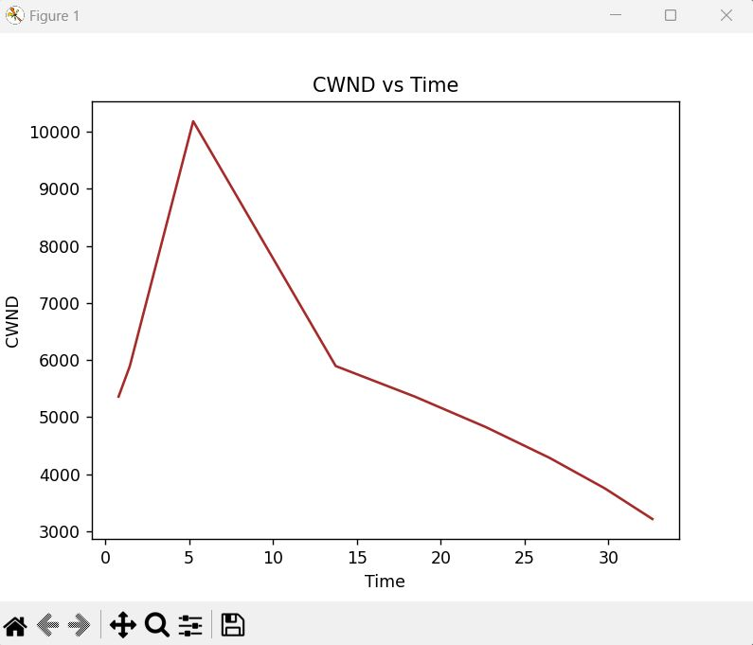
TCP VEGAS

Slide 16
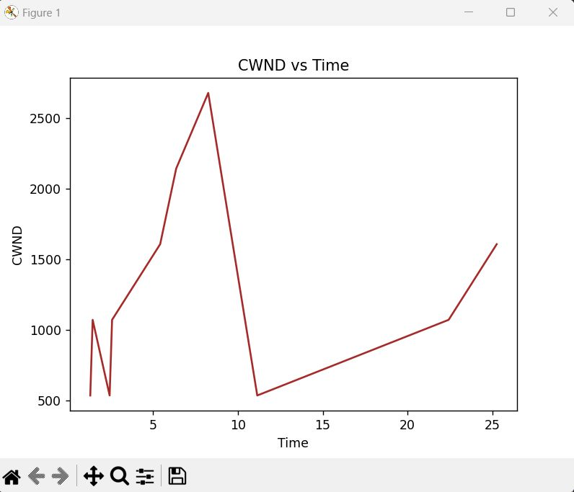
TCP CUBIC

Slide 17
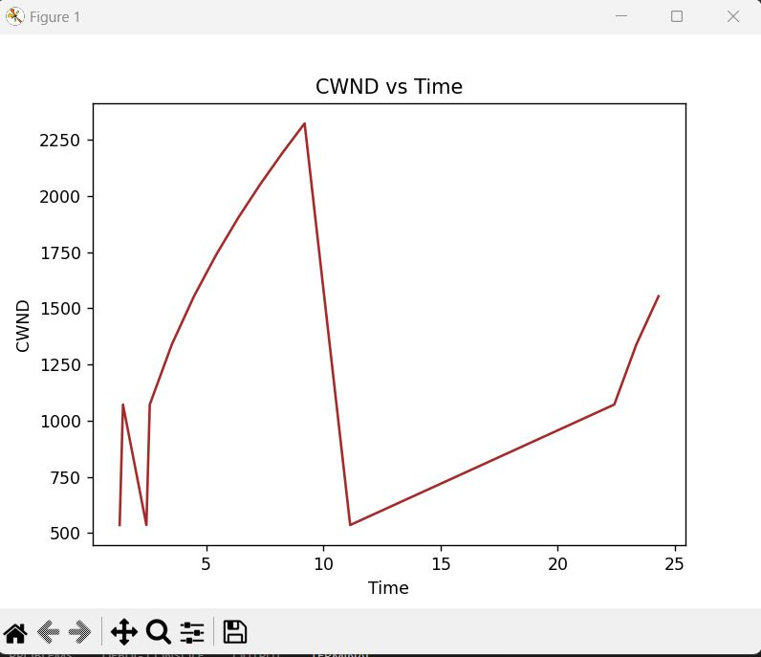
TCP NEW RENO

Slide 18
RESULTS:
THROUGHPUT VS TIME FOR ONE BUILDING BLOCKAGE

Slide 19
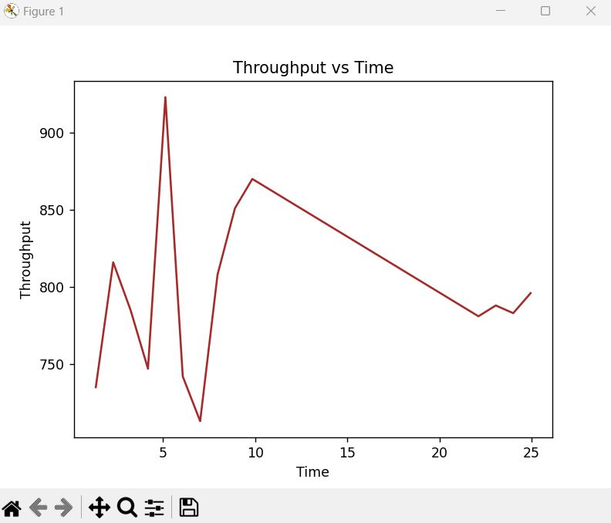
TCP CUBIC

Slide 20
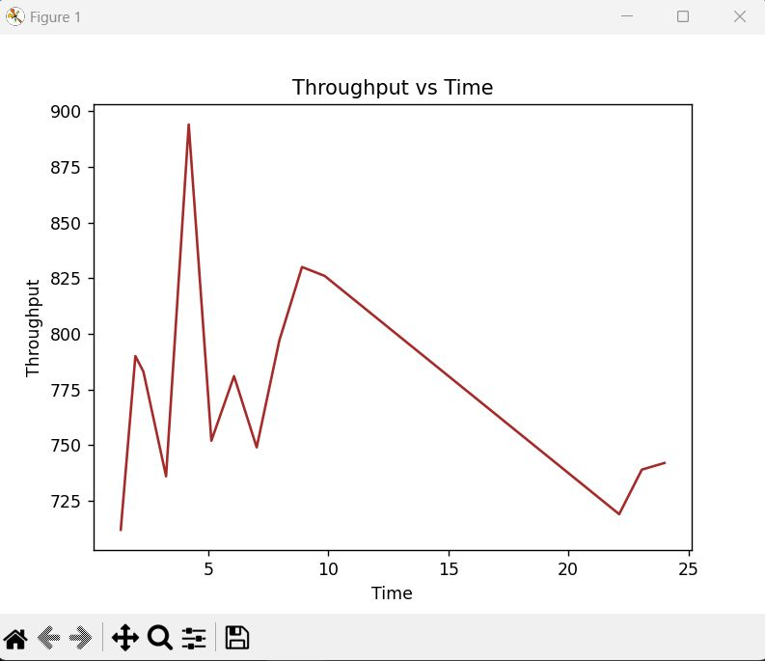
TCP NEW RENO

Slide 21
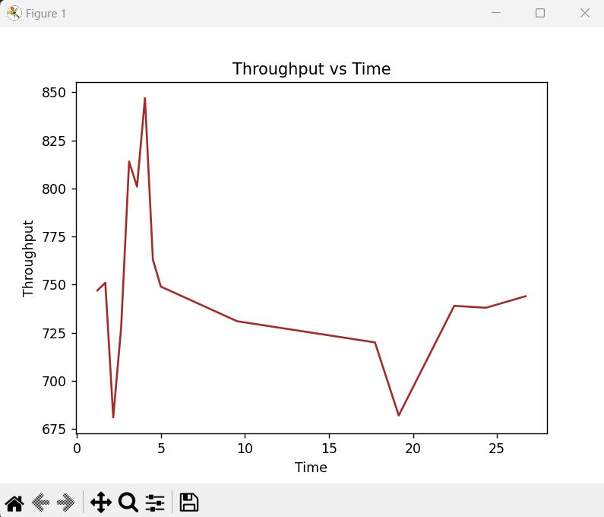
TCP VEGAS

Slide 22
RESULTS:
THROUGHPUT VS TIME FOR MULTIPLE BUILDINGS,TREES AND HUMAN BLOCKAGE

Slide 23
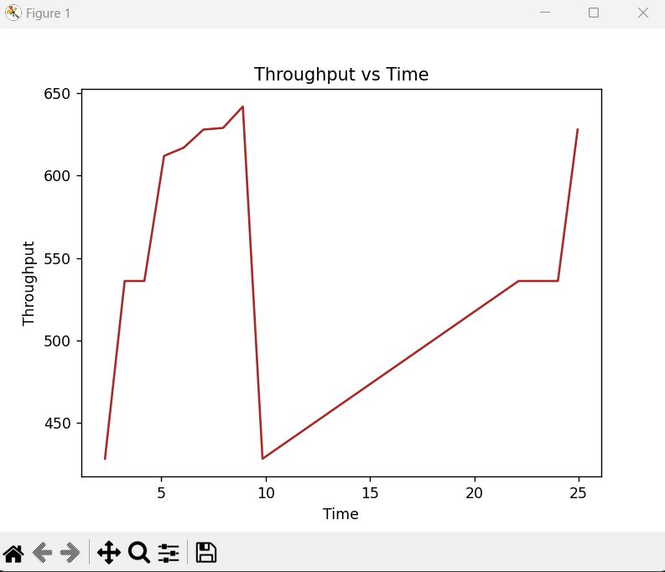
TCP CUBIC

Slide 24
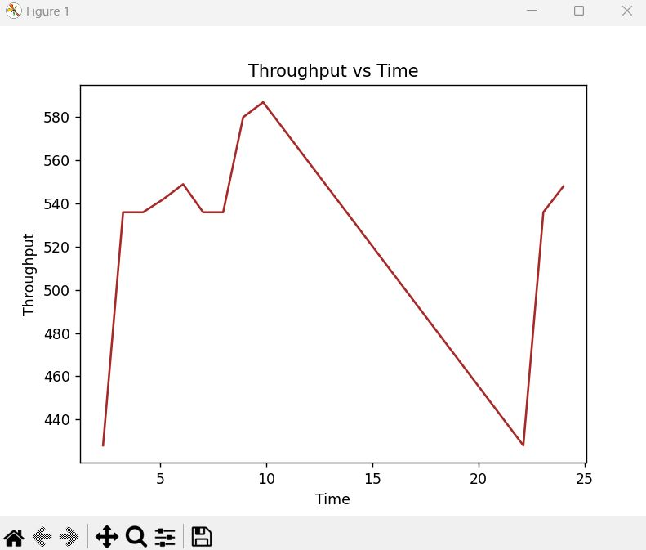
TCP NEW RENO

Slide 25
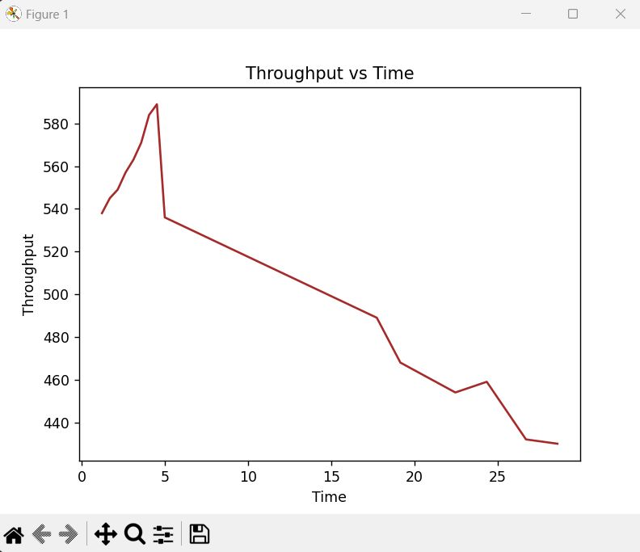
TCP VEGAS

Slide 26
CONCLUSION
TCP congestion control algorithms, such as TCP Cubic, New Reno, and Vegas, can struggle to perform well in high-frequency networks due to the variable and unpredictable nature of the channel conditions. These algorithms rely heavily on packet loss as a congestion signal, which can lead to inefficient use of network resources and increased latency.
The graphs of TCP Vegas cwnd over time in a high-frequency network might show more frequent and rapid changes in cwnd compared to a lower frequency network. This can be due to the higher variability in channel conditions in high-frequency networks, which can lead to more frequent and sudden changes in RTT.
Studies have shown that TCP BBR can perform well in high-frequency networks by maintaining a high throughput and low latency, even in the presence of congestion. This is because TCP BBR is able to detect the available network capacity more accurately and adjust its sending rate accordingly, without relying on packet loss as a congestion signal.

Slide 27


